Slide 1

Towards common metadata using GSIM and DDI 3.2 EDDI conference, Copenhagen 2-3 December 2015
Mogens Grosen Nielsen
mgn@dst.dk
Flemming Dannnevang
fda@dst.dk
Statistics Denmark

Slide 2
Agenda
Vision, strategy and challenges
Claims in the paper
Metadata users and business processes
Metadata terminology and models
Metadata portal
Conclusion

Slide 3
Vision: Integrated and reusable metadata
Statbank
Methods
´Papers on methods’
Documentation/qaulity
Concept
Variable/dataset
Concept database
Variabeldatabase
Hvad betyder
Classifications
Klassifikationsdatabase
Classification database

Slide 4
Strategy on quality and metadata
Fulfill user-needs, comply with quality requirements and increased efficiency
Standards: GSBPM, GSIM, DDI, SDMX
Principles a) Metadata integrated into GSBPM), b) reuse of metadata c) metadata used actively

Slide 5
Challenges
Documentation attached to statistical product after it is has been published
User needs introduced too late
Lack of awareness on common models and standards
GSIM seems to complicated

Slide 6
Claims
Reusable metadata require improved understanding of
the role of metadata in relation to users
metadata in relation to production processes
metadata-terminology

Slide 7
Metadata, users and business processes
General Environment: Political/legal context, Technology/standards
Ressources: staff, IT-systems etc.
Management processes
Respondents/ registers etc.
Users
Support processes: Quality, metadata, methods & IT
User needs /orders

Slide 8
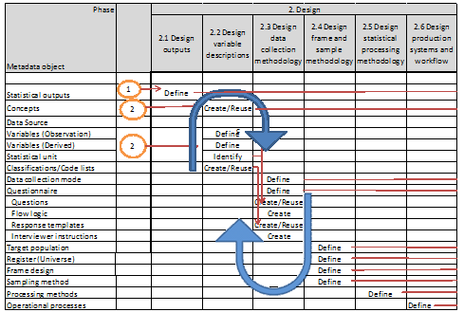
Metadata and business processes

Slide 9
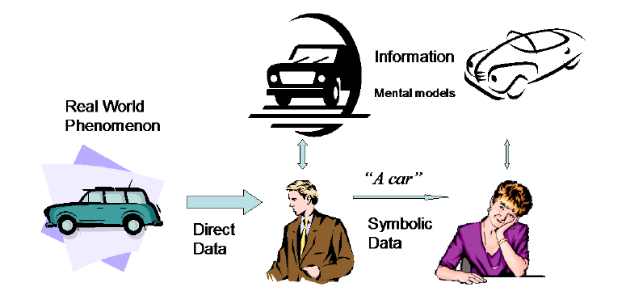
Metadata terminology: Reality, data and information
Compatible frames of reference needed!

Slide 10
Sharing and reusing data and metadata
Sharing of data requires compatible frames of reference
Compatible frames of references can be ensured via metadata
Need for both metadata-terminology and domain-specific metadata

Slide 11
Frames of references related metadata terminology and statistical metadata.
 | Frames of reference inside NSI’s | Frames of reference of external users
Terminology for statistical metadata | Complex and simplified metadata terminology (e.g. selected terms from GSIM) | Simplified metadata terminology (e.g. classification, variable, code-list)
Statistical metadata | Domain specific metadata (complex and simplified). | Domain specific metadata simplified

Slide 12
Terminology: simplified definition of statistical metadata (from SDMX)
Reference metadata:
Conceptual metadata (e.g. definition of income)
Methodological and processing metadata (e.g. description of data processing)
Quality metadata (e.g. Availability)
Structural metadata:
Metadata act as identifiers and descriptors of the data (e.g. variables, code-lists, dataset)

Slide 13
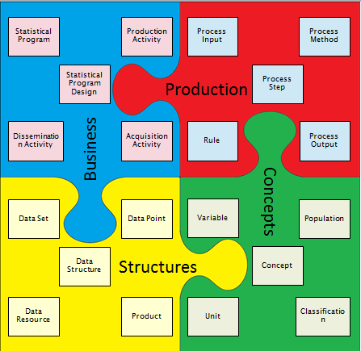
Terminology: complex definition of statistical metadata (from GSIM)

Slide 14
Frame of reference for complex metadata terminology
Model / level | Use in Stat DK
Concep-tual | Selection of variable, concept etc from GSIM
Concep-tual | GSIM compliant DDI model (3.2)
Logical | DDI model (3.2)
Physical | GSIM compliant DDI model implemented in Colectica

Slide 15
Metadata for dimensional data using GSIM terminology – an example

Slide 16
CONCECPT
NoOf
UNIT TYPE
Person
VALUE DOMAIN
PositiveInteger
measures
VARIABLE
NoOf
measures
measures
Takes meaning from
REPRESENTED
VARIABLE
NoOf
POPULATION
LivingPersonsInCPH2014
measures
INSTANCE
VARIABLE
GenderPersonsInCPH2014
is defined by
Takes meaning from
INSTANCE
VARIABLE
LivingPersonsInCPH2014_NoOf
INSTANCE
VARIABLE
CivilstatusPersonsInCPH2014
measures
Identified by
Data Structure Component
DIMENSIONAL DATA STRUCTURE
SC_LAYOUT
DATA SET
”SC_2014.XLSX”
has
DATAPOINT
Cell(2,2)
subtype of
is structured by
has
DATUM
”145000”
Identifier Component
Gender
is subtype of
Identifier Component
Civil status
Measure Component
CountOfPersons
DATA STRUCTURE
SC_LAYOUT
has
Attribute Component
”Other att. info”

Slide 17
CONCECPT
Civill status
UNIT TYPE
Person
measures
measures
VARIABLE
PersonCivilstatus
Uses
CONCEPTUAL DOMAIL ENUMERATED
PersonCivilstatusDomain
contains
CATEGORY SET
PersonVivilStatusCategories
Takes meaning from
REPRESENTED
VARIABLE
PersonCivilstatusRepresentation
contains
CATEGORY ITEM
Marrried
Takes meaning from
Corresponds to
Category Item
Unmarried
INSTANCE
VARIABLE
CvilstatusPersonInCPH2014
Category Item
Other
measures
measures
POPULATION
LivingPersonsInCPH2014
VALUE DOMAIN
ENUMERATED
CivilStatusEnumeration
Takes value from
CODELIST
CivilStatusCdelList
contains
CODE ITEM
Marrried
Category Item
Unmarried
Category Item
Other

Slide 18
From GSIM to DDI 3.2 to Colectica – main activities and issues
To DDI 3.2
High/Low level mapping
Data structure conceptually very different
To Colectica
Import, organising and linking elements
Organising data so common metadata can be easily administrated and reused

Slide 19
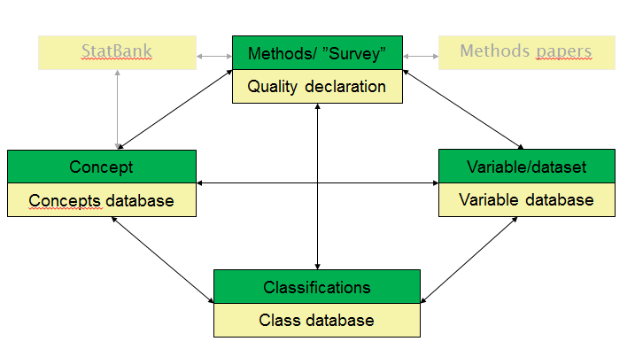
Models implemented and used in metadata portal- simplified model
Lists of statistics
Lists of concepts (unittypes and pro-perties)
Lists of registers, data-set and variables
Lists of classifications and code lists.

Slide 20
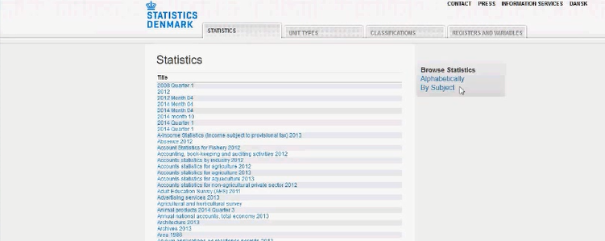
Statistics - list

Slide 21
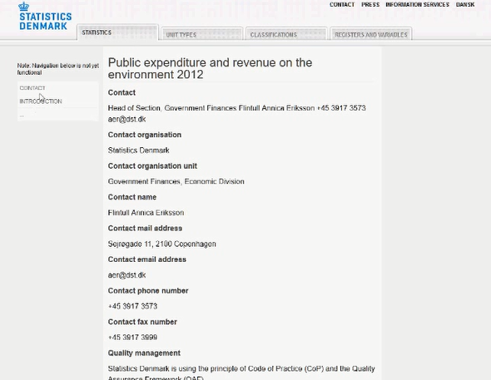
Statistics – ”public expenditure”

Slide 22
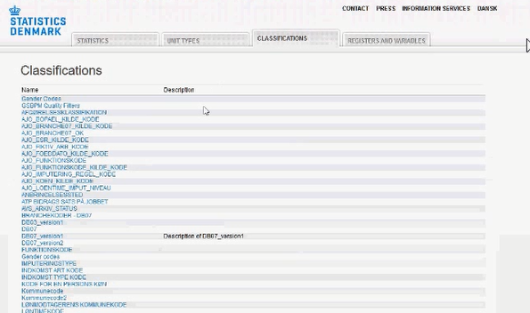
Classifications - list

Slide 23
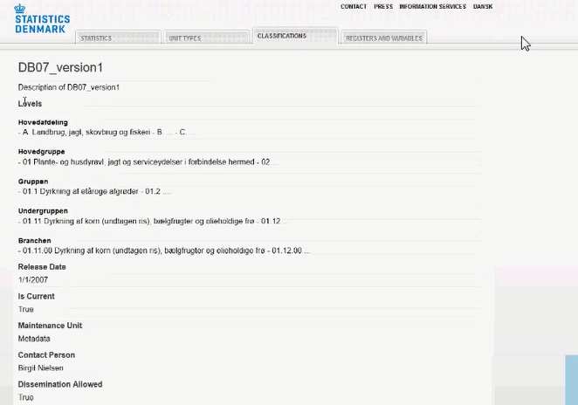
Classifications: ”Activity codes – NACE”

Slide 24
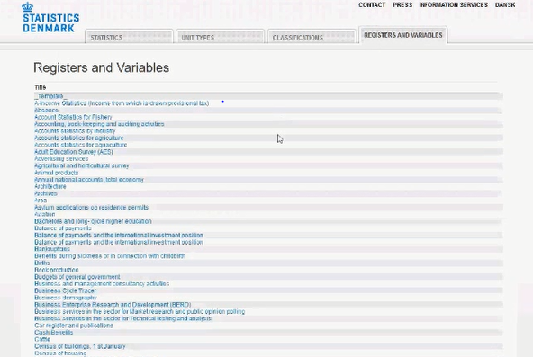
Registers and variables - list

Slide 25
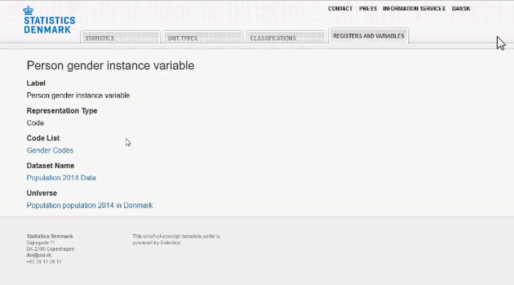
Registers and variables – ”Person gender”

Slide 26
Conclusions
Common and reusable metadata require
Coordinated work on handling metadata in relation to user needs and business processes and efforts in developing precise metadata terminology
Development of metadata terminology and applications require careful modelling going from conceptual level to physical level.
Compatible frames of reference is needed to ensure common understanding

