Slide 1

Classifications in Statistics Denmark – current situation and steps towards a DDI-based classification system
EDDI15, Dec 1-4
Diana Ransgaard Sørensen (drs@dst.dk), Statistics Denmark

Slide 2
Agenda
Vision and ongoing work
Existing business processes
New business processes
Prototype
Next step: Plans for 2016

Slide 3
Vision: Integrated and reusable metadata
Methods
Documentation of statistics
Concept
Variable/dataset
Concept database
Variabeldatabase
Hvad betyder
Classifications
Klassifikationsdatabase
Classification database

Slide 4
Challenges
Little reuse
Existing database not widely used
Parallel classification systems
Standards not implemented

Slide 5
Initiation of work on classifications
Standards
GSIM (Generic Statistical Information Model)
A common language/terminology
Clarifying basic concepts
The Copenhagen mapping
Business processes
Business processes (how are classifications being used)

Slide 6
The Copenhagen mapping
Implements the GSIM Statistical Classifications Model with DDI Lifecycle.
Describes:
how the GSIM terminology for statistical classifications maps to DDI 3.2
offer a set of controlled vocabularies.
Example:

Slide 7
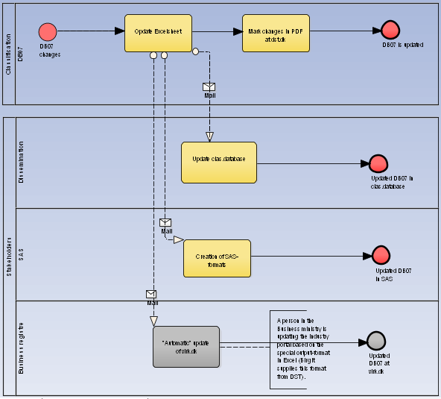
Existing business processes

Slide 8
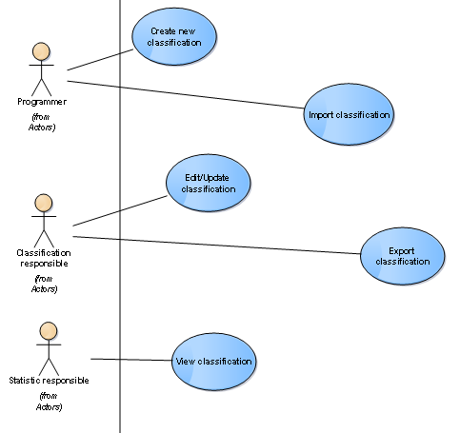
New business processes

Slide 9
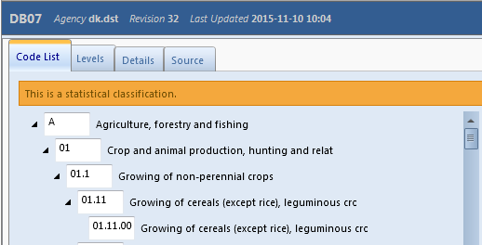
Prototype: a common classification system

Slide 10
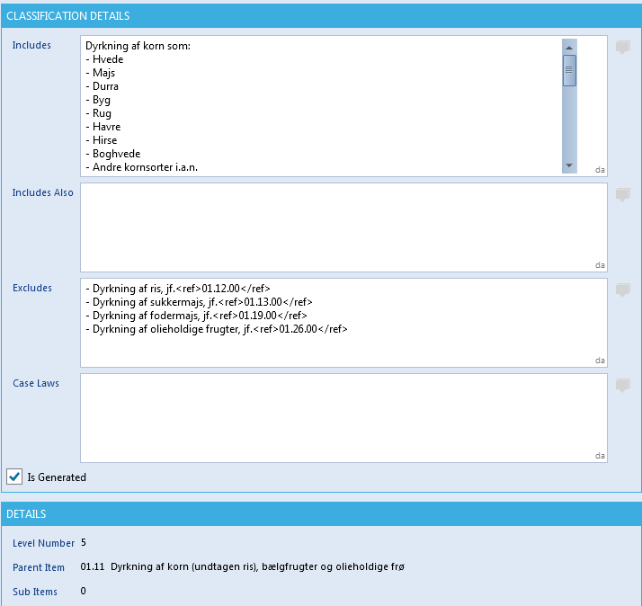
Prototype: a common classification system (2)

Slide 11
Project plan 2015
Phase 1: (initiation):
Overview of classifications used in Statistics Denmark
Phase 2: (needs, requirements and prototype):
Description of existing work processes
Description of new work processes
Requirements, specifications and use cases
GSIM-based conceptual model
Conducting and reporting from meetings with stakeholders
Phase 3 (it-design and development):
IT design and development
Basic model implemented in Colectica
Customizing Colectica to classifications
Conceptual model of classifications
Prototype (Import of 2-3 classifications)

Slide 12
Next steps
Import of all classifications in Statistics Denmark
Customizing for specific needs, e.g. floating statistical classifications
Integration with other metadata including dissemination

Slide 13
Thanks for your attention
Diana Ransgaard Sørensen (drs@dst.dk), Statistics Denmark

