Slide 1
What comes first? Metadata or Data Access?
A. Michelle Edwards, Ph.D., MLIS
William Block, Ph.D.
Cornell Institute for Social and Economic Research

Slide 2


Slide 3
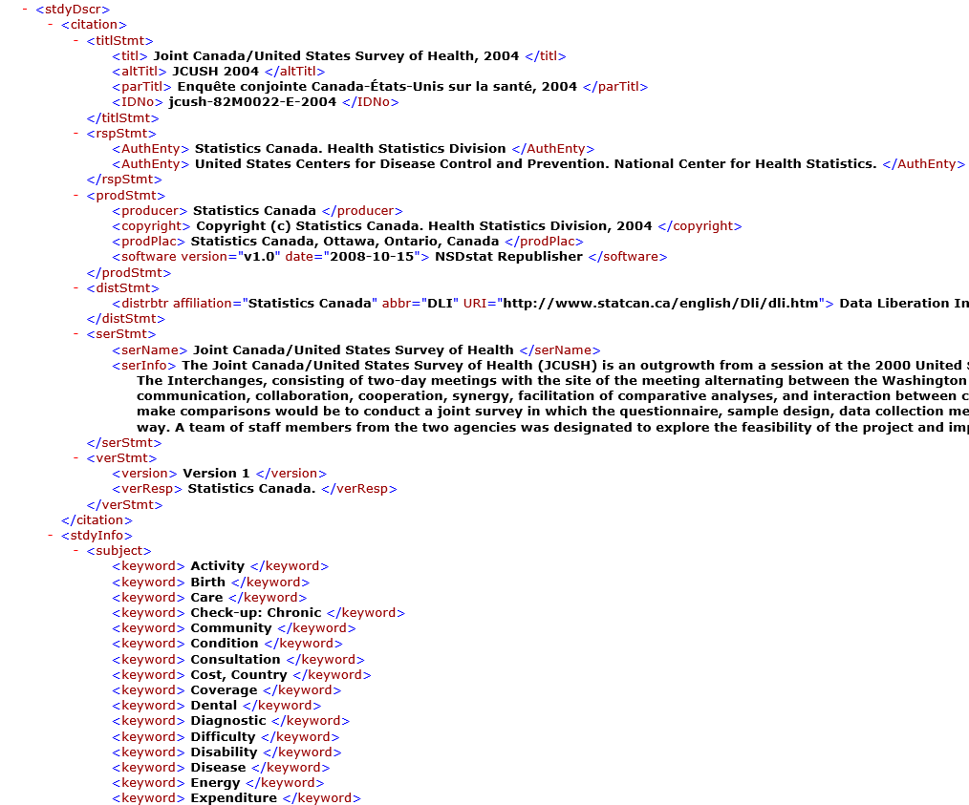
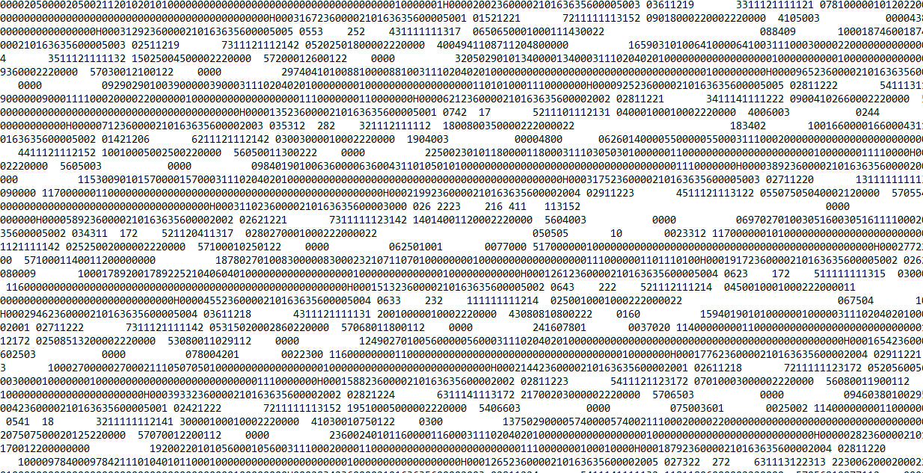

Slide 4
Overall Goal:
To take advantage of DDI

Slide 5


Slide 6
Cornell Data Archives
Currently 3-4 different data archives on campus:
CISER Data Archive (Cornell Institute for Social and Economic Research)
NDACAN Data Archive (National Data Archive on Child Abuse and Neglect)
Roper Center for Public Opinion Research
eCommons – Cornell’s Institutional Repository

Slide 7
Current State of the Archives
Each is a separate entity and will remain as such
Each archive has its own workflow
Each has its own mandate, collection policy, staff, and access portal
Build relationships and create links

Slide 8
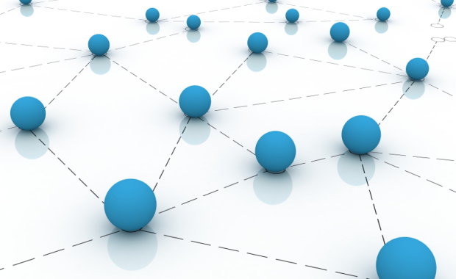

Slide 9
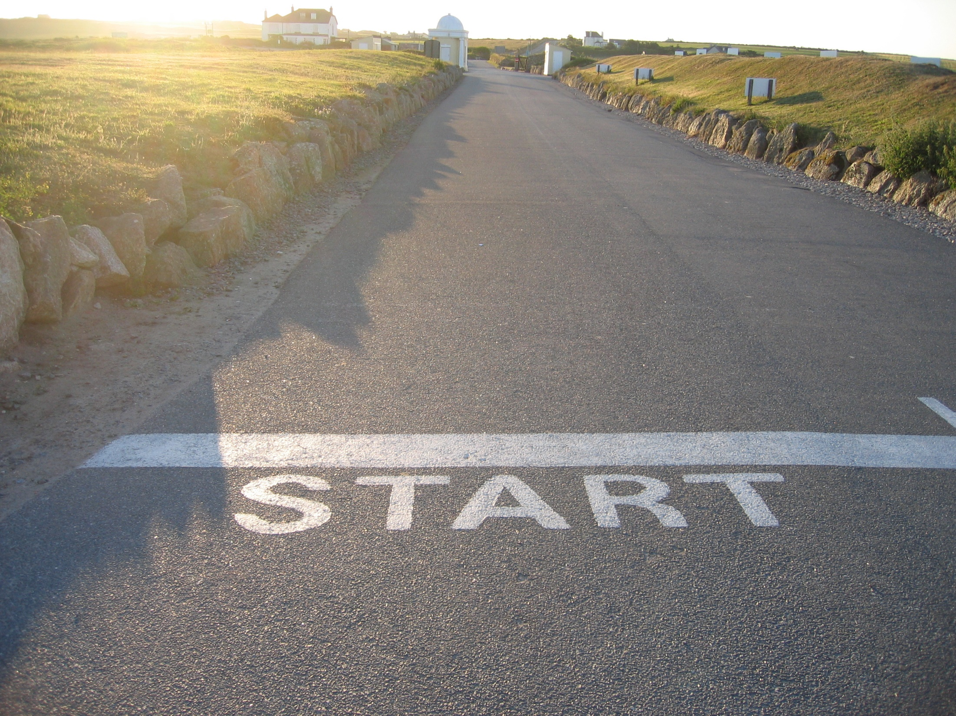
Notes:
Ask a LOT of questions
What do we want to offer our community?
Data Access or Data Deposit?

Slide 10
What do we want to offer our community?
Data Access:
Easy search and more detailed search
Ability to self-serve
Data Deposit:
Easy ingest form
Ability to self-serve

Slide 11
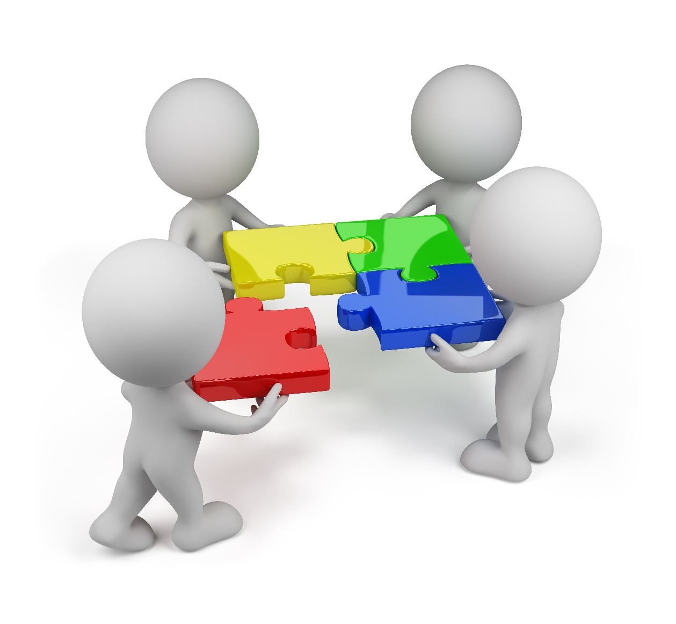
DDI is a Natural FIT!

Slide 12
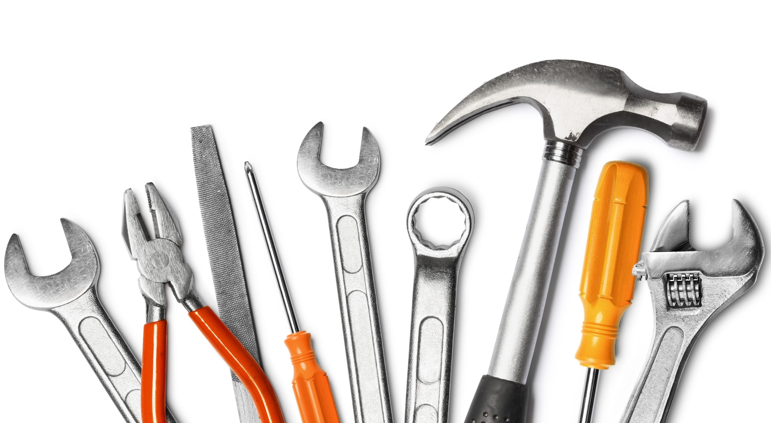

Slide 13
Options
Throw current system out the door and start over – maybe build something from scratch?
Evaluate current system and determine how it fits with new tools?

Slide 14
What does the Archive need?
Make a list!
Tracking metadata throughout workflow?
Increase the metadata available for user searches?

Slide 15


Slide 16
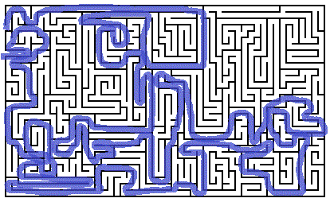

Slide 17
Current State of Affairs
WANT:
Preserve current archiving practices
Track archive workflow processes
Increase study level metadata
Easy INGEST form for data depositors
Increase efficiencies in current processes

Slide 18
Current State of Affairs
Evaluating several options
Dataverse
Collectica Curation Tool
Ced²ar

Slide 19


Slide 21


Slide 22
Questions / Contact
Michelle Edwards ame87@cornell.edu
Bill Block block@cornell.edu

