Slide 1
Advances in metadata systems
Ingo Barkow, Associate Professor for Data Management

Slide 2
Agenda
Introduction
Metadata in the educational sciences
PIAAC as an example for an educational survey
Results from the first survey
Meaning of the results for DDI
Q&A

Slide 3
Introduction
Survey is part of my dissertation process at the University of Szeged (Hungary)
Research was done during a sabbatical from August 2014 – February 2015
Goals of the dissertation
Improve the metadata handling in computer-based assessment, especially in large-scale studies
Use the results to improve open source computer-based assessment platforms and item banks
Focus only on computer-based assessment (not qualitative data)

Slide 4
Metadata in the educational sciences
Research process in the educational sciences is very similar to the social sciences
Models like the Generic Longitudinal Business Process Model (GLBPM) can also be applied here
Most large-scale studies (e.g. PISA, PIAAC, PIRLS, TIMMS) use a mix of questionnaires and cognitive items
Shift from paper-based assessment towards computer-based assessment
Metadata standards (e.g. QTI, SCORM) exist, but only for very specific parts of the research process

Slide 5
Metadata in the educational sciences
Specific challenges in computer-based assessment
Layout and screen size must be fixed to avoid changes in item difficulty
Scoring rules have to be implemented (and documented)
Very complex item types (e.g. simulations)
Mode effects (e.g. paper to computer, computer to tablet)
Use of logfile data analysis e.g. for diagnostic assessment
Statistical parameters (e.g. Cronbach‘s Alpha) have to be stored to support adaptive testing
Items are usually highly confidential (e.g. SAT, GMAT)

Slide 6
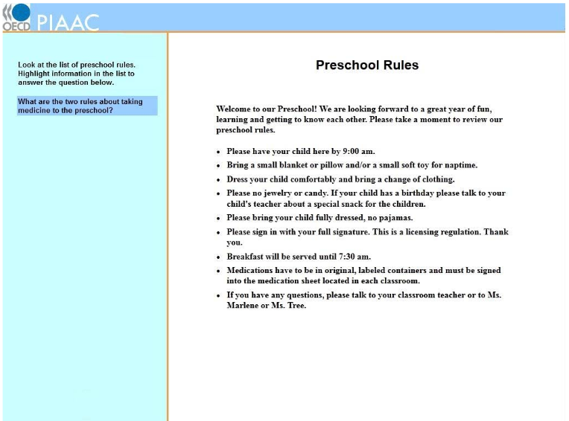
PIAAC Literacy Item

Slide 7
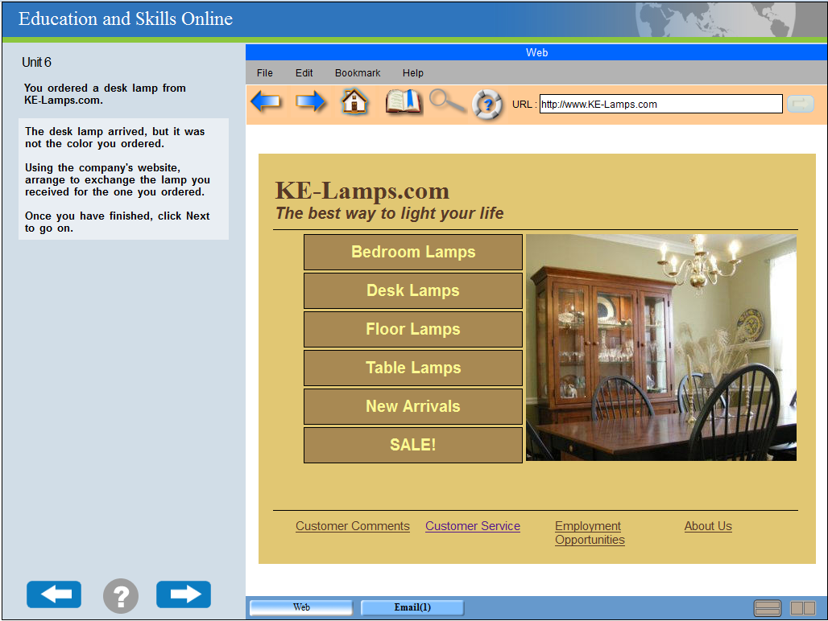
PIAAC Problem Solving Item

Slide 8
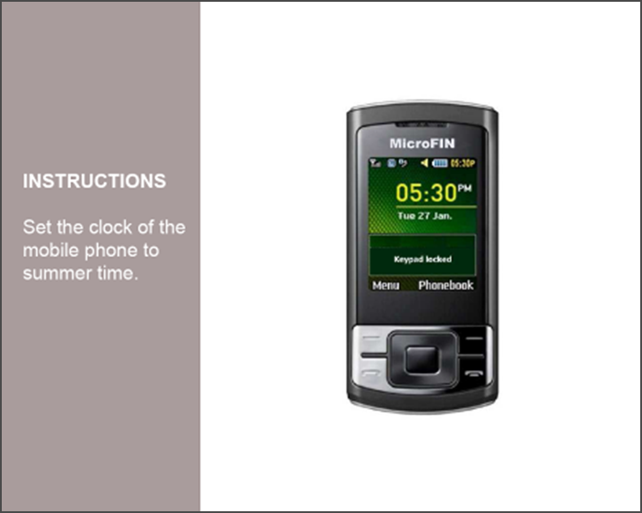
CBA Itembuilder MicroFIN item

Slide 9
The survey
Target group – researchers working in the fields of educational sciences and social sciences
Questionnaire on data management and metadata standards
Web survey using 45 questions in 30-35 minutes with complex branching (e.g. separate data users from data producers)
Tool: Limesurvey V2.05 with SkeletonQuest responsive design template (optimization for tablets and mobiles)
Data collection from November to December 2014
Collection of 221 interviews with 120 fully completes (not sufficient)
Second data collection was conducted between April 2015 and July 2015
Bigger sample – 405 interviews with 295 completes
No changes in result

Slide 10
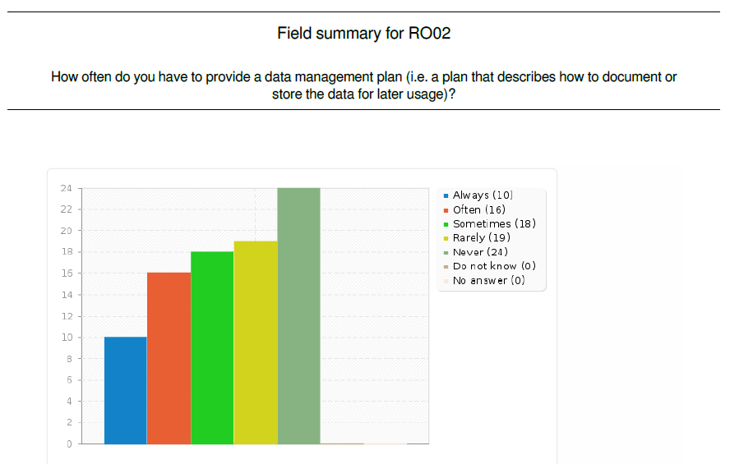
10

Slide 11
Rank | Standard | Usage “often” | Usage “rarely”
1 | Data Documentation Initiative (DDI) | 18 | 12
2 | Dublin Core | 9 | 13
3 | Questionnaire and Text Interoperability (QTI) | 5 | 3
4 | Machine Readable Cataloguing (MARC) | 3 | 7
5 | Statistical Data and Metadata Exchange (SDMX) | 2 | 5
6 | Learning and Test Interoperability (LTI) | 2 | 1
7 | Learning Object Model (LOM) | 1 | 4
8 | Shareable Content Object Reference Model (SCORM) | 0 | 8
9 | Metadata Encoding and Transmission Standard (METS) | 0 | 4
9 | Text Encoding Initiative (TEI) | 0 | 4
11 | QueDex | 0 | 0
11

Slide 12
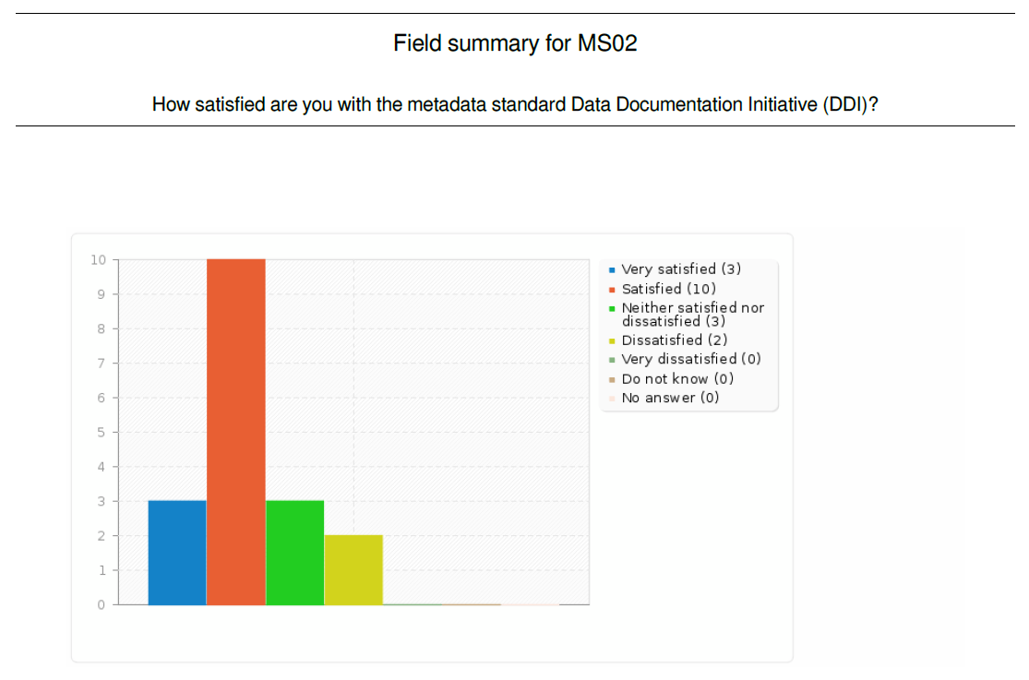
12

Slide 13
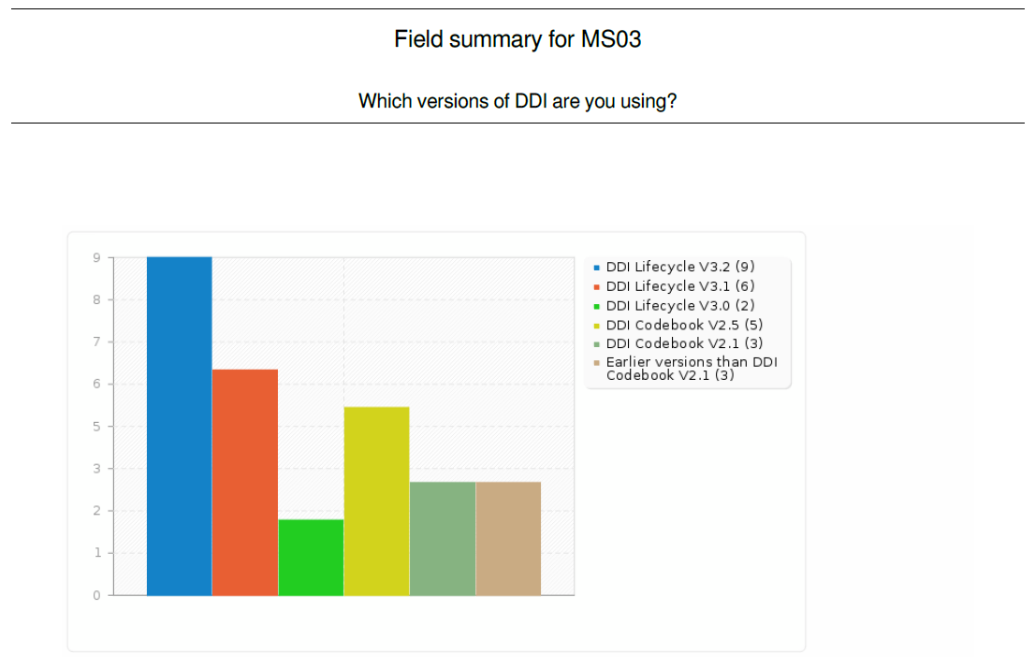
13

Slide 14
Rank | Metadata Standard | Usage “Do not know”
1 | QueDex | 95
2 | Learning and Test Interoperability (LTI) | 87
3 | Shareable Content Object Reference Model (SCORM) | 85
3 | Text Encoding Initiative (TEI) | 85
5 | Machine Readable Cataloguing (MARC) | 82
5 | Metadata Encoding and Transmission Standard (METS) | 82
7 | Questionnaire and Text Interoperability (QTI) | 81
8 | Learning Object Model (LOM) | 80
9 | Statistical Data and Metadata Exchange (SDMX) | 78
10 | Dublin Core | 66
11 | Data Documentation Initiative (DDI) | 43
14

Slide 15
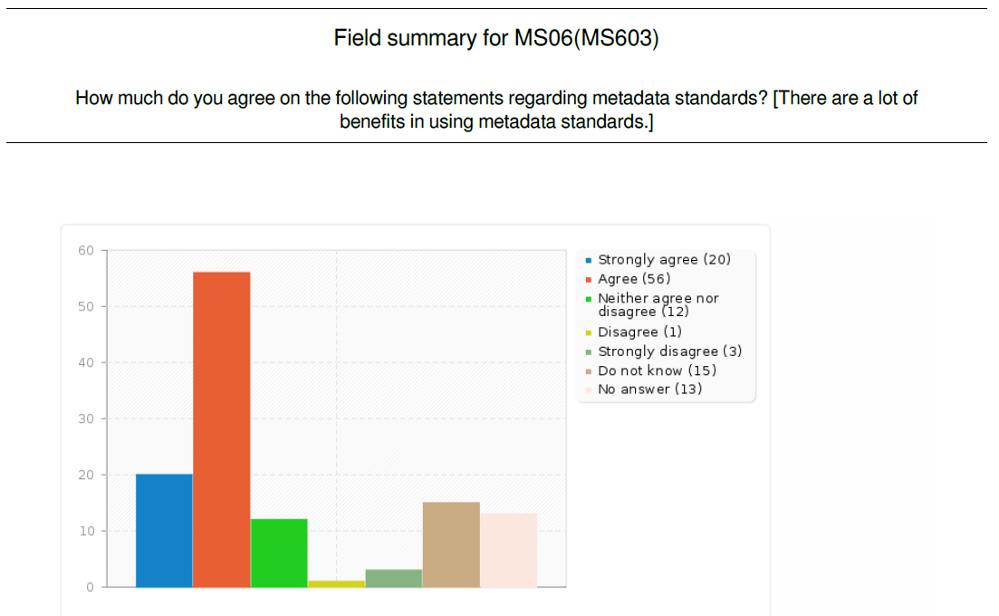
15

Slide 16
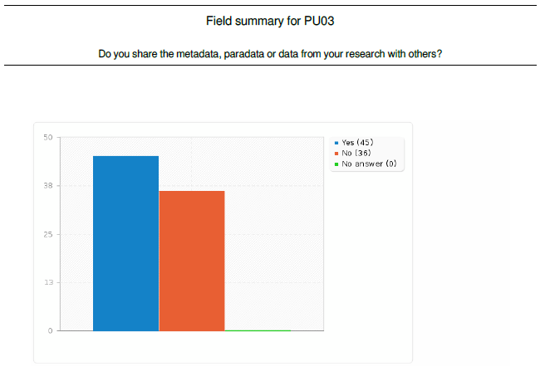
16

Slide 17
Rank | Opinion | Strongly agree | Agree | Neither agree nor disagree | Disagree | Strongly disagree | No answer
1 | Preparation of data needs to much effort | 8 | 15 | 8 | 1 | 2 | 2
2 | I have no resources or support from my employer to hand in the data | 8 | 14 | 10 | 2 | 1 | 1
3 | My organization or I have security concern | 5 | 10 | 9 | 4 | 7 | 1
4 | I do not know where to hand in my data for archiving | 3 | 8 | 14 | 4 | 6 | 1
5 | Somebody could misinterpret my results | 3 | 5 | 12 | 7 | 7 | 2
6 | Somebody could use my data before me | 1 | 14 | 5 | 8 | 6 | 2
17

Slide 18
Rank | Category | Very important | Important | Neither important nor unimportant | Not that important | Not at all important | No answer
1 | Data is cited as secondary publication | 30 | 34 | 7 | 4 | 2 | 4
2 | Support from the employer | 26 | 31 | 10 | 6 | 4 | 4
3 | Co-authorship in secondary publications based on the data | 17 | 35 | 12 | 5 | 8 | 4
4 | Archive provides list of publications based on the data | 15 | 43 | 13 | 2 | 5 | 3
5 | Archive informs data producer who accessed the data | 12 | 31 | 24 | 7 | 4 | 3
6 | The data producer receives a financial compensation | 7 | 12 | 28 | 16 | 13 | 5
18

Slide 19
Meaning of the results for DDI
DDI can be extended to support computer-based assessment platforms
Educational scientists know DDI better than native educational metadata standards like QTI or SCORM
As expected layout, scoring rules and logfiles have a higher importance for educational scientists than for social scientists
If the DDI Alliance wants to extend DDI4 for the educational sciences two further modules might be needed in the long run:
„Simple cognitive item“ (e.g. hotspot, point&click, multiple choice, cloze test)
„Complex cognitive item“ (e.g. simulations, MicroDYN, MicroFIN)

Slide 20
Thanks for your attention.

