Slide 1



The DASISH Questionnaire Design Documentation Tool:
Updates on the development of the tool
Benjamin Beuster, Stig Norland, Hilde Orten
NSD – Norwegian Social Science Data Services
EDDI 2015 - 7th Annual European DDI User Conference, Copenhagen, December 2 – 3 2015

Slide 2
Outline
The DASISH Questionnaire Design Documentation Tool (QDDT) and the Question Variable Database (QVDB), update
The Questionnaire Design Documentation Tool (QDDT)
New conceptual model (extract of conceptual model for the QVDB)
New technical approach

Slide 3
The QDDT and QVDB
Tools for surveys under development by NSD.
Work on the tools started under the Data Service Infrastructure for the Social
Sciences and Humanities (DASISH) project. It now continues under
Synergies for Europe’s Research Infrastructure in the Social Sciences (SERISS).
Our work on the tools was presented at EDDI 2013 and 2014
Material developed under DASISH is available on GitHub

Slide 4

QDDT and QVDB – recap of aims
Assist large-scale survey projects in processes related to questionnaire development,
data and metadata production, archiving and dissemination
Internal users: QDDT: Document the questionnaire design process and develop questionnaires
QVDB: Develop variables, standards and data products
External users:
QDDT: Understand how each item and concept was developed (QDDT)
QVDB: Find and reuse questions and variables (QVDB)
Reusable model and code
Interoperability with DASISH Translation Management Tool (TMT) and other tools,
using DDI

Slide 5
QDDT and QVDB – What was achieved while DASISH?
A common metadata model from the three DASISH tools, QDDT, QVDB and the TMT
Specifications for the QDDT and the QVDB
High level conceptual model for the QVDB
A prototype of the QDDT

Slide 6
Further developments: What will be kept and what is new?
The common metadata model and the specifications for the QDDT and the QVDB will be kept
Conceptual model for the QVDB has been detailed. An extract of this works as a model for the QDDT.
A new prototype of the QDDT based using new technologies is currently under development
The development of the QVDB builds on the QDDT. One or two tools remains to be decided.

Slide 7
Conceptual model QDDT (extract of model for QVDB)

Slide 8
QDDT Architecture
Angular 2 + Typescript
No Javascript in dev tools, only in browser
Typescript can transpile to ES3
Supports «evergreen» browsers (Chrome, FireFox, Opera, Safari, and IE10/11)
Spring MVC API
RESTful API
JSON for free
no need for a SOAP service stack
Spring security (OAuth2)
Tokenbased
No state for requests
Persistence Layer implemented with Hibernate + Envers
Revisions
Database agnostic
Since qddt is open source, we chose Postgres
Browser
Angular2
Http/JSON
REST Backend
Router Layer
Service Layer
Persistence Layer
Database

Slide 9
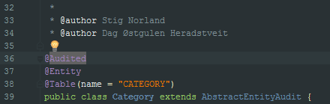
Versioning
Provide historical versioning of entity data
Each transaction relates to one global revision number
Can be used to identify groups of changes (much like a changeset in source control)
Any changeset can be labeled (business version)
Find revision by date or label name
Controlled vocabulary controls business versioning
Envers
Implemented by anotations in domian classes and inclusion of hibernate-envers-jar in classpath

Slide 10
Data model
(Relations simplified)
Sub system for temporal comparison
(Relations omitted)

Slide 11
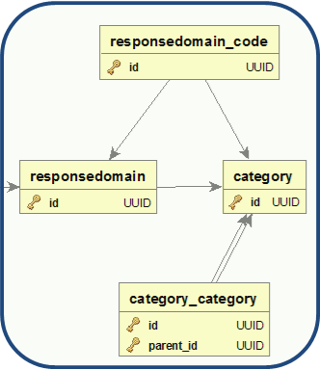
Category group structure
Category Group
«managed scale representation»
Category
Low
CODE
High
CODE
«Scale dimension»
RANGE

Slide 12
Responsdomain root category structure
«Scale/MissingCodes»
MIXED
«Scale dimension»
RANGE
Category Groups
(managed representation)
Category Roots
(managed representation)
Categories
Low
CODE (value 1)
High
CODE (value 9)
«Don’t Know»
CODE
(value 88)
«Not applicable»
CODE
(value 66)
«MissingCodes» MULTIPLE_SINGLE
StructuredMixedResponsedoman
«Scale 1-9 Missing values»

Slide 13
Design of a domain class
Study
Description String
Authors Set<User>
addComment(String)
Comments Set<Comment>
Instruments Set<Instrument>
SurveyProgram SurveyProgram
TopicGroups Set<TopicGroups>
AbstractEntityAudit
Name String
Agency Agency
BasedOnObject UUID
ChangeComment String
ChangeKind enum:ChangeKind
Version SemVer
AbstractEntity
Id UUID
Created DateTime
CreatedBy User
Updated DateTime

Slide 14
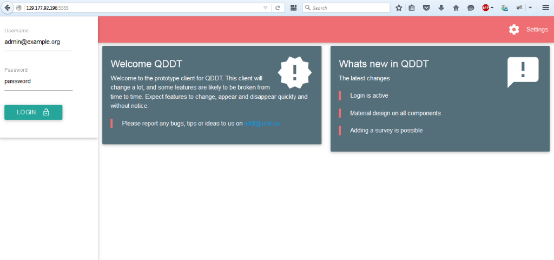
Login screen

Slide 15
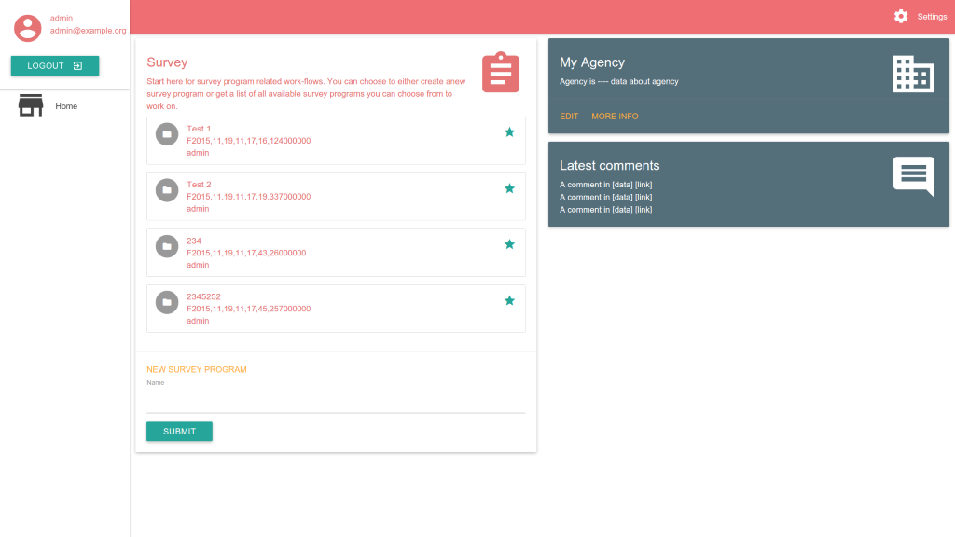
Survey screen

Slide 16

Acknowledgements
Special thanks to Joachim Wackerow (consultant), Dag Østgulen Heradstveit (NSD) and
Knut Kalgraff Skjåk (NSD)
Thank you for your attention!
surveytools@nsd.no

Slide 17
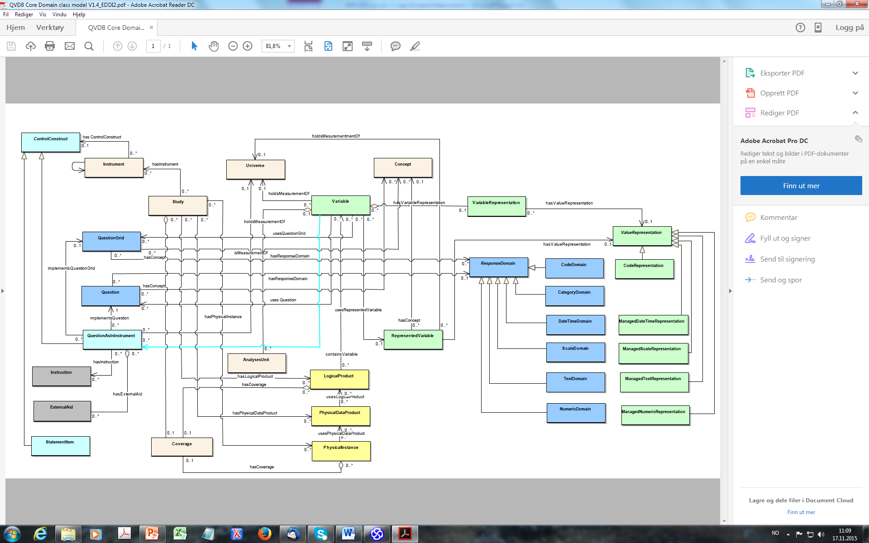
Conceptual model based on DDI 3.2 - QVDB

Slide 18
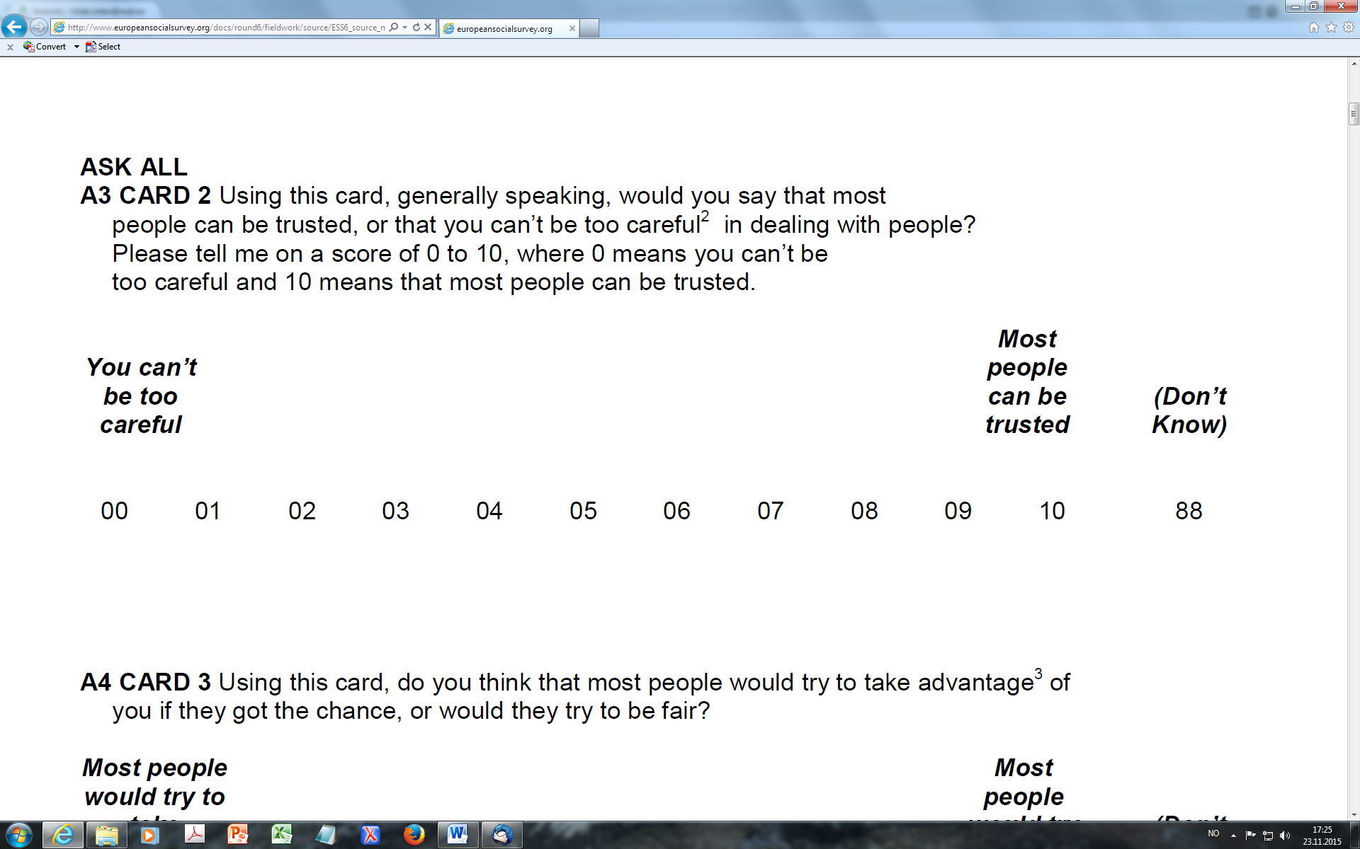
DDI StructuredMixedResponseDomain, example
Not versionable
Versionable
Categories, Anchor
Values; NumberRange for scale (high, low, min, max)
Code
CodeList
ManagedRepresentation (Scale, MissingValues)
StructuredMixedResponseDomain

