Slide 1
Implementing DDI-Lifecycle for Data Collection within the German Longitudinal Election Study
Manuela Blumenberg, Claus-Peter Klas, Wolfgang Zenk-Möltgen (GESIS – Leibniz-Insitute for the Social Science)
EDDI - Annual European DDI User Conference 2015

Slide 2
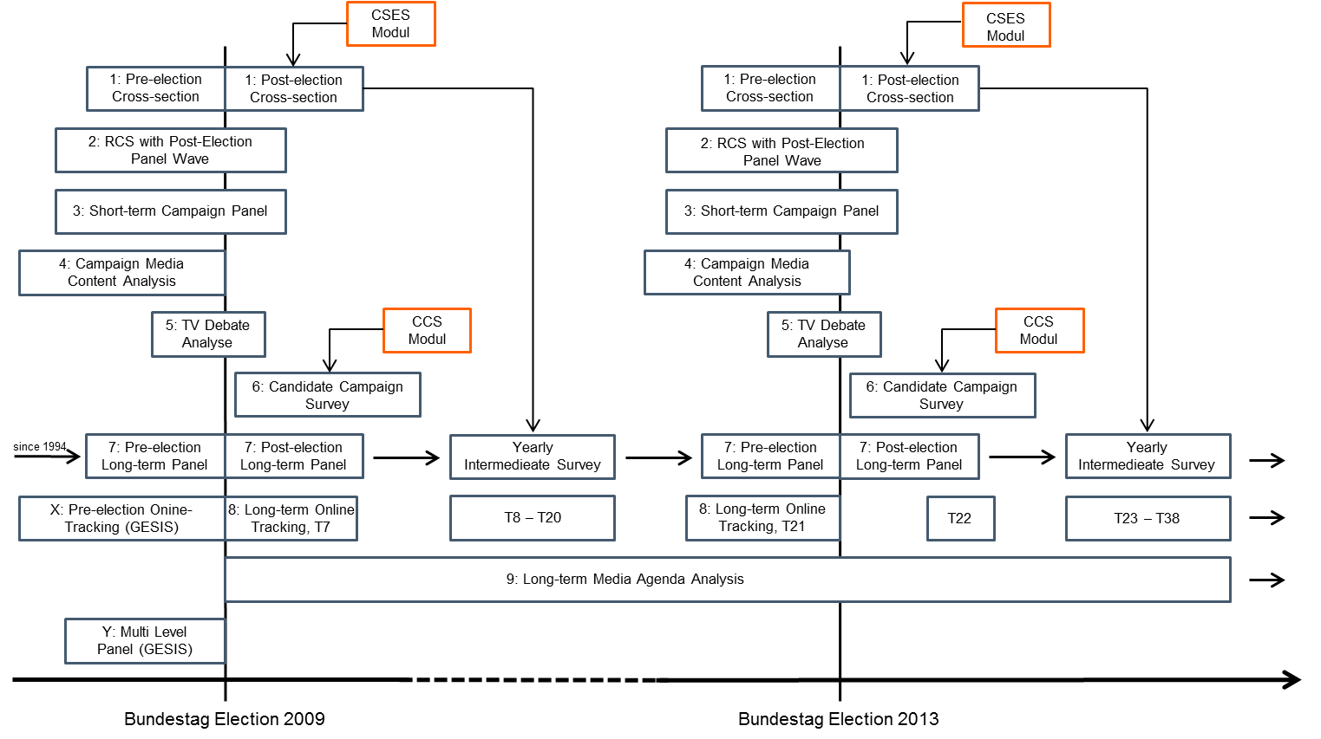
German Longitudinal Election Study

Slide 3
One portal for the whole study lifecycle
Functions
Study and study description
Questionnaires
Administrating of and discussions on questions
Export to DDI, SPSS, Word, and PDF
Transfer of data and meta data for archiving
→ Standardization of operational procedure with DDI

Slide 4
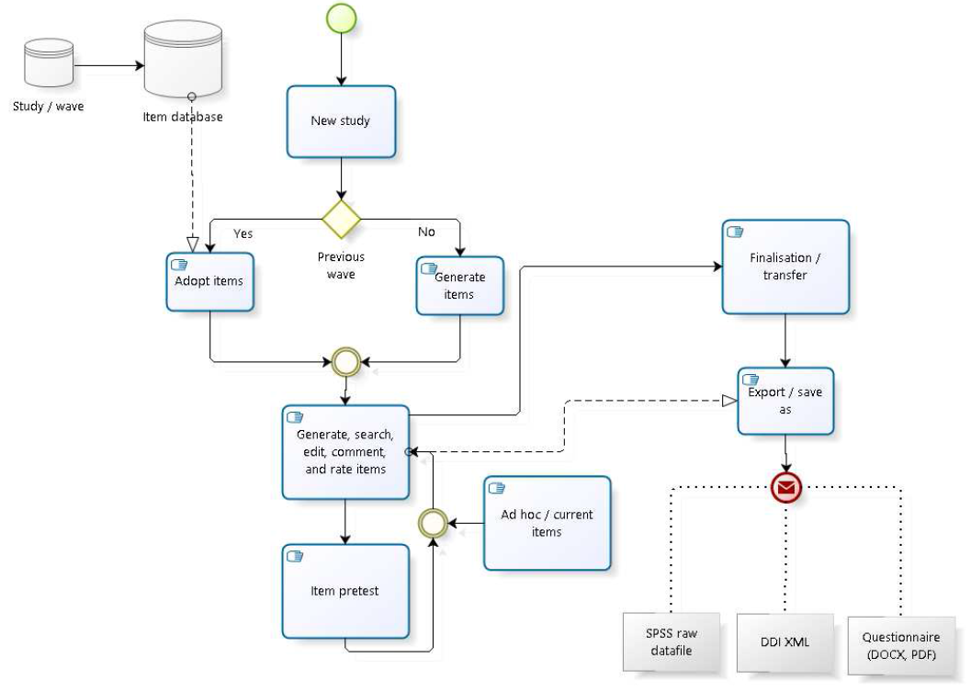
Creating of items / questionnaire

Slide 5
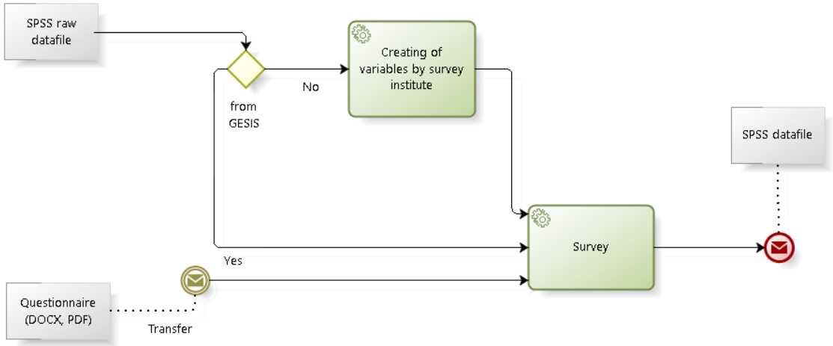
Survey

Slide 6
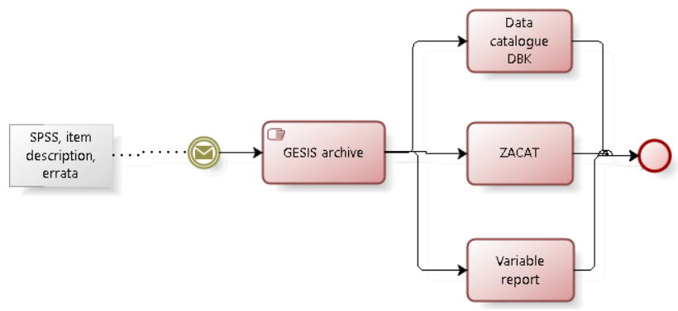
Archiving and dissemination

Slide 7
Goals
Support in each part of study lifecycle
Harmonization of processes
Integration of other GESIS tools
Short-term goal
Preparation of the portal for the GLES 2017
Long-term goal
Preparation of the portal for other survey programs

Slide 8
Thank you for your attention!
Contact
Manuela Blumenberg
Email: manuela.blumenberg@gesis.org
Claus-Peter Klas
Email: claus-peter.klas@gesis.org
Wolfgang Zenk-Möltgen
Email: wolfgang.zenk-moeltgen@gesis.org

