Slide 1
The Metadataportal (MDP) of the German Institute for Employment Research (IAB) – first live demonstration
EDDI 2015
02.12.2015 Copenhagen (Denmark)
David Schiller, IAB
Dana Müller, IAB

Slide 2
Introduction
The Institute for Employment Research (IAB) is the research institution of the German Federal Employment Agency (BA).
The IAB-MDP project is carried out by the Research Data Centre (FDZ) of BA at IAB and lead by Dana Müller.
The MDP is implemented by a international consortium lead by TBA21.
Two versions
Developer version at TBA21 in Hungary
Productive version at IAB in Germany

Slide 3
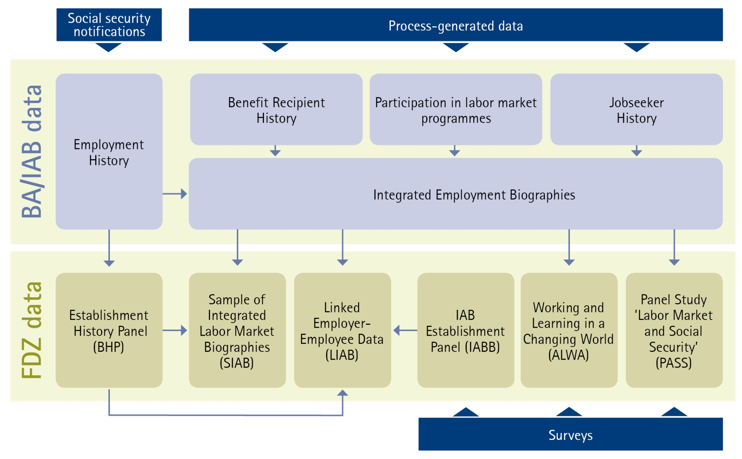
IAB data sources

Slide 4
The IAB-MDP – two components
Meta data editor (IAB internal)
Web portal (public)
2. In progress
3. Publish
4. Outdated
5. Archived
1. New
IAB data documentation

Slide 5
Outline of live demonstration
Internal editor
Language support (English / German)
Accessibility (e.g. for people poor eyesight).
User management (different roles and departments)
Master Data (standard documentation texts)
Documentation creations process
Search function and keywords
External web portal
Search via data products or search engine
Basket function for customized reports

Slide 6
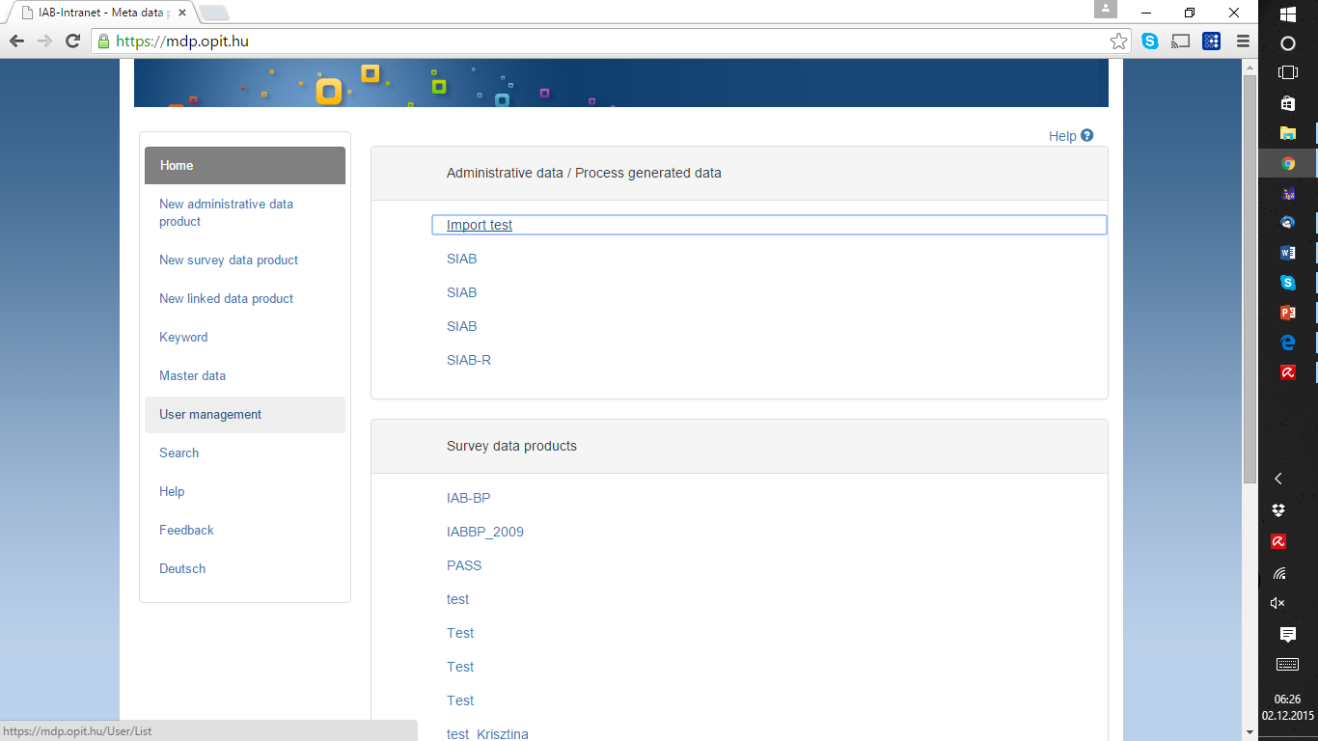

Slide 7
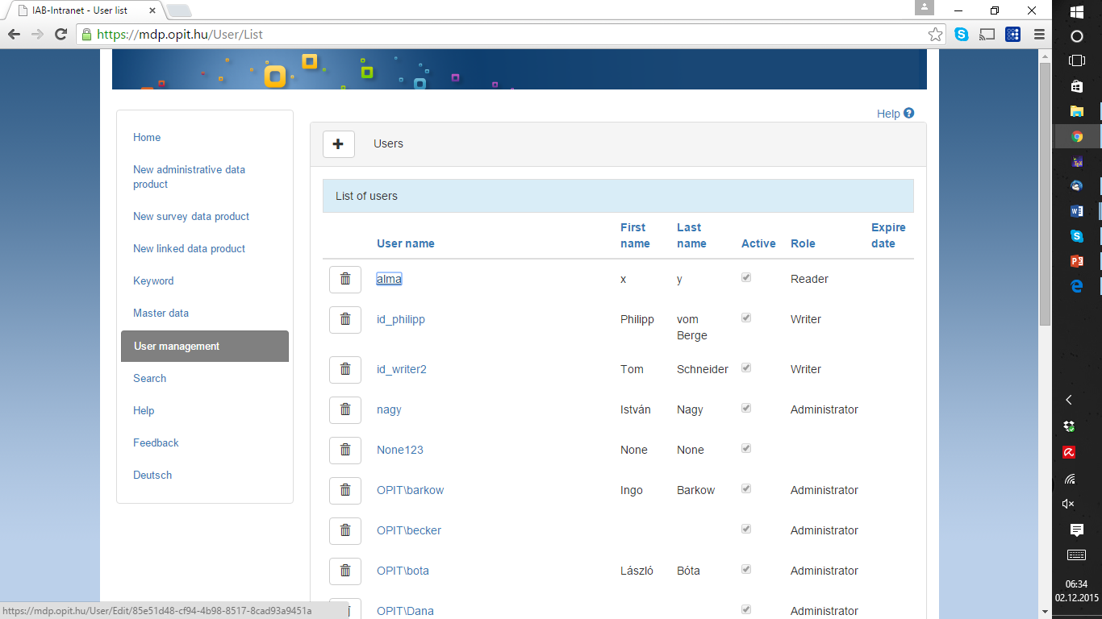

Slide 8
User roles within IAB
Administrator (IT) – god father of software solution
Administrator (FDZ) – responsible for issues related to final release of data documentation
Administrator (Departments) – responsible for department related data documentation issues
Editor – user responsible for creating data documentation
Publisher – user responsible for final expectance of data documentation
Reader – user only able to look at the documentation

Slide 9
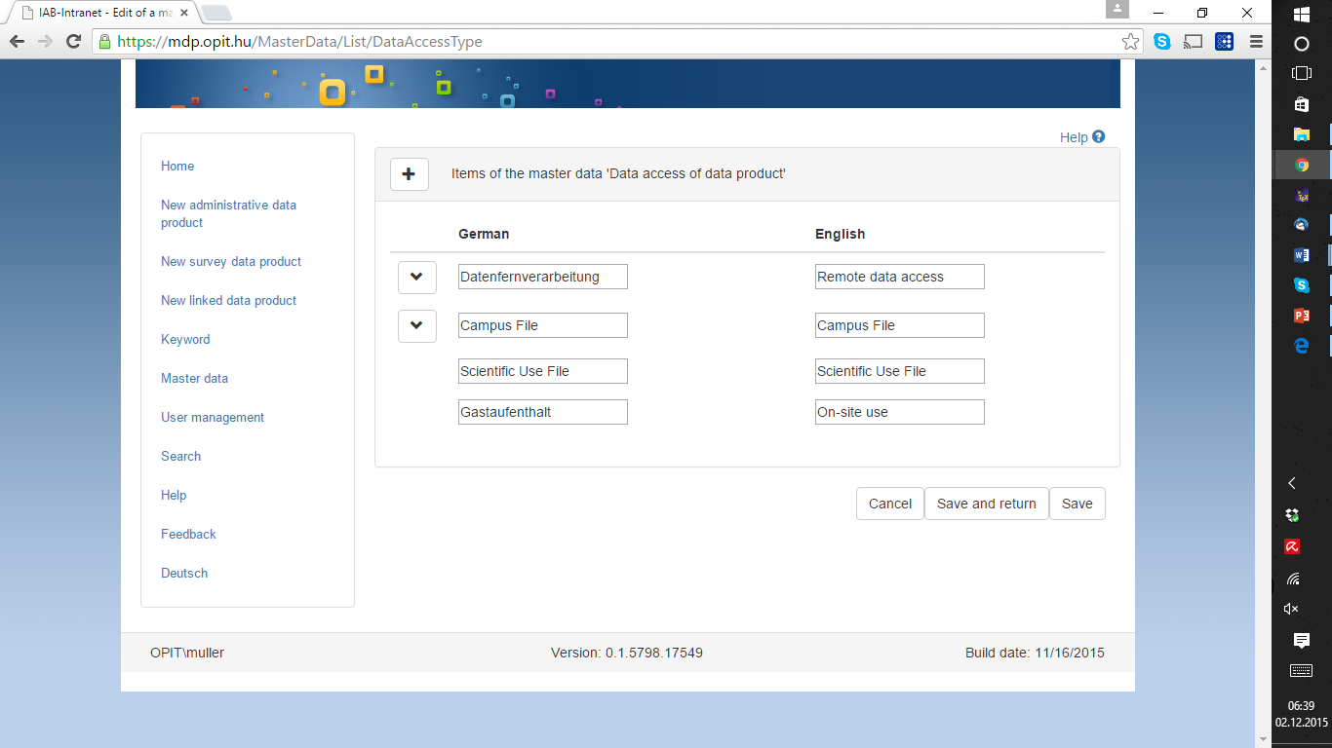

Slide 10
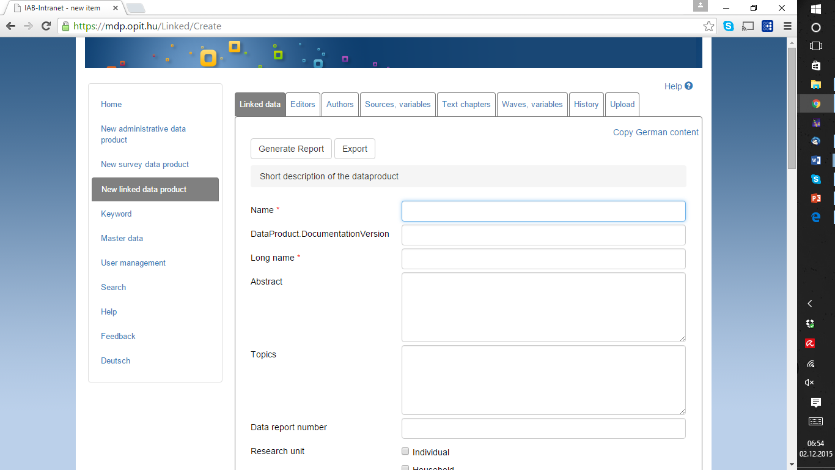

Slide 11
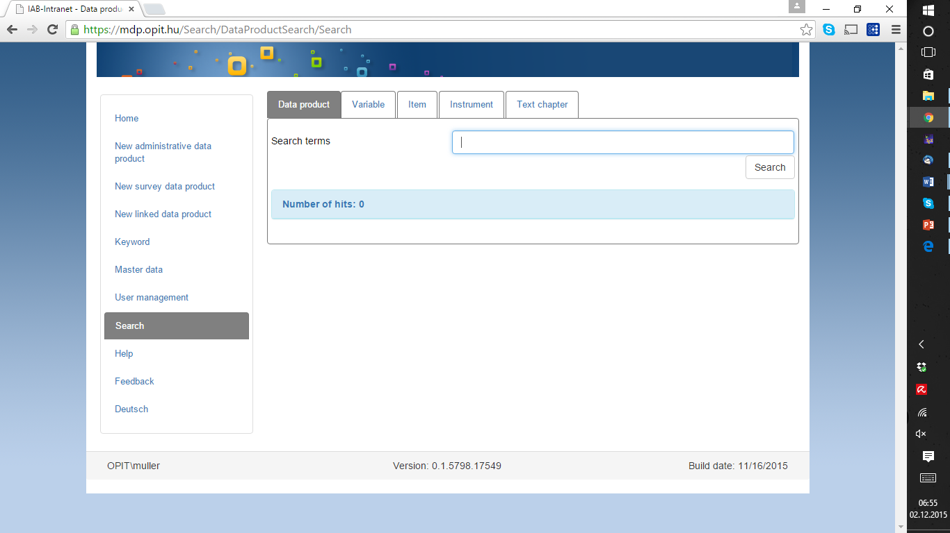

Slide 12
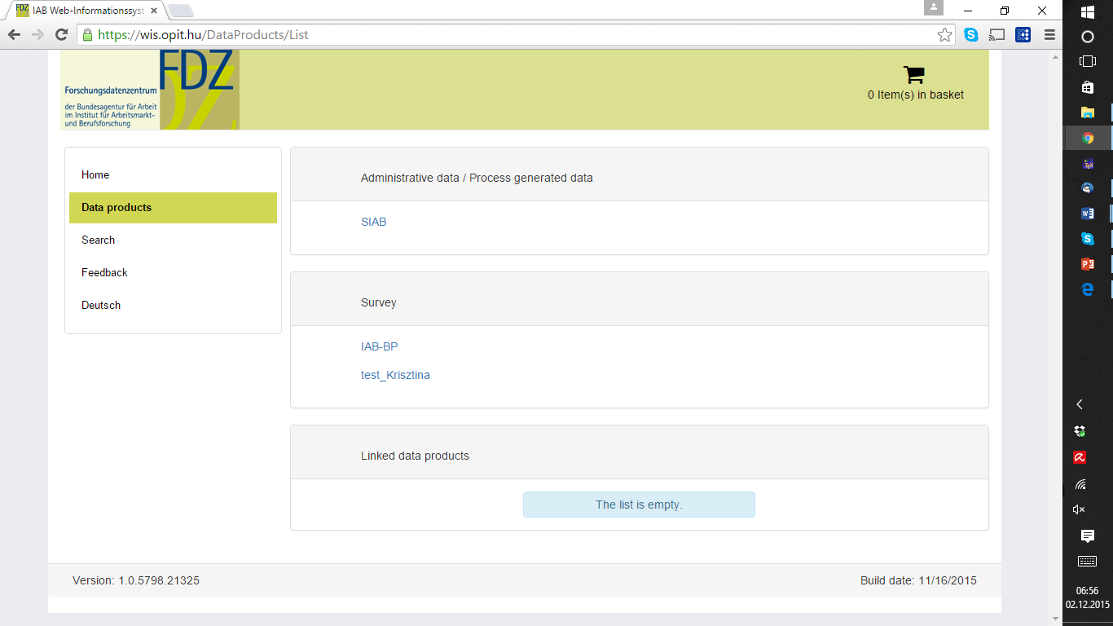

Slide 13
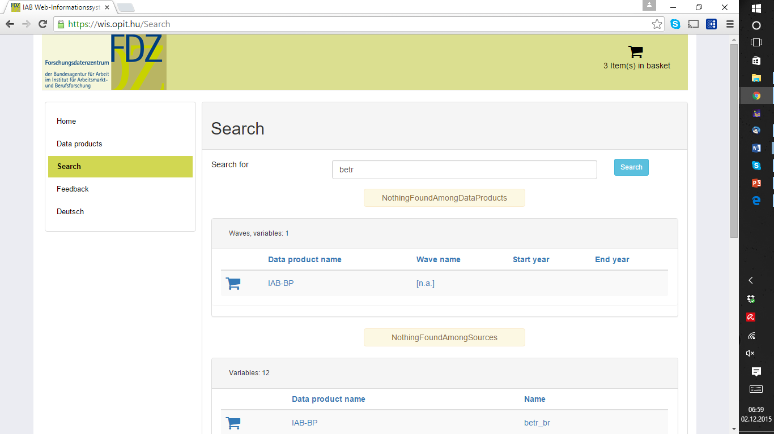

Slide 14
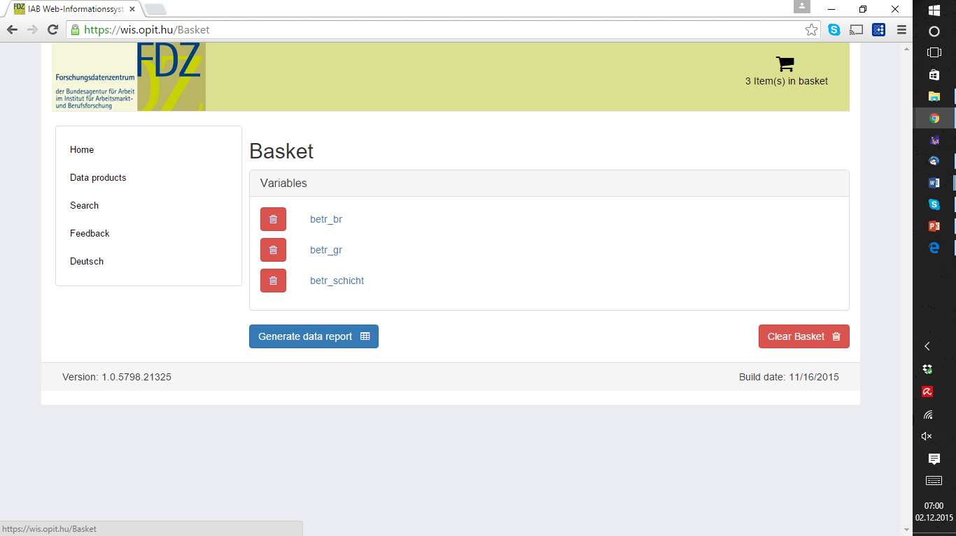

Slide 15
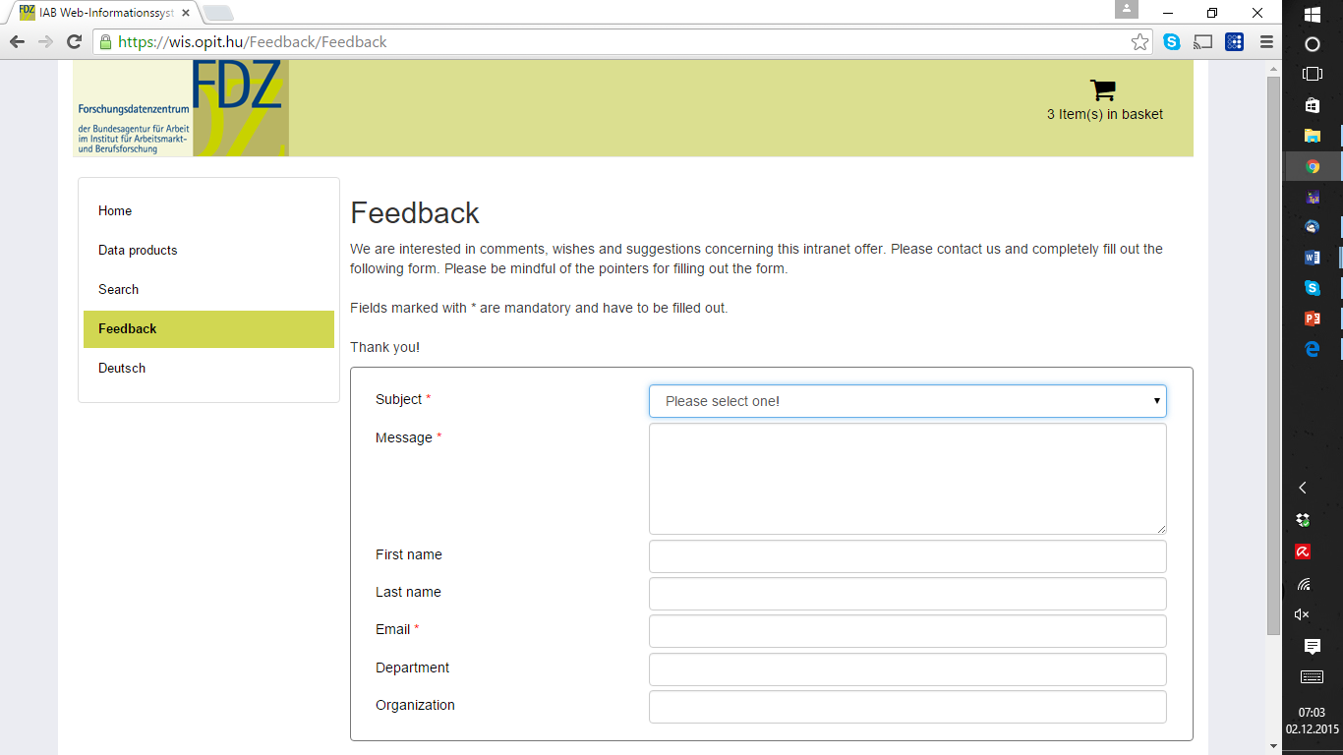

Slide 16
Thank you for your attention
david.schiller@iab.de
dana.mueller@iab.de
http://fdz.iab.de

Slide 17
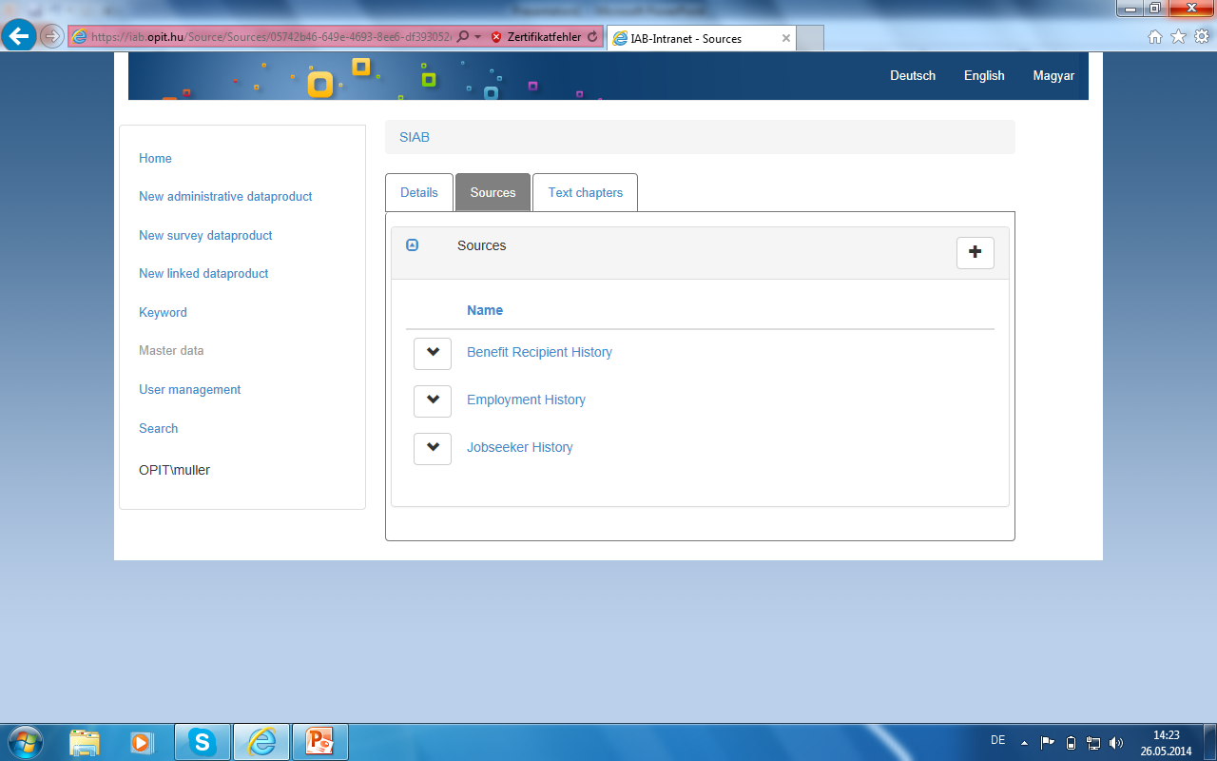
Incorporation of multiple data sources

Slide 18
Import and support for multiple sources
IAB cares about different data sources:
Existing data sets stored in Stata.
Data sets deriving from questionnaires.
Process generated data from multiple sources.
All of them have to be incorporated in the data documentation system without running into issues of non-working interfaces.
Solution: use of exchange standards to import information.

Slide 19
Structure of IAB data creation process
A number of departments are involved:
ITM – extracting research data out of the data warehouse of the German Federal Employment Agency
Different departments (like “education and employment over the life course) – caring about survey belonging to their topic of interest
KEM – methods department responsible for data editing issues (weighting etc.)
FDZ – Research Data Centre giving access to external scientists
Consequently: need for data documentation tool that supports the data creation process.

Slide 20
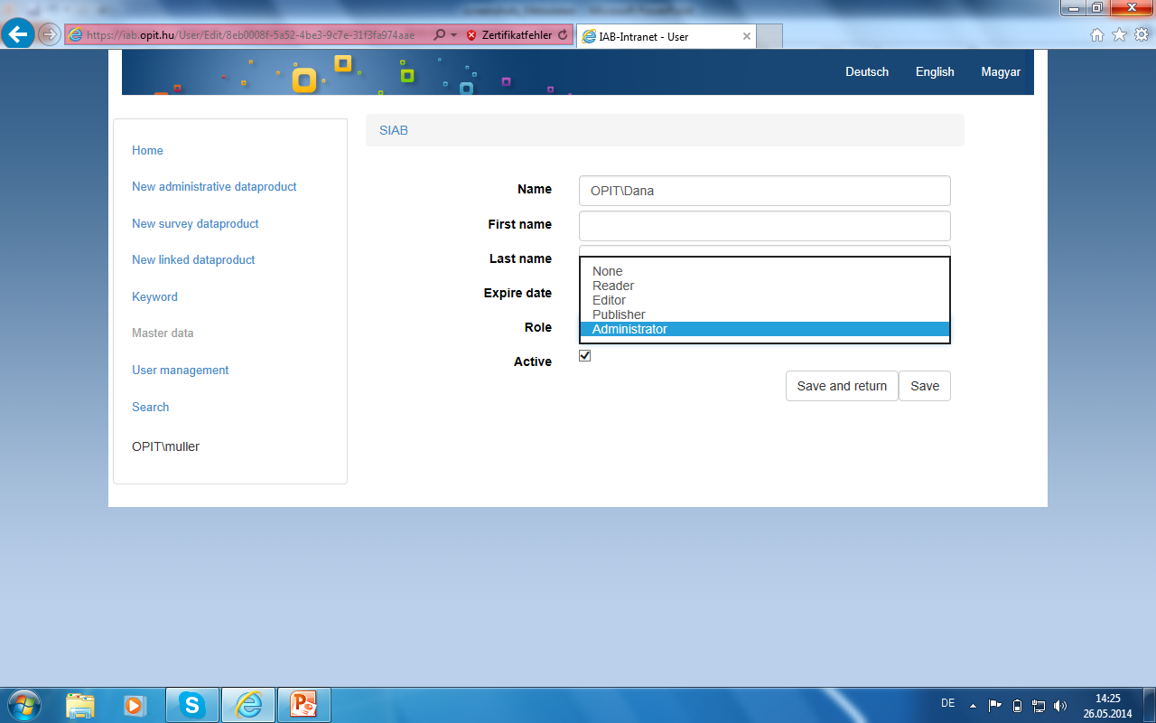
User roles management within IAB

Slide 21
Outlook
Software was developed at OPIT (software development company) in Budapest, Hungary.
Complicated process of implementation into IT structures of the German Federal Employment Agency.
Currently two equal versions in Hungary and Germany.
Need for further testing and developing.
Solution should go live in the 2nd half of 2015.

Slide 22
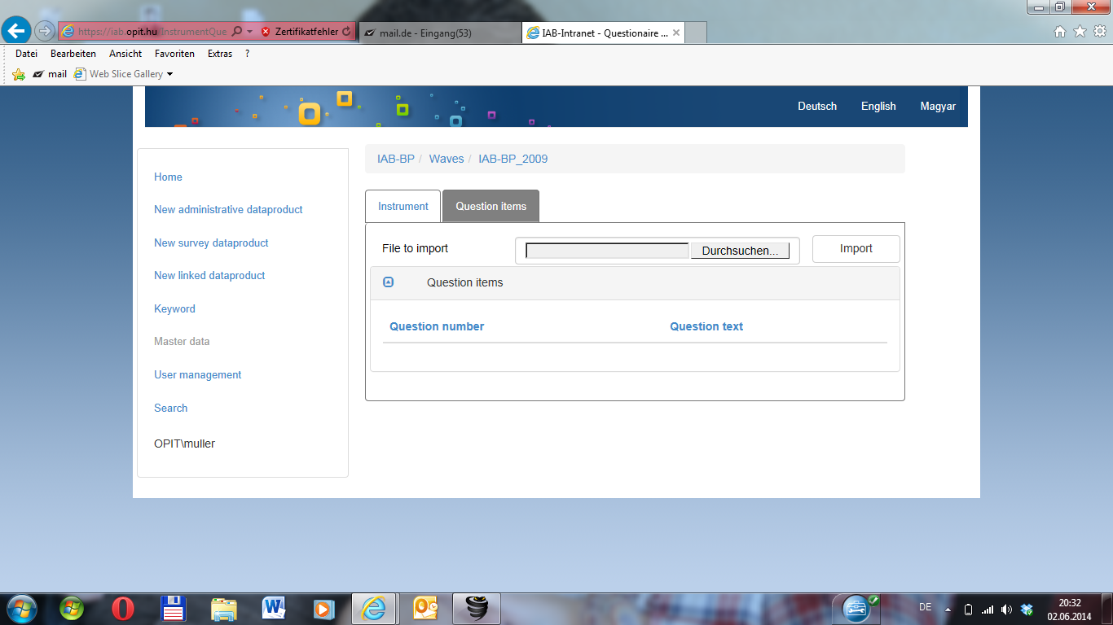
Import of questionnaires

Slide 23
The future – even more data sources
IAB offers a powerful source of research data.
Information about everybody how was employed from 1975 on a daily basis.
Additional information coming from surveys to enrich the process generated data.
In the future linkage with surveys not generated by IAB and with other process generated data sources (including Big Data).
Current exchange format of choice – DDI 3.2.

Slide 24
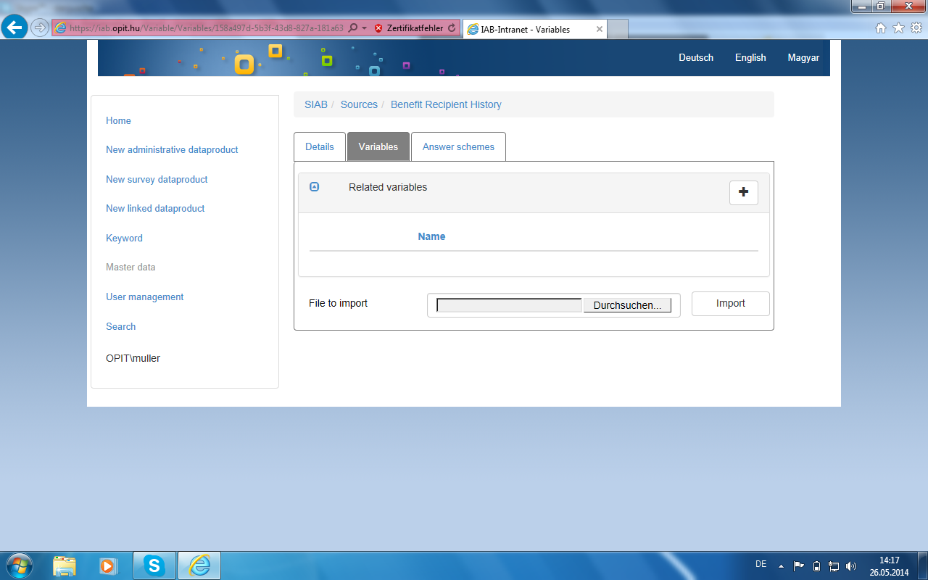
Import of XML files from Stata

