Slide 1

Building a statistics lighthouse for all decision makers
Lars Thygesen & Carsten Zangenberg
EDDI 2015
Copenhagen

Slide 2

Why are we here?
Because all good decisions rely on facts
Provide the basic facts on society – a common reference point
Basis for democracy and economy
A lighthouse in the Sea of Information
Notes:
The purpose of official statistics is to provide a common basis for people’s understanding of society, and thus help them making informed decisions. This purpose of course requires that statistics have a high quality. One dimension of this is that statistics are easily accessible and understandable to all kinds of users.
When two friends are discussing how big problems there are with immigrants in the country, they should turn at once to the official statistics source. They should have a common reference point

Slide 3
Strategy of official statistics organisations
Provide basis for informed decisions by:
Government
Research
Enterprises
Citizens
International organisations
Notes:
Government needs to know, e.g., how the economy is developing, how many poor people there are, or local government needs to know how many schoolkids
Research, e.g. in health and its relation to work participation, whether people who have a certain disease descend from parents and grandparents that have the same or a similar disease
Plan location of branches
Hold their politicians responsible, or understand phenomena in society

Slide 4
What we have to do?
Produce high quality statistics
Make it available
But it is not enough!
Data information statistics knowledge
Knowledge has to enter the heads of users

Slide 5
Simplified definition of statistical metadata
Reference metadata:
Conceptual metadata (e.g. definition of income)
Methodological and processing metadata (e.g. description of data processing)
Quality metadata (e.g. Availability)
Structural metadata:
Metadata act as identifiers and descriptors of the data (e.g. name on variables, dataset etc)

Slide 6

The Statistical Information System
CPR
Educa-
tion
Employ-
ment
Person
id:
Person Number
Tax
Inter-
view
x,y
Question-
naire
Social
x,y
Health
etc
Dwelling
id:
Address
Enterprise
id:
CBR-No
x,y
x,y
Cadastre
BDR
CBR
VAT
Notes:
A model of the population and also the populations of enterprises and dwellings and real estate + the concepts we needed to know about them
Also the links between them.

Slide 7

A treasure!
Immensely rich data
High data quality
Combining & linking
Longitudinal studies
But how can users benefit?

Slide 8
How metadata can help
Support users to find the statistics most suitable for their purpose
Users must be able to understand contents and quality, and thus fitness for their purpose
Metadata must be very well structured and integrated with the data
Easy to maneuver from one part to others

Slide 9

How can we serve users? They should be helped to…
find possibly useful statistics
Most users don’t know what exists
Accessibility
or other search - needs metadata
make sure if the statistics are suitable
study exact characteristics
Contents
Quality
Methods
compare with other statistics and metadata

Slide 10
The role of metadata
General Environment: Political/legal context, Technology/standards
Ressources: staff, IT-systems etc.
Management processes
Respondents/ registers etc.
Users
Support processes: Quality, metadata, methods & IT
User needs /orders

Slide 11
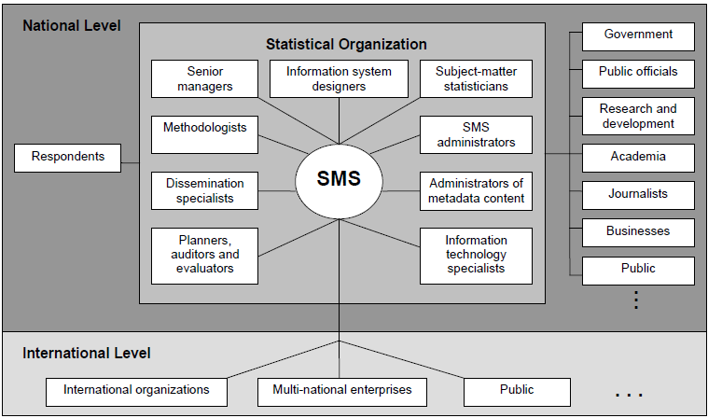
Metadata users

Slide 12
Metadata vital for end users of statistics
Availability of statistical outputs
Metadata related to the statistical outputs
Metadata on concepts and definitions, classifications, aggregations, statistical and evaluation methods, terminology, history, etc.
Metadata about quality (e.g. explanatory notes, indicators)
Access to microdata
Time series
Updating procedures
Statistical revisions
Responsibility for individual statistical outputs

Slide 13
Understanding statistics and metadata
Language and Terminology
Concepts versus data
Populations and units
Attributes
Stocks versus flows / events

Slide 14
Statistics are not all in one place, nor completely coherent.
Many organisations in each country produce official statistics
Difficult to get an overview of what exists and how are the connections and differences between the concepts measured
If you need data from several countries – which is increasingly needed – it becomes even worse

Slide 15




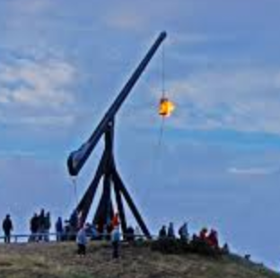
Where to go?
User

Slide 16
Coordinated metadata
Within each data provider
Between several data providers
In a country
Several countries
Eventually across the world

Slide 17
Portals and standards
Organisation-wide, nation-wide, Nordic, world-wide
Metadata standards are required.
Standards must be so intuitive that users, advanced as well as simple, can benefit.
Must be easy to explain to producers of statistics
Easy to implement in the production processes.
DDI
+ other standards specifying detailed contents

Slide 18
The chosen standards
DDI to achieve:
the right structure of metadata concepts,
links between metadata terms & concepts,
connection to business processes
independence of IT solution
SDMX & SIMS to achieve:
Total coverage of metadata items
Inter-operability with other metadata systems
Flexibility in presentation
Easy exchange with Eurostat and others
GSBPM to achieve:
Metadata to be produced in the right processes
Metadata guidelines integrated with other guidelines

Slide 19
Statistics and DDI in a hurry
using
Study
Survey
Instruments
measures
made up of
about
Concepts
Questions
Universes

Slide 20
with values of
Categories/
Codes,
Numbers
Variables
Questions
Dimensions
Measures and
attributes
collect
used for
made up of
Used for
resulting in
used for
Responses
Data Files
N-Cubes

Slide 21
Classical metadata elements: ”The Diamond model”
StatBank
Methods/ ”Survey”
Methods papers
Quality declaration
Concept
Variable/dataset
Concepts database
Variable database
Hvad betyder
Classifications
Klassifikationsdatabase
Class database

Slide 22
Dissemination aspects

Slide 23
Different users have different needs
Pupils need comprehensible descriptions
Analysts need for change management
Researchers need specific and detailed information - also the historical

Slide 24
Metadata must provide a perceived added value for end-users
Only one in four uses quality declarations
For those who do not use quality declarations, two out of three indicates, they do not know what it is

Slide 25
Who uses documentation
Municipalities 50 pct.
Media and press 0 pct.
Educational institutions 70 pct.
Private companies 50 pct.
Ministries and organizations 100 pct.

Slide 26
Who says that we need to improve
Municipalities 50 pct. !
Media and press 0 pct.
Educational institutions 70 pct. !
Private companies 50 pct. !
Ministries and organizations 100 pct. !

Slide 27
How do we communicate metadata
Terminology
Basic DDI concepts
Portals
Dissemination products
Statbank
Publications
Communication
Search Box

Slide 28
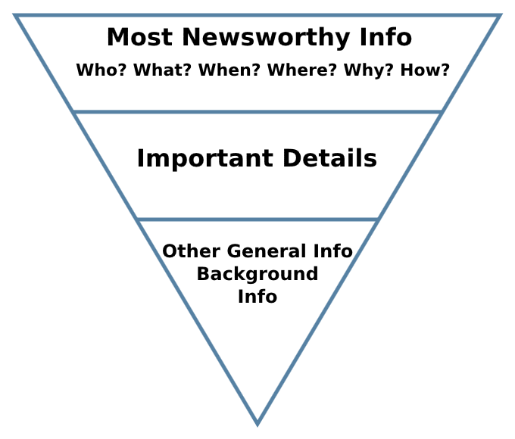
Inverted news pyramid

Slide 29
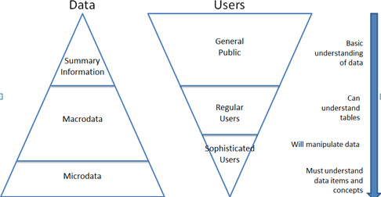
Different data needs

Slide 30
User types
User behavior (eg Farmer, Miner and Tourist)
Sector (eg ministries, authorities, media, academia)
Knowledge e.g. of statistics (experts or new users)

Slide 31
”Words don’t come easy” (F.R.David)
Even professionals may have difficulty with the understanding of our concepts and definitions - I wonder how our users understand?
How do we ensure that the language understood as intended - of different target groups?
“Lost in Translation”
Can we get something from search engines on the web?
Can specialists from our Information Services help from the queries received?

Slide 32
“I only believe in statistics that I doctored myself” (W. Churchill)
Explanations, definitions and special considerations are essential for the understanding of statistical data
The quality of the metadata is often as important (or more) as the quality of the statistical data
Communication, perception and understanding are essential quality dimensions
Metadata may be an integral part of the statistical data regardless of how those are presented

Slide 33

One bite at a time
DDI

Slide 34
One bite at a time
DDI
Sometimes perhaps two..

