Slide 1

Managing Private and Public Views of DDI Metadata Repositories
EDDI2012

Slide 2

In This Talk
Presenter: Dan Smith
Challenges in confidentiality
How to expose metadata to the public
Colectica Workflow Services
User Experience
Technical Implementation
Future Directions

Slide 3
About the Speaker
Former: IBM Advanced Internet Technology Group
Semantic Web (OWL-S and SWRL)
Persistent Identifiers (LSID)
Present: Colectica
Many DDI 3 based software tools and customizations
Workshops and DDI training
DDI Technical Implementation Committee

Slide 4
Challenges – Metadata Driven
Metadata now drives production systems
Everything is recorded
Some metadata used for processing may not be public
Intermediary versions of metadata
Internal locations of holdings
Organization personnel due to privacy concerns
Variable statistics may differ internally and externally

Slide 5
Challenges - Legal
Legal issues in distributing metadata
Privacy laws regarding particular studies
Patient protections
Licensed code lists that can not be republished

Slide 6
Challenges - Organizational
Specific organization decisions about metadata release
An organization may want to publish only a portion of their information
Only data file descriptions
Only questionnaires

Slide 7
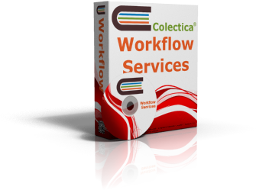
Colectica Workflow Services
Colectica Workflow Services manage a publication process
Approvals
Redacting, filtering, and pruning published metadata
Audit log of approval process
Included with Colectica Repository

Slide 8
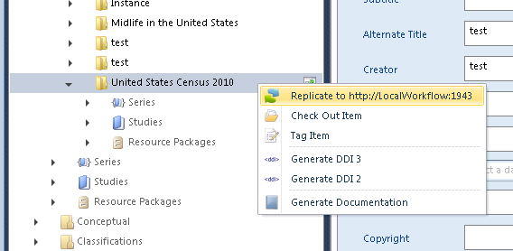
Publication Process - Selection
User selects a metadata product to publish in Colectica Designer
Chooses where to publish the item

Slide 9
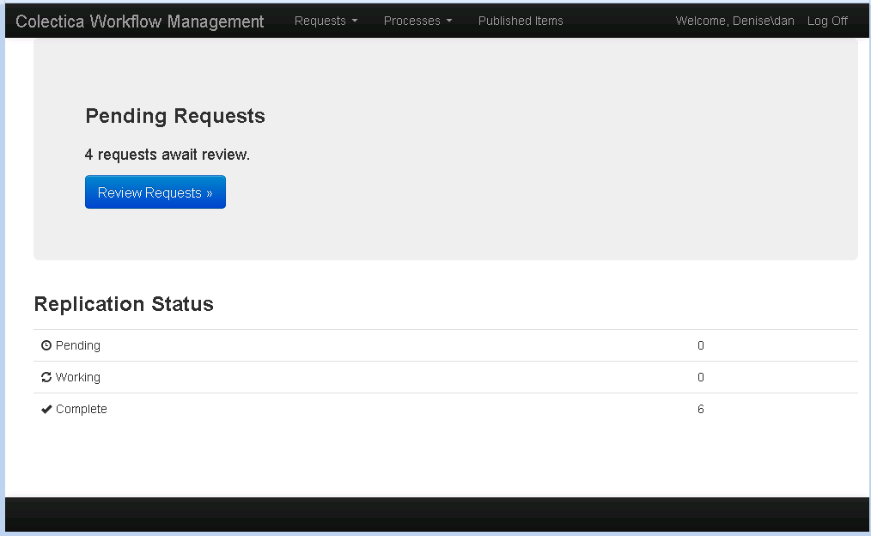
Publication Process - Request
A publication request is submitted to the Workflow Services

Slide 10
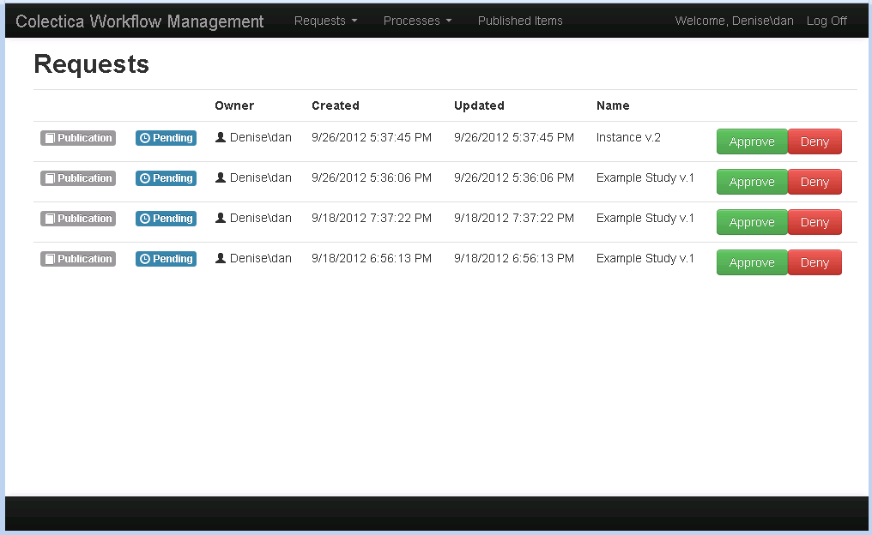
Publication Process - Review
Another user with appropriate permissions can view and approve the publication

Slide 11
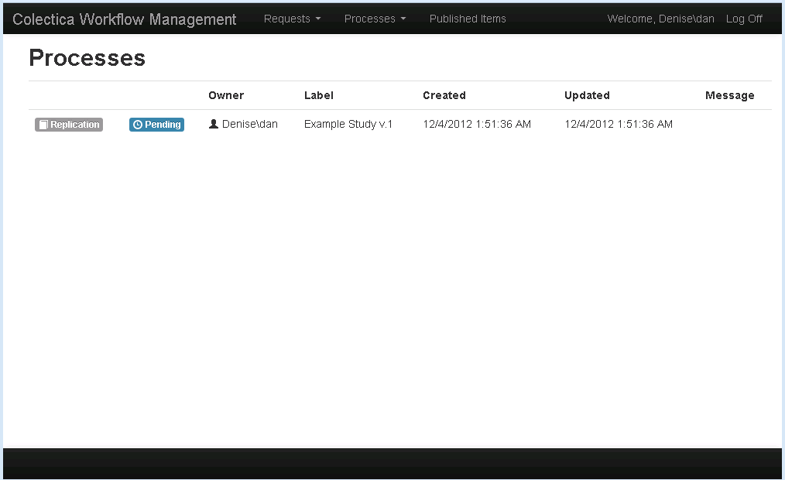
Publication Process - Publish
Workflow Services redacts/filters and publishes the metadata

Slide 12
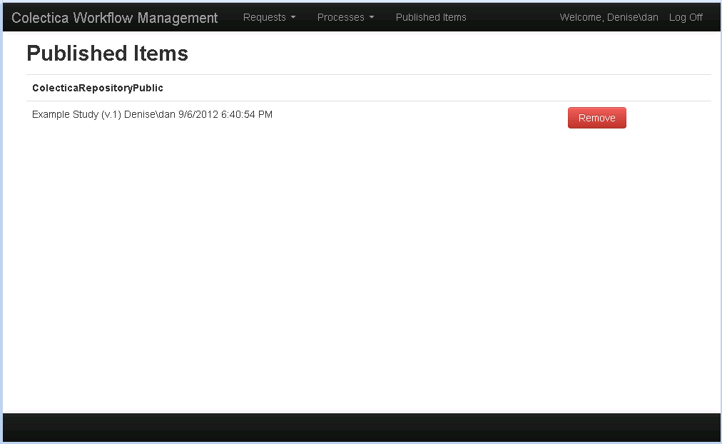
Publication Process - Provenance
Audit trail of published metadata

Slide 13
Technical
Rules are created in the Workflow Service that control what information becomes public
Two types of rules
Per item rules control content within individual items
Per publication rules control whole items and their relationships
Combining these two rule types gives an organization full control.

Slide 14
Technical – Included Samples
Sample rules are included
Filter published questionnaire flow
Filter custom fields of a specific type
Example - Don’t disclose the “Data Custodian”
Filter by intended audience
Colectica allows multiple audiences to be defined for many fields, filter the “Internal Audience”

Slide 15
Technical – External view
Public metadata has same identification as the internal metadata
Some fields may not be available
Some items may be entirely hidden
Consistent identity information allows an organization to benefit from reuse
External reuse is still visible
Third party metadata can be linked to internal view

Slide 16
Future Directions
More sample filters based on customer feedback
Improved searching within publication audit trail
Ability to publish to XML files in addition to another repository instance
Public implementation at Statistics New Zealand in April 2013

Slide 17



Thank you
 | Web | colectica.com
 | Blog | blogs.colectica.com
 | Twitter | @Colectica
 | YouTube | youtube.com/colectica

