Slide 1





Implementation of DdiEditor in DDA EDDI12 – 4th Annual European DDI User Conference Bergen December 3rd-4th 2012
Anne Sofie Fink
Danish Data Archive

Slide 2
Outline of the presentation
DDA – Danish Data Archive
Introduction to the DdiEditor
New work practices for data curation processes
Experiences from on-going software development
Further development

Slide 3
Danish Data Archive (DDA)
National data archive for structured research data for social science and health science
Kind of material: | Survey data
Activities: | Data retrieval Data processing and preservation Data dissemination
Funding: | Publicly funded
Staffing: | App. 20 employees, 2-3 software developers
Organisational affiliation: | Unit in the Danish National Archives (Statens Arkiver)

Slide 4
DdiEditor 2.0 Framework for data processing and processes
Ingest of wiki text file and SPSS-file (incl. descriptive statistics)
Linking of variables and questions
Use of generic code
Creation and use of resource packages
Manipulation of metadata elements
Integration of study description and metadata on variable level
Production of DDI-L data and documentation for long term preservation and dissemination
Export to statistical software – SPSS Syntax file and csv data file
User documentation – style sheet-based codebook

Slide 5
Wiki syntax
Data input in wiki syntax Questions, variables, categories, concepts, universes, instrumentation (question flow)
Syntax for repeated questions and categories
Syntax for multiple questions
Syntax for filtering (if then else/while/sequence)
Naming of concepts
Naming of sub universes

Slide 6
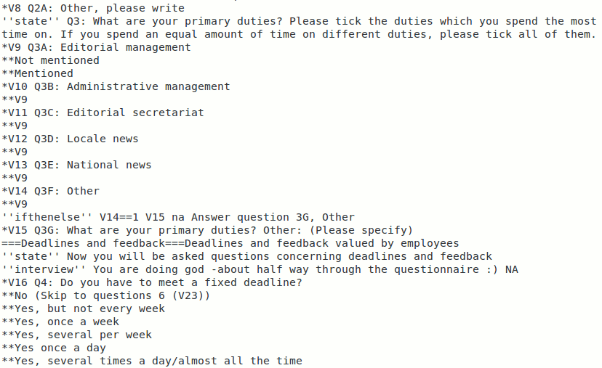
Section of wiki file

Slide 7
SPSS file
Variables – naming and labeling
Codes
Adding DDA-variables (DDA no. and DDA serial number)
Recoding of values for missing data (DDA standards: 9, 10, 11 - unknown, not relevant (na), not participating)
Definition of measurement scale for variables (ordinal, nominal and scale)
Production of descriptive statistics (frequencies on ordinal and nominal variables)

Slide 8
Genericode and resource packages
DdiEditor plug in for creation of controlled vocabularies
Genericode for DDA CVs
Study state classes
Access restrictions
CESSDA Subjects categories
Resource packages
International
E.g. occupation, education
National
E.g. family relationship, regions
Survey specific
Complex/complicated category structures e.g. health condition

Slide 9
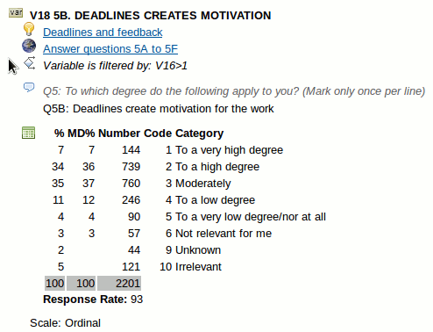
DDI-XSLT Print User documentation – Codebook style output - Variable

Slide 10
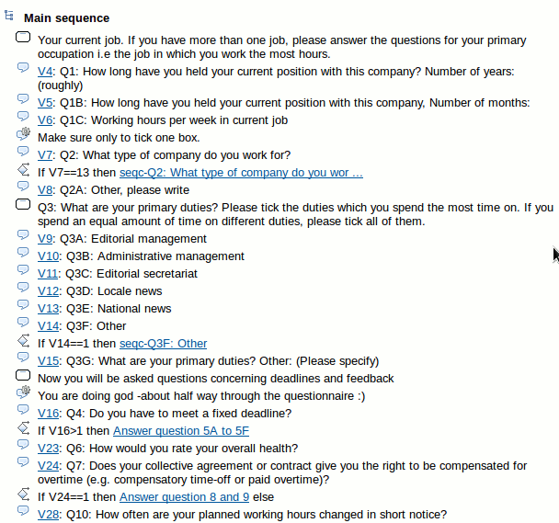
DDI-XSLT Print User documentation – Codebook style output - Instrumentation

Slide 11
Experiences from on-going software development and releases
Between enthusiasm and resistance
Bug tracking to replace zero-defects mindset
SCRUM as software development methods
Test, test, test, …
And corporation

Slide 12
Conclusion
Support for new curation processes
Production of dynamic data and documentation in DDI-L for preservation and dissemination
Export to SPSS
Creation of genericode for DDA cv’s
Creation of resource packages
… and way forward

Slide 13
Further development
Less dependence on wiki based input
User friendly creation of resource packages
Support for linking of metadata elements on study and variable level for longitudinal studies
Support for automatic review processes
Versioning of metadata elements
Support for data exchange
Import from web survey tools to DdiEditor

Slide 14
What to know more?
Come to the poster session
Try out the Ddieditor
Have a look at the DdiXslt (SND and DDA)
See the landing page solution
Visit: http://code.google.com/p/ddieditor
Questions(!) & thanks
Contact information: asf@dda.dk

