Slide 1
An Early Prototype of the Comprehensive Extensible Data Documentation and Access Repository (CED²AR)
William C. Block and Jeremy Williams,¹
John Abowd and Lars Vilhuber,²
and Carl Lagoze³
¹ Cornell Institute Social and Economic Research, Cornell University
² Labor Dynamics Institute, Cornell University
³ School of Information, University of Michigan
Presentation at the 4th Annual European DDI User Conference (EDDI12)
Norwegian Social Science Data Services, Bergen, Norway
3 December, 2012

Slide 2
Outline
The Problem: Curation of Data Locked within a Secure Environment is Difficult
NCRN Solution:
CED²AR Prototype
CED²AR Search API
DDI bridging the boundary between confidential and public metadata
Questions and Discussion

Slide 3
Curating Data Locked within a Secure Environment is difficult
By definition: Access is Restricted
Lack of Curation throws up a barrier to Future Discovery and Access
Replication of Results becomes increasing difficult
Important! The Scientific Method depends on the ability to replicate the results of research

Slide 4
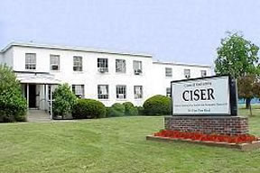
Research Opportunities at the Cornell Census Research Data Center
4
Notes:
IAN: The goal of this talk is to introduce you to the Research Data Center located at Cornell, to tell you about some of the current research projects going on at the RDC, to tell you about the many expansive datasets available for research at the RDC, and to tell you a little bit about the research process.
I am the Administrator of the facility and your first point of contact for questions regarding research projects you may wish to undertake.
WARREN: I am the Research Director of the RDC at Cornell. I am leaving Cornell the end of the semester and Bill Block, Director of CISER, will take over directing the research functions including proposal development. The Cornell Research Data Center is located at 391 Pine Tree road, near East Hill Plaza, at CISER – the Cornell Institute for Social and Economic Research. [Ad lib plug for CISER]

Slide 5
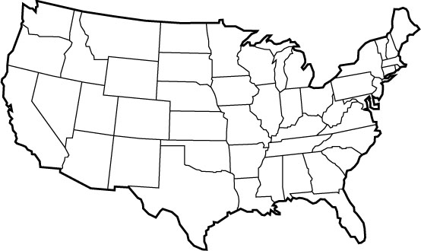








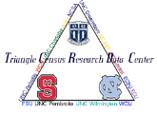

The RDC Network
5
Notes:
IAN: The Center for Economic Studies was created at Census in 1982 to provide secure access to confidential microdata for external researchers wanting to use business microdata collected in economic surveys. That original Census Research Data Center in Maryland has grown into a national network of 8 RDCs around the country, Cornell and Baruch being two of the most recently opened.
RDCs:
Boston 1994, UC Berkeley 1999, UCLA 1999, Research Triangle 2000, Michigan 2002, Chicago 2002, New York - Cornell 2004 and Baruch 2006
Minnesota 2009 Georgia?
There is an active proposal to open an RDC at the University of Georgia. One effect of this growing national network is that it facilitates collaborative projects involving researchers at different sites.

Slide 6
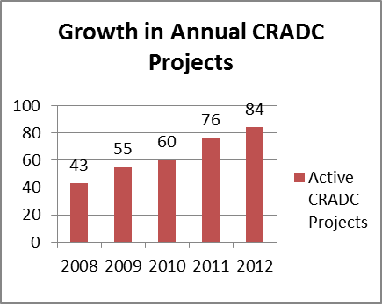
We see this problem at Cornell: Research with Restricted Data increasing at CISER

Slide 7
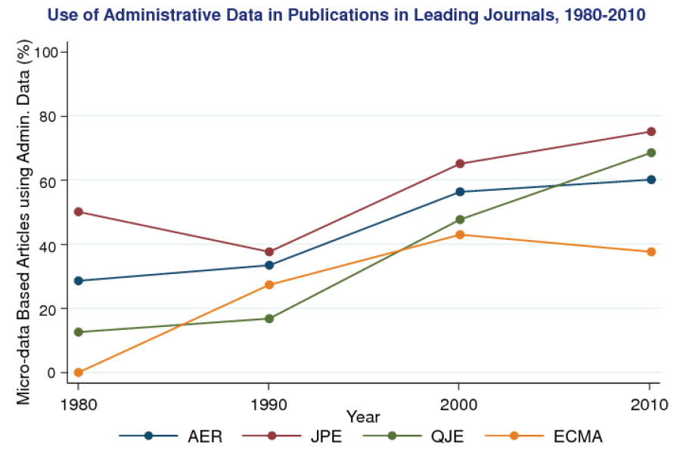
Increasing Use of Restricted Data in Research
Source: Raj Chetti, NBER Summer Institute 2012

Slide 8
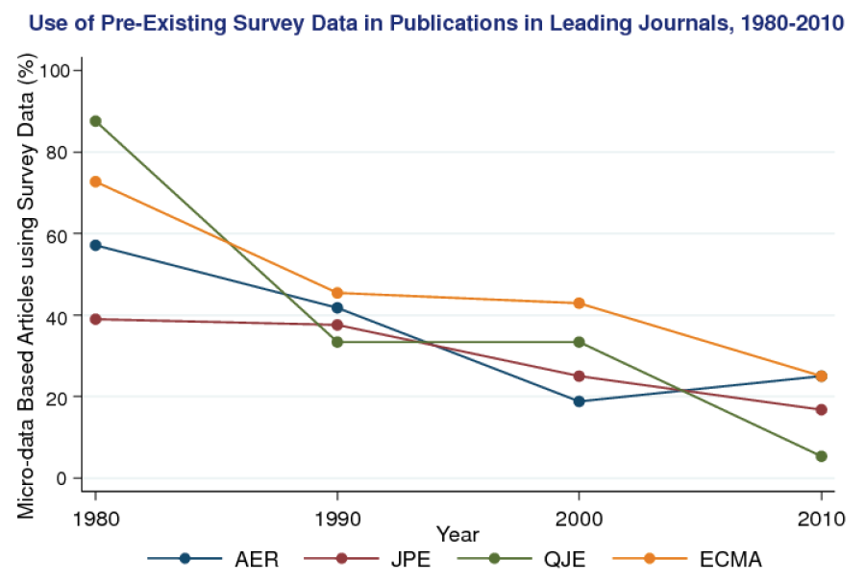
Use of Public Use Data Declining
Source: Raj Chetti, NBER Summer Institute 2012

Slide 9
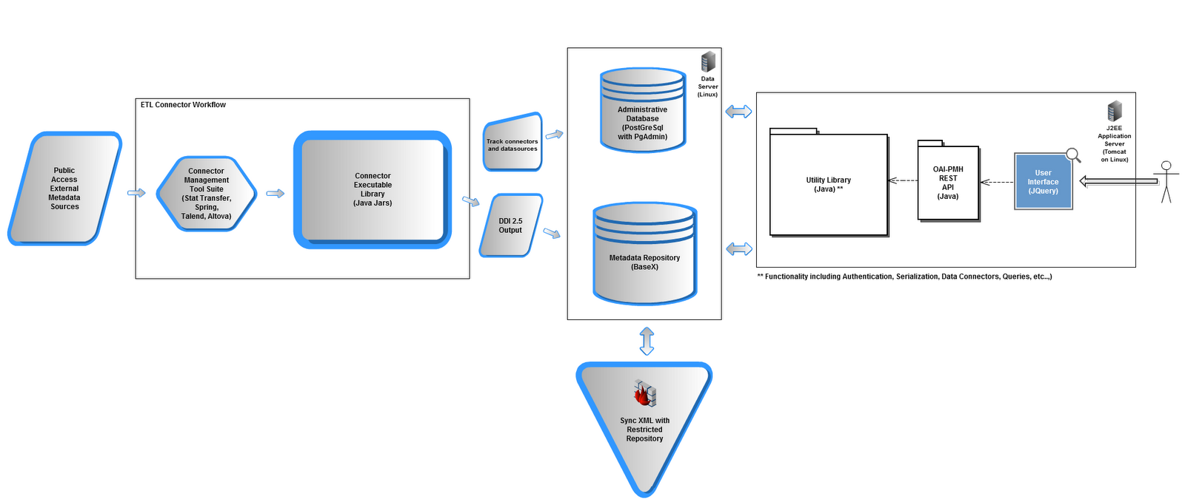
Proposed Solution: Cornell’s NCRN Node
CED²AR
DDI Solution to Confidential Metadata
Improved documentation and discoverability of both public and restricted data from the federal statistical system

Slide 10
CED²AR Overview and Goals
Collect and standardize disparate metadata into a single DDI repository
Provide a web interface for researchers to access
Build an API for developers to use
Use open standards
Provide thorough documentation

Slide 11
Acknowledging CS 5150 Contributions Jeremy Williams* Benjamin Perry Justin Burden Chantelle Farmer Shudan Zheng Jessica Kane *CISER and NCRN staff member, EDDI co-author, and coordinator of the CS5150 team
http://rschweb.ciserrsch.cornell.edu:8080/CED2AR_Web/
11

Slide 12
CED²AR Search API
The API Supports all of these query functions:
Return
a chosen set of fields within the DDI schema
Where
a chosen set of supported DDI search fields
and, or, and not
contains, starts-with, ends-with
Sort
descending, ascending
Limit
give me results 10-50 from each codebook
The API makes interacting with the repository easier because it abstracts away the underlying XQUERY necessary to perform the query.
12

Slide 13
CED²AR Search API
Some Example DDI things (resources):
Codebooks:
http://rschweb.ciserrsch.cornell.edu:8080/CED2AR_Query/codebooks
Codebook Named SSB
http://rschweb.ciserrsch.cornell.edu:8080/CED2AR_Query/codebooks/SSB
Variables of Codebook Named SSB
http://rschweb.ciserrsch.cornell.edu:8080/CED2AR_Query/codebooks/SSB/variables
A particular variable in the SSB Codebook named totfam_kids
http://rschweb.ciserrsch.cornell.edu:8080/CED2AR_Query/codebooks/SSB/variables/totfam_kids
13

Slide 14
CED²AR Search API
Ability to create complex queries across codebooks
Give me all variables across all codebooks where the variable text contains the word 'house' and the variable label contains the word 'dwelling' but does not start with the word 'number' (and sort it backwards by variable name)
http://rschweb.ciserrsch.cornell.edu:8080/CED2AR_Query/search?return=variables&where=variabletext=*house*,variablelabel=*dwelling*,variablelabel!=number*&sort=-variablename
14

Slide 15
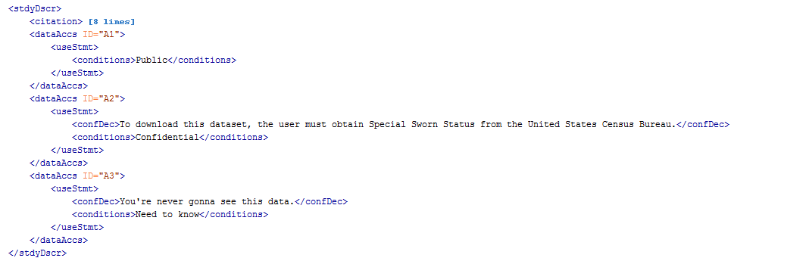
NCRN DDI Solution at the Variable Level: <dataAccs>
15

Slide 16
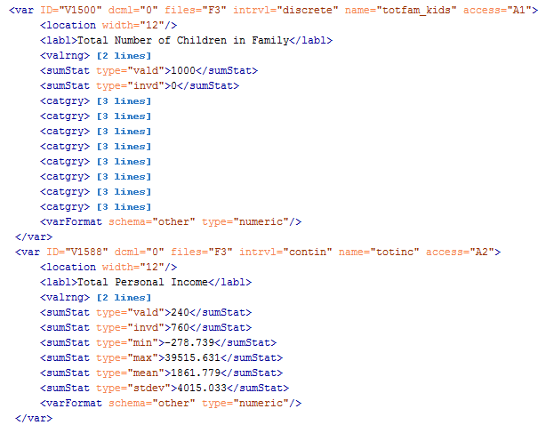
Variable Level Solution (continued)
16
Notes:
In this scenario, totfam_kids is public and totinc is confidential

Slide 17
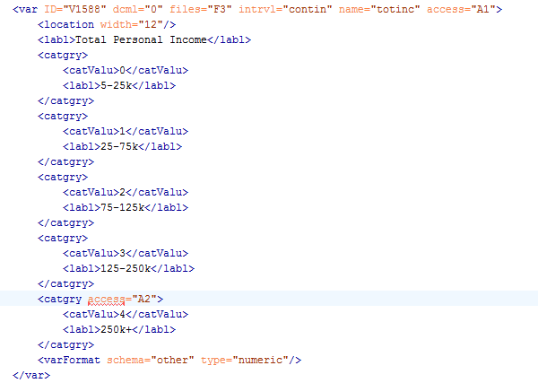
No DDI Solution at the level of a Value Label
Small tweak to the DDI Codebook Schema would fix this.
17
Notes:
Wouldn’t it be cool if we could make totinc public, but make certain value codes confidential (currently not possible to assign access id to catgry element in DDI 2.5)

Slide 18
Takk!
Spørsmål?
block@cornell.edu
ncrn.cornell.edu

