Slide 1
DDI and GSIM – Impacts, Context, and Future Possibilities
Arofan Gregory
Metadata Technology

Slide 2
Overview
The general situation for GSIM – DDI
Implementing GSIM with DDI
Detailed view of some GSIM areas and overlap/gaps with DDI
Describing data
Describing questionnaires
Describing codelists, categories, and concepts
Describing events and processing
Looking forward

Slide 3
GSIM and DDI
GSIM is a creation of the HLG-BAS group under UN/ECE
DDI is a creation of the DDI Alliance
There is no immediate formal relationship between these organizations
However, both organizations have made statements that they will work together to make DDI a good implementation vehicle for GSIM

Slide 4
GSIM, DDI, and Official Statistics
GSIM is a key standard for official statistics organizations
Some official statistical organizations already use DDI or are planning to do so
IHSN Metadata tools (developing world)
DDI-Lifecycle (ABS, Stats NZ, INSEE, Eurostat)
GSIM is a potential vehicle for the widespead adoption of DDI among official statistical organizations

Slide 5
Models at Different Levels
GSIM is a Conceptual Model
It is technology and implementation-neutral
DDI is an Implementation Model
It is cross-platform and application-neutral
It is implementated in XML (and soon, RDF), but isn’t technology-neutral
Specific applications have their own, internal models
These are bound to specific technologies and platforms

Slide 6
Implementing GSIM at a Technical Level
To allow re-use of applications and services, agreements must exist on many levels
Conceptual models must match (GSIM)
Implementation models must match (DDI)
Application models must match (TBD – web services? Others?)
There is still a lot of work around mapping DDI to GSIM, and then agreeing on how DDI XML will be used within applications before we have reusable, interoperable GSIM-based services and applications

Slide 7
What is the Usefulness of GSIM?
To make applications work together on all levels, we will need to map existing application models to each other
On the basis of DDI
On the basis of GSIM
From a technical perspective, this can be very difficult
Having an agreed base model at the conceptual and implementation level makes it easier/possible

Slide 8
Describing Data
DDI describes two kinds of data
Microdata sets
Aggregate (“dimensional”) data sets – Ncubes
Both exist in GSIM
In DDI microdata, each case/unit has a set of variables, at least one of which is the case identifier
Others hold observations or derived or supporting values (such as weights)
Ncube structures use variables as dimensions, observations, and attributes to describe the matrix structure of tables

Slide 9
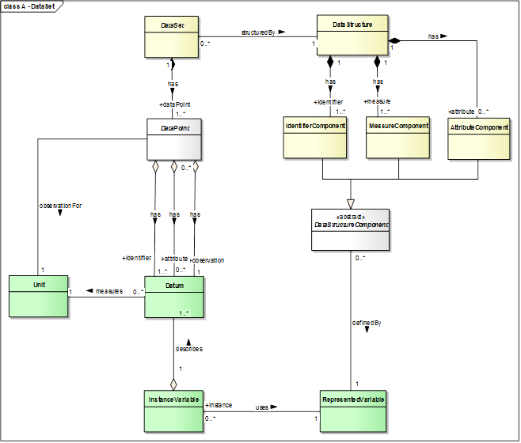

Slide 10
Other GSIM Constructs
GSIM does make a distinction between “unit data structures” and “dimensional data structures”
GSIM supports hierarchical relationships in data sets
Both are based on the core data model you have seem

Slide 11
Unit Data Set

Slide 12
Dimensional Data Set

Slide 13
Describing Questionnaires
DDI – Lifecycle has a very complete description of a questionnaire/instrument
Includes the mode and specifics of the instrument
Includes the questions, statements, and instructions used
Includes the flow logic of the questionnaire
Can have multiple-question “blocks”
GSIM does the same
With less detail
Largely based on DDI

Slide 14
GSIM Survey Instrument

Slide 15
Classifications, Codelists, Categories and Concepts
DDI has codelists which take their meaning from categories.
DDI has concepts associated with variables and questions.
GSIM has all of this, and more!
GSIM is “concept-rich”
GSIM also has a pure classification model, which is not as complete in DDI-Lifecycle (a bit in 3.2)

Slide 16
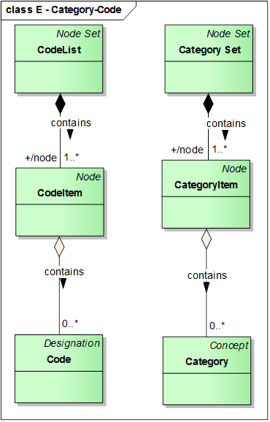

Slide 17
Nodes and Node-Sets

Slide 20
Events and Processing
DDI provides us with several ways to describe events and processing
Lifecycle Events
Collection Events
“Coding” Elements
Generation Instructions
General instructions
GSIM gives us much, much more!
Some of this is very specific to statistical agencies

Slide 21
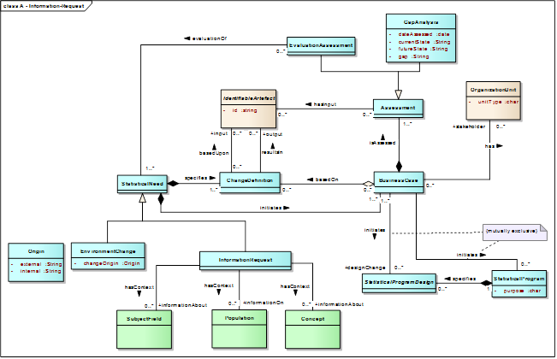

Slide 25
Looking Forward
DDI and GSIM have some very strong alignments
There are also some gaps
DDI may need to add support for some functionality
But maybe not everything – maybe SDMX can fill some gaps
This is a two-way alignment
GSIM may need to adjust to better fit DDI implementation

Slide 26
Looking Forward (cont.)
As we look to the next major re-design of DDI, we will be working proactively with GSIM
Representative from GSIM were invited to the first working session this year at Schloss Dagstuhl
DDI will continue to attend events around GSIM sponsored by HLG-BAS
Like the Geneva meeting this past November
Possibility for proactive engagement at a technical level
SDMX-DDI Dialogue
DDI Working Groups?
Others?
GSIM may also provide a strong basis for other types of work within the DDI Community, less focused on official statistics
Like the “Generic Longitudinal Process Model”, which was based on GSBPM

Slide 27
Looking Forward
Some external projects involve both archives and statistical agencies
Data without Boundaries (DwB) is a prime example
DwB is using a DDI-based metadata model
May lead to production implementations in future
If archives and statistical agencies use the same metadata…
Archiving of official data becomes much easier
Both communities can leverage the same tools. Approaches, and resources (where appropriate)
Microdata access is an obvious point of stnergy

Slide 28
Questions?

