Slide 1
Generic Statistical Information Model (GSIM) Thérèse Lalor and Steven Vale United Nations Economic Commission for Europe (UNECE)

Slide 2

The Challenges
Riding the big data wave
Increasing cost & difficulty of acquiring data
New competitors & changing expectations
Competition for skilled resources
Rapid changes in the environment
Reducing
budget
Notes:
ABS, like other National Statistical Institutions, faces shared constraints and challenges.
External Challenges
rapidly changing external environment
More sophisticated users
Demand for timeliness and responsiveness
increasing demand for more accessible and ‘joined up’ data to solve complex policy questions
Constraints
Reduced funding and volatility in funding
Our costs are increasing significantly – unable to contact many households, response rates dropping, difficult to recruit and retain interviewers
skills shortages – competing for statistical and ICT skills across government
complex work programs
siloed processes
and aging infrastructure
2

Slide 3
These challenges are too big for statistical organisations to tackle on their own. We need to work together

Slide 4










Response from Official Statistics
A High Level Group consisting of 10 heads of national and international statistical organizations was created

Slide 5
Using common standards, statistics can be produced in a more efficient way
No domain is special!

Slide 7
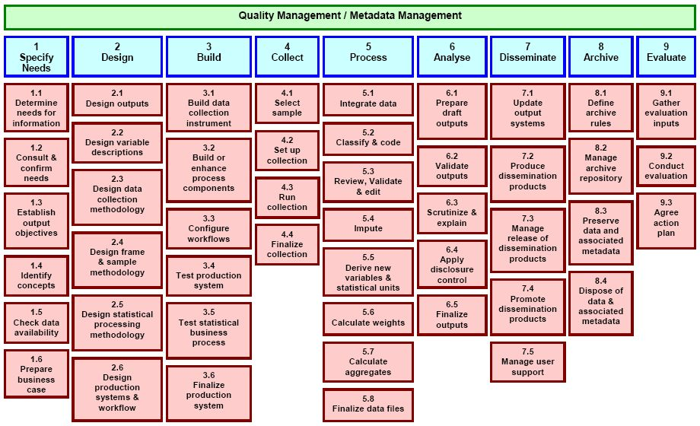
The GSBPM

Slide 8
The GSBPM is used by more than
50 statistical organizations
worldwide to manage and
document statistical production

Slide 9
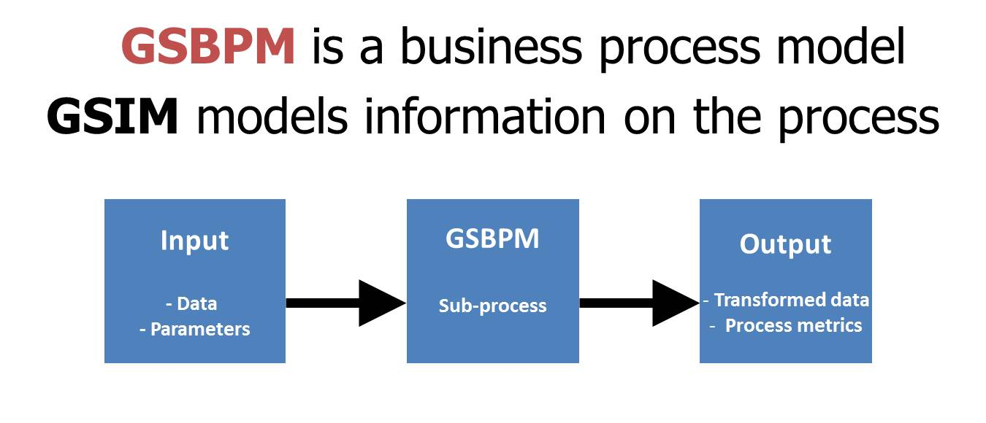
GSIM is complementary to GSBPM
Another model is needed to describe information objects and flows within the statistical business process
Notes:
Achieving (i) & (ii) also requires a consistent approach to information flowing in and out of functions
DDI and SDMX can provide a standard way of representing and “carrying” (at least some of) the required information

Slide 10
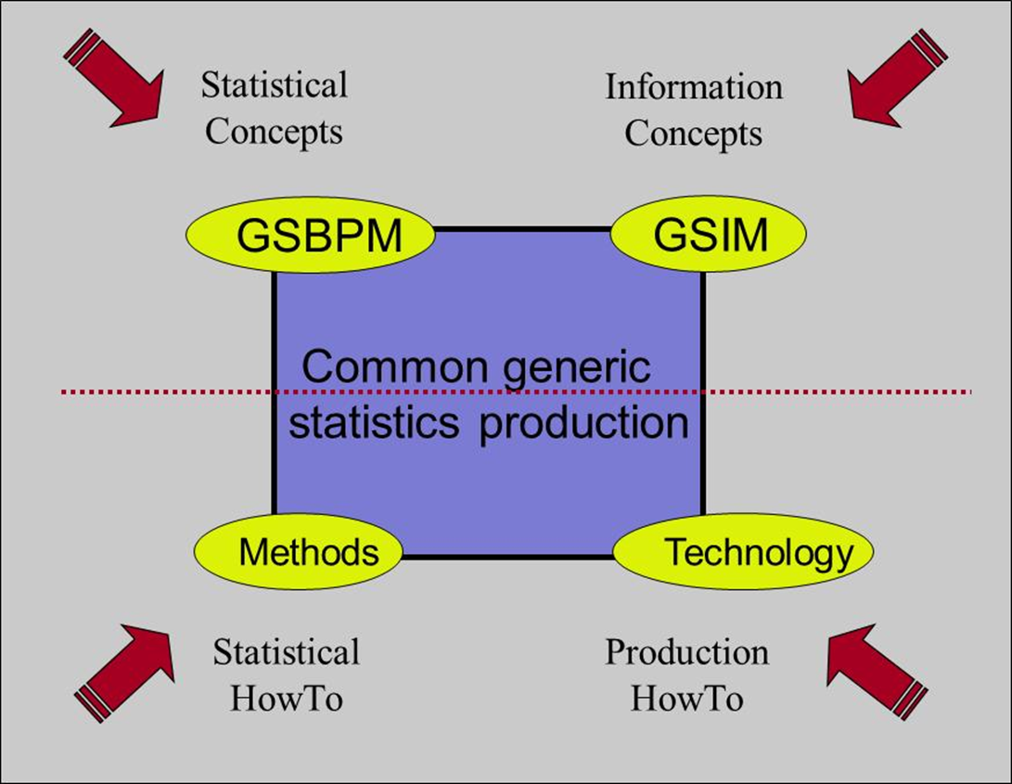
Introducing the GSIM
You are here
Notes:
10

Slide 11
What is GSIM?
A reference framework of information objects
It sets out definitions, attributes and relationships regarding information objects
It aligns with relevant standards such as DDI and SDMX
Notes:
not directly tied to them, nor other concrete implementation details
Provides common semantics that can be used unambiguously across and between different implementations

Slide 12
Purposes of GSIM
Improve communication
Generate economies of scale
Enable greater automation
Provide a basis for flexibility and innovation
Build staff capability by using GSIM as a teaching aid
Validate existing information systems
Notes:
between different disciplines involved in statistical production, within and between statistical organizations; and between users and producers of official statistics.
by enabling greater collaboration within and between organizations, especially through reuse of information, methods or technology.
of the statistical production process, thus increasing efficiency and reducing costs.
including support for the easy deployment of new statistical products and the adoption of new types of statistical data sources
that provides a simple, easy to understand view of complex information, with clear definitions
and compare with best practice in other organizations.

Slide 13
GSIM is a conceptual model: It is a new way of thinking for statistical organizations
Notes:
The conceptual model is explicitly chosen to be independent of design or implementation concerns,
The aim of a conceptual model is to express the meaning of terms and concepts used by domain experts to discuss the problem, and to find the correct relationships between different concepts.
The conceptual model attempts to clarify the meaning of various, usually ambiguous terms, and ensure that problems with different interpretations of the terms and concepts cannot occur.
Such differing interpretations could easily cause confusion amongst stakeholders, especially those responsible for designing and implementing a solution, where the conceptual model provides a key artifact of business understanding and clarity.
Once the domain concepts have been modeled, the model becomes a stable basis for subsequent development of applications in the domain. The concepts of the conceptual model can be mapped into physical design or implementation constructs
13

Slide 14
GSIM enables:
Communication
Coordination
Cooperation
Collaboration
Notes:
Communication - the main purpose of interoperability (GSIM?) is to exchange information
Coordination - align activities for mutual benefit, avoiding gaps and overlaps, and thus achieve results efficiently
Cooperation - interoperability (GSIM?) is used for obtaining mutual benefits by sharing or partitioning work.
Collaboration - engagement to achieve results that the participants would be unable to accomplish alone - interoperability (GSIM?) is a backbone for the collaboration
14

Slide 15
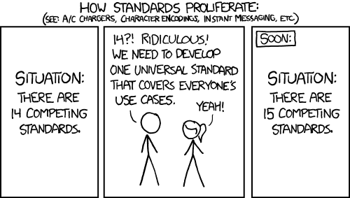
Notes:
NOT the aim!!
15

Slide 16

Conceptual model
GSIM
DDI
Implementation
standards
SDMX
Other relevant standards
Geospatial standards
Notes:
GSIM is an umbrella
It is a conceptual model, not an implementation model.
It doesn’t compete with DDI and SDMX but provides a generic additional layer.
As a reference framework, GSIM Provides over-arching guidance to the development and use of statistical implementation and technology standards. GSIM is not directly tied to any particular implementation standard or technology solution.
16

Slide 17
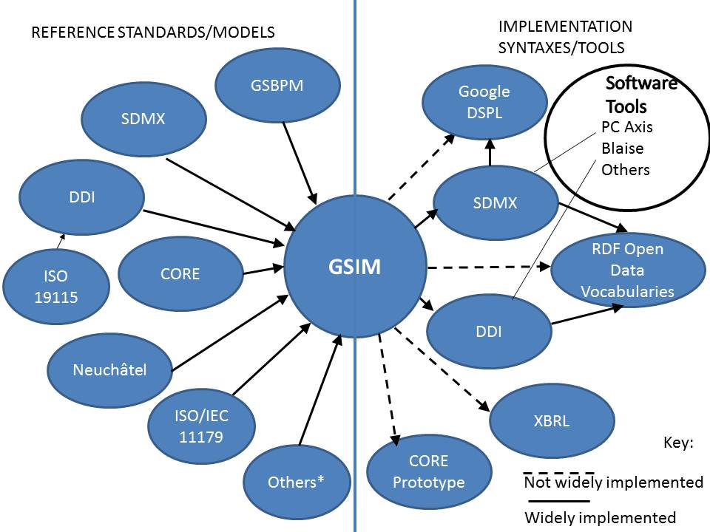
17
Notes:
Ensuring GSIM relates to existing metadata standards, such as DDI and SDMX, has also been a priority throughout its development. The involvement of experts in these standards was an important part of Sprint 2 and continues to be a priority for the detailed work during the coming months.
17

Slide 18

Business
Production
Structures
Concepts
Notes:
18

Slide 19


Slide 20
Statistical Need
may initiate
Business Case
initiates
Statistical Program
Design
Statistical Program
changes
design of
has
identifies
defines
CONCEPTS
Acquisition Activity
Production Activity
Dissemination Activity
Concept
describes
Population
specifies
comprises
includes
may include
Process Input
defines
measures
comprises
specifies
Classification
Variable
Unit
Process Step
uses
Statistical Activity
is
associated
with
specifies
describes
has
Process output
STRUCTURES
may include
BUSINESS
PRODUCTION
Data Structure
has
Data Set
includes
Data
Resource
uses
Data Channel

Slide 21
GSIM: The “sprint’ approach
The HLG-BAS decided to accelerate the development of the GSIM
“Sprints” – 2 week workshops for 10-12 experts (IT, methodology, statistics, ...)
Sprint 1 – Slovenia, February 2012
Sprint 2 – Republic of Korea, April 2012
Integration Workshop, Netherlands, September 2012
Notes:
Locked people in rooms
21

Slide 22
Moving to GSIM in practice
GSIM could lead to:
A foundation for standardized statistical metadata use throughout systems
A standardized framework to aid in consistent and coherent design capture
Increased sharing of system components
Notes:
22

Slide 23
Moving to GSIM in practice
Common terminology across and between statistical agencies.
It allows NSIs and standards bodies, such as SDMX and DDI, to understand and map common statistical information and processes.
Notes:
While GSIM is a conceptual model, it can be implemented to different levels.
As a reference framework, GSIM Provides over-arching guidance to the development and use of statistical implementation and technology standards. GSIM is not directly tied to any particular implementation standard or technology solution.
Where GSBPM defines the statistical production process and sub-processes; GSIM defines the information associated with the statistical production process, including the flows of information, the business rules and process-related quality metrics. GSIM can however be implemented as a standalone framework or integrated with local business process models.
23

Slide 24
GSIM v1.0
Released in December 2012
We need people to use GSIM “in anger”. Then we will know how best to improve it.

Slide 25
More information
GSIM
http://www1.unece.org/stat/platform/display/metis/Generic+Statistical+Information+Model+(GSIM)
Poster Session @ EDDI
Today at lunch time

