Slide 1



Powering Official Statistics at Statistics New Zealand with DDI-L and Colectica
A Case Study

Slide 2
Authors
Adam Brown
adam.brown@stats.govt.nz
Sally Vermaaten
sally.vermaaten@stats.govt.nz
Jeremy Iverson
jeremy@colectica.com
Dan Smith
dan@colectica.com

Slide 3
Statistics New Zealand
“Turning data into relevant knowledge, efficiently.”
Ensure New Zealand has the statistical information it needs to grown and prosper
We do this by:
Make sure the right statistics are produced
Make sure as many people as possible use the statistics to support informed decision making
Notes:
Start with an introduction to Statistics New Zealand.

Slide 4





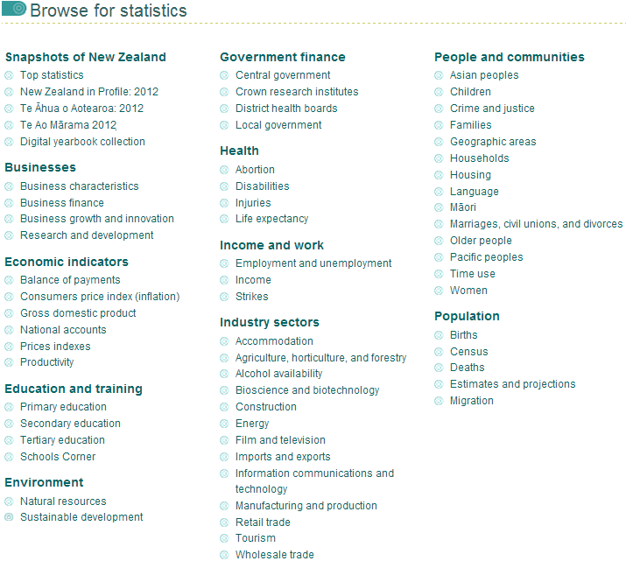
Browse for Statistics
http://www.stats.govt.nz/browse_for_stats.aspx
Notes:
In order to meet these goals, Statistics New Zealand disseminates data on many topics.

Slide 5
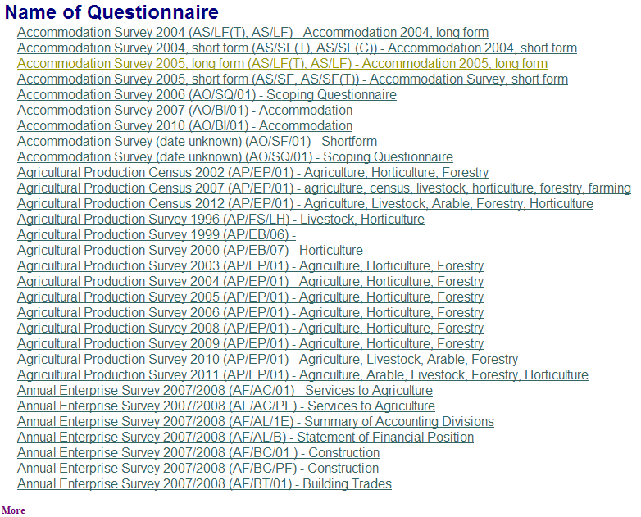
Questionnaires and Forms
http://www2.stats.govt.nz/domino/external/quest/sddquest.nsf/byName?openview
Notes:
Statistics New Zealand is responsible for data collection. This is just a small list of the questionnaires they use.

Slide 6
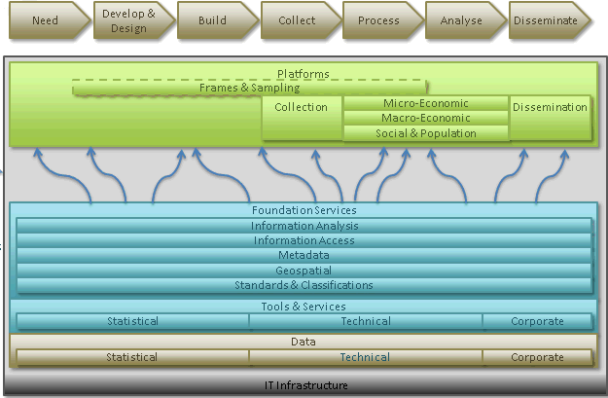


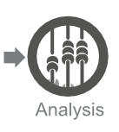
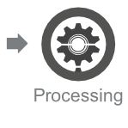
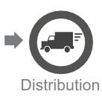
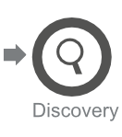
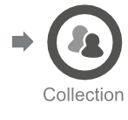

DDI Data Lifecycle
Notes:
As a National Statistics Office, Statistics New Zealand is involved in every step of the data lifecycle.
[Statistics New Zealand selected DDI as a metadata model
after conducting our own metadata modelling work and finding that DDI 3 while not a perfect fit it was 80% of the way there
in particular the lifecycle model of DDI 3 fit our Generic Business Process model well
Adopted DDI but are also actively involved in GSIM (Generic Statistical Information Model) work and we see adoption of DDI as a good stepping stone / way of adopting GSIM and we are eager to see the two become more aligned]

Slide 7
Statistics New Zealand Metadata Infrastructure Project
Create canonical sources for key information created and used during the statistical business process
Solution: central repositories
Notes:
In 2011 Statistics New Zealand has had a project to improve the systems that record the information used throughout the data lifecycle.
[Primary aim of the project is to create efficiencies. In addition to tools such as Colectica also developing and implementing standards and guidance re. roles, responsibilities, how and where info should captured.]

Slide 8
Overview
1. Use of Colectica at Statistics New Zealand
2. Colectica Integration
3. Results
Notes:
This case study will take a look at the solution that is currently in production, breaking things into three parts.

Slide 9
Use of Colectica at Statistics New Zealand

Slide 10
Architecture: Repository
Central, authoritative source of metadata
Built on DDI 3, ISO 11179, and Web Service standards
Full audit trail and provenance tracking
Item relationships
Search
Annotations
Secure Authentication and Encryption
Item and Type-based permissions
Colectica Portal (Public)
Colectica Repository (Public)
Colectica Workflow Server
Colectica Designer
Colectica SDK
Colectica Toolkit
Colectica Portal (internal)
Colectica Repository (Production)

Slide 11
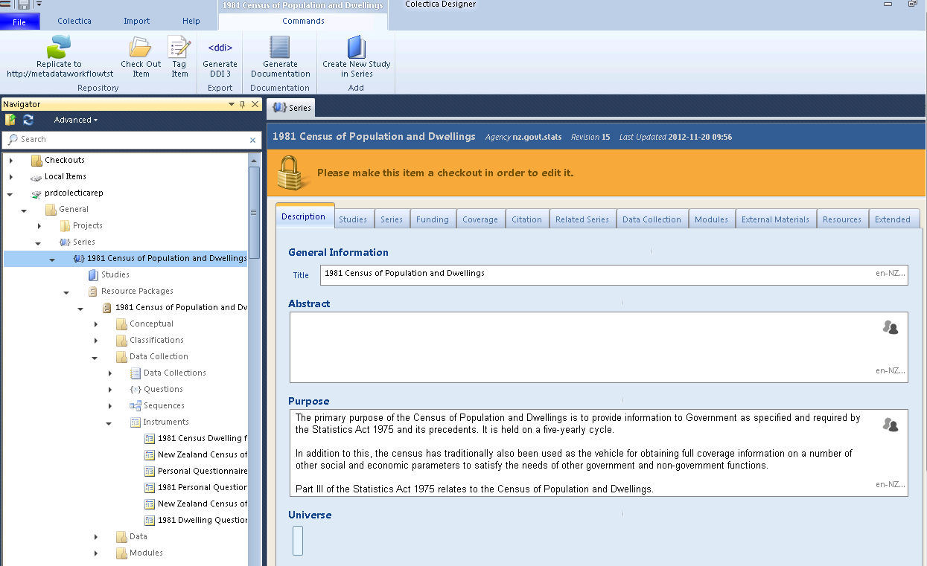
Architecture: Designer
Create, ingest, manage, and edit metadata
Usable DDI 3 for end-users
Publish data to Repository
Colectica Designer
Colectica Repository (Production)
Notes:
Two types of users at New Zealand using Designer:
Data Custodians. These are statistical analysts designated by their teams to be responsible for documenting data and ensuring the data are discoverable. They capture information about their own outputs.
Internal Data Archive staff. They had been using DDI 2, creating it by manually editing the XML. They are creating records for historical studies, and have found the benefit of DDI 3 is they are able to reuse resources that already exist in the repository.

Slide 12
Architecture: SDK
Colectica Designer is one way to access Colectica Repository
Programmers can also interact with Colectica Repository to build custom tools
Colectica SDK and Web Services enable this
Colectica Designer
Colectica SDK
Colectica Repository (Production)
Notes:
Colectica SDK is used by the application development team at Statistics New Zealand to create new tools that work with the data stored in the repository.
We’ll talk about this some more in a few minutes.

Slide 13
Architecture: Toolkit
Command line tools for batch processing
MetadataConverter SPSSToDDI3 BlaiseToDDI3 CASESToDDI3 | DocumentationGenerator Validator RepositoryImport RepositoryExport
Colectica Designer
Colectica SDK
Colectica Toolkit
Colectica Repository (Production)
Notes:
Used by administrators to move data in to and out of systems.
[Note that SNZ only uses a few of these as we don’t really use SPSS or CASES]

Slide 14





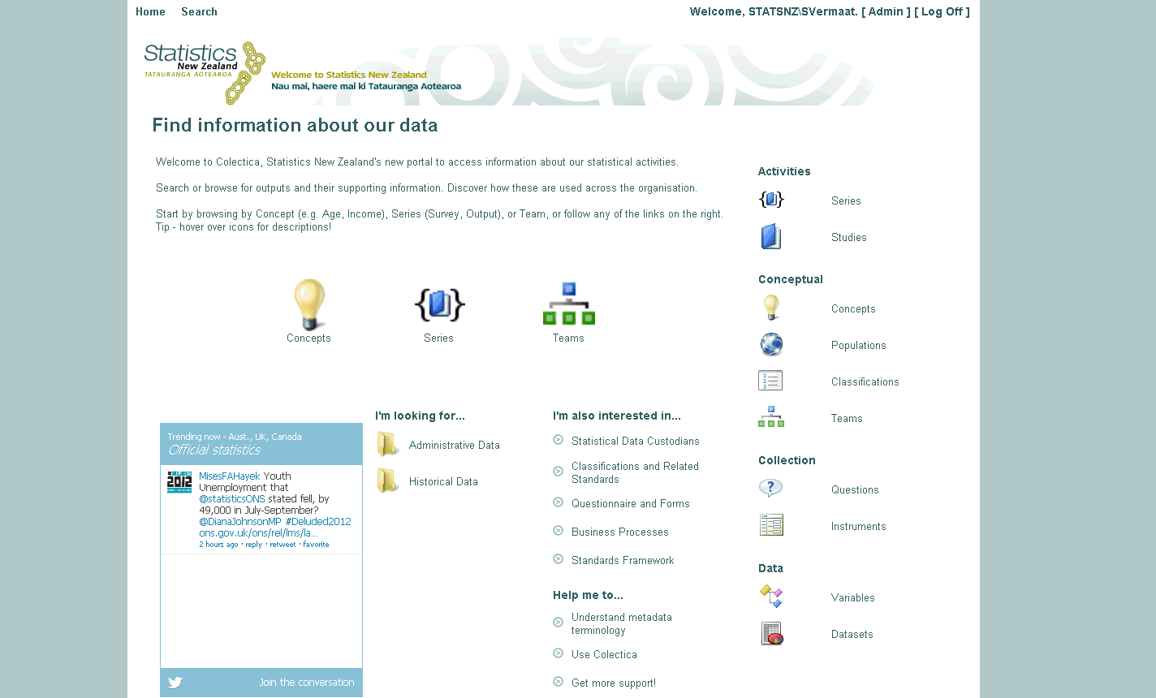
Architecture: Portal
Colectica Portal
http://metadata/
Search and browse metadata from Colectica Repository on the Web
Colectica Designer
Colectica SDK
Colectica Toolkit
Colectica Portal (internal)
Colectica Repository (Production)
Notes:
This is accessible by everybody at Statistics New Zealand.
It’s especially used by the Client Services Team. This is the Statistics New Zealand help line that public users of their data can call to ask for help. The team uses the portal to find detailed information about data in the New Zealand repository.
Working toward the biggest use case, which is exploring interesting data by concept. For example, find all the data that has to do with Smoking. Everybody knows their own stuff but few people know what’s going on throughout the organization. The hope with Colectica is to break that pattern.
This Portal is only available internally right now. We’ll talk about a public portal shortly.

Slide 15
Architecture: Publication Workflow
Internal Repository
Workflow Services
Public Repository
Colectica Repository (Public)
Colectica Workflow Server
Colectica Designer
Colectica SDK
Colectica Toolkit
Colectica Portal (internal)
Colectica Repository (Production)
Notes:
The Workflow Services allow a few things.
An internal user submits a publication request to the workflow services.
A manager who has the appropriate permissions reviews the request and either approves or denies it.
If the request is approved, the request is processed. As part of the processing, certain types of data or fields, which are only appropriate for internal staff, are removed by the workflow services.
After filtering, the information is available in the public Repository, where it can be accessed worldwide.

Slide 16
Architecture: Public Portal
Available April 2013
Colectica Portal (Public)
Colectica Repository (Public)
Colectica Workflow Server
Colectica Designer
Colectica SDK
Colectica Toolkit
Colectica Portal (internal)
Colectica Repository (Production)
Notes:
To complete the picture, another instance of Colectica Portal will run on top of the public instance of Colectica Repository. The plan is for this to be available in April 2013.

Slide 17
Architecture: Not Quite a Complete Picture
Colectica Portal (Public)
Custom Tools
Colectica Repository (Public)
Colectica Workflow Server
Colectica Designer
Colectica SDK
Colectica Toolkit
Colectica Portal (internal)
Colectica Repository (Production)
Notes:
This is a pretty good overview of the architecture of how SNZ is using Colectica, but it’s not really complete.
There are also a number of custom tools built using Colectica SDK that work off the information in Colectica Repository.
[Also, SNZ’s overall architecture for metadata will include some other metadata components (e.g. classification management system) that will for example allow for advanced management and business process workflows around some key types of metadata. The pieces will interoperate with Colectica and will be DDI friendly. SNZ’s overall metadata strategy also extends beyond systems and critically includes work to fit tools into business processes and engage with specialised areas.]

Slide 18
Architecture: Production and Test Environments
Production
Test
Notes:
There is also a parallel test environment that Statistics New Zealand uses to ensure changes to the software work well with the production workflow.
[Also have a UAT]

Slide 19
Colectica Integration
Notes:
Colectica offers a good amount of software, but it didn’t perfectly meet the needs of Statistics New Zealand.
This is something that often comes up when discussing off-the-shelf software: each potential user has unique needs, so they often prefer to design and build systems specific to their environments.
The nice thing about Colectica is that it isn’t a static solution that you have to take or leave. It can be extended and customized, and we did a good amount of this with Statistics New Zealand.

Slide 20
Getting to Production
Option 1
Goal
Build from scratch
Option 2
Goal
Extend
Notes:
Instead of starting from 0%, start from 80%
[For national statistical agencies this is a helpful step up as they seek to move from a boutique to industrialised production process. Use of Colectica allows agencies to benefit from already developed base infrastructure that are common to the research community and focus their efforts on developments to support statistical agency specific functionality.
Note that ‘Goal’ here is a reference metadata system that allows for documenting key information created and used throughout the statistical process and a central hub for connecting and interacting with other to-be-developed metadata systems.]

Slide 21
Extending Colectica
Versioning and synchronization improvements
Item-level and item-type permissions
Repository usage statistics
Colectica Portal customization
Colectica Workflow Services
Colectica SDK for custom integrations
Notes:
We made some specific improvements to the software as part of Statistics New Zealand’s adoption.
The Repository’s versioning is much more robust.
Item level permissions
Repository usage statistics
Workflow Services is a completely new product built to meet their publication requirements.

Slide 22
Integration: Questionnaire Design
Old: Questionnaire designers create static flow charts, give to Blaise programmers
New: Application team created a prototype tool that pulls questions from Colectica, allows design of question flow, and creates Blaise
Notes:
No more searching through email to find the right Word document with the latest questions.
The correct question comes straight from the central repository.

Slide 23
Integration: Additional Tools
Data Processing
Data Dissemination
Notes:
These are under development at Statistics New Zealand, by their technical team.
[Specifically Colectica will be used as a source to populate structured and contextual metadata into other systems, e.g. variables populated into processing and analysis systems and releasing metadata along with data to external researchers]

Slide 24
Results
Notes:
This system has been in production for the last several months, so lets take look at some of the results.

Slide 25
Key Result 1 – Metadata Capture
“We used to record all metadata at the end of the lifecycle.”
“Now, survey designers capture the information when they first think of it.”
Notes:
What we had in the past was duplication of info into each of the systems. Not just duplication, not from a single source. Copy and pasting, re-entering into different systems.
Capture the information when they first think of it. And then use that to load the data collection system, data processing system., etc, load dissemination with much more of the contextual metadata.
More metadata, and more accurate metadata.
[About efficiency]

Slide 26
Key Result 2 - Archiving
Old Process:
Manually mark up DDI 2 XML
New Process:
Information is entered into Colectica
A program grabs DDI from Colectica, harvests all information from network drives, ingests into Archive
Archivists just have to understand Colectica
With content guidelines created by Statistics New Zealand, this is very easy

Slide 27
Key Result 2 - Archiving
Time to Train Archivists
3 - 4 Months
Notes:
Old: 12-16 weeks to get somebody up to speed
Now: 2 weeks

Slide 28
Facts and Figures
1,008 | 200
Datasets | Series
20 - 40 | 219
Metadata Creators | Unique Portal Users
Notes:
Many more datasets will be added soon
All series have abstract, purpose, and citation information. Some have more detail
[]

Slide 29
Future of Colectica and NSOs
Improving support for GSIM
Continue to improve usability of the Colectica interface for those unfamiliar with DDI
Continue to work with statistical agencies to tailor Colectica to their needs and meet their goals of modernisation
Notes:
Adopted DDI but are also actively involved in GSIM (Generic Statistical Information Model) work and we see adoption of DDI as a good stepping stone / way of adopting GSIM and we are eager to see the two become more aligned]

Slide 30
Thank You
Adam Brown
adam.brown@stats.govt.nz
Sally Vermaaten
sally.vermaaten@stats.govt.nz
Jeremy Iverson
jeremy@colectica.com
Dan Smith
dan@colectica.com

