Slide 1
Data without Boundaries A European Project to Enhance Access to Official Microdata
Roxane Silberman, Réseau Quételet
Christof Wolf, GESIS – Leibniz-Institute for the Social Sciences
European DDI User Meeting, 3-4 December 2012, Bergen, Norway

Slide 2
DwB project in a nutshell
A European Commission FP7 project 2011-2015
Overall objective
Enhance researchers’ access to official microdata in Europe
Both national and European
Focus on transnational access within the ERA
Focus on confidential microdata
How ?
A dialogue between two existing infrastructures : CESSDA (Data archives European network) and the European Statistical System (ESS) ie NSIs, NSAs, Central Banks, Eurostat, ECB
Building on volunteering partners from the different communities
Proposing standards and setting up pilots
Enlarging the discussions and agreements to the whole communities

Slide 3
Main issues
How to facilitate transnational access to official microdata (SUF and confidential)
Legal issues
Accreditation issues (multiple accreditation)
Technical and methodological issues (European remote access network)
But we need…
Front office
Build a central point of access where the researchers can discover what data are available and offer user-friendly metadata
Avoiding creating silos
linking the ESS and the CESSDA portal

Slide 4
Metadata issues
In a fragmented landscape for official microdata
NSIs, NSAs, Eurostat …. and CESSDA partners
A lot of information not available, not structured
Different metadata standards
Objectives
Provide an overview of metadata standards usage and current projects in NSIs and Data Archives in Europe
Participate and contribute to the SDMX/DDI dialogue
Contribute to a consistent mapping between SDMX and DDI
Draft a metadata model that could be used for harvesting NSIs metadata
Collect and structure information about available national and European microdata in a way compatible with the proposed metadata model
All this will feed into a European Service Centre for OS to be linked to the CESSDA portal

Slide 5
European Service Centre for OS data
Offer overview of existing official statistics microdata in Europe available for research, including information on access conditions and contact points
Offer detailed metadata for integrated European microdata from official statistics, i.e. data prepared by Eurostat and European census data from IECM (Barcelona)
Offer routines to work with these data
Offer training for official statistics microdata
Provide platform for discussion and exchange
Organize exchange between data producers, i.e. NSIs, service providers, e.g. data archives, and research community

Slide 6
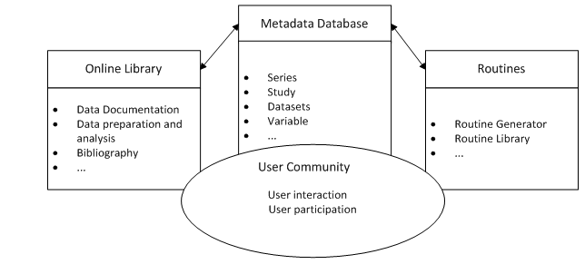
Structure of European Service Centre Web Service

Slide 7
Presentations
Arofan Gregory & Marion Wittenberg: Resource Discovery for Official Statistics First the requirements and functionality of a web portal offering information on and metadata for official statistics are discussed. Then the metadata model and its relationship to DDI and other standards will be presented. This work is part of WP8 and 12 of DwB.
Raphaëlle Fleureux, Cyril Jayet & Arnaud Szulek: CIMES: A Tool for Describing European Official Statistics Microdata A web-based tool developed under DwB WP5 to document microdata bases. With its help we hope to finally arrive at a complete catalogue of microdata from official statistics throughout Europe and thereby improve access and comparative research.

Slide 8

Thank you for your attention!
Contact:
Roxane Silberman <roxane.silberman@ens.fr>
Christof Wolf <christof.wolf@gesis.org >
Website:
http://www.dwbproject.org/

Slide 9
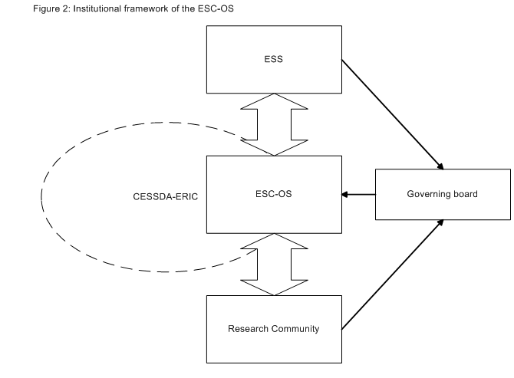
Institutional Framework of European Service Centre

