Slide 1
CIMES, a tool for describing European Official Statistics Microdata
Presented by
Raphaëlle Fleureux, Cyril Jayet, Arnaud Szulek / CNRS-RQ
Bergen, EDDI 2012, December 4, 2012

Slide 2
Outline
DwB WP5 Objectives and Tasks
CIMES
The Documentation Schema
Technical aspects
Demo
State-of-Play & Further Developments

Slide 3
DwB WP5 : Objectives and Tasks
Objective : Provide comprehensive overview of official statistical data in Europe
Task 2: Collect, structure and code information on available microdata from official statistics at the national level for each country in Europe
Task 3: Collect, structure and code information on integrated European microdata from official statistics held by Eurostat and national censuses

Slide 4
CIMES
In the task 2 of WP5, we agreed on a documentation schema based on DDI2 and 3
We tested different softwares (Nesstar, Colectica, etc.) and they were not really relevant for the purpose of this documentation (in terms of correspondence to the schema, and of financial and technical aspects)
➔ We decided to develop our own tool at CNRS-RQ: CIMES (Centralising and Integrating Metadata from European Statistics)

Slide 5
A Three-levels Schema
Series: a group of studies, for example Labour Force Survey (LFS)
Study: the actual collection of data, for example LFS 2007
Dataset: a set of files disseminated, for example LFS Scientific Use File (SUF) 2007
➔ In order to give a large and comprehensive overview of official microdata available in Europe, a simple schema is needed. The variable level will not be documented.

Slide 6
A Two- or Three-levels Nested Hierarchy
2 levels
3 levels
German Microcensus
Series
Life Events and Health Survey 2006
German Microcensus 2007
German Microcensus 2008
Study
Life Events and Health Survey 2006 PUF
German Microcensus 2007
SUF
German Microcensus 2007
PUF
German Microcensus 2008
SUF
Dataset

Slide 7
Schema Fields: Series Level
Series level | DDI 2.1 | DDI 3
Title | 2.1.5.1 <serName> | ddi:Group/r:Citation/r:Title
Subtitle |  | ddi:Group/r:Citation/r:SubTitle
Alternative Title |  | ddi:Group/r:Citation/r:AlternateTitle
Abstract | 2.1.5.2 <serInfo> | ddi:Group/g:Abstract
Keywords |  | ddi:Group/r:Coverage/r:TopicalCoverage/r:Keyword
Geographic Coverage |  | ddi:Group/r:Coverage/r:SpatialCoverage/r:Description
Time Period Covered |  | ddi:Group/r:Coverage/r:TemporalCoverage/r:ReferenceDate/r:HistoricalDate
Time Method |  | ddi:Group/d:DataCollection/d:Methodology/d:TimeMethod
Notes |  | ddi:Group/r:Note

Slide 8
Schema Fields: Study Level
Study level | DDI 2.1 | DDI 3
Title | 2.1.1.1<titl> | s:StudyUnit/r:Citation/r:Title
Subtitle | 2.1.1.2 <subTitl> | s:StudyUnit/r:Citation/r:SubTitle
Alternative Title | 2.1.1.3 <altTitl> | s:StudyUnit/r:Citation/r:AlternateTitle
Producer | 2.1.3.1 <producer> | s:StudyUnit/r:Citation/r:Publisher
Abstract | 2.2.2 <abstract> | s:StudyUnit/s:Abstract
Keywords | 2.2.1.1<keyword> | s:StudyUnit/r:Coverage/r:TopicalCoverage/r:Keyword
Geographic Coverage | 2.2.3.4 <geogCover> | s:StudyUnit/r:Coverage/r:SpatialCoverage/r:Description
Universe | 2.2.3.9 <universe> | s:StudyUnit/c:ConceptualComponent/c:UniverseScheme/c:Universe/c:HumanReadable
Sampling Procedure | 2.3.1.4 <SampProc> | s:StudyUnit/d:DataCollection/d:Methodology/d:SamplingProcedure
Date of Collection | 2.2.3.2 <collDate> | s:StudyUnit/d:DataCollection/d:CollectionEvent/d:DataCollectionDate/r:HistoricalDate
Time Period Covered | 2.2.3.1 <timePrd> | s:StudyUnit/r:Coverage/r:TemporalCoverage/r:ReferenceDate/r:HistoricalDate
Kind of Data | 2.2.3.10 <dataKind> | s:StudyUnit/s:KindOfData
Documents | 5.0 <otherMat>
Sources | 2.3.1.8 <sources>
Notes | 2.2.4 <notes> | s:StudyUnit/r:Note

Slide 9
Schema Fields: Dataset Level
Dataset level | DDI 2.1 | DDI 3
Dataset Identification Number | 2.1.1.5 <IDNo> | p:PhysicalDataProduct/r:UserID
Name |  | p:PhysicalDataProduct/p:PhysicalDataProductName
Access conditions |  | p:PhysicalDataProduct/p:PhysicalDataProductName xml:lang="en"
Other Access Conditions | 2.4.7.7 <conditions> | a:Archive/a:ArchiveSpecific/a:Item/a:Access/a:AccessConditions
Description of accreditation procedures
Contact | 2.4.2.4 <contact> | a:Archive/a:OrganizationScheme/a:Organization
Notes |  | a:Archive/r:Note

Slide 10
CIMES: Technical Aspects
HTML5 Web-based tool
MySQL database and PHP scripting engine.
Javascript (Mootools framework) and CSS3 client side.
Works with any standard compliant browser (and even with Internet Explorer 8…).
DDI2 import functionality
The CIMES tool can be hosted on any web server (Apache, IIS) with minimal configuration/modification.
There is no other client software installation needed.
Every update and bug fix is immediately made available to all the users.

Slide 11
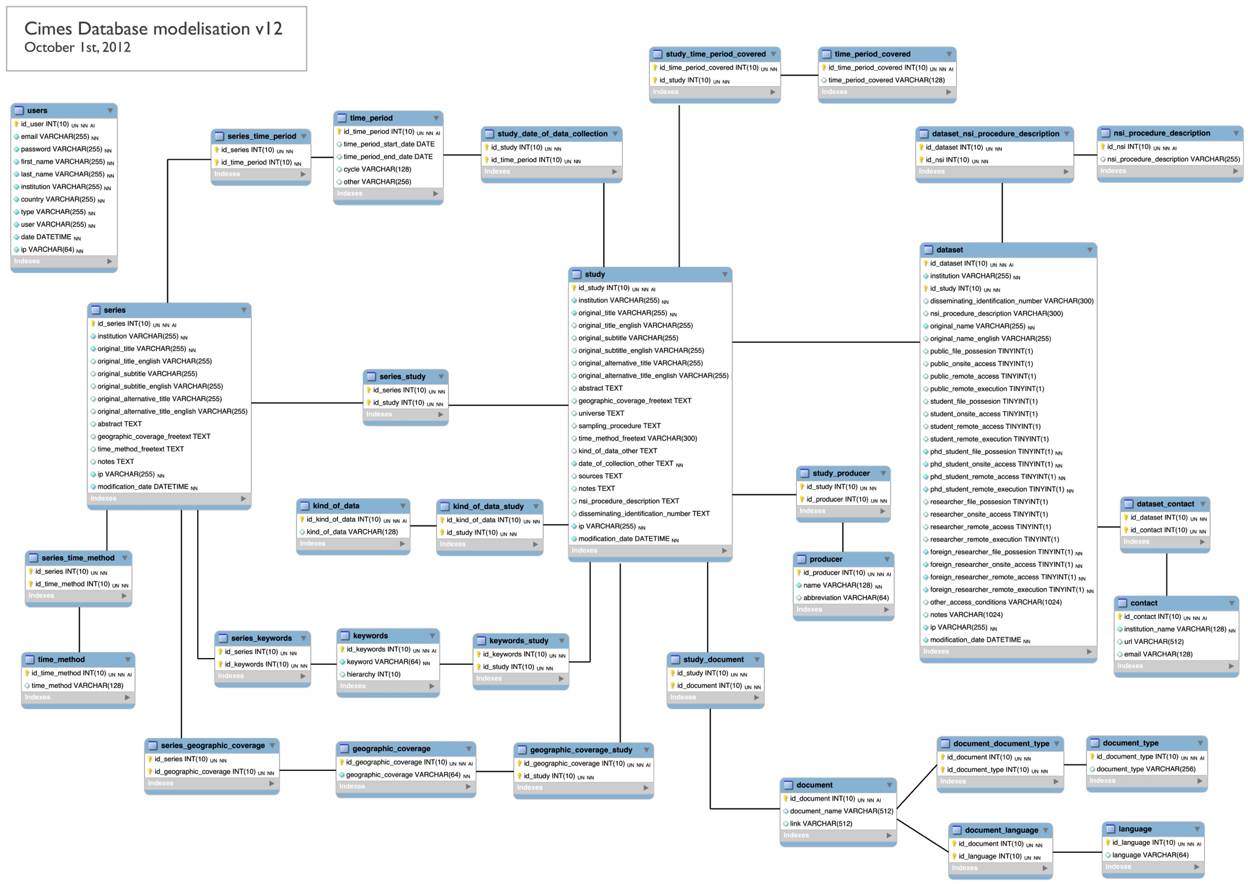

Slide 12
State-of-play & Future Developments
We plan to document surveys on most commonly studied topics in comparative research projects in order to facilitate international comparisons across c.a. 20 European countries
Living conditions, Employment, Education, Social Mobility, Structure of Earnings, Working Conditions, Innovation.
We plan to make the metadata available by the end of the year 2013

Slide 13

Thanks for Listening
DwB website: http://www.dwbproject.org/

