Slide 1
Register-based Data and Statistical Services
By
Svein Nordbotten
EDDI 12 – 4th Annual European DDI User Conference
December 3, 2012 in Bergen, Norway

Slide 2
Important events in the 1950s

Slide 3
Electronic Computers
high processing speed
huge internal storage capability
processing controlled by internally stored programs

Slide 4
Permanent Population Registers
unique and permanent identification numbers
comprehensive and continuously maintained registers
used by central and local public agencies

Slide 5
Real World System
Society conceived as different types of interacting objects
Each object type associated with set of attributes
Each object has a unique and permanent identifier
At any point of time, each object have a set of attribute values

Slide 6
Statistical Register-based/Archive/File Systems
Data collection, storage and use
Basic assumptions:
Object registers with permanent Ids are established, and maintained
Attribute catalogues are established/maintained for all object types
Data with IDs are collected based on the registers
Data are organized and saved by IDs, attributes and time
Data are retrieved on request by IDs, attributes and time
Data are processed according to needs subject to confidentiality.

Slide 7
Archive Data Container from the 1960s
Attributes
Census
attributes
Human
population
Objects
Census
day
Time

Slide 8
Events in Developing Statistical Archive Systems
1960: Paper based on a speech given to the Meeting of Nordic Statisticians
1967: Statistical File System. Handbook. United Nations.
1965-1970: Papers on development, uses and legal aspects of the system
1965: US National Data Center Proposal from the Ruggles Committee
1967: Miller, A. R.: The National Data Center. The Atlantic
1970-1980: ARKSY project in Sweden
1973: Infological Approach to Data Bases by Bo Sundgren
1981: First Register-based Population Census in Denmark
1990-: More register-based data applications and documentation

Slide 9
Selection of Current Applications
Censuses (population, location registers)
Demographics (demographic registration)
Foreign trade (custom data)
Income (taxation data)
Social statistics (registration of social services)
Employment (unemployment registration)
Education (registration of students and exams)
Health (medical registrations)
Crime ( police, court, prison registrations)
Business (business registers)
Research (based on microdata and microdata series)

Slide 10
What about the future?

Slide 11
Present Status for Official Statistics
Budgets restrictions for NSIs
Response burden complaints from the public
Growing demand for official statistics
Continuing technological development

Slide 12
Targets for Future Improvement
Metadata systems (continuing)
Identification and integration (continuing)
Increased use of administrative data (continuing)
Use of electronic footprints (new)
Conversion of non-numeric data (new)
Storage and re-use of microdata (continuing)
Online and instant end user service (continuing)
Standardization and cooperation (continuing)

Slide 13
Statistical File System
Users
Processing system
(extract, integrate,
compute, publish)
Metadata system
File archive

Slide 14
Administrative and Statistical Data
Volume of units collected
Collection cost/unit
: Administrative data
: Statistical data

Slide 15
Electronic footprints

Slide 16
Electronic Recording
Examples of electronic recordings which can
provide data for official statistics:
Creditt card transactions
Commodity (RFID) tracking
Toll road (RFID) recording
Electronic tickets for travelling
Public services offered electronically
Immigration control.
Mobile phone use
Internet and social media use
GPS tracking of traffic and transport
Mixed active/passive recording

Slide 17
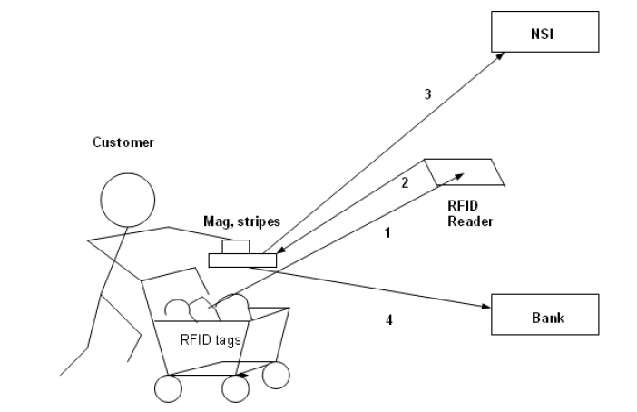
Use of Electronically Observed Data (EOD)
in Official Statistics I
5
58th World Statistics Congress of the International Statistical Institute, Special Topic Session 25: Analyzing Internet Traffic Flows and digital footprints for statistical purposes, Dublin August 2011.

Slide 18
Shop transaction integrated with NSI microdata
Shop
Shop ID
Commodity code
Quantity
Price
Time
Credit card ID
NSI
Shop ID
Commodity code
Quantity
Price
Time
Credit card ID
Owner ID
Owner microdata

Slide 19
Use of EOD in Official Statistics II
Car register
Population
register
Toll road
Microdata
Integration
S
Statisitics

Slide 20
Integration of EOD with Existing Data
Recorded EOD
Car number
Location
Time
Car register
Car number
Location
Time
Owner ID
NSI microdata
Car number
Location
Time
Owner ID
Owner microdata

Slide 21
Social media

Slide 22
Some Internet Activities
Every minute of the day:
100,000 tweets are sent
684,478 pieces of content are shared on Facebook
2 million search queries are made on Google
48 hours of video are uploaded to YouTube
3,600 photos are shared on Instagram
571 websites are created
$272,000 is spent by consumers online
(Source: Wikipedia)

Slide 23
Data for Statistical Indicators
Social
T
Social Media
data
Target
data
l
Select sources
and frequency.
Collect text
Test correlations
P
Parse , extract
and count
Estimate model
parameters.
Model
computation
Statistical
indicators

Slide 24
Estimators
indicator_{i} = f _{i} ( x_{i,j}, x_{i,j+1}, x_{i,j+2},…..) i=1, 2, …….
where
indicator is a target statistic
x_{i,j}, x_{i,j+1}, x_{i,j+2},….. are counted observations in social media
f _{i} is an estimated relationship between indicators and
observations

Slide 25
End user services

Slide 26
End User Services
Statistical file (archive/register-based) systems
Online and instant database service to statistics
Remote electronic access to microdata
Model-based statistics
Pre-approved analytical programs
Access by mobile devices

Slide 27
Access and reuse of microdata

Slide 28
Reuse of Microdata
The Confidentiality Dilemma
Statistical Tables and Data Cubes
Anonymized Microdata Files
Random Error Distorted Microdata
Remote Access Facilities
Data Laboratories
UN/ECE (2007): Managing Statistical Confidentiality & Microdata Access –
Principles and Guidelines of Good Practice. New York and Geneva.

Slide 29
External
user
Submit
requests
Displayresults
Review
metadata
Process
micro-files
Analyze
micro-files
Process
requests
Confidentiality
screening
SFS

Slide 30
Model-based Statistics and Program Repertoires
Traditional statistical assumptions
Sample survey assumptions
Complete surveys regarded as samples
Statistics based estimates
Processing/analytical program repertoires
Do users really need to inspect the microdata?

Slide 31
Statistics for everybody

Slide 32
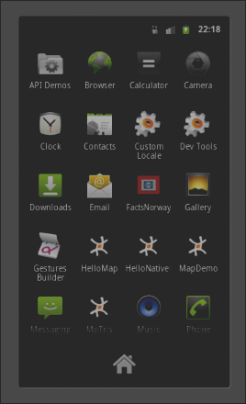
APP for Android smart-phones and devices
FactsNorway

Slide 33
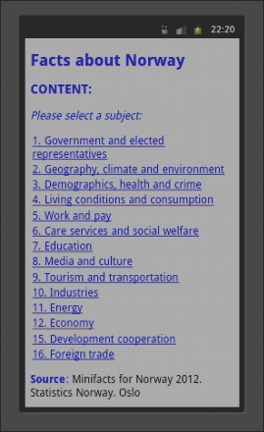
Index to Facts about Norway
Living conditions
and consumption

Slide 34
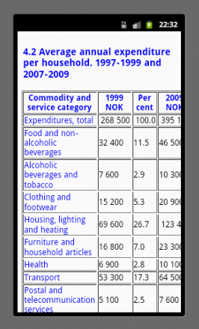

Slide 35
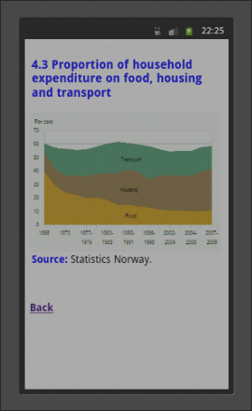

Slide 36
Thank you for your attention!
If you are interested, you are welcome to more
information on the topics reviewed at:
http://www.nordbotten.com/articles/

