Slide 1
REDCap and DDI
Larry Hoyle
Institute for Policy & Social Research
University of Kansas

Slide 2
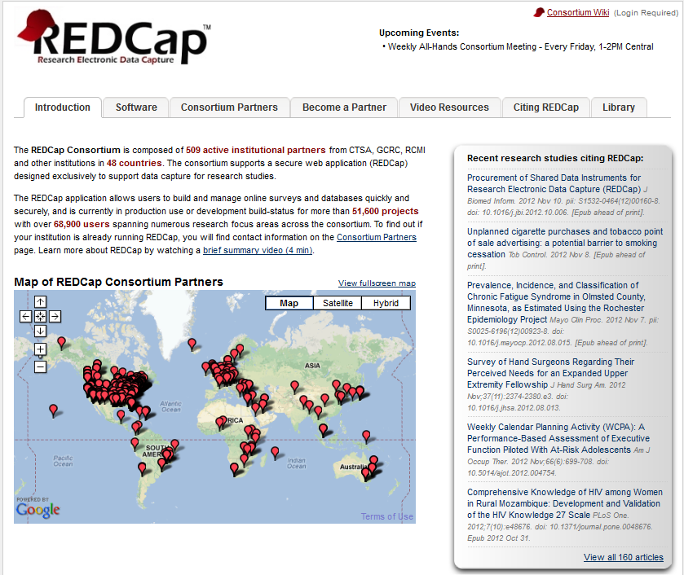
REDCap Consortium http://project-redcap.org/

Slide 3

REDCap Citation
Application
Interface
Audit Trails
Export and import

Slide 4
REDCap as an Environment
Secure
Web based
Build and manage online surveys and databases
Online Designer
Excel template file
Exports to SPSS, SAS, Stata, and R
Project management features
Calendar, scheduling, reporting, triggers, longitudinal studies, rights and permissions

Slide 5

Start Screen

Slide 6
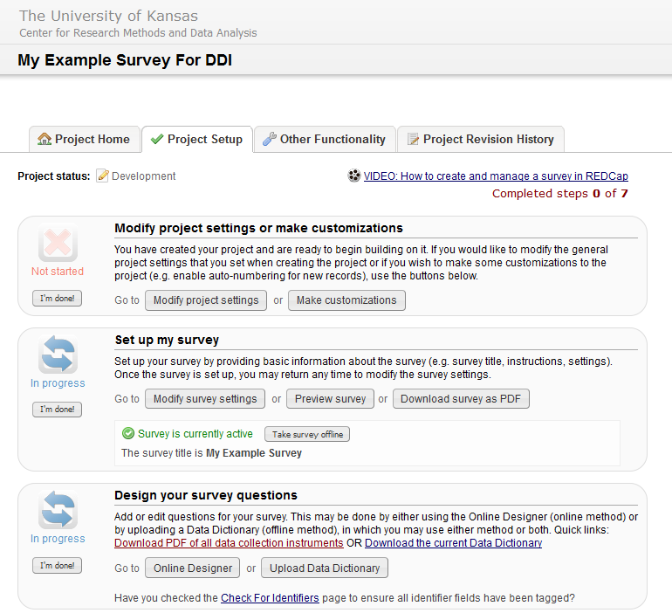
Online Designer – Project Setup

Slide 7
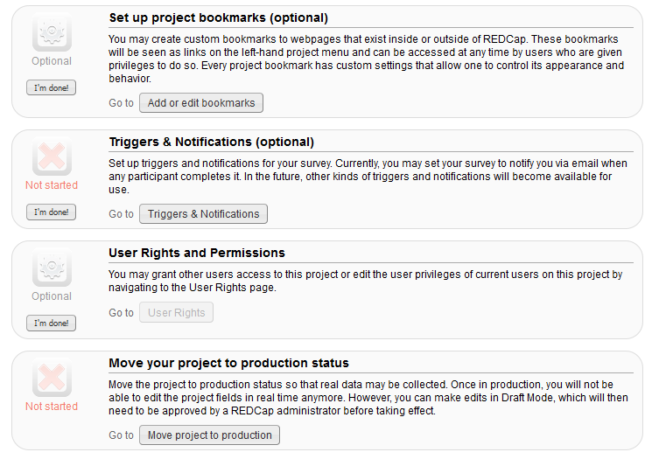
Project Setup (continued)

Slide 8
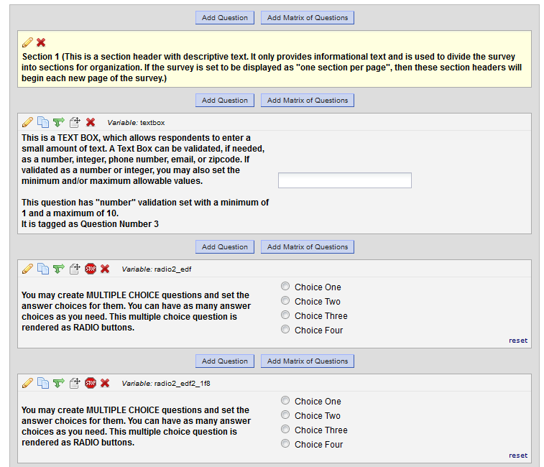
Online Designer – Question Sequence

Slide 9
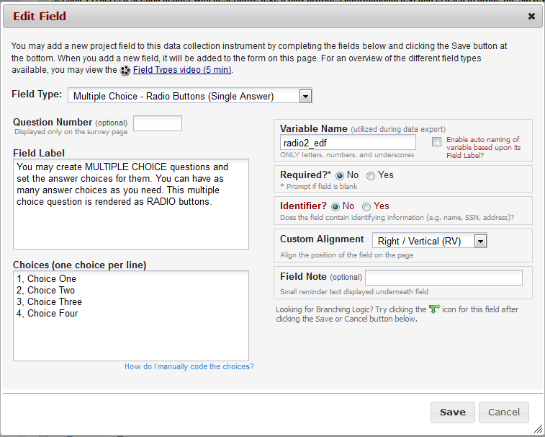
Individual Question

Slide 10
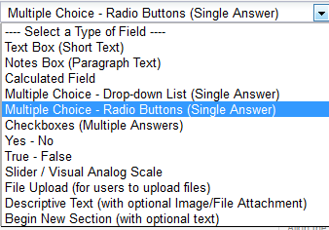
Field Types

Slide 11
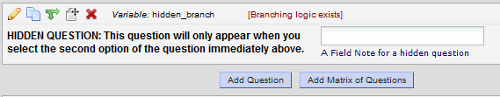
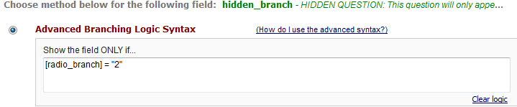
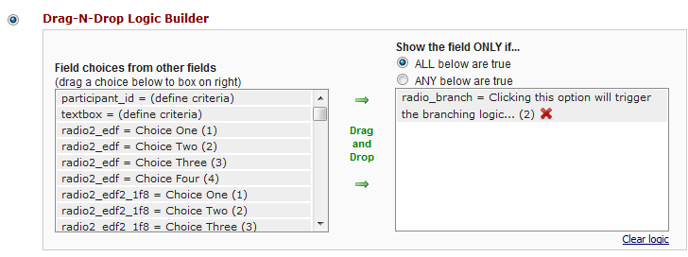
Branching

Slide 12
redCap to DDI
A REDCap survey description can be exported to a csv file. An R program reads the csv and writes a DDI 3.1 file.

Slide 13
One Row, CSV File (Excel Template)
Variable / Field Name
Form Name
Section Header
Field Type
Field Label
Choices, Calculations, OR Slider Labels
Field Note
Text Validation Type OR Show Slider Number
Text Validation Min
Text Validation Max
Identifier?
Branching Logic (Show field only if...)
Required Field?
Custom Alignment
Question Number (surveys only)
Matrix Group Name
TASK
From:
One row per question
(with Header and Note)
To:
Hierarchical DDI structure

Slide 14
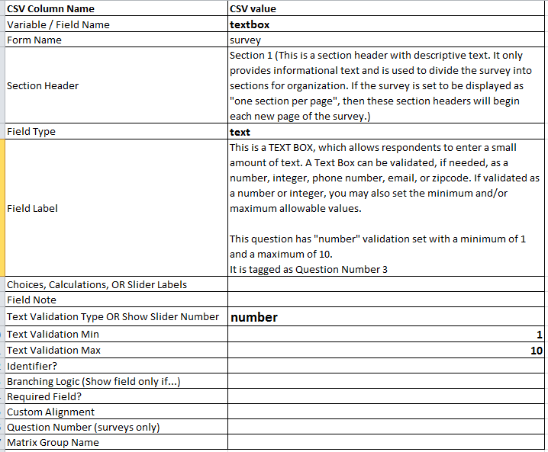
Example: text field containing a number
Field Type: text
Text Validation Type OR Show Slider Number: number
Extrema

Slide 15
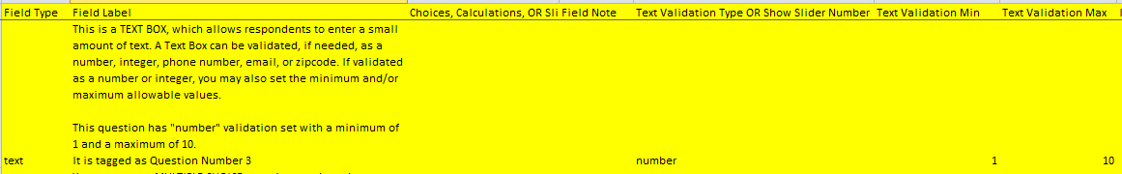
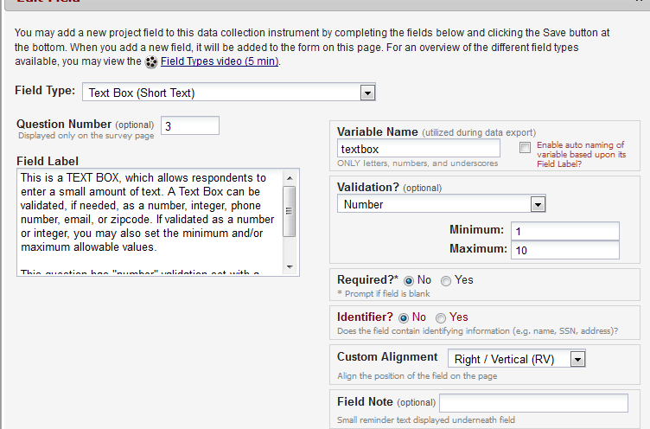
Example: text field containing a number

Slide 16
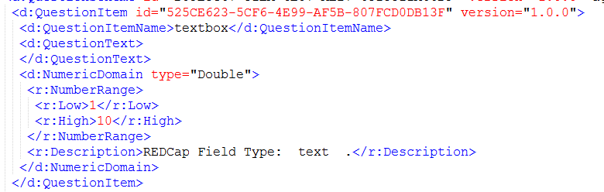
DDI – Question w/ Numeric Domain

Slide 17
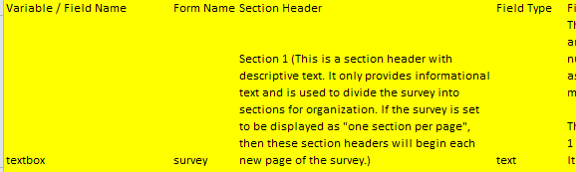
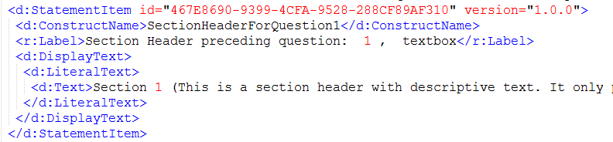
Section Header – in same row as data field

Slide 18

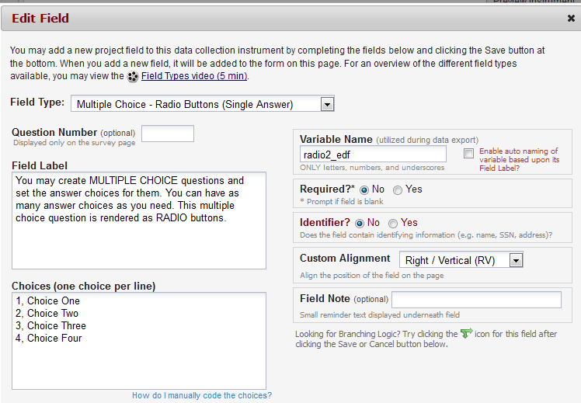
Example: coded variable w/ radio buttons

Slide 19
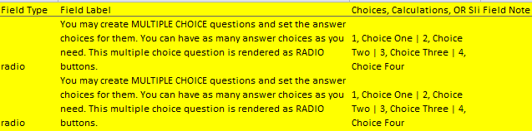
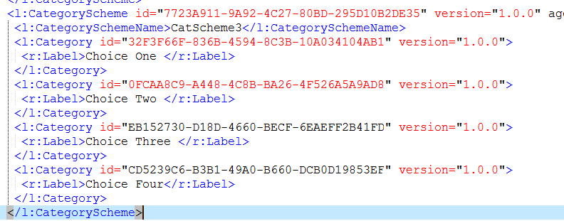
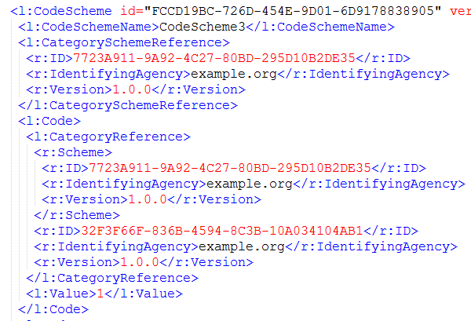
REDCap Code and Category Strings Repeat
In DDI, only one Code and Category Scheme to be used by reference

Slide 20
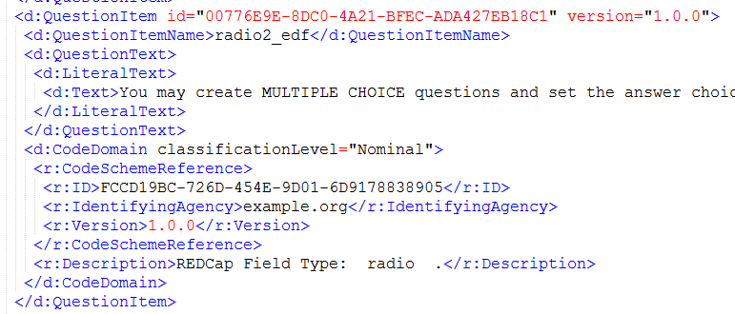
Lots of References
Question references CodeScheme
CodeScheme references CategoryScheme
Note: the program generates random style UUIDs

Slide 21
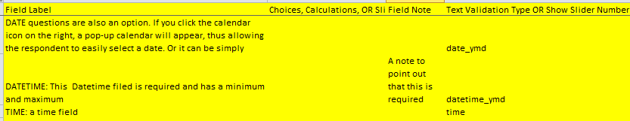
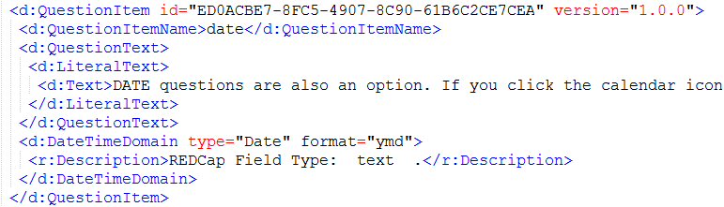
DateTime fields
Text Validation Type OR Show Slider Number: date_ymd

Slide 22

Sliders
Return a value between 0 and 100
End and mid points labeled
Optionally display the numeric value
How to represent?
Numeric ?
Categories for some values (0, 50 , 100)?
Recorded in the NumericDomain Description

Slide 23
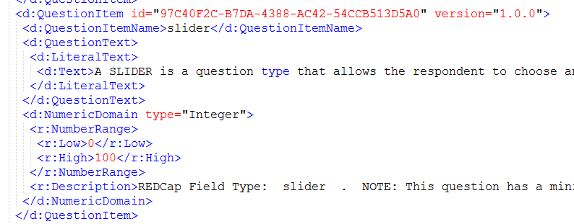
Slider as Numeric question/variable
This Description added to the NumericDomain
REDCap Field Type: slider .
NOTE: This question has a minimum of 0 and a maximum of 100.
The end and middle points were labeled as:
0, You can provide labels above the slider | 50, Middle label | 100, Right-hand label

Slide 24
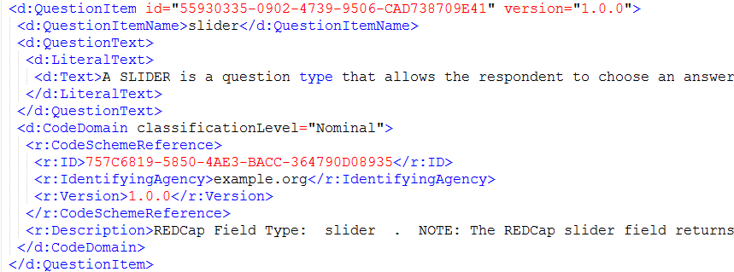
Could be Slider as Coded variable
This Description added to the CodeDomain
REDCap Field Type: slider .
NOTE: The REDCap slider field returns a numeric value between 0 and 100,
but may have labels for the end and mid points.

Slide 25
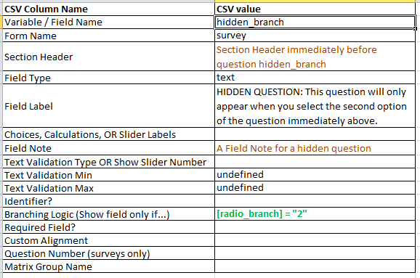
CSV values for a conditional question
The header and note will also be displayed conditionally
The Question and surrounding text will appear when this REDCap expression is true
Branching Logic (Show field only if...) [radio_branch] = "2"
hidden_branch,survey,"Section Header immediately before question hidden_branch ",text,"HIDDEN QUESTION: This question will only appear when you select the second option of the question immediately above.",,"A Field Note for a hidden question",,undefined,undefined,,"[radio_branch] = ""2""",,,,

Slide 26
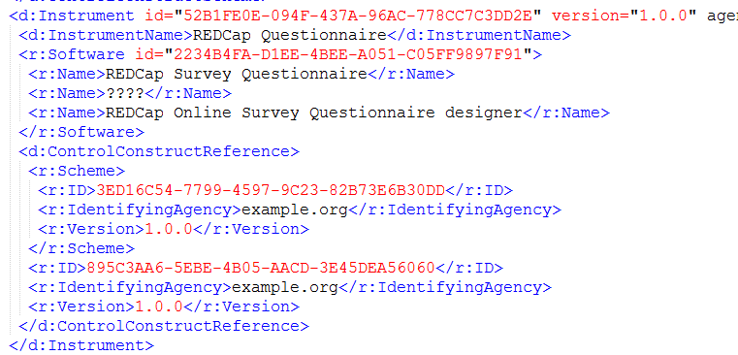
ControlConstruct chain to build the Instrument
DDI d:StatementItem
DDI d:StatementItem
DDI d:Sequence
DDI d:QuestionConstruct
DDI d:IfThenElse
DDI d:Sequence
(master sequence)
DDI d:Instrument

Slide 27
More complex Instrument issues
REDCap can set an option that ends the session upon entry of a particular value (a "stop action")
This could be represented with IfThenElse of a Sequence
Not done in this version
REDCap has a Matrix Group construct
This is partly a layout issue but could be better documented with a sub-sequence than in this version of the program

Slide 28
DDI to REDCap
Going the other way – defining a REDCap survey by transforming a DDI 3.1 file to a REDCap csv template.

Slide 29
Hierarchical DDI to one row per Question
REDCap uses Code/Category schemes by repetition instead of by reference
DDI Instruments may be much more complex than a simple sequence with a conditional display of a question.
Combining REDCap calculated fields with conditional display might allow Loop, RepeatUntil etc. function.
Parsing Instrument and ControlConstructs not done in this version.
E.g. no Section Headers or Field Notes

Slide 30
Hierarchical DDI to one row per Question
URNs not evaluated
Coded questions treated as "radio" fields.
"checkbox" (multiple response)
multiple variables not generated
placed note in CodeDomain Description (not machine actionable)
treated as radio
Calculated fields not generated
Could look for d:ComputationItem
Would require parsing arbitrary programming code and generating REDCap syntax

Slide 31
Issues
The metadata models for REDCap and DDI are not exactly the same. Where do they not match up?

Slide 32
Issues
Full DDI complexity not representable in REDCap
REDCap co-mingles layout with content metadata dropdown, radio, slider, matrix, checkbox
REDCap field type of “file” – file upload action
REDCap CSV does not include project management features that it has (email triggers, scheduling.
DDI 3.1 doesn’t handle numeric variables with some labeled values well (like slider fields)

Slide 33
Issues
REDCap allows minimum and maximum for DateTime types
DDI allows multiple low, high pairs for numeric variables – REDCap has just one pair
DDI 3.1 has no Description for a QuestionItem, no good place to put notes about display options
REDCap can mark a Question as "required“
DDI RepeatUntil?
REDCap can mark a Question as having personally identifiable information.

Slide 34
Issues
ResourcePackage vs. Studyunit
Where do Questions, Variables, Categories, Codes go?
Used ResourcePackage (more compatible with Colectica, which I used for validation)

Slide 35
Future
REDCap has an api – develop extensions that would work directly in REDCap?
Capture (and import?) project management level metadata?

Slide 36
Contact
Larry Hoyle
Senior Scientist
Institute for Policy & Social Research,
University of Kansas
1541 Lilac Lane, Blake 607
Lawrence, KS 66045-3129
LarryHoyle@ku.edu
http://www.ipsr.ku.edu

Slide 37
R details

Slide 38
Used R XML Package
Used the R package "XML"
http://cran.r-project.org/web/packages/XML/XML.pdf
Author Duncan Temple Lang
Maintainer Duncan Temple Lang <duncan@r-project.org>
Title Tools for parsing and generating XML within R and S-Plus.
Depends R (>= 1.2.0), methods, utils

Slide 39
R tools, Redcap to DDI
Used Hash Tree representation: xmlHashTree()
Allowed non-sequential addition to elements
Fixed framework added first and then elements extended
CategorySchemes
CodeScheme
VariableSchemes
QuestionScheme
ControlConstructs and Instrument
Hash table to find the index number of the code and category schemes

Slide 40
R tools, DDI to Redcap
Used internal tree representation from reading DDI with xmlTreeParse()
Built code and category string in REDCap format e.g.
1, bad, or worse | 2, good, or better
Built a URN like string for complete category identifiers – used this as a hash key to the category value
Did the same for CodeSchemes with the value being the REDCap code and category string

