Slide 1
Questasy: Documenting and Disseminating Longitudinal Data Online with DDI 3
Edwin de Vet

Slide 2
CentERdata
Research institute
University of Tilburg, Netherlands
Data collection
Manage several panels
Quantitative Analysis
Software solutions
Notes:
Non-profit organization founded in 1997
Manage panels including the LISS Panel of the MESS Project, the CentERpanel, the DHS Panel, and more
Software solutions
Several tools for data collection and dissemination for major research projects including
LISS panel in Netherlands
Understanding Society in UK
European Values Study & SHARE project across Europe
DDI tools include Questasy and DatapluS project (in IASSIST session D1 on Thursday morning )

Slide 3
LISS Panel
~6000 households in Netherlands
Studies conducted on various schedules
Includes longitudinal studies
Datasets prepared on various schedules
Notes:
6000 households with almost 10,000 panel members
Questasy started out of a need for a dissemination system for the LISS Panel
Longitudinal Panel
Track Studies & Questions as they are used across waves
Present this to researchers

Slide 4
Questasy
Web application based on DDI 3
Manages data & metadata
Written in CakePHP (MySQL)
Theming
Sphinx search engine
http://www.lissdata.nl/dataarchive/
Notes:
Questasy is a web application
Manages the metadata and data files, primarily for longitudinal panels
The admin interface went live in January 2009, and that’s when metadata entry started.
The researcher interface went live 2 months later for researchers to access the data/metadata

Slide 5
Features
Public
Browse studies, questions, variables, publications, concepts, topics, codebooks
Researcher
Download datasets, create custom datasets (basket)
Administrator
Enter and edit metadata & data, upload of files

Slide 6
DDI - Questasy
Study Unit
Conceptual Component
Concept Scheme
Data Collection
Logical Product
Physical Instance
Collection Event
Question Scheme
Construct Scheme
Question Item
Question Construct
Concept
Category Scheme
Category
Code Scheme
Code
Variable Scheme
Variable
Phys. Data Product

Slide 7
Questasy 5.0 – New features
Questions: multilingual
DDI 3.1 import

Slide 8
Multilingual – Up to version 4.3
Tables for questions and categories contain two fields for languages
LISS data: two languages (English – Dutch)
SCP data: one language (English)

Slide 9
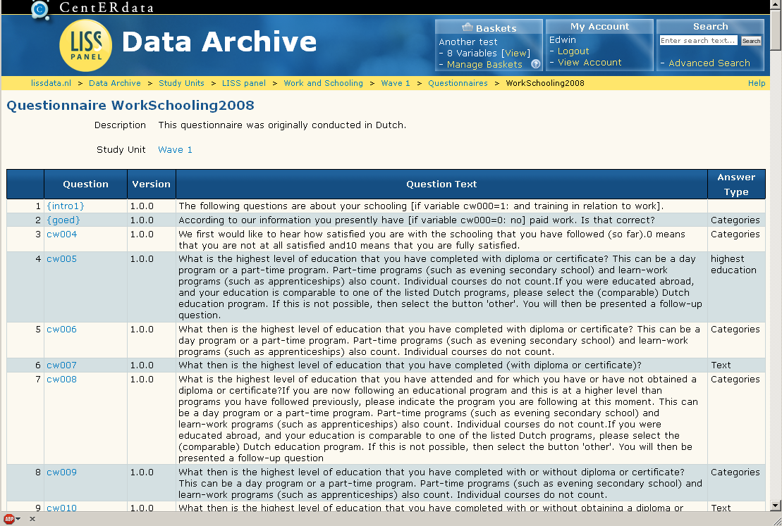
Overview Questionnaire

Slide 10
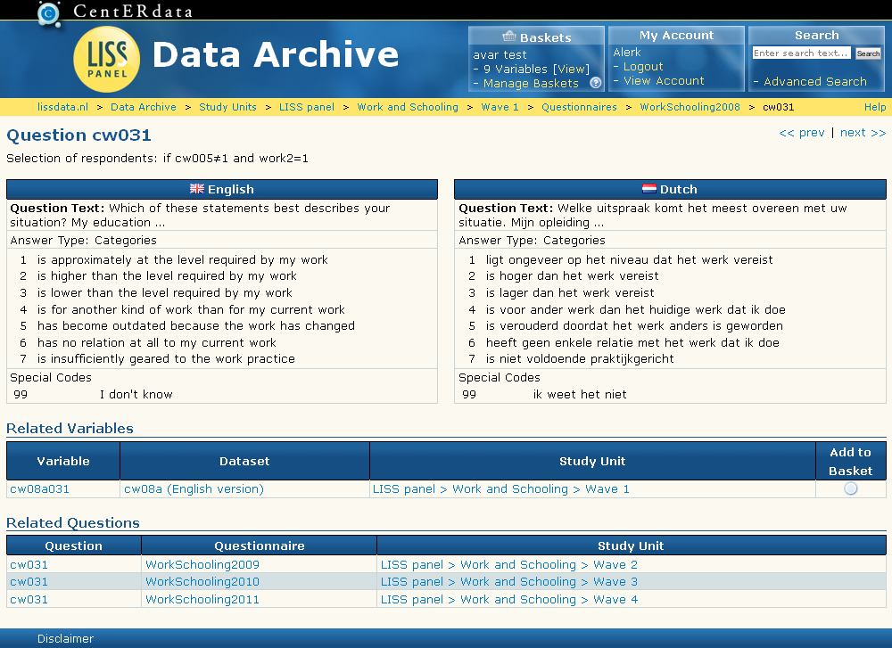
Question View – LISS data

Slide 11
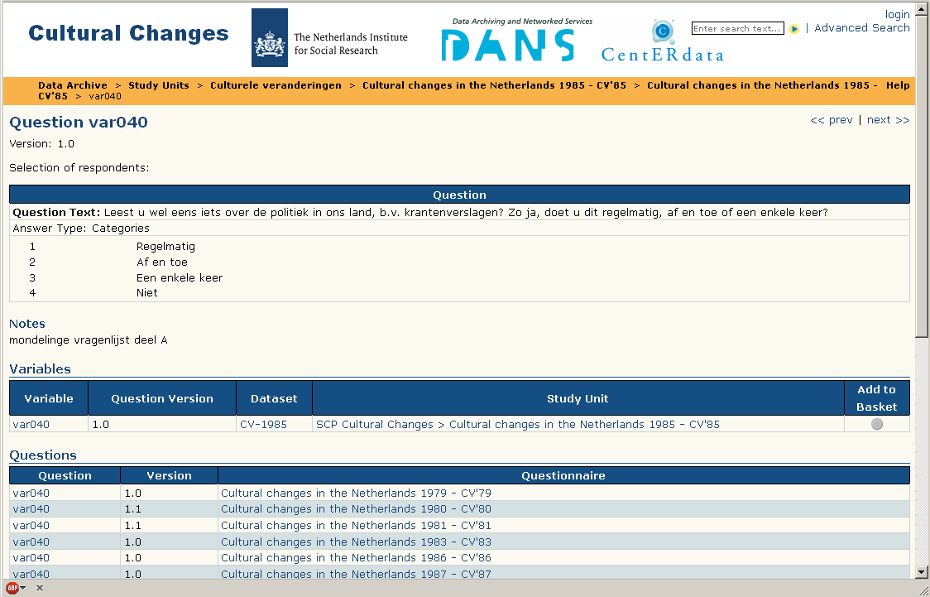
Question View – SCP data

Slide 12
SHARE project
Survey of Health, Ageing and Retirement in Europe
Face-to-face interviews
Interviews programmed in Blaise
Interviews translated into various European languages (> 20)

Slide 13
Multilingual
New tables for question texts (and category texts)
Configurable
Backwards compatible
5.0
Question Item
Up to 4.3
Question Text
text
Question Item
text1
text2
Lang

Slide 14
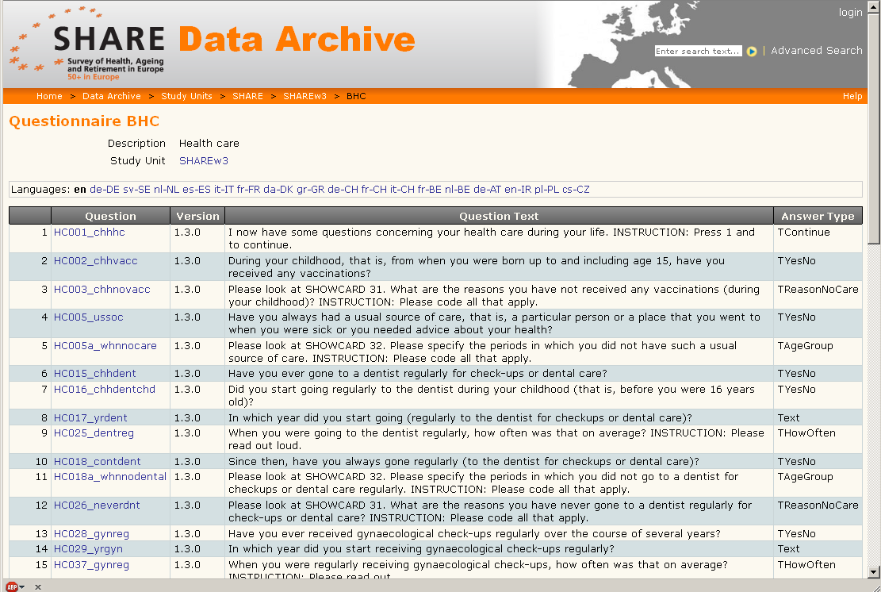
Questionnaire Overview

Slide 15
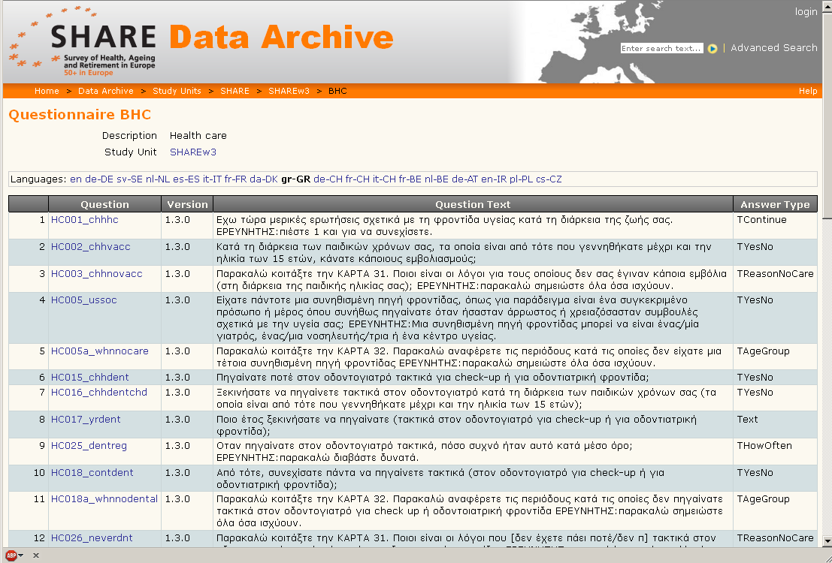
Questionnaire Overview

Slide 16
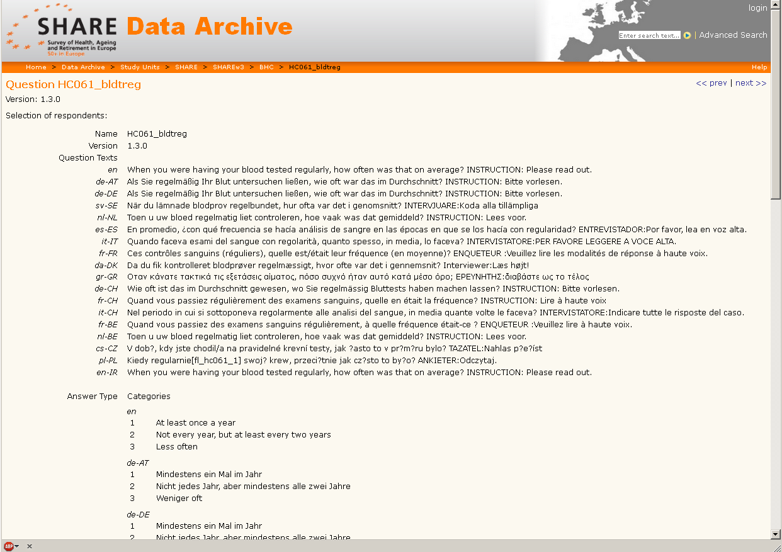
Single question view

Slide 17
Import of metadata before 5.0
Variables: OMS import from SPSS
get file = "SPSSfile.sav" . oms /destination format = oxml outfile = "OMSfile.xml" viewer = no . display . omsend .
Questions: Blaise import
Only on Windows servers with Blaise installed, uses the .bmi file
Custom import
Done for study Cultural Changes (Netherlands Institute for Social Research)
Manually

Slide 18
DDI 3.1 Import
DDI 3.1 export already existed
Import and export supports single wave and longitudinal studies
Import and export supports multilingual questions

Slide 19
DDI Import - Single wave
StudyUnit
Question Items
Question Constructs
ns1:DDIInstance
s:StudyUnit
d:DataCollection
d:QuestionScheme
d:ControlConstructScheme
l:LogicalProduct
l:CategoryScheme (multiple)
l:CodeScheme (multiple)
l:VariableScheme

Slide 20
DDI Import - Longitudinal study
StudyUnit
Longitudinal study
StudyUnit
Wave 1
StudyUnit
Wave 2
StudyUnit
Wave 3
Question Constructs
Question Constructs
Question Constructs
Question Items
ns1:DDIInstance
g:Group
g:StudyUnit (multiple)
s:StudyUnit
d:DataCollection
d:ControlConstructScheme
l:LogicalProduct
l:VariableScheme
g:ResourcePackage
d:QuestionScheme
l:CategoryScheme (multiple)
l:CodeScheme (multiple)

Slide 21
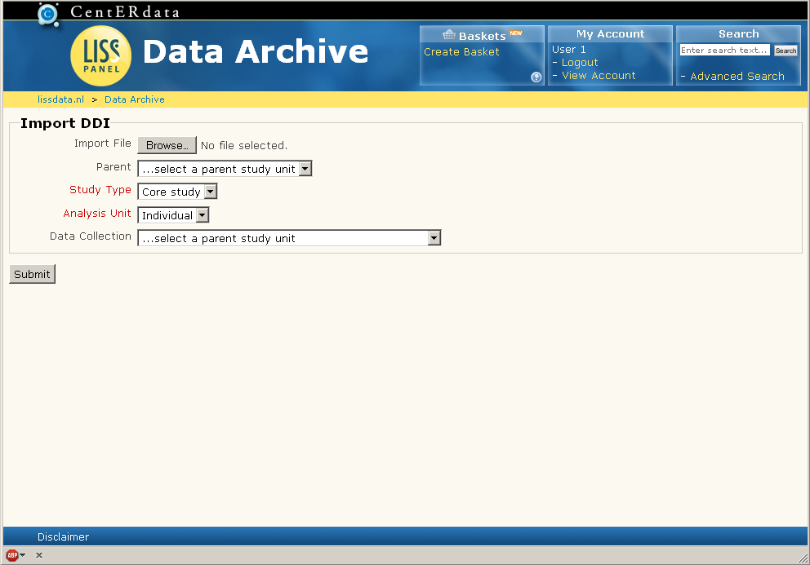
DDI Import - Interface

Slide 22
DDI used to transfer metadata
Transfer data between one Questasy instance to another instance
Transfer data between Questasy and other applications (TMT)
Conclusion: it works!

Slide 23
Licensing
Free
Including source code
License agreement available
Available for non-profit scientific & government institutes

