Slide 1
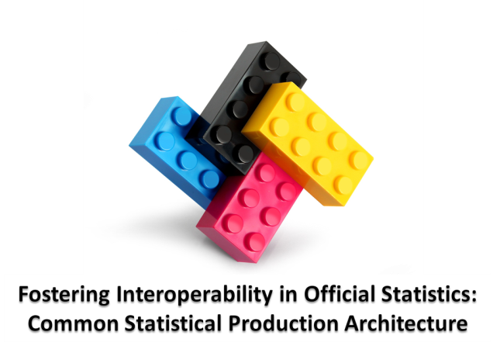

Slide 2
The problem we are trying to solve
Collect
Process
Analyse
Disseminate
NSI 1
Survey A
Survey B
Historically statistical organisations have produced specialised business processes and IT systems
Notes:
2 big barriers that hinder modernisation of statistical organisations are:
Rigid processes and methods; and
Inflexible and ageing technology environment.

Slide 3
How does Architecture help?
Many statistical organisations are modernising and transforming using Enterprise Architecture
Enterprise Architecture shows what the business needs are and where the organisation wants to be, then aligns efforts accordingly
It can help to remove silos and improve collaboration across an organisation
Notes:
Architecture is intrinsically linked to a transformation in a complex system and is concerned with maintaining coherence across a set of activities

Slide 4
EA helps you get to this
Survey A
Survey B
NSI 1
Survey C
Collect
Process
Analyse
Disseminate

Slide 5
…but if each statistical organisation works by themselves…..

Slide 6


…we get this….
Collect
Process
Analyse
Disseminate
Canada
Sweden

Slide 7
This makes it hard to share and reuse!
Collect
Process
Analyse
Disseminate
Canada
?
Sweden
?

Slide 8
…but if statistical organisations work together?
Notes:
HLG sponsor project: Desired Project Outcomes
Increased:
interoperability in Official Statistics through the sharing of processes and components
ability to find real/genuine collaboration opportunities
ability to make international decisions and investments
sharing of architectural/design
knowledge and practices

Slide 9


This makes it easier to share and reuse!
Collect
Process
Analyse
Disseminate
Canada
?
Sweden
?

Slide 10
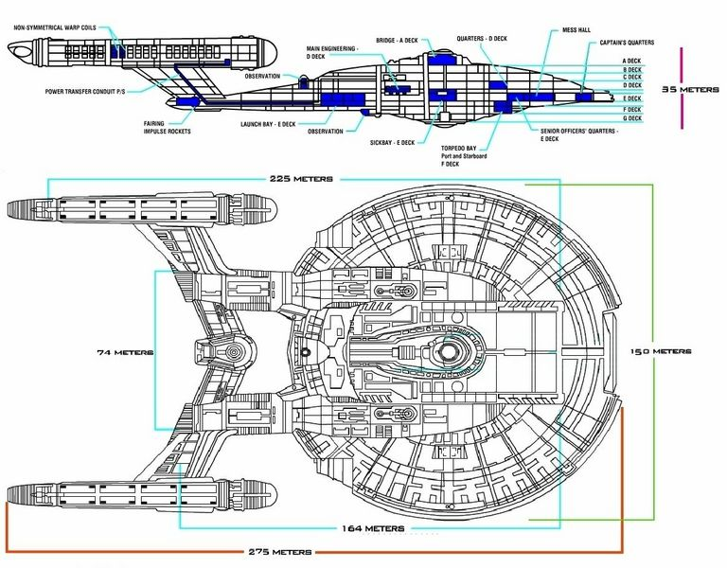

2 Strands to the project
Architecture Proof of Concept

Slide 11
The Architecture

Slide 12
CSPA Definition
Common Statistical Production Architecture (CSPA): framework about Statistical Services to create an agreed top level description of the 'system' of producing statistics which is in alignment with the modernization initiative
CSPA provides a template architecture for official statistics, describing:
What the official statistical industry wants to achieve
How the industry can achieve this, i.e. principles that guide how statistics are produced
What the industry will have to do, compliance with the CSPA

Slide 13
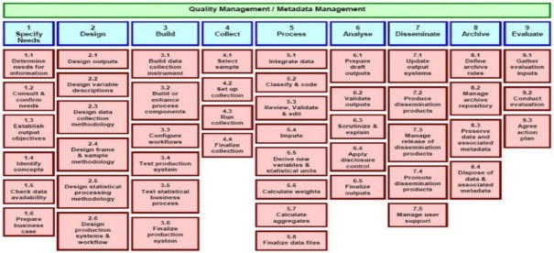



Business Architecture
Information Architecture
Application Architecture
Technology Architecture
Notes:
An important concept in architecture is the separation of concerns. For that reason, the architecture is separated into a number of layers:
Business Architecture: what the industry does and how it is done (statistics in our case) [mention: link to Statistical Network]
Information Architecture: understanding of the information, its flows and uses across the industry, and how that information is managed
Application Architecture: the set of practices used to select, define or design software components and their relationships
Technology Architecture: the infrastructure technology underlying (supporting) the business and application layers

Slide 14
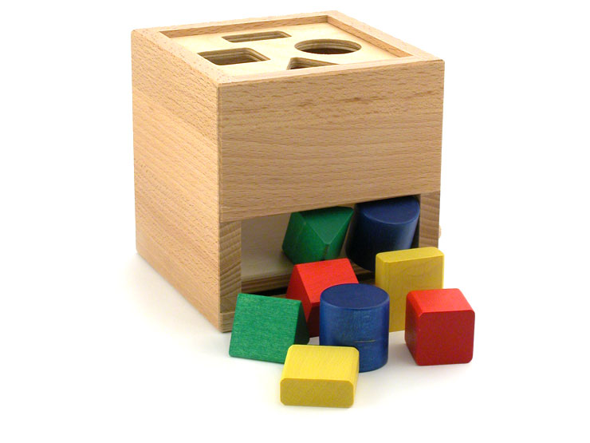
A statistical service
GSIM object structures
(formats)
GSBPM -process
GSIM object instances
http://www.illeccio.com/page.php?lang=en&product_id=37
Notes:
At the core of the architecure is the concept of statistical Service:
It is a set of activities that are self contained and which can be executed autonomously
It required well define input and provide well define output. It can be parametrised
Link to GSBPM and GSIM
IN the statistical world, we use GSBPM to describe our activities and we use GSIM to describe the objects (information, parameters) and their structure

Slide 15
The concept of Plug and Play
Standardised Service:
Standardised input and output
Meet generic nonfunctional requirements
Can be easily used and reused in a number of different processes
Notes:
We use the analogy of the lego block
the connector are standardised, they can be easily assembled
the block can be used and reused for many deferent purpose (wall, castle, ….)
It usually have an IT conotation but this is not necessary : service are broader that this

Slide 16
Proof of Concept

Slide 17


Choosing the PoC components Lego pieces could be:
Wrapped legacy/existing
Brand new
OR
Notes:
For pragmatic reason – ensuring the architecture is valid for our current environments – wrapped legacy/exisitng has been selected
Timing
Good stuff – just not easy to share

Slide 18






The Proof of Concept
5 countries played the role of Builders
3 countries played the role of Assemblers
Editrules
CANCEIS
Blaise
G Code
SCS
Notes:
Agreed components for the proof of concept

Slide 19
What Did the Services Do?
DataEdit: Localization of erors
CANCEIS: Localization of errors, editing, imputation
Blaise: Administration of questionnaire and collection of data
G Code: An auto-coding service
SCS: An auto-coding service

Slide 20
Using DDI in the Proof of Concept

Slide 21
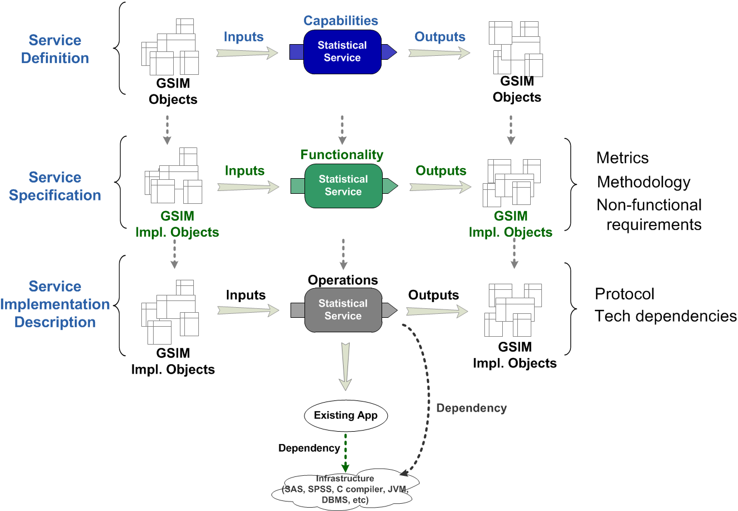
CSPA Service Design and Implementation
E.g. DDI or SDMX

Slide 22
Learning curves
Proof of Concept required knowledge about:
The tool which was wrapped (CANCEIS, Blaise etc)
GSIM implementation standards (DDI in this case)

Slide 23
What did we prove?

Slide 24
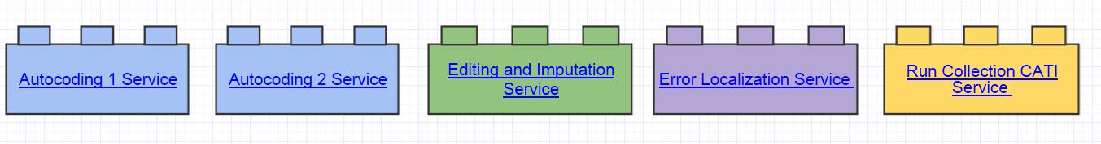
CSPA is practical and can be implemented by various agencies in a consistent way

Slide 25
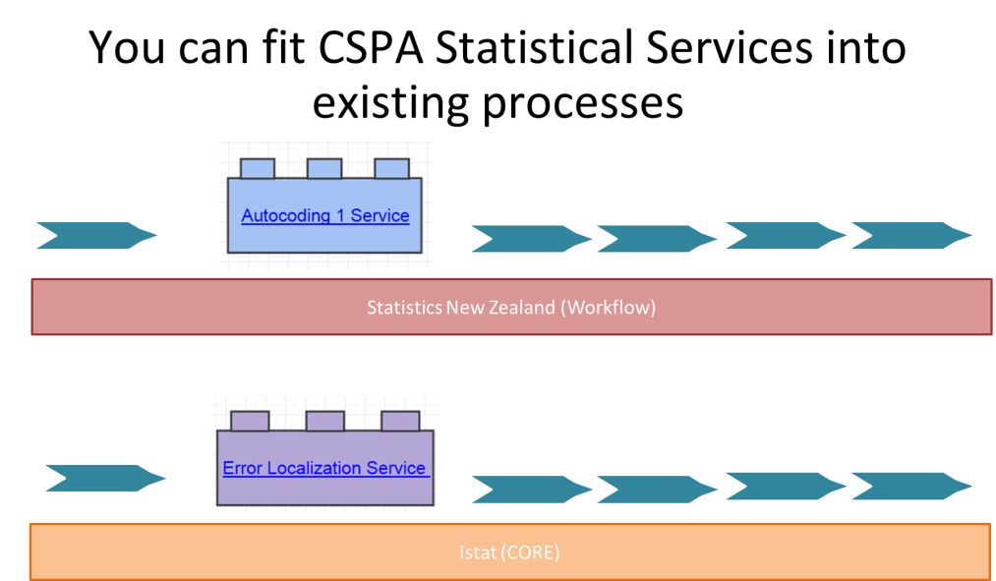
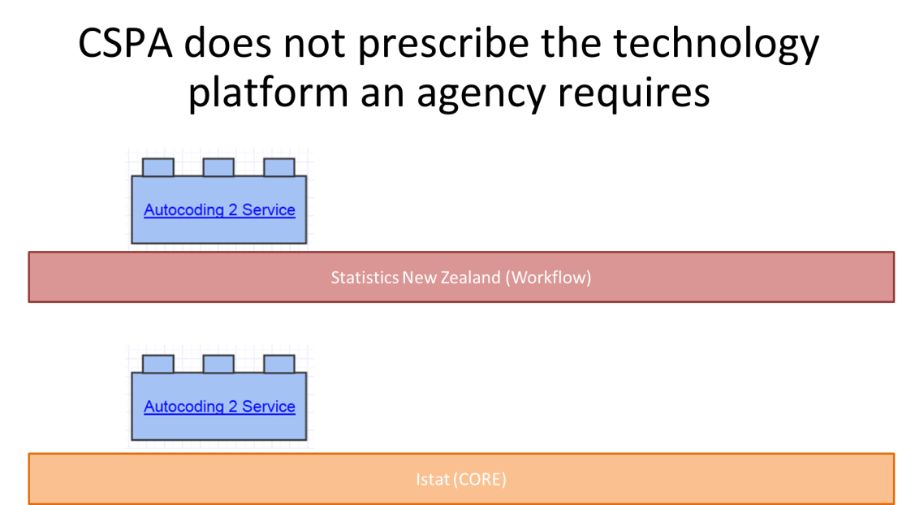
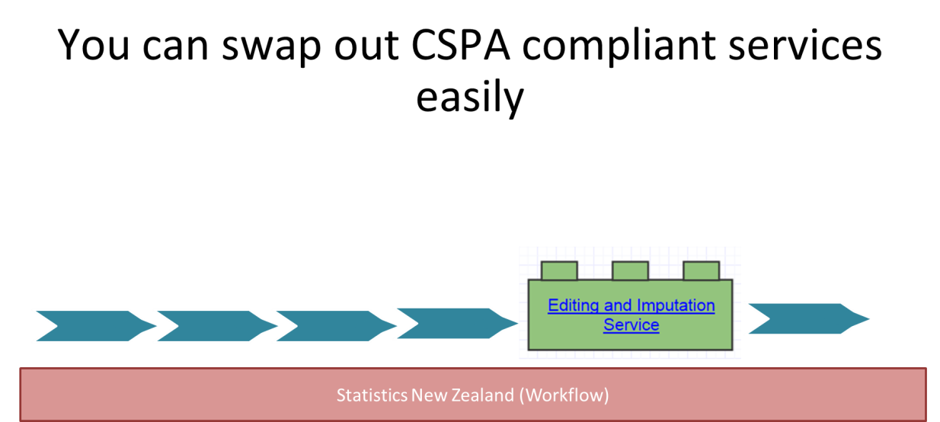
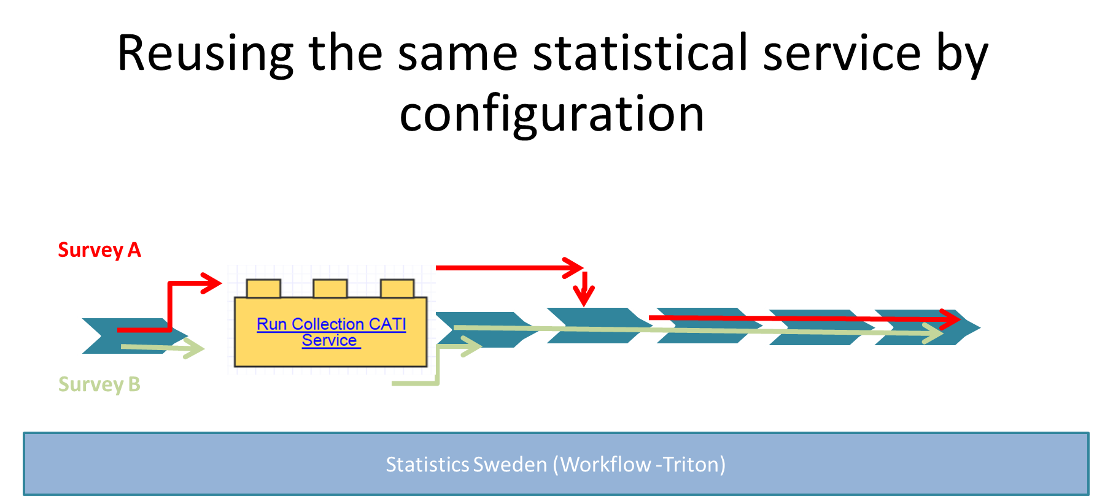

Slide 26
What was the CSPA POC Experience with DDI?
Being a lifecycle-oriented project, the CSPA POC agreed to use DDI 3.1, the latest production version of DDI Lifecycle
The services focused in two areas: questionnaires and (mostly) editing of microdata (re-coding, localization of errors, imputation)
DDI Lifecycle was the natural choice
DDI maps reasonably well to GSIM
DDI profiles and “implementers guide” now being produced

Slide 27
DDI Lessons Learned (1)
For data editing, DDI Lifecycle can be massive overkill
Much of the required detail is simply not needed (better in 3.2)
Data editing is a relatively “metadata-light” application
A few data files needed to be described, for input data sets, edited data sets, and reports (tables of which variables were imputed, or where errors might be located)
These files were mostly very simple .CSV files
We also needed a codelist (codes and categories) for the coding services
A *really simple* data set description is needed
No interest in study-level information: it is not used by these applications
This document will be included in DDI 4.* and later

Slide 28
DDI Lessons Learned (2)
It is important to maintain the continuity of metadata across the lifecycle
The editing phases of the lifecycle do not use a lot of metadata
The tools often consume metadata, but do not produce much! (SAS, etc.)
Study-level metadata is often fairly static
Variables, logical records, physical data description, statistics can be “recovered” from post-process set-ups, etc.
Otherwise, the processing phases of the life-cycle can be a “metadata black hole”!

Slide 29
DDI Lessons Learned (3)
CSPA as an architecture is services-oriented
The definition of services is broad (TOGAF), but web services and RESTful services both fit the definition being used
DDI is not service-oriented: there are no standard service interfaces
Most “files” were passed into the CSPA POC services as location references
DDI was passed in wholesale in XML form
This would not be necessary is we had a standard RESTful syntax, etc.
Metadata could be obtained as needed by the services at run-time from minimal input parameters

Slide 30
DDI Lessons Learned (4)
The CSPA architecture is designed to support more than just data-production processes
Also “support” functions such as classification management
In GSIM, the Study Unit maps neatly to a cycle of data production
There is no good corresponding container for support functions: Study Unit is about data production
Resource Packages represent reusable resources, and map against other things in GSIM
For the CSPA POC, this was not an issue: all services were data-oriented

Slide 31
An Interesting Decision: Rules Language
For the CSPA POC, many GSIM inputs were “Rules”
For imputation
For editing
For validation
There was no good “rules language” for expressing these in a standard way
Decision was made, for future work, to use the platform-neutral “Expression Language” now being developed
For use with SDMX and DDI, or as “stand-alone”
Second face-to-face meeting will be in Basel, end of January 2014

Slide 32
Summary
DDI was able to support the CSPA POC use cases
Too complex, and too steep a learning curve
Standard DDI services interfaces should be developed
Need to think about the overall data production lifecycle and how to persist the metadata
Need to consider the GSIM objects not only for cyclical data production, but also for “support” functions such as metadata management

