Slide 1
Implementing a longitudinal data portal with a customized version of Questasy
EDDI12 – Bergen, Norway
4.12.2012
Toni Sissala

Slide 2
Requirement

Slide 3
Requirement
Longitudinal data portal consisting of periodically collected variable-level metadata.
Web application.
Supports DDI.
Helps researchers find, acquire and deposit data.
Implemented as a part of a five-year project FSD-Upgrade
Relieves the workload of our user services by consolidating electronic dissemination of data.

Slide 4
Requirement
Search engine capable of indexing variable-level data
View showing sequences, means and other statistical measures at variable level
Login system integrated to FSDs single-sign-on system
Possibility to manage user roles and ACLs
Finding out how a question text differs across waves
FSD should be able to administer and uphold the system without the need for outside assistance
FSD should be able to customize the system

Slide 5
Evaluation

Slide 6
Evaluation
Tools already developed by the DDI community
As reference,
be applicable through customization
or fully implemented with minor changes.
License should allow modifications
Building our own system vs. customizing an existing one
Customizable software has benefits:
easy to evaluate against use cases
we could develop additional functionality
saves the time and effort required to build a system from scratch

Slide 7
Evaluation
Questasy – a web application developed by CentERdata
facilitates access to metadata collected within longitudinal studies
database model is based on DDI
offers a way to link variables between waves of the studies
free software, license allows modifications
actively developed by CentERdata

Slide 8
Evaluation
Additional benefits from Questasy:
Browse and categorize study elements by:
topics associated with studies
concepts associated with variables
Access Control Lists – limit access for each action per user role
Conclusion: FSD will be using Questasy as a platform on which to base the longitudinal portal
Some customization required

Slide 9
Development

Slide 10
Development
It was already decided that we would
brand the layout of the software to reflect the look of our homepage
translate the user interface to Finnish.
Additional reviews to find out if there are any issues in the software regarding the functions and principals it upholds

Slide 11
Development
Questasy has an importer for variables
Imports OMS-files that can be exported from SPSS
Since a study can hold hundreds of variables, this feature is very useful
Problem: each imported variable should have a corresponding question presented in a questionnaire. Questionnaires are populated manually.
Solution: to develop a question importer that generates questionnaires
Variables need to be linked to corresponding questions.
Problem: manual work done variable by variable
Solution: automated group linker –functionality

Slide 12
Development
Extending the database to contain statistical measures derived from the variables
Problem: Questasy’s built-in variable importer doesn’t support statistical measures
Solution: Create a new importer for variables
imports DDI2 files
supports statistical measures
additional benefit: only DDI file required to import both variables and questions
Multilingual support for the user interface
Not yet in use

Slide 13
Development
FSD decided to develop the following features:
DDI importer for questions. Supports the generation of a questionnaire.
Support for statistical measures: database, CRUD-functionality
DDI importer for variables. Supports statistical measures.
GroupLinker to automate linking of variables and questions
Multilingual support for the UI
Branded layout
UI translated into Finnish

Slide 14
Development
Variable Basket feature to work on a Linux server
Problem with StatTransfer and ODBC-API: StatTransfer doesn’t support ODBC-connections on a Linux machine
FSD would like to use the Variable Basket feature. We might be able to replace the back-end with something we could use.
Solution remains open
Interoperability:
Second stage of development. Not yet implemented.
Integration to the SSO system
Integration to the electronic data dissemination system

Slide 15
Interoperability

Slide 16
Interoperability
Integrate the portal’s authentication back-end to a Single-Sign-On system for FSD web services
The SSO system is also under development
It will use HAKA-federation as an Identity provider
HAKA consists of nearly all universities and polytechnics in Finland
Portal will direct users to download datasets from the electronic data dissemination system (AILA)
The dissemination system is currently under development
Also a key element of the FSD Upgrade project

Slide 17
Implementation

Slide 18
Implementation
Consists of three stages
I Stage – Demo to advertise the upcoming portal:
no login / register functionality
no downloads
already implemented and published online
II Stage – Interoperability:
login system via the SSO for FSD web services
possibility to download datasets
research interface to collect metadata while the study is in progress
III Stage – New features:
Variable Basket feature with a Linux compatible back-end
import / export DDI3

Slide 19
Screenshots

Slide 20
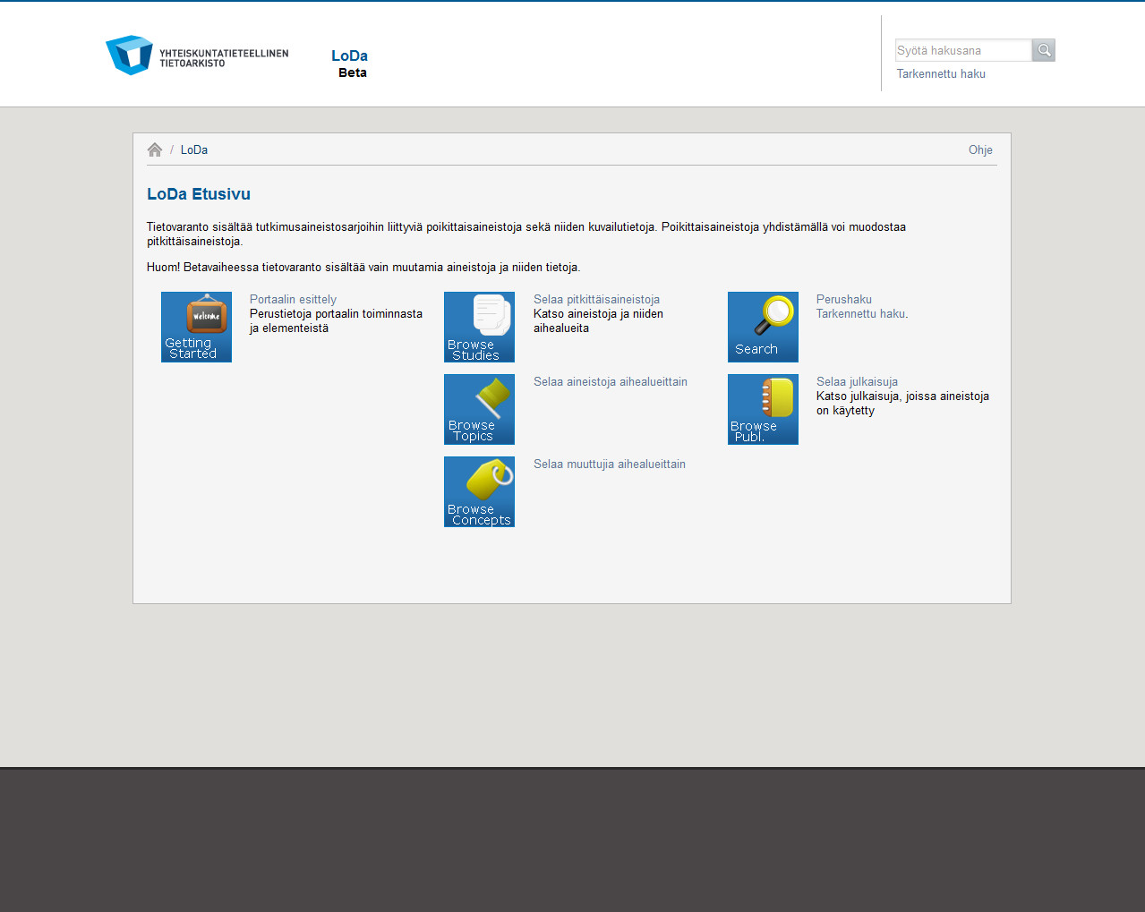

Slide 21
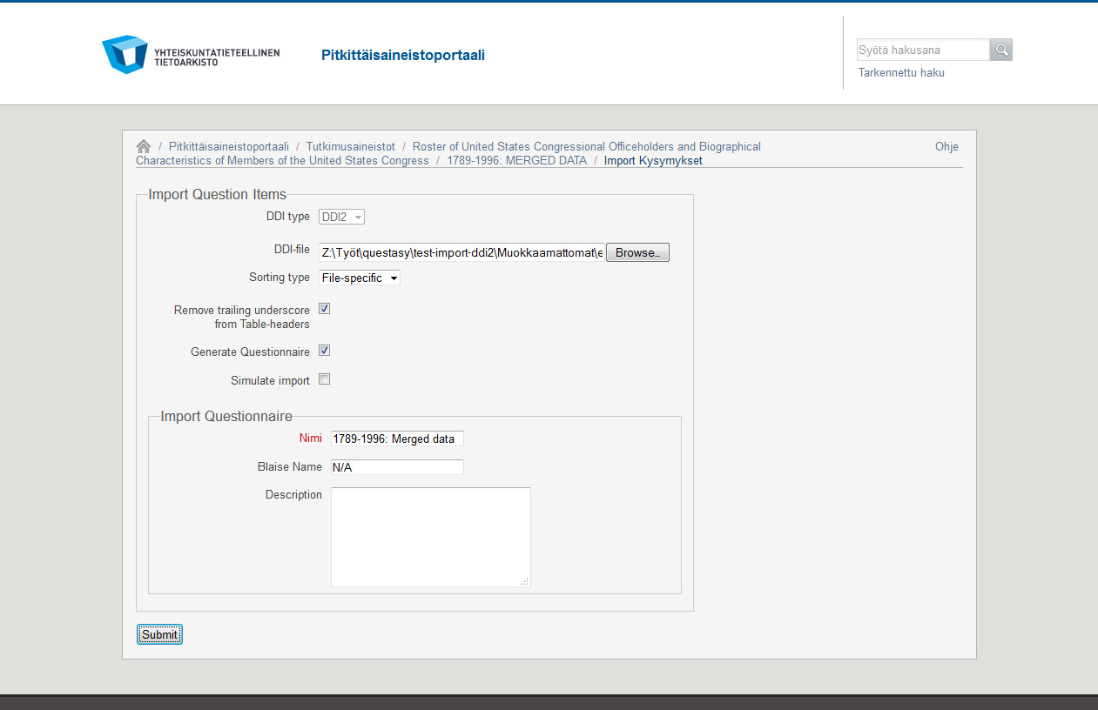

Slide 22
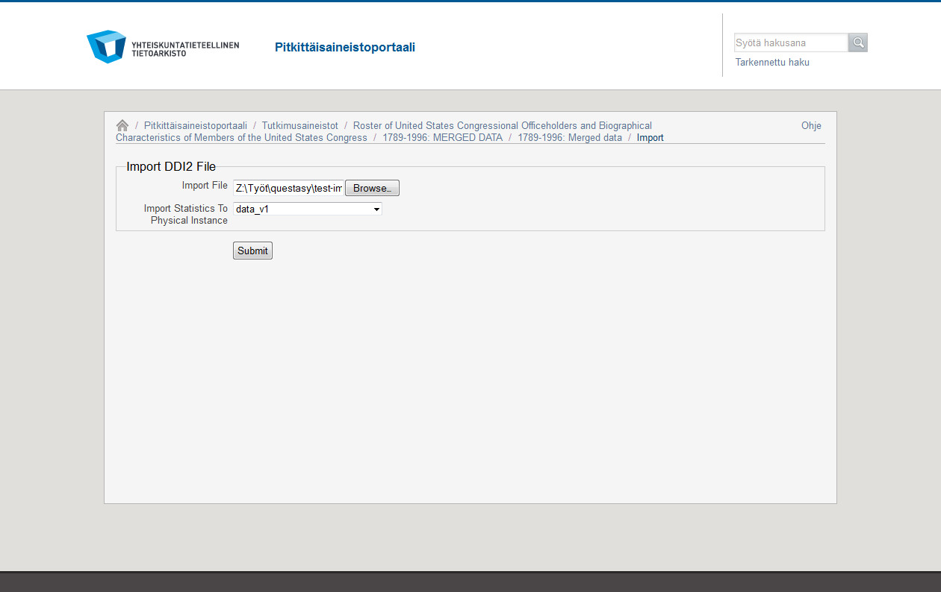

Slide 23
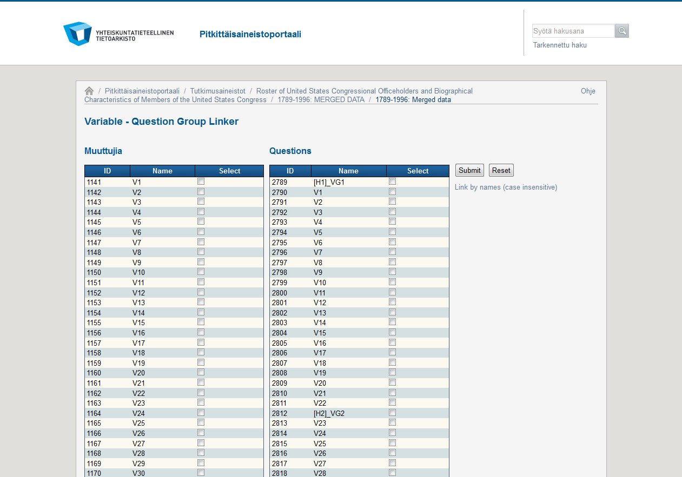

Slide 24
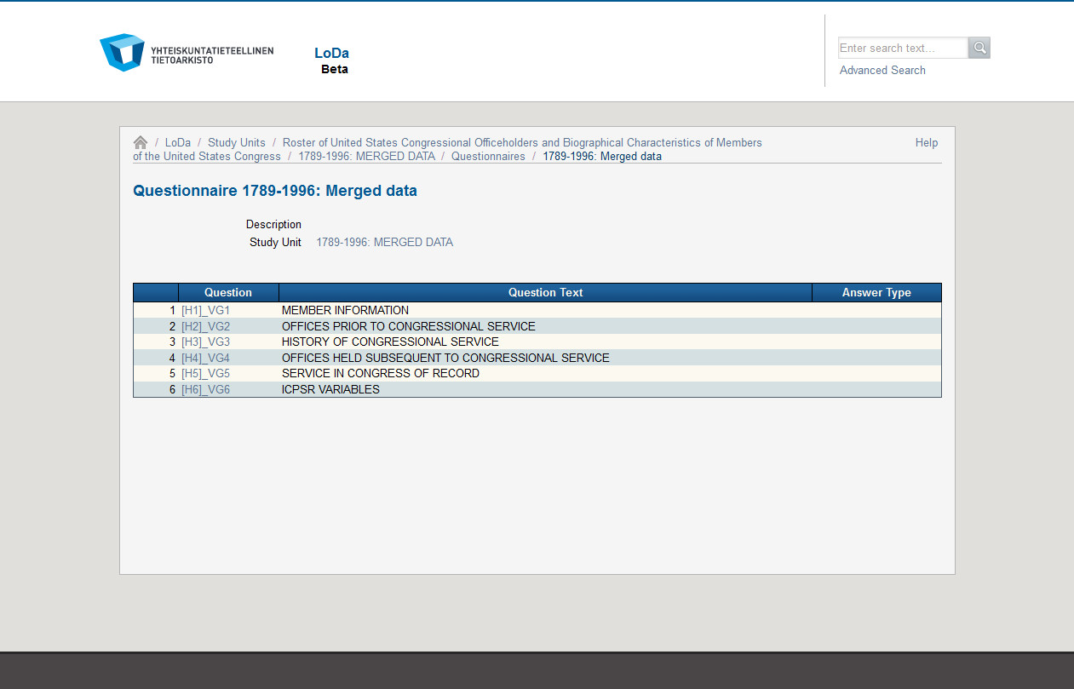

Slide 25
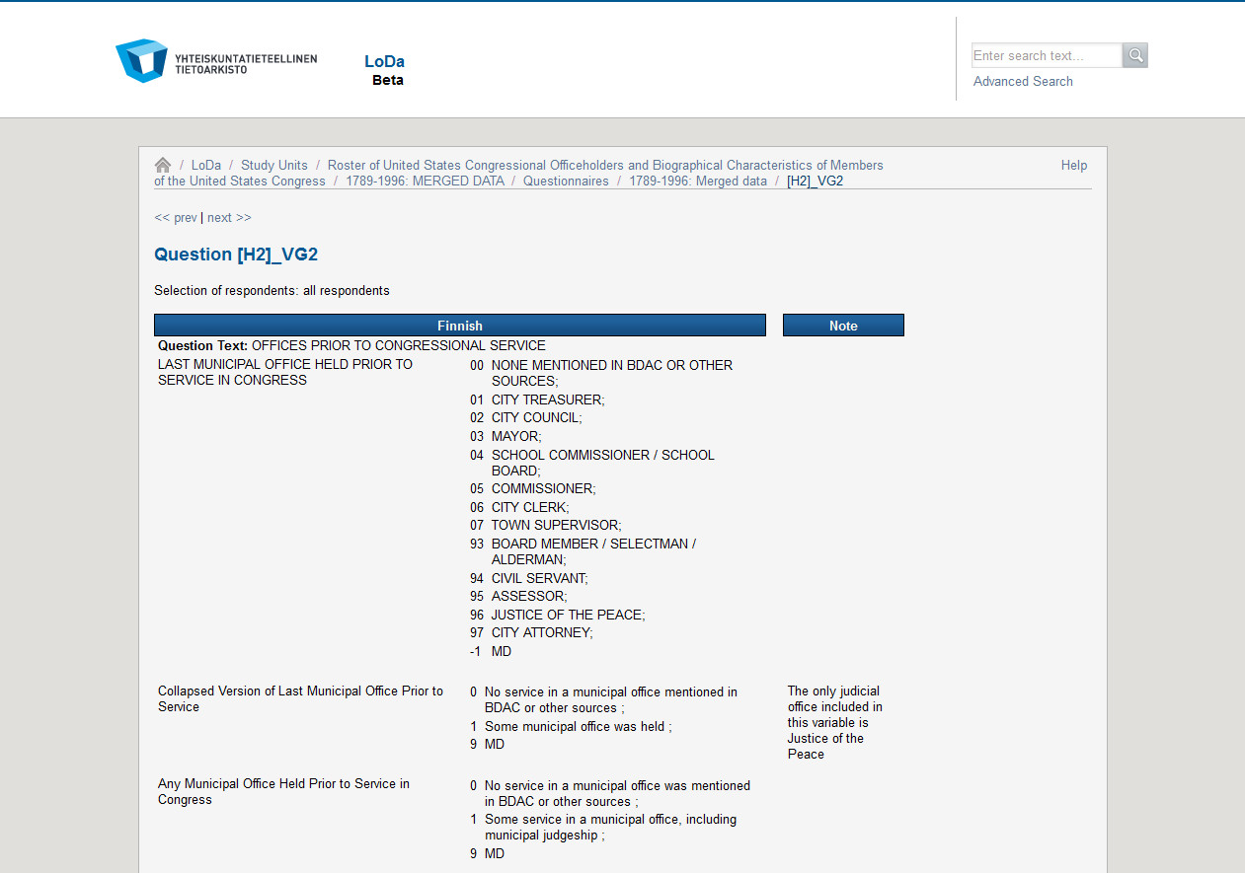

Slide 26
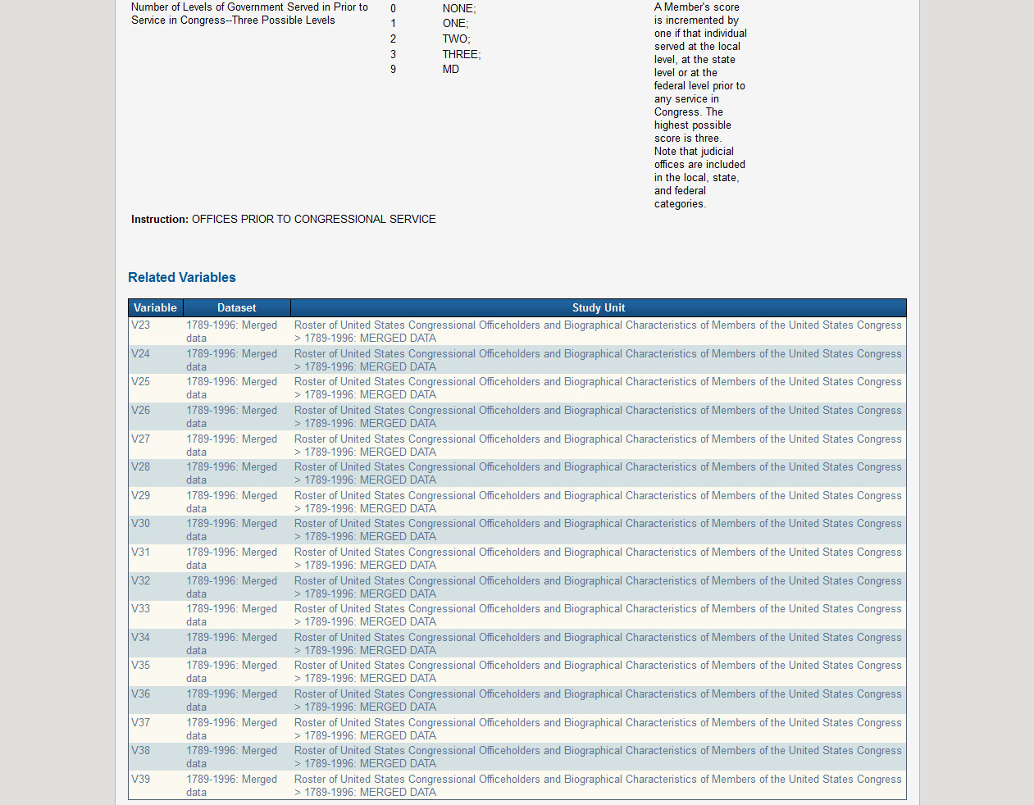

Slide 27
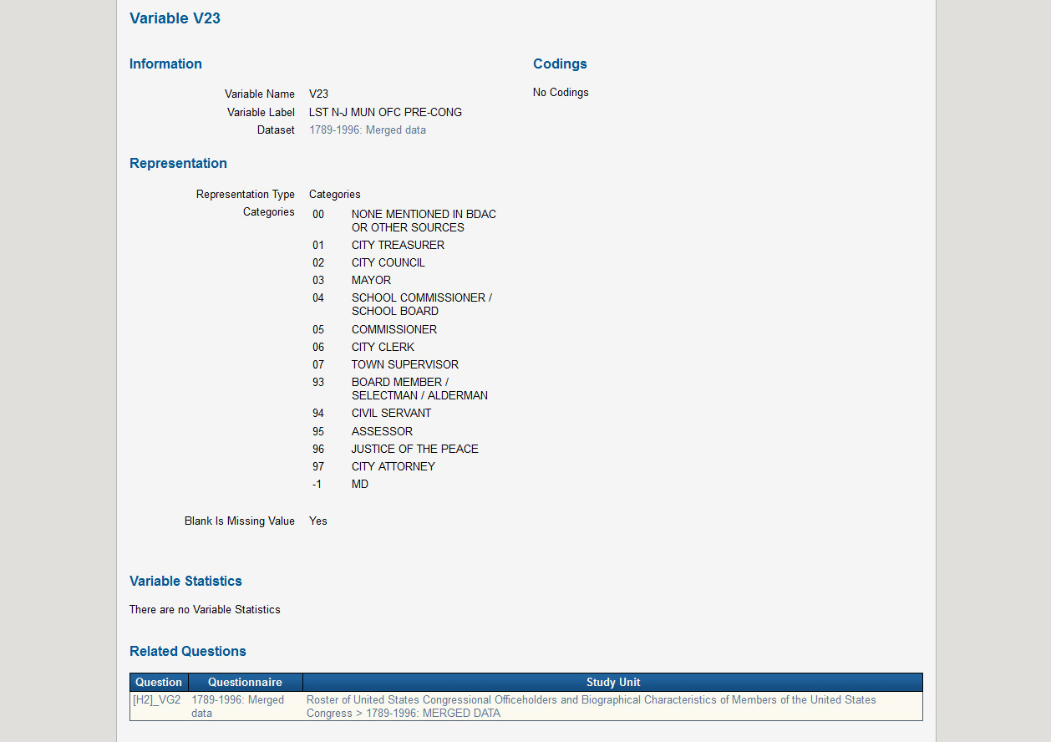

Slide 28
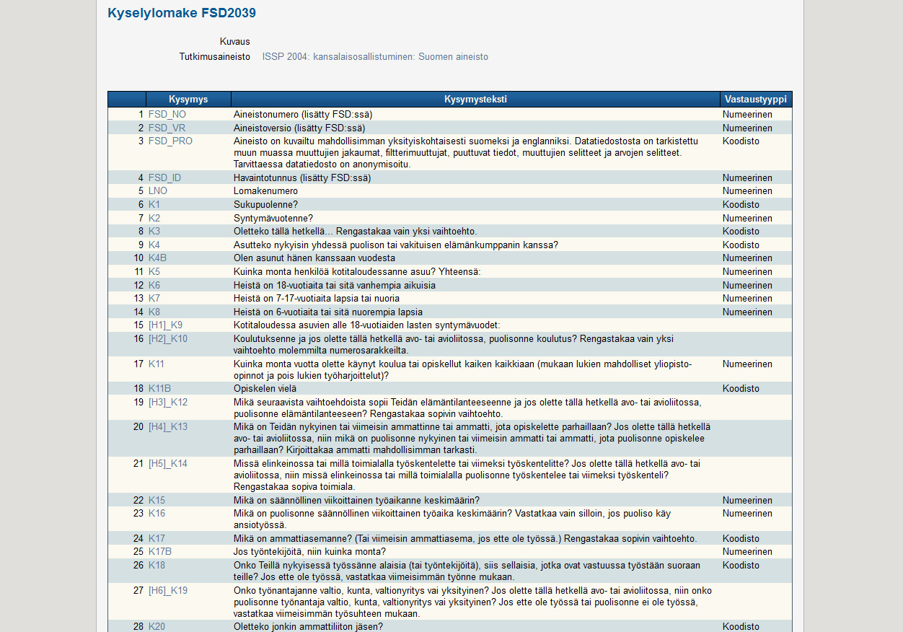

Slide 29
