Slide 1
Metadata Management for Research Data with DBKfree
Wolfgang Zenk-Möltgen
GESIS – Leibniz Institute for the Social Sciences
EDDI13 – 5th Annual European DDI User Conference
Réseau Quetelet - French Data Archives for Social Sciences
December 3-4, 2013

Slide 2
Outline
DBKfree – Data Catalogue Software
DBKSearch Functions for End Users
DBKEdit Functions for Metadata Managers
DBK Technical & License
DBK Web Services

Slide 3
DBKfree – Data Catalogue Software
Preview of DBKfree version 2.0 beta
Will be used by GESIS with the start of 2014
Will be released to public during 2014
Completely new layout
Registration for users integrated with ZACAT and datorium
Download portal of the GESIS Data Archive

Slide 4
DBK at the GESIS Data Archive
Contains study descriptions of primary data from survey research and historical time series
Has more than 5100 studies, e.g. ALLBUS, ISSP, Eurobarometer, Politbarometer, DeutschlandTrend, European Values Study, German Longitudinal Election Study, Comparative Study of Electoral Systems, Youth Studies and many more…
Uses a generic metadata schema for the description of social science data
Was developed since the 1960ies, together with international archives and the DDI Alliance
Provides metadata management to publish it in different retrieval and distribution platforms
Includes a version history for the datasets, including errata documentation and persistent identifiers (DOIs by da|ra)
Enables a standardisation of the metadata, e.g. geographic coverage , collection dates, and publications
http://www.gesis.org/en/services/research/data-catalogue/

Slide 5
DBKSearch Functions for End Users
Quick, Simple & Advanced Field Searches
Configurable Result Lists
Browse Studies, Products & Groups
Tag Clouds for Overviews
New Registration for Users
Data Download & Shopping Cart

Slide 6
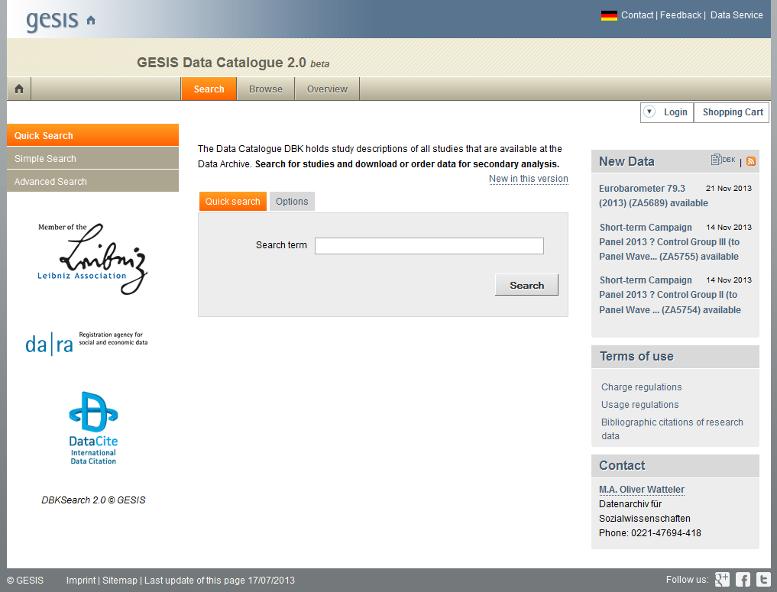

Slide 7
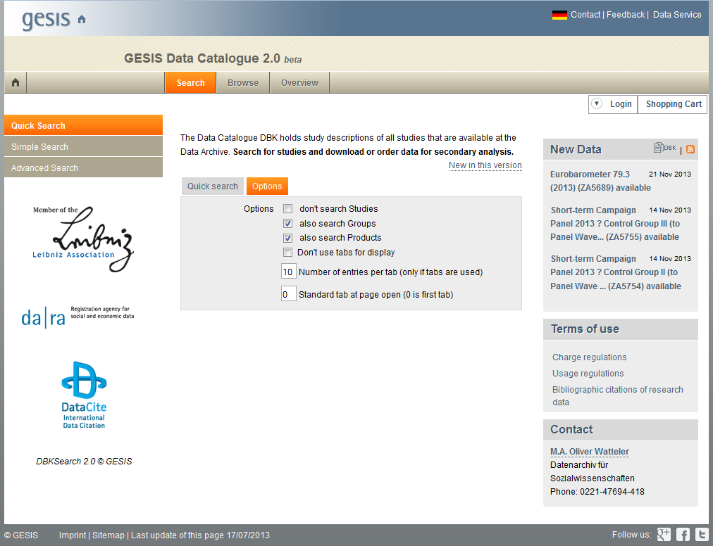

Slide 8
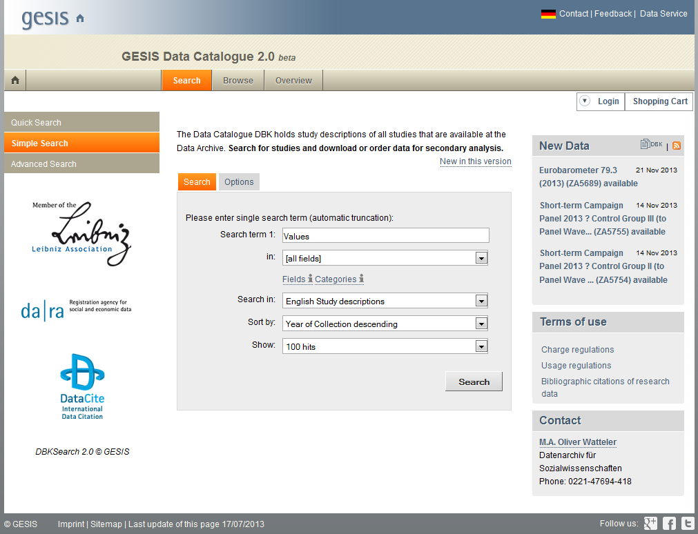

Slide 9
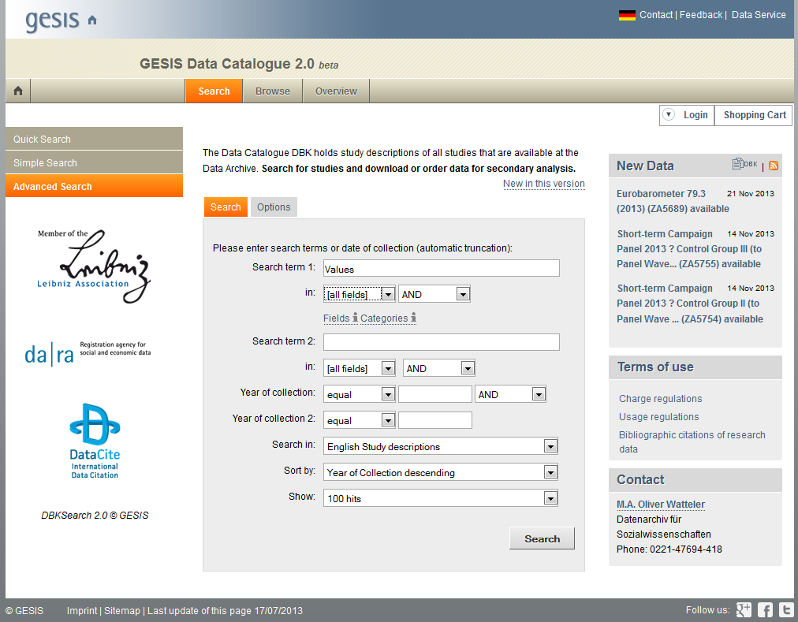

Slide 10
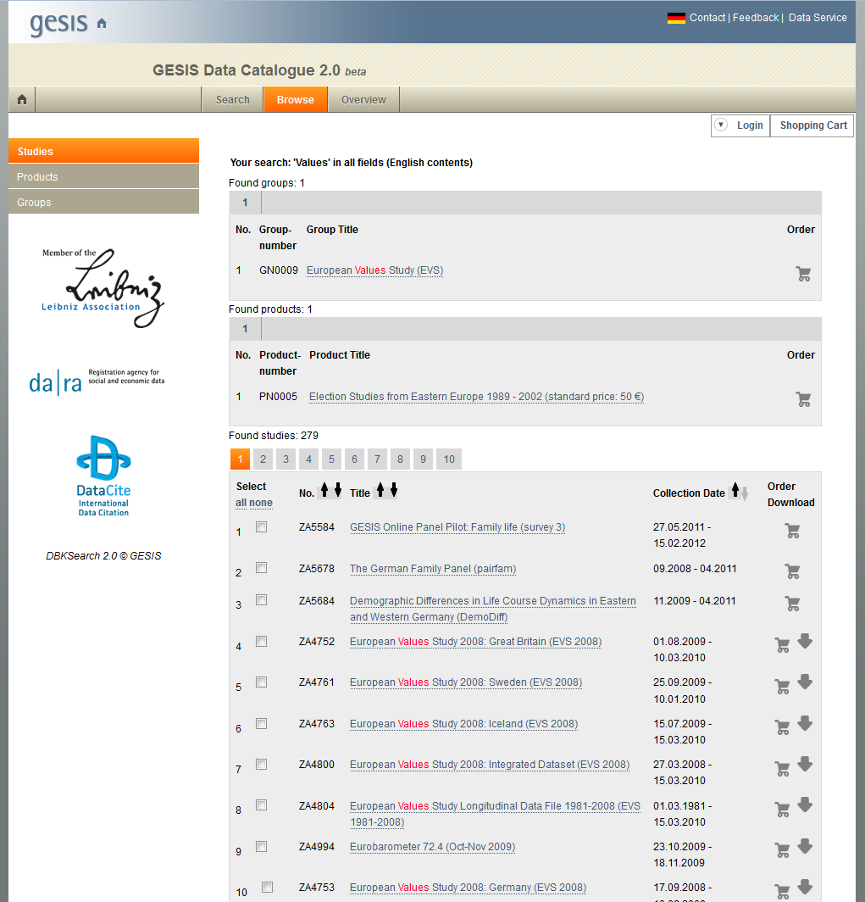

Slide 11
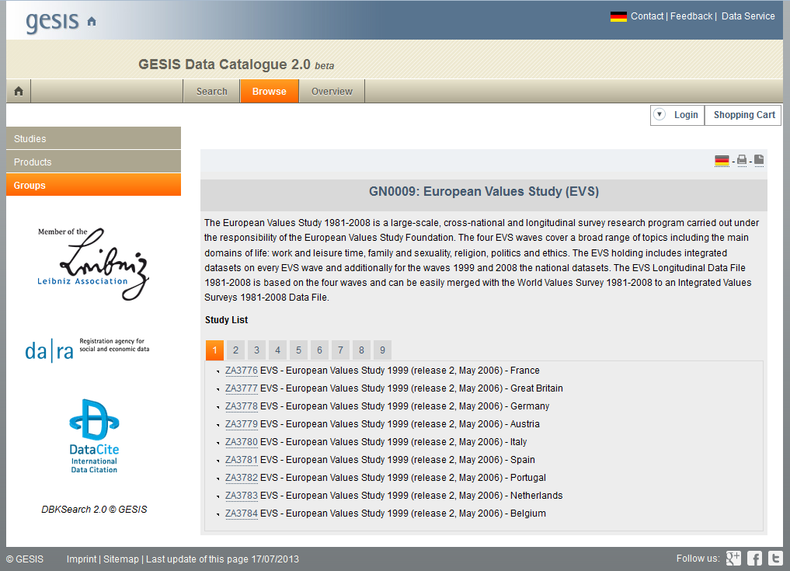

Slide 12
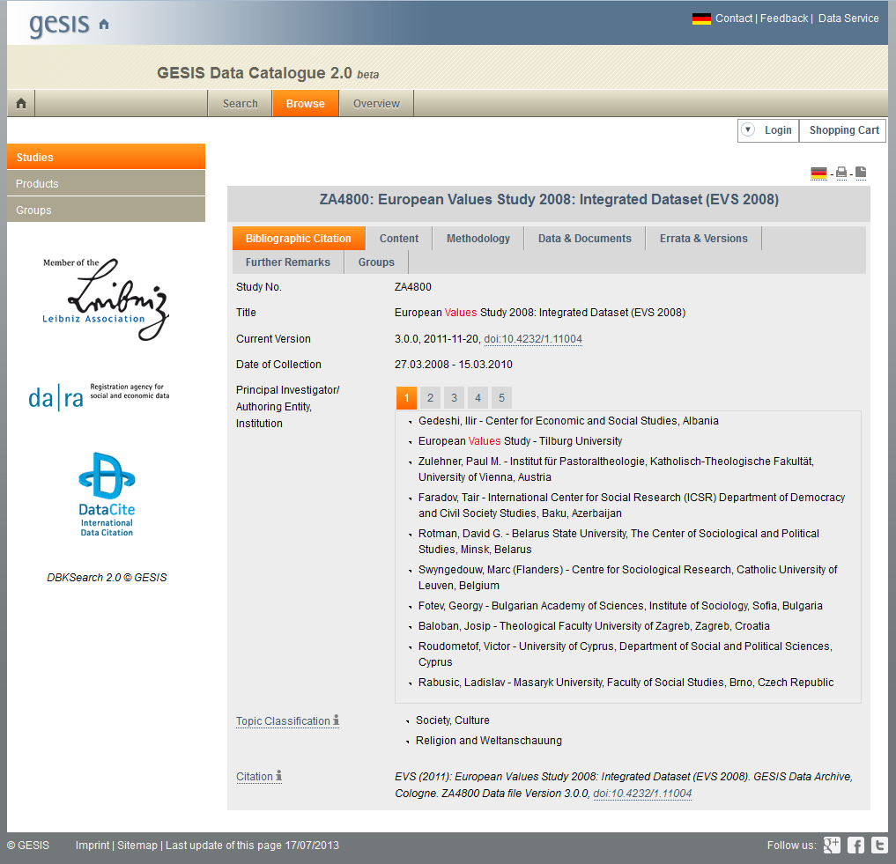

Slide 13
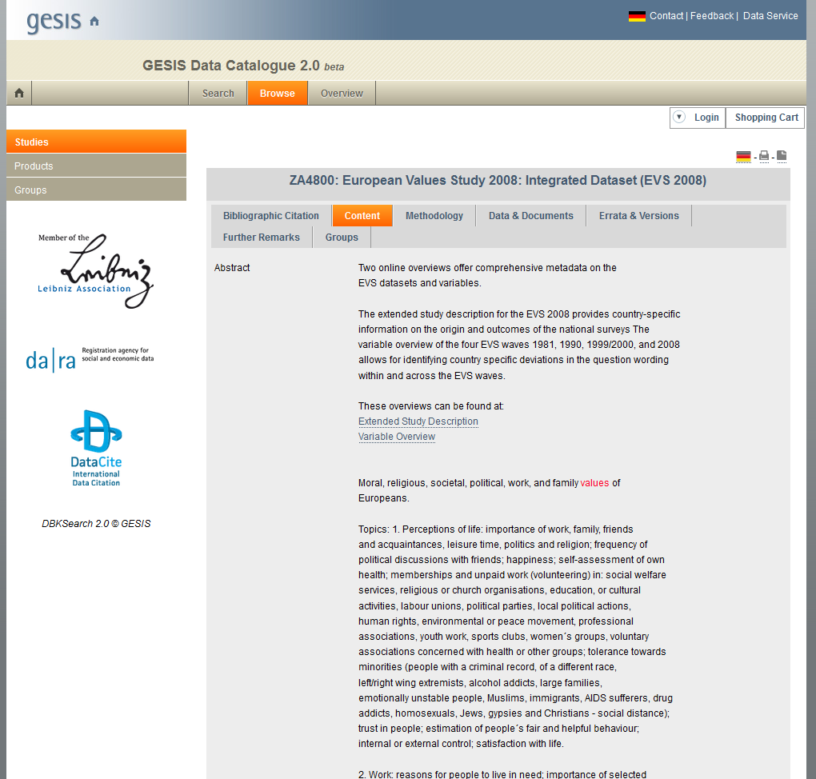

Slide 14
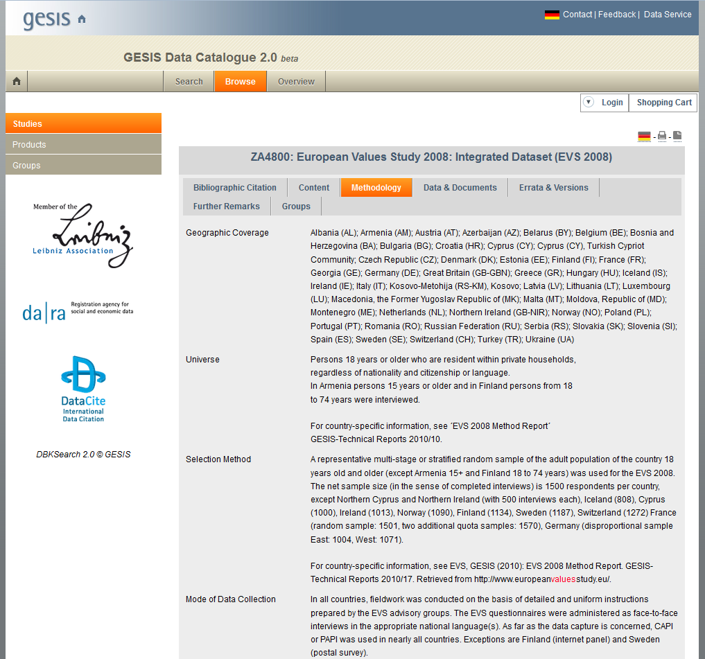

Slide 15
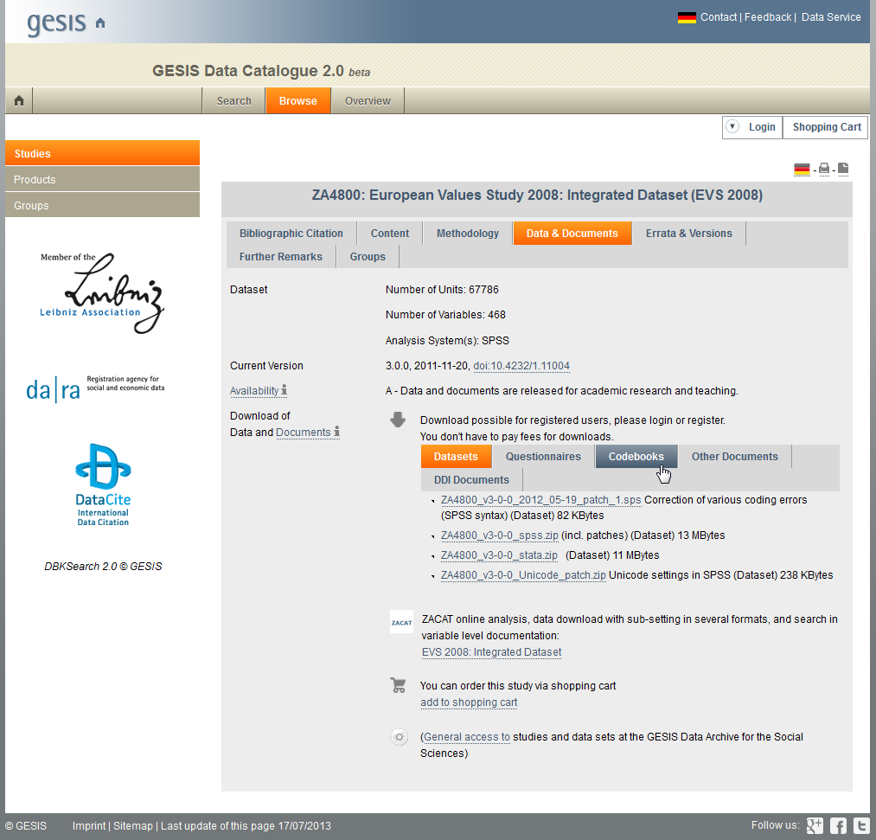

Slide 16
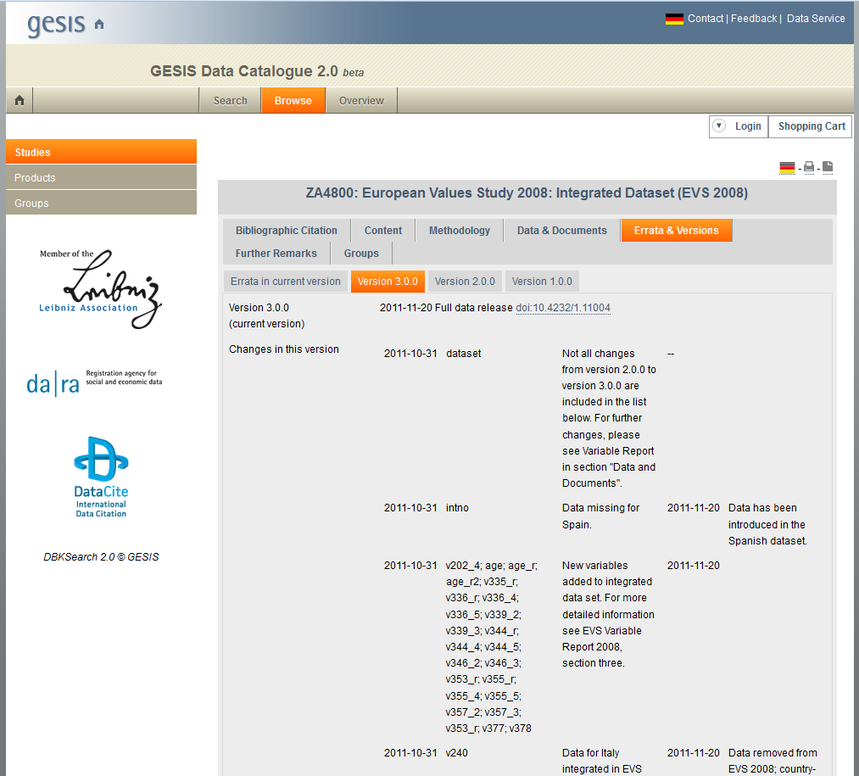

Slide 17
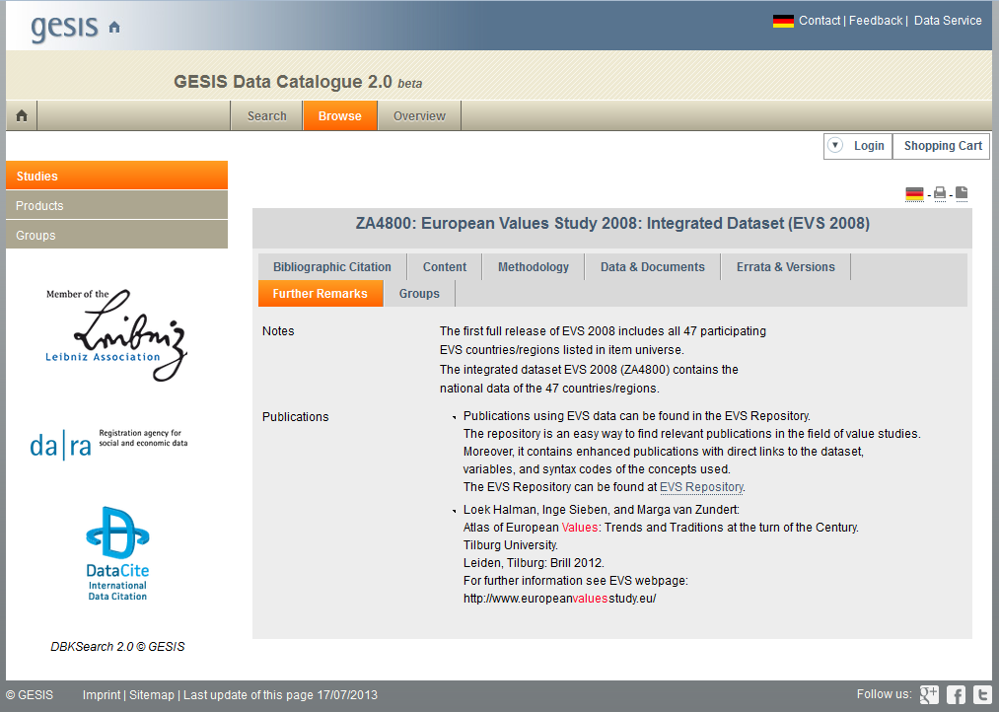

Slide 18
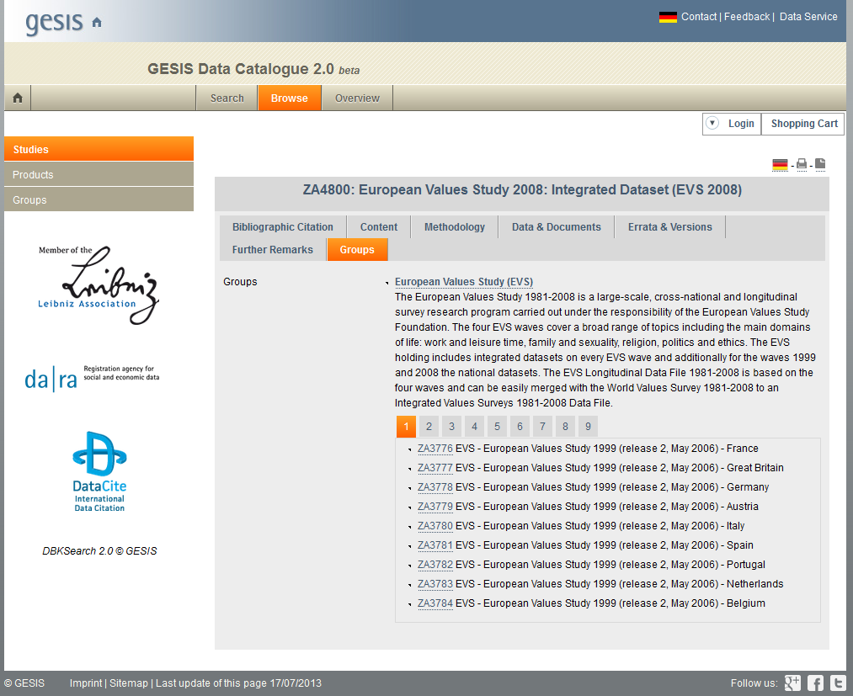

Slide 19
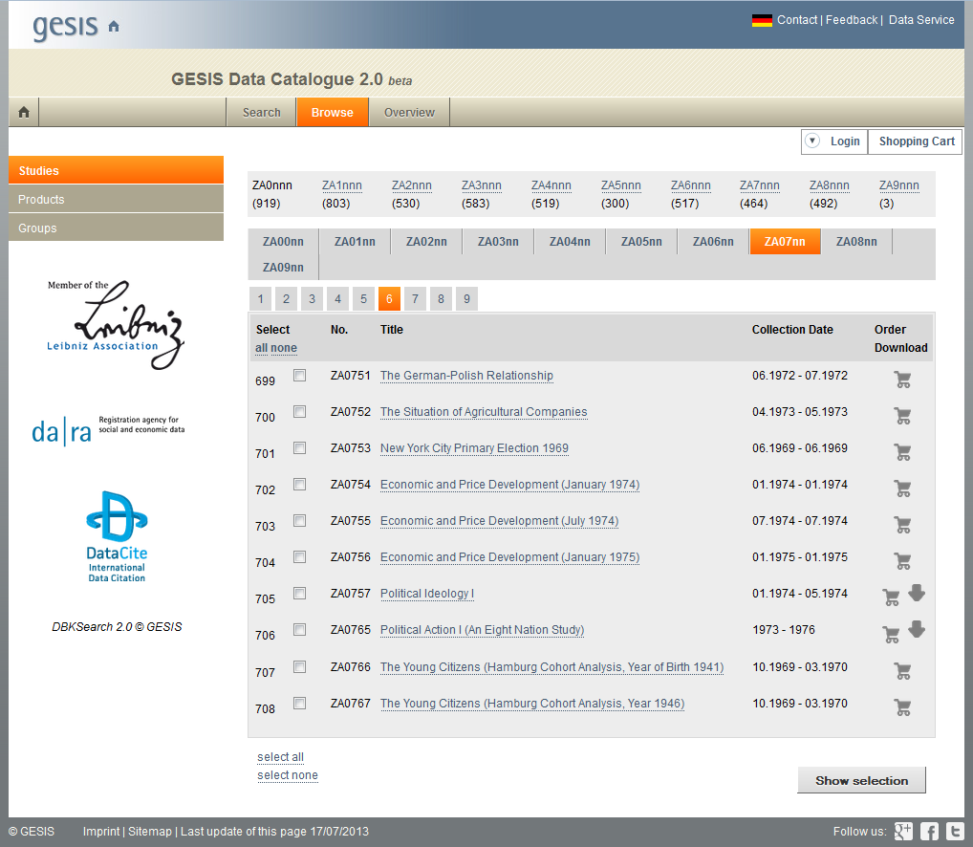

Slide 20
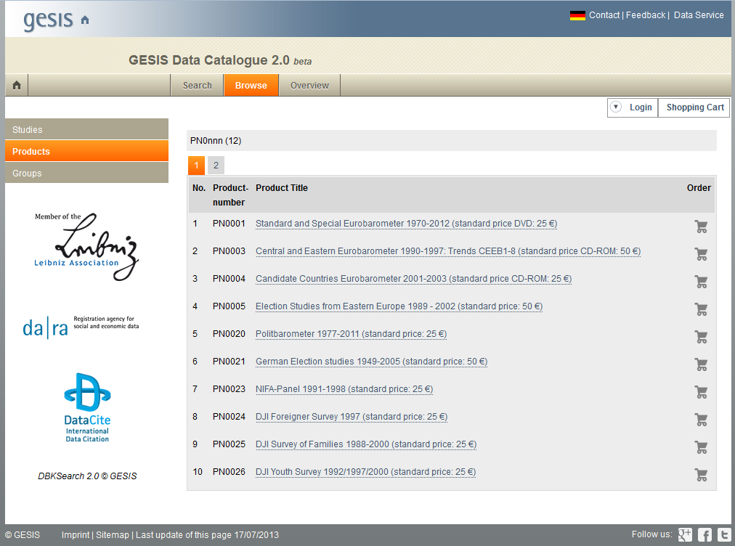

Slide 21
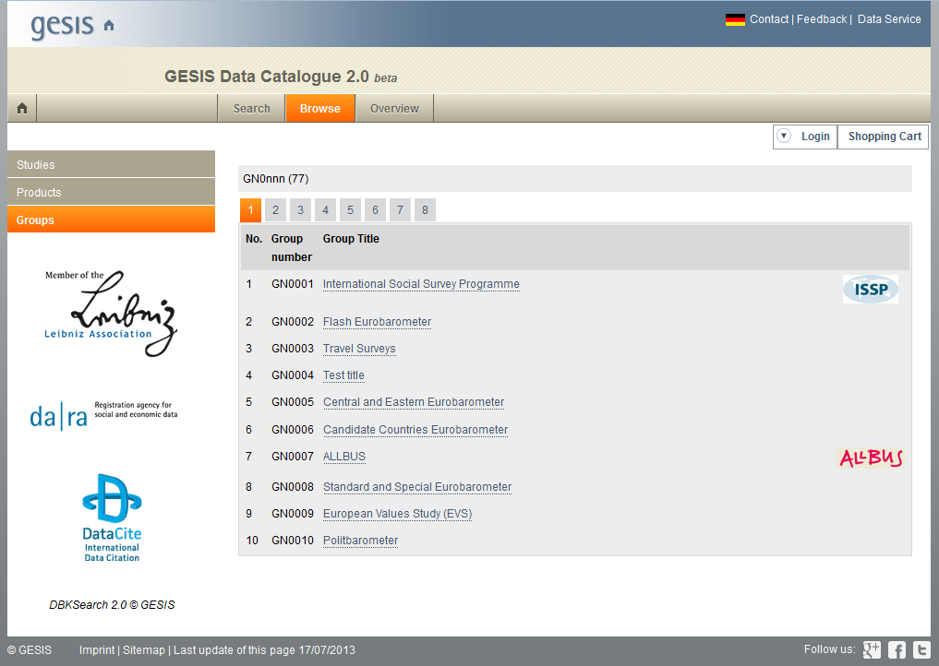

Slide 22
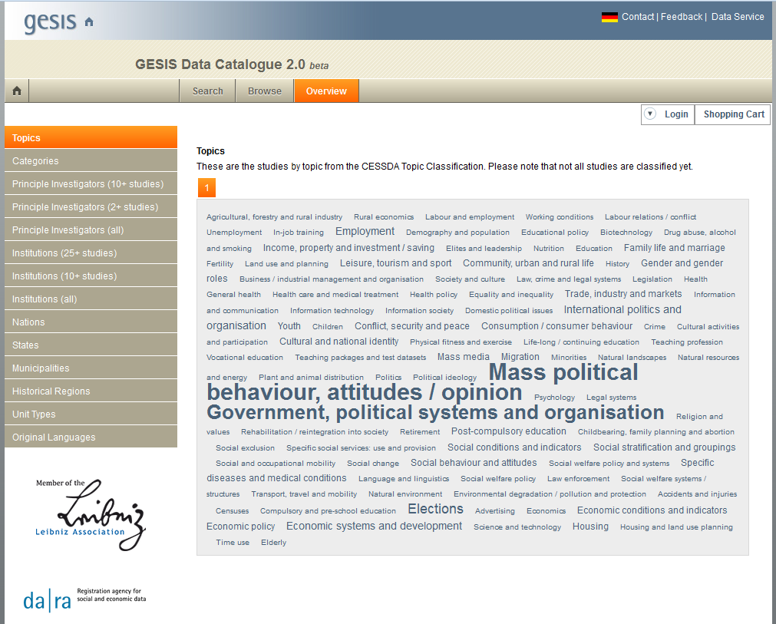

Slide 23
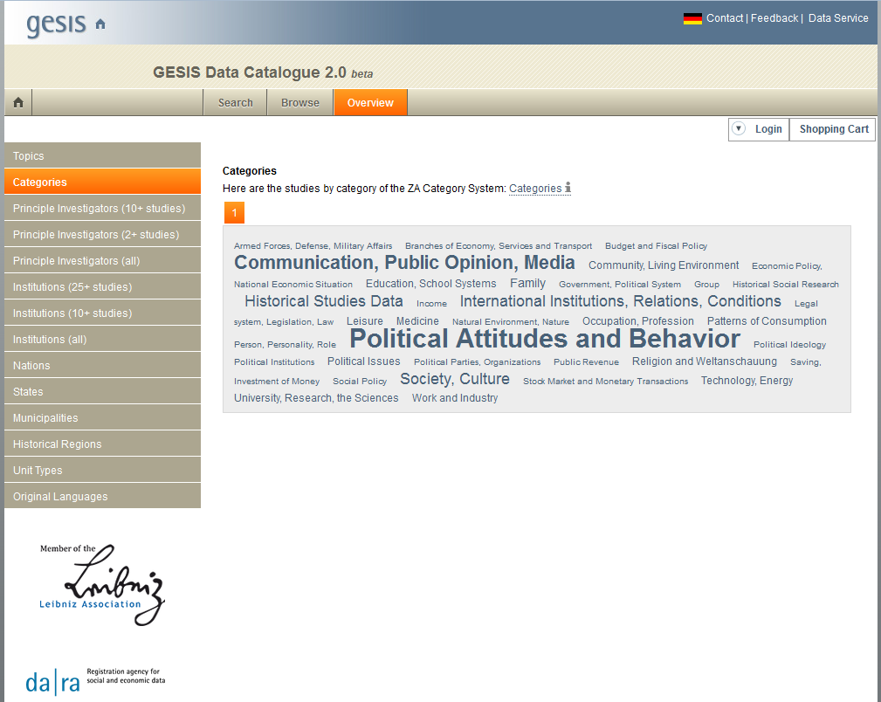

Slide 24
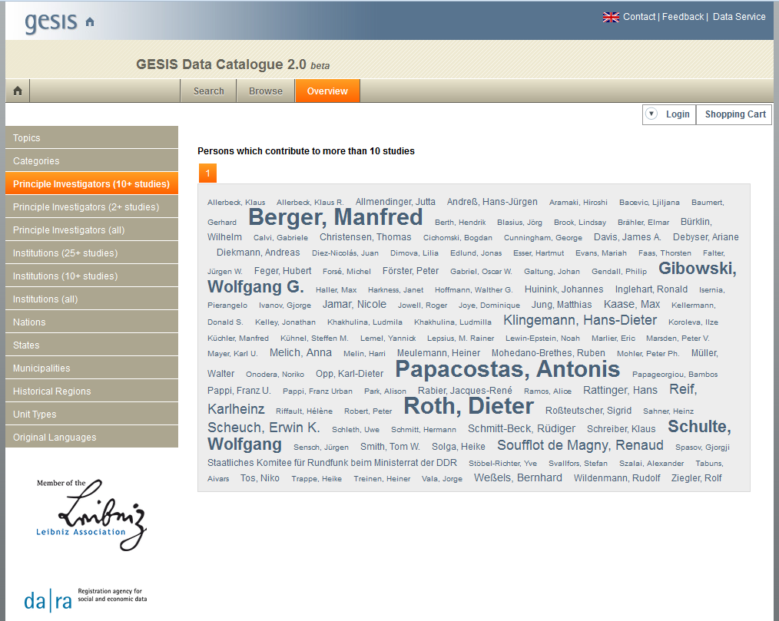

Slide 25
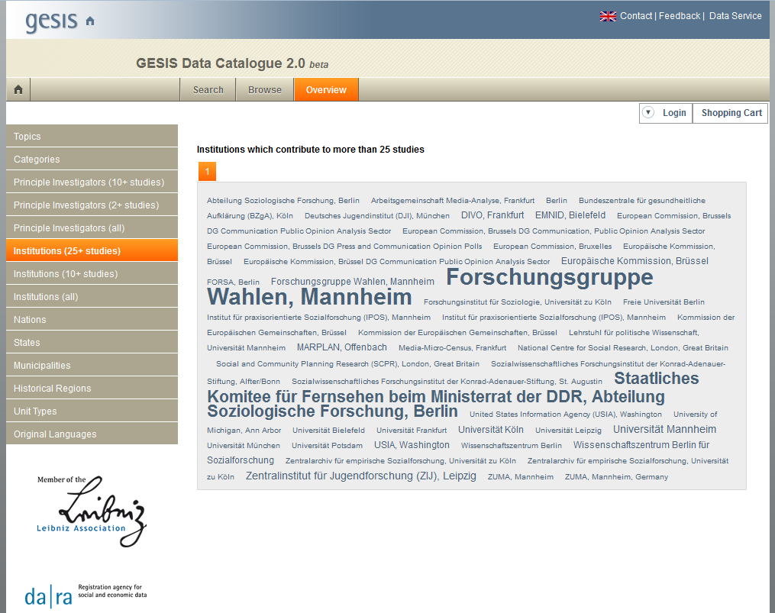

Slide 26
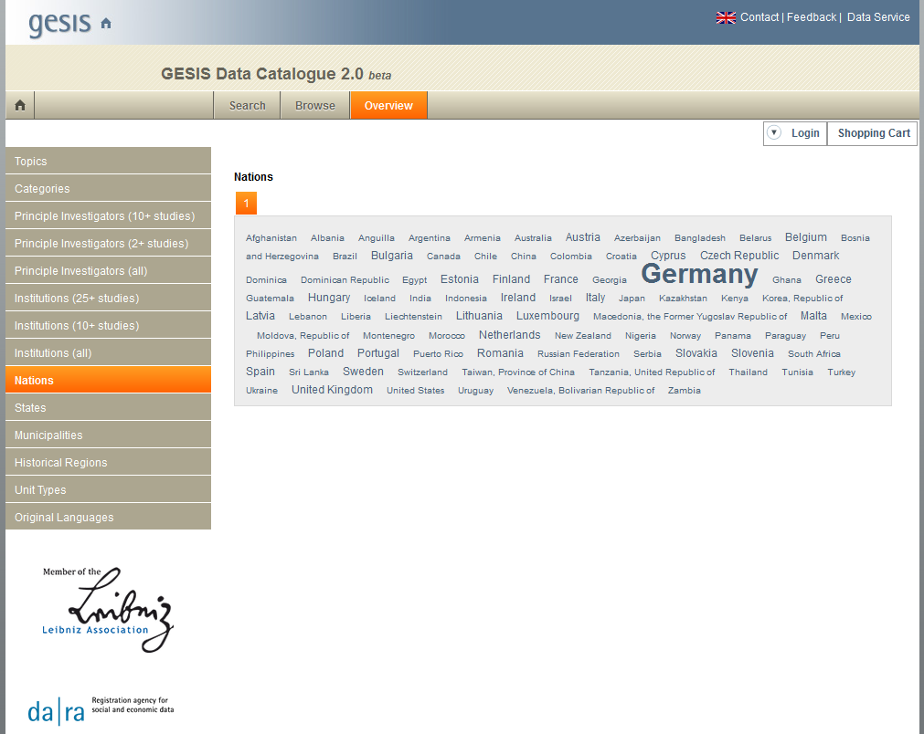

Slide 27
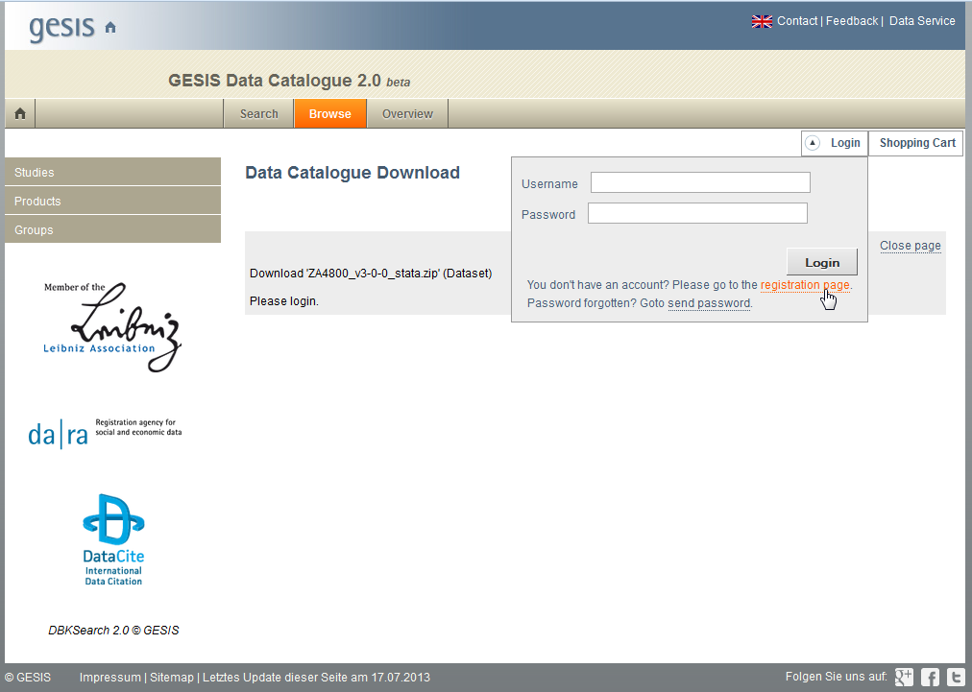
Registration 2.0

Slide 28
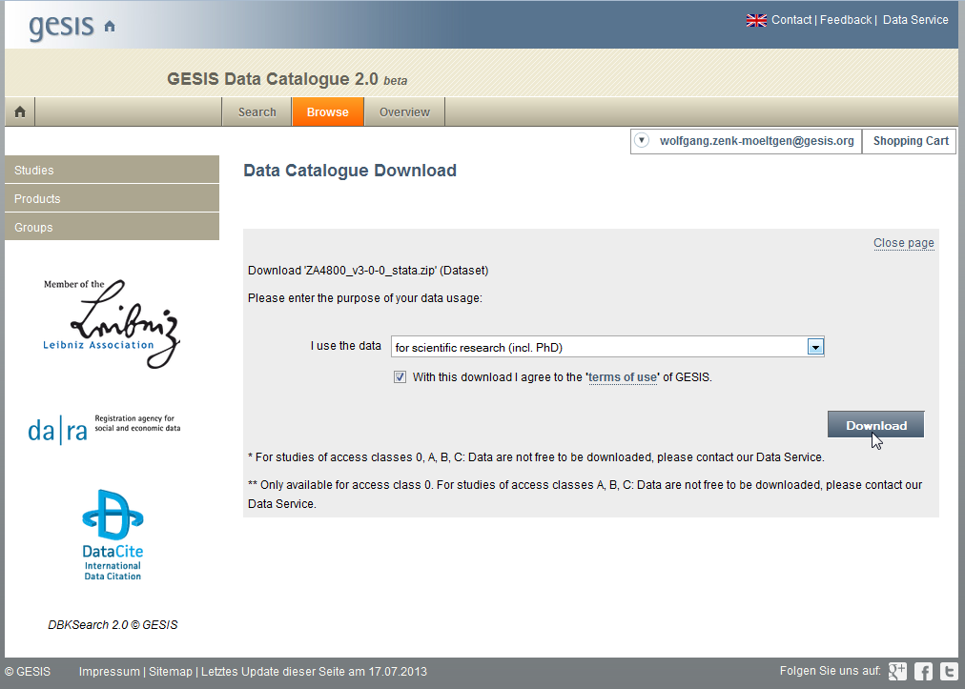

Slide 29
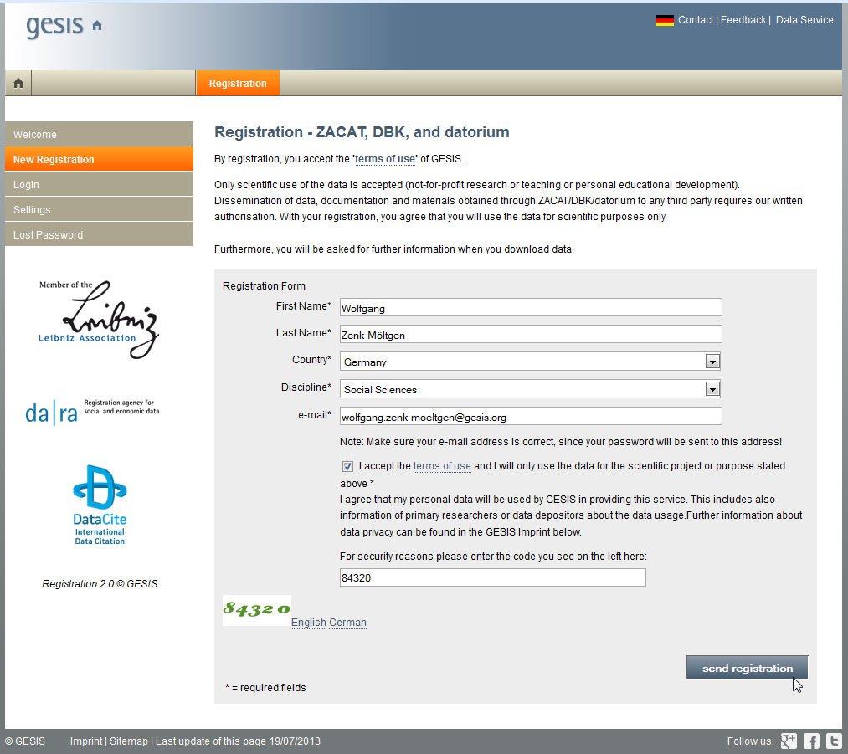

Slide 30
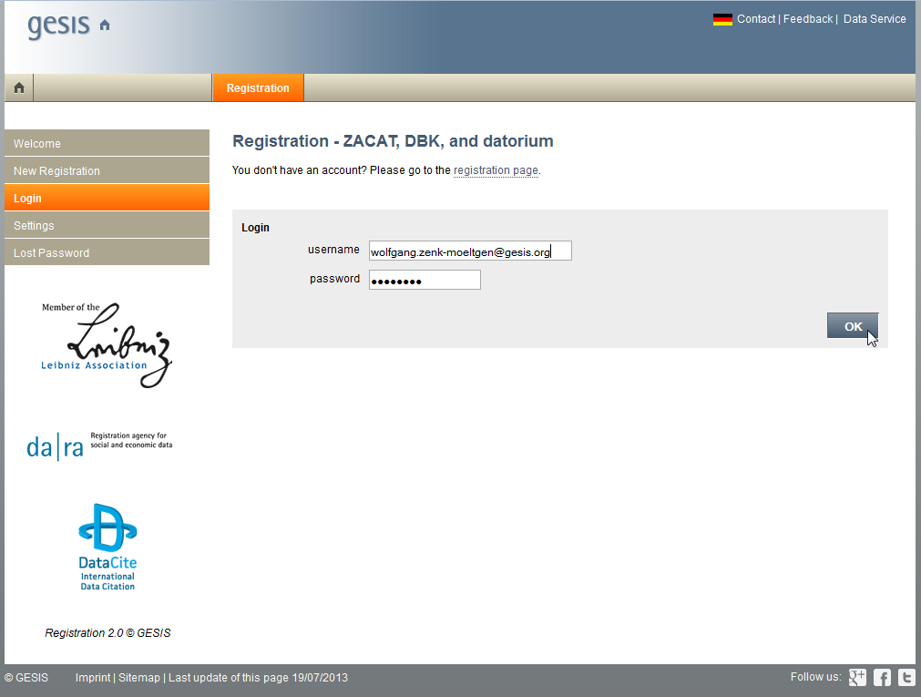

Slide 31
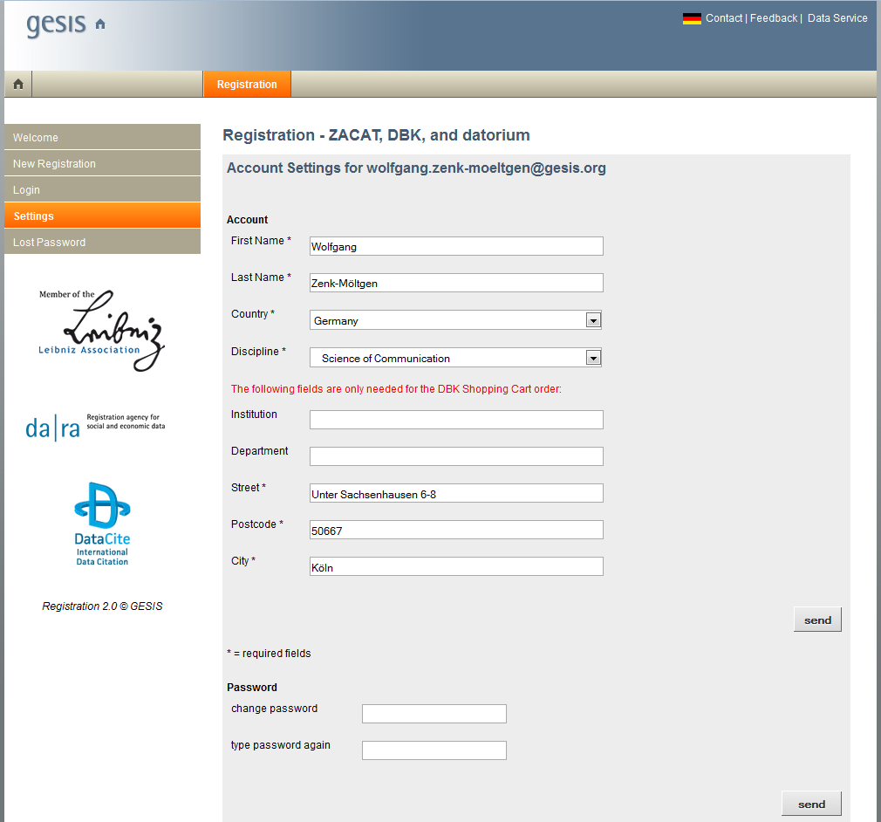

Slide 32
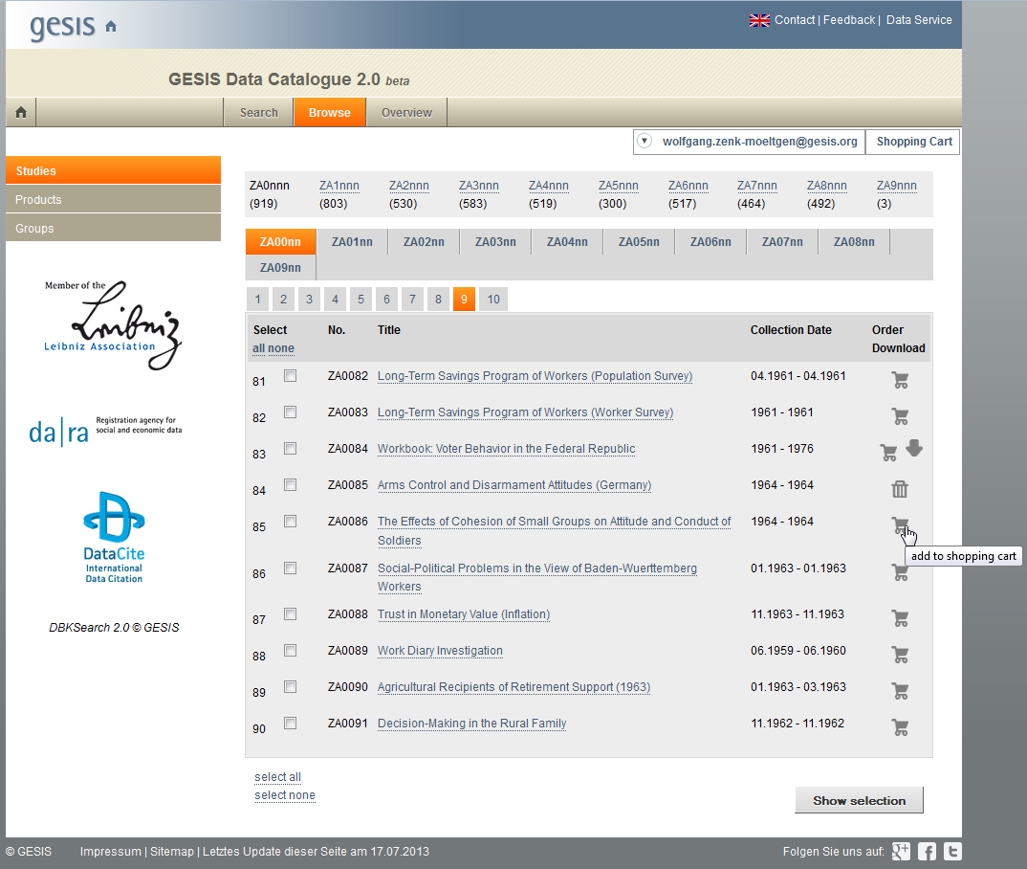

Slide 33
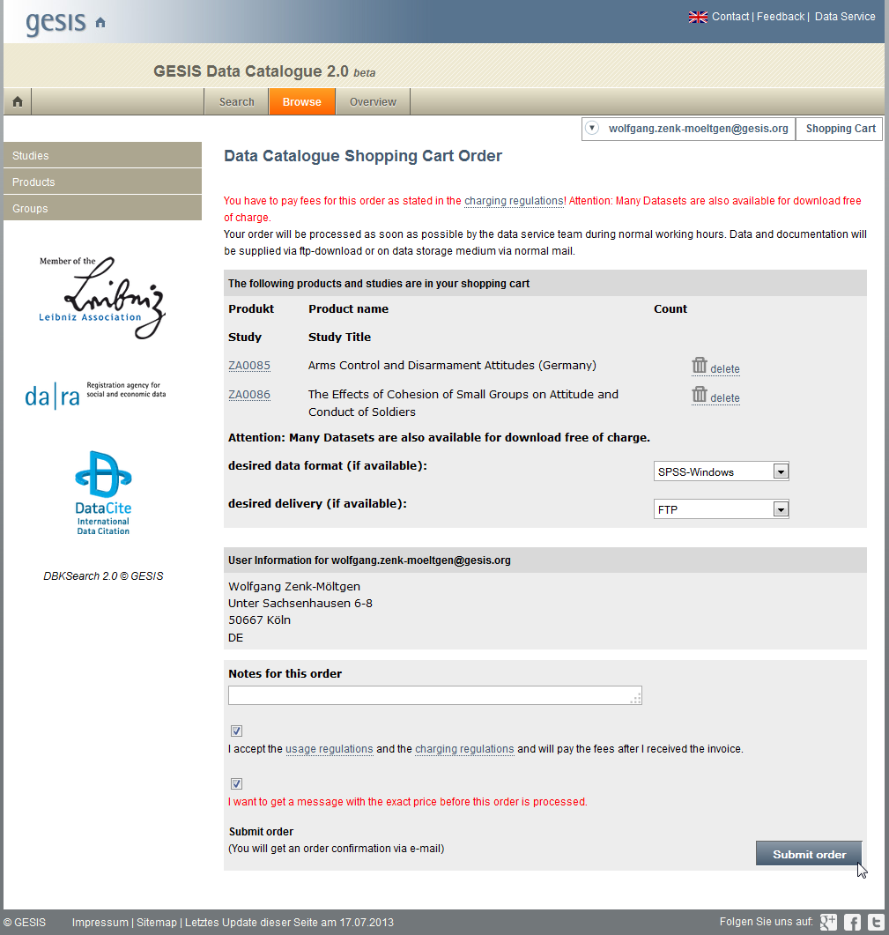

Slide 34
DBKEdit Functions for Metadata Managers
English Interface now available
Create, Search and Browse: Studies, Products, Groups, Prefaces & Drafts
Edit Metadata & Register DOIs (by da|ra)
Do Checks and View Logfiles
Create Newsfeed Entries
Manage Users, Groups of Users & Rights

Slide 35
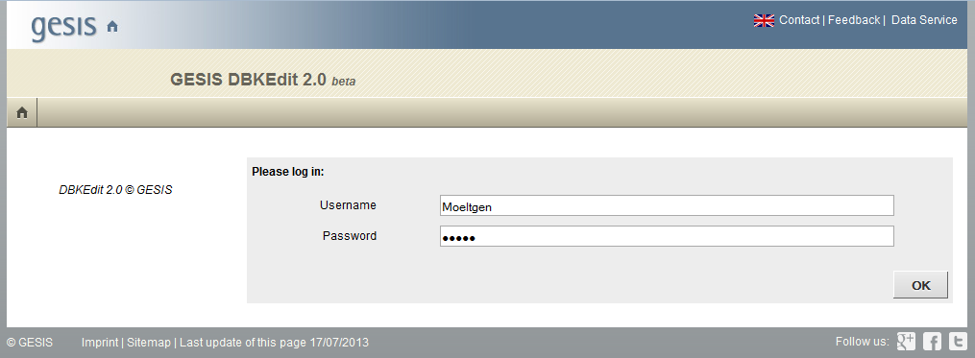
DBKEdit 2.0 beta

Slide 36
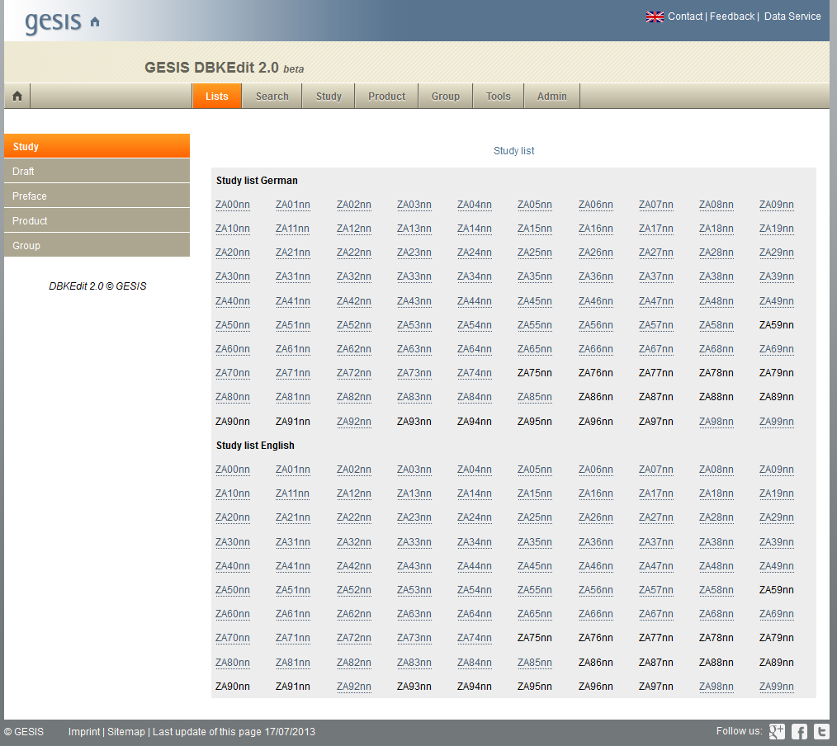

Slide 37
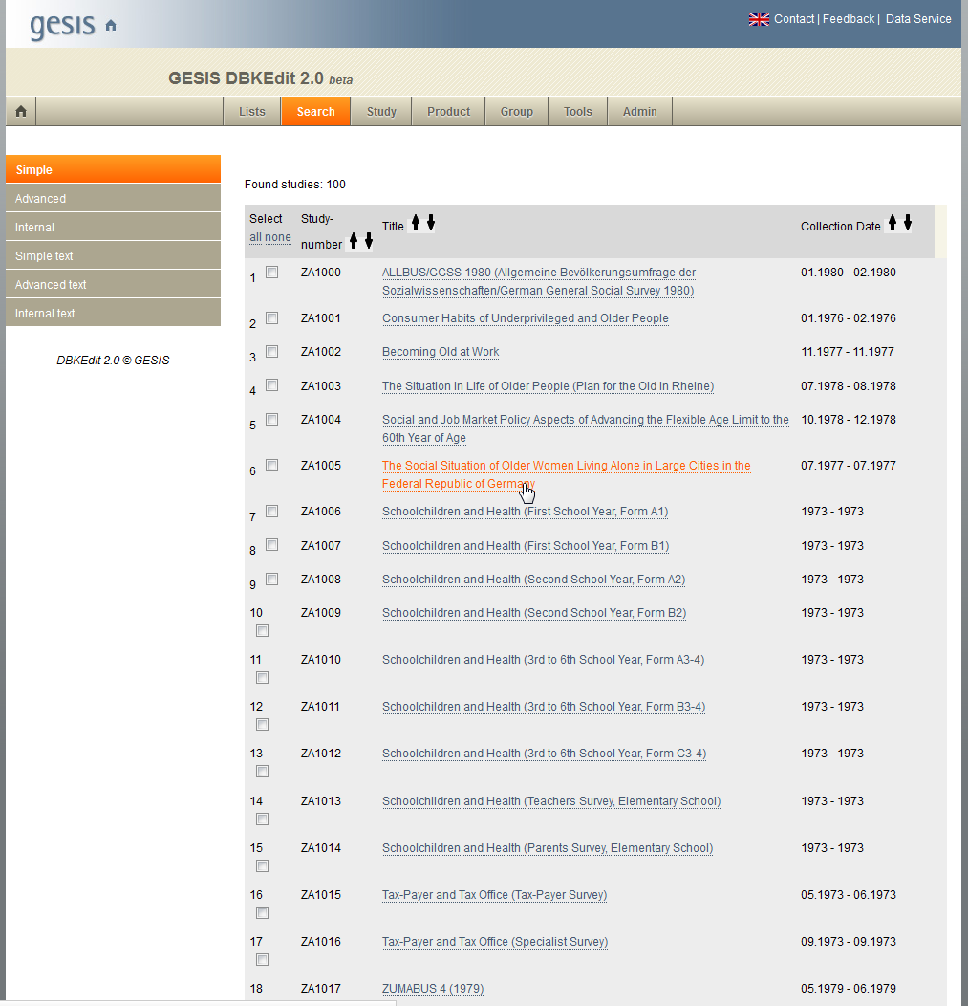

Slide 38
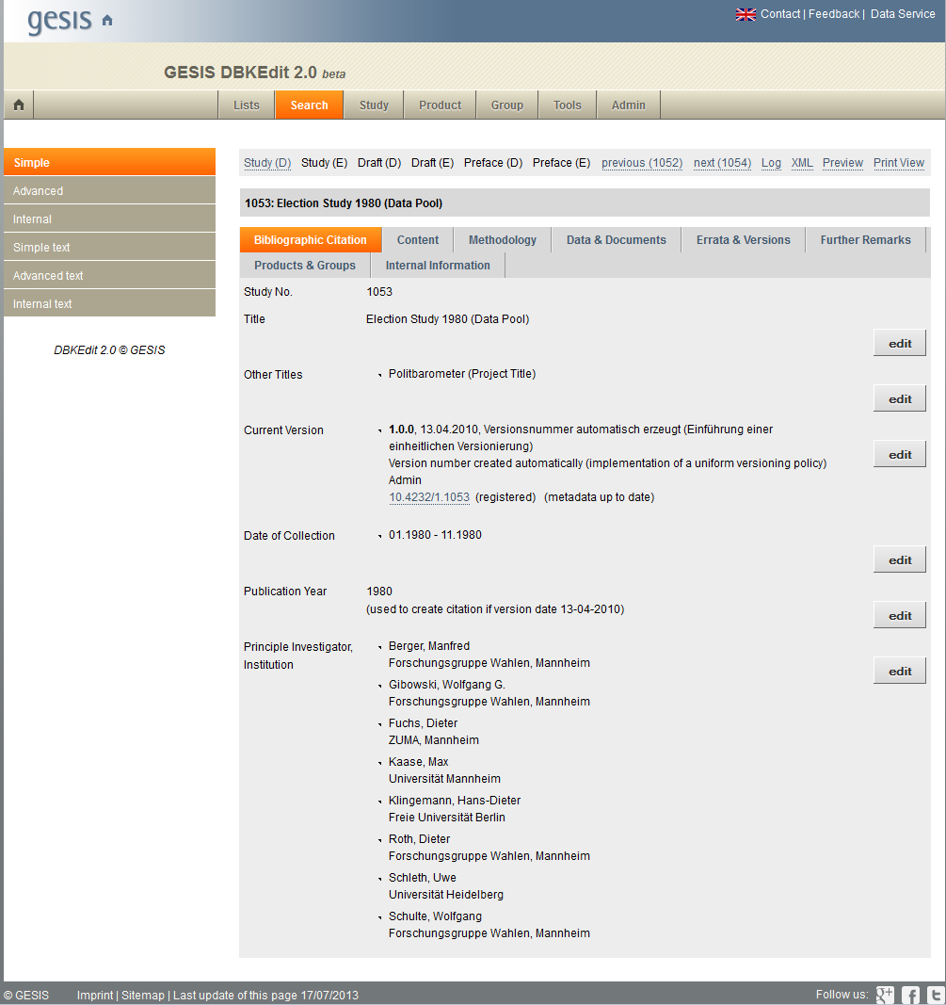

Slide 39
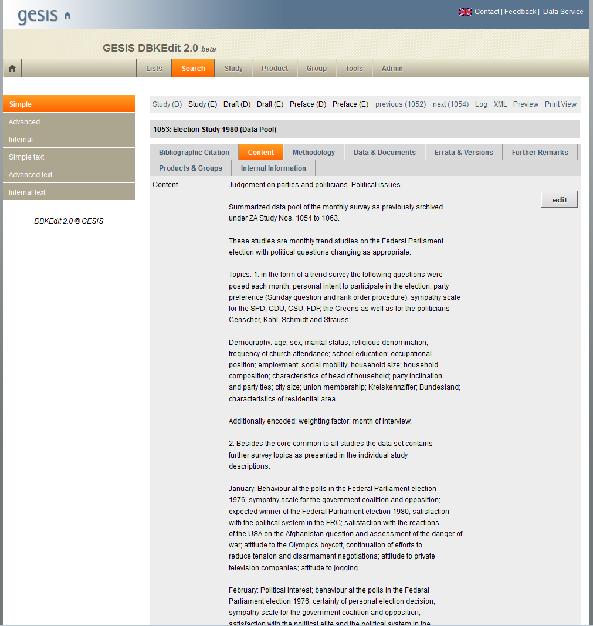

Slide 40
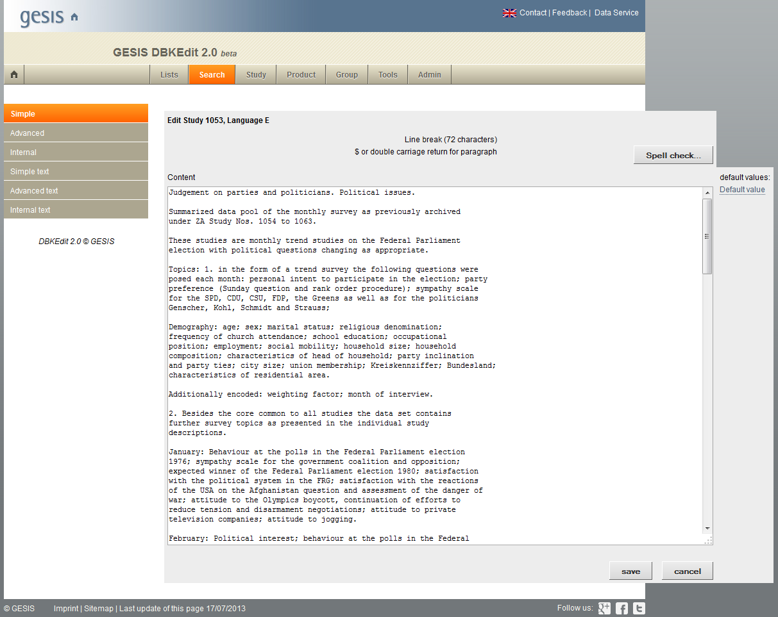

Slide 41
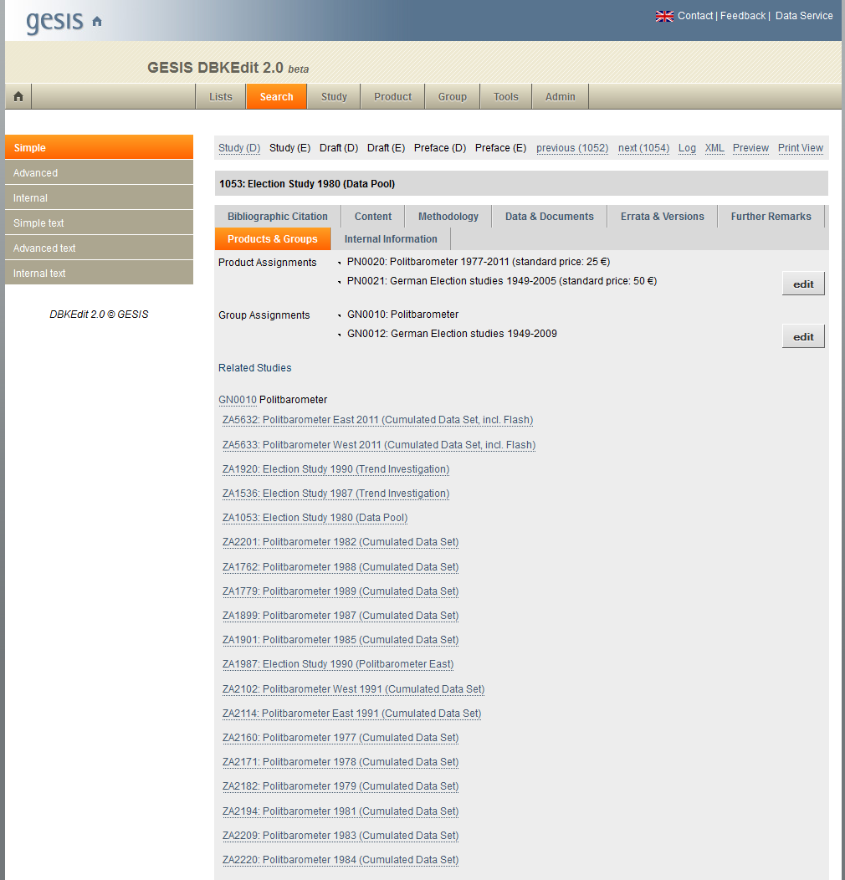

Slide 42
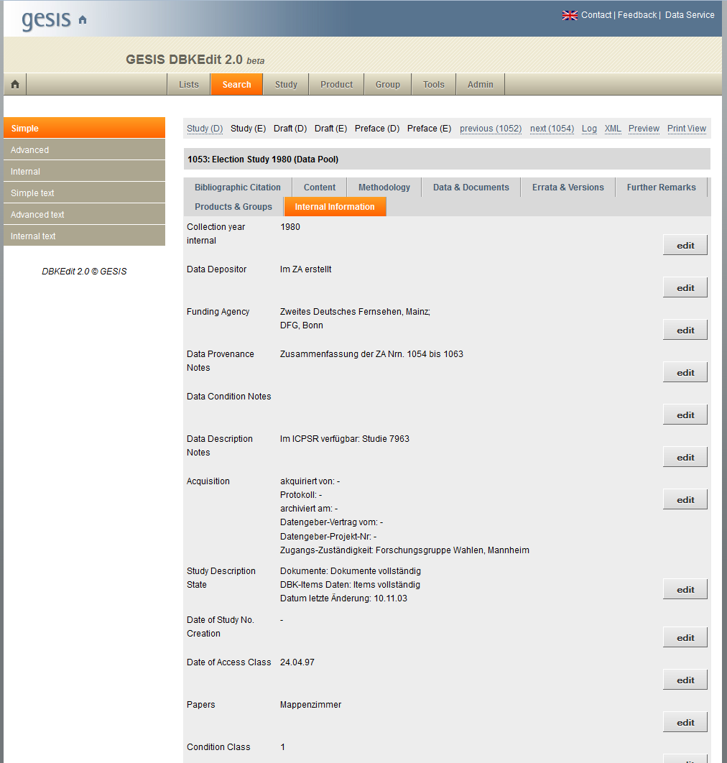

Slide 43
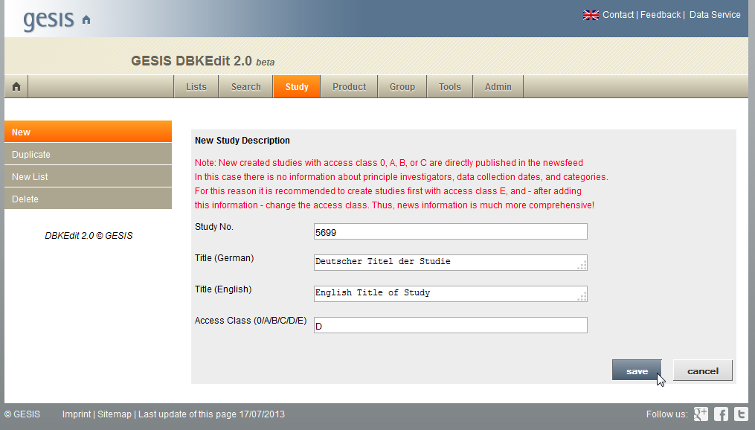

Slide 44
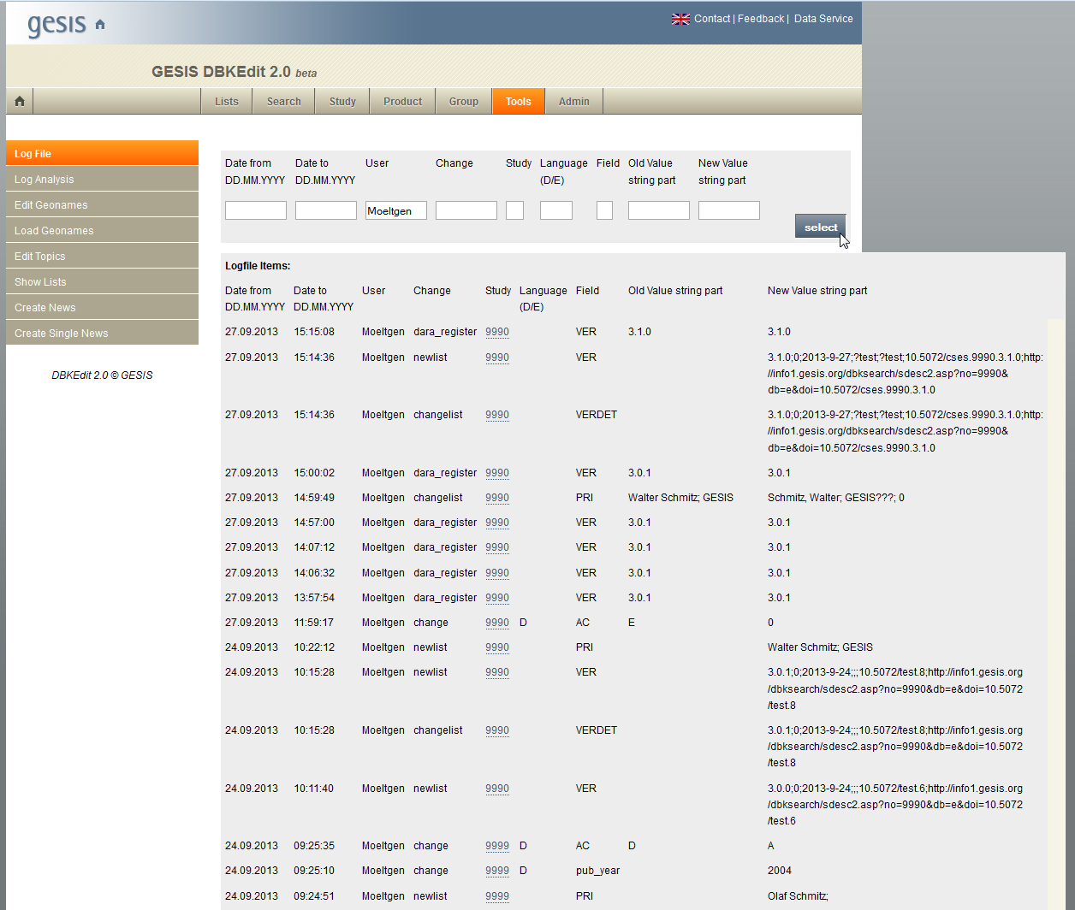

Slide 45
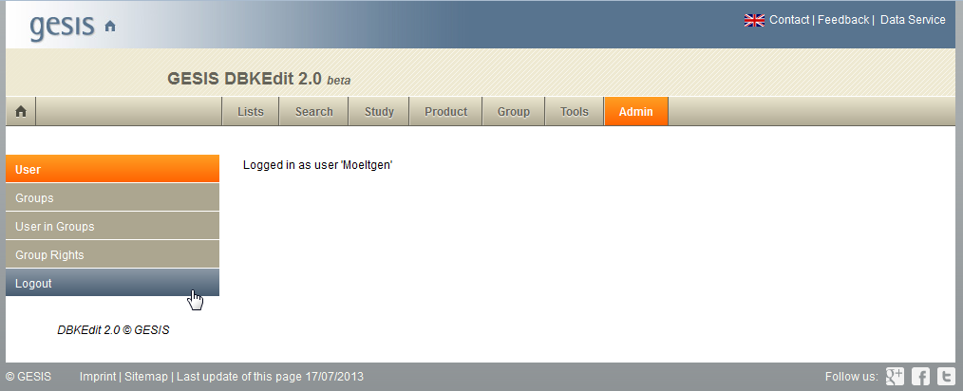

Slide 46
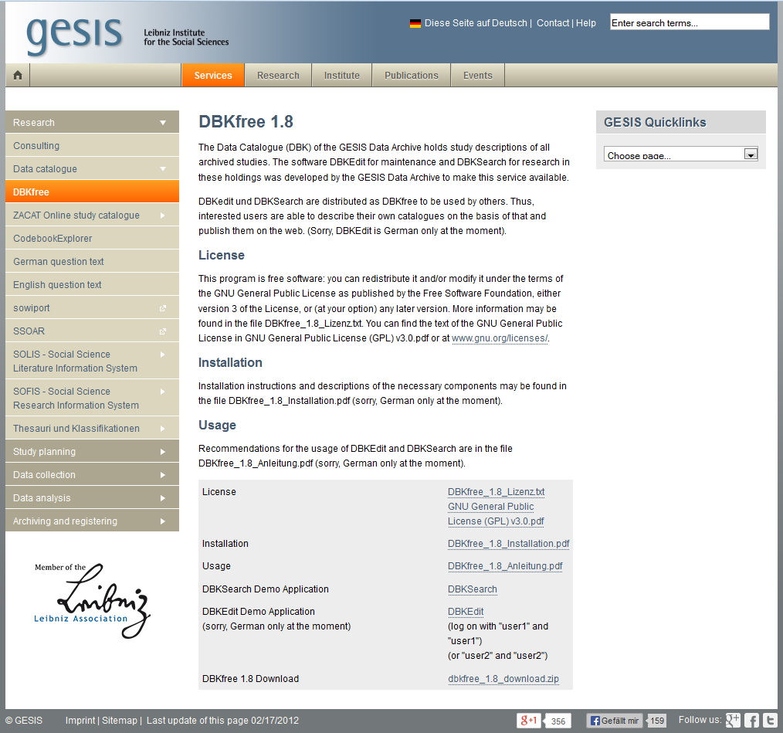
DBKfree Technical & License
ASP Server Pages
IIS 7.5
MySQL 5.6
GNU General Public License (GPL) v3.0
Download the current version 1.8 here:
http://www.gesis.org/en/services/research/data-catalogue/dbkfree/
New version 2.0 will be announced there…

Slide 47
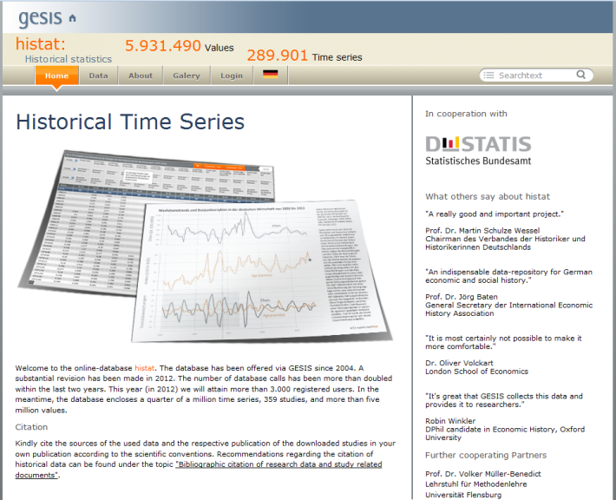
DBK Web Services: DBKWeb
Authenticate
Study_AddGeography
Study_AddPrincipleInvestigator
Study_AddPublication
Study_ClearGeography
Study_ClearPrincipleInvestigators
Study_ClearPublications
Study_Create
Study_CreateVersion
Study_Delete
Study_GetDOIbyVersion
Study_GetNewNumber
Study_SetAbstract
Study_SetAccessClass
To manage basic functions for study descriptions from other applications
SOAP Protocol is used
Example: HISTAT application for Historical Time Series: http://www.gesis.org/histat/

Slide 48
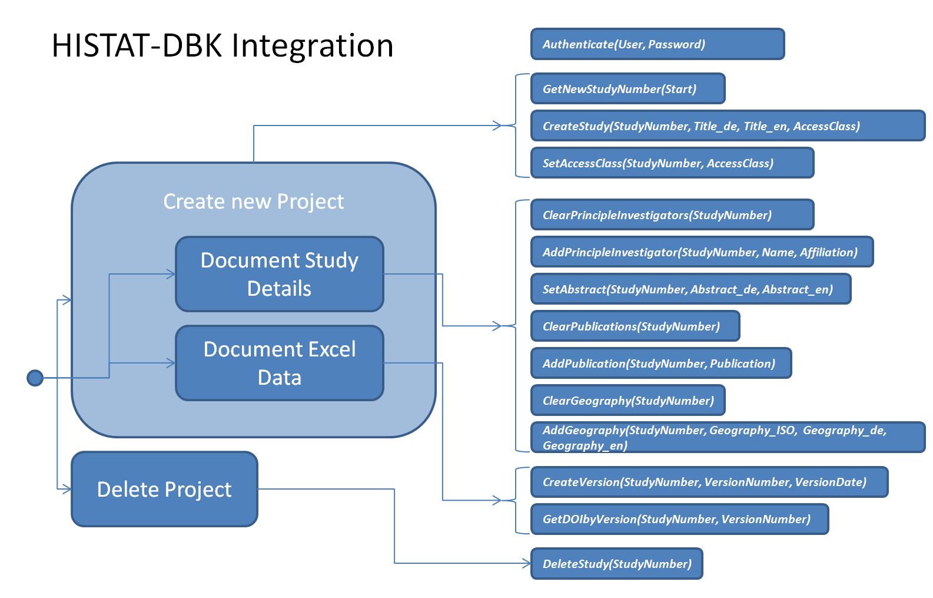

Slide 49
DBK Web Services: DBKDDI
GetStudyList
Study_GetDDI20
Study_GetDDI31
To access DBK DDI-Codebook and DDI-Lifecycle Exports from the web
SOAP Protocol is used
Already available at http://info1.gesis.org/dbkddi/

Slide 50
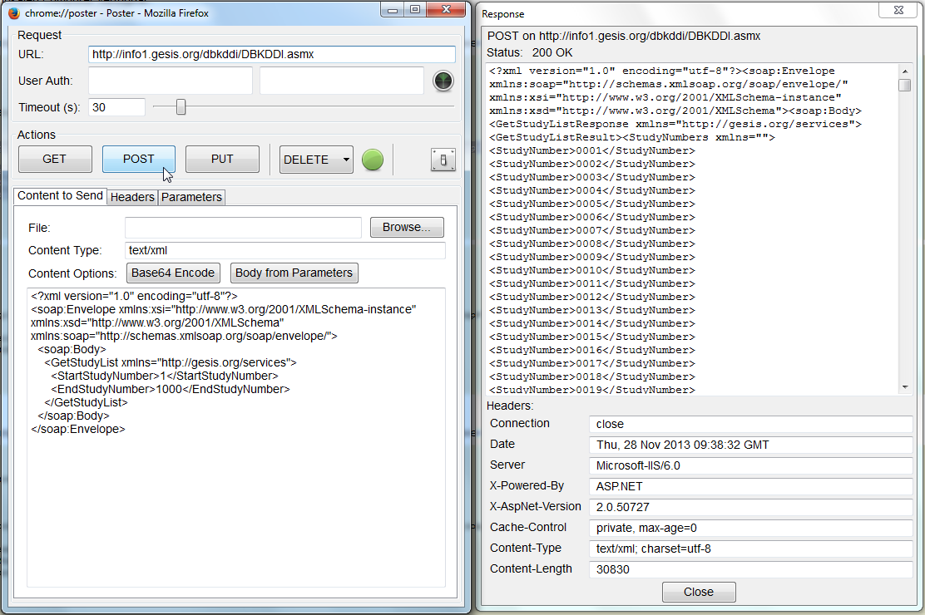

Slide 51
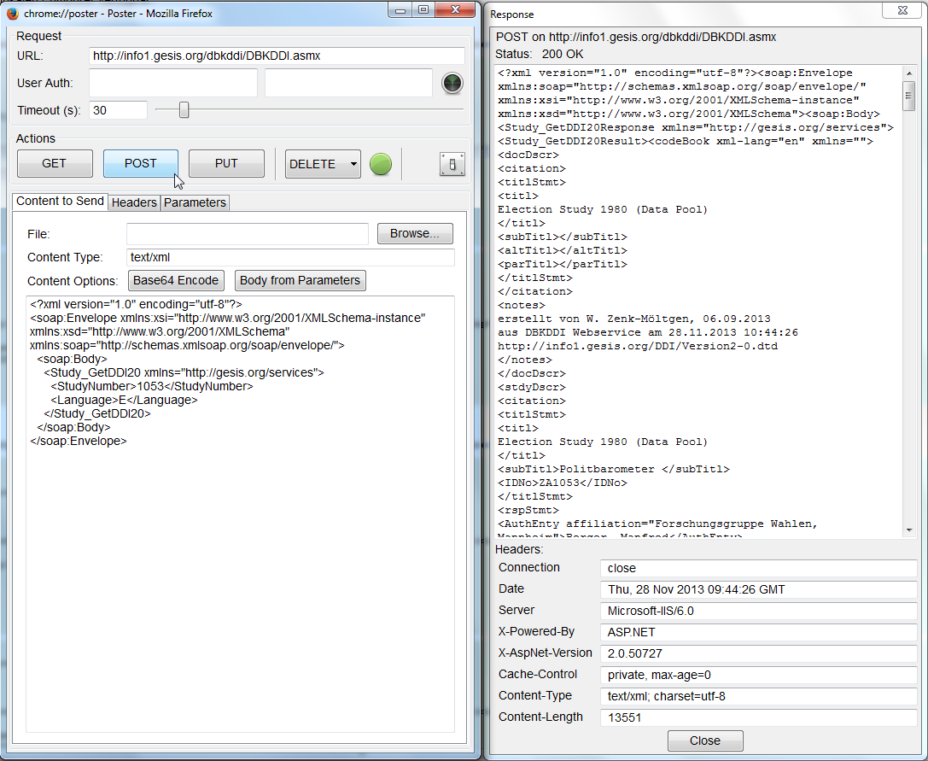

Slide 52
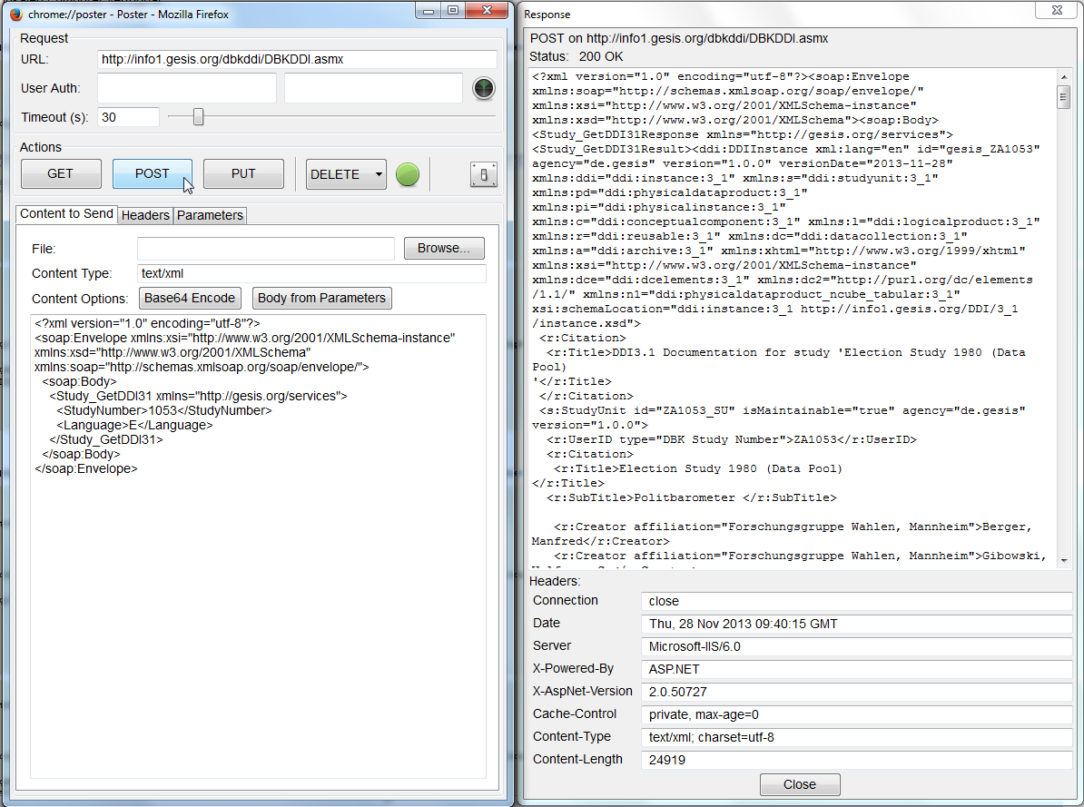

Slide 53
Thank you!
Contact: wolfgang.zenk-moeltgen@gesis.org

