Slide 1
Integrating DDI with metadata for qualitative data: implementing the QuDEx standard
Louise Corti, UK Data Archive
Agustina Martinez, Liverpool John Moores
Daren Bell, UK Data Archive
EDDI13, Paris
December 2013

Slide 2
Digital futures project: rationale & aims
18 month wham-bang capital project
Provide enhanced access to key qualitative data via online data browsing and exploration: UK Quali Bank
Based on existing metadata schemas, known technologies. Oh, and expert consultants
Offer a mechanism for reliably citing data located in the system
Project includes large-scale digitisation of precious and undigitized materials
Maximise the impact from existing research and resource investments – demonstrate re-use

Slide 3
UK Data Service: qualitative data services
We have one of the largest qualitative data collections - over 350 data collections
Currently users find and download these from our website
not so easy to find, but study documentation good
no searching within collections
no file manifest shown until download
can be a bit of guess work!
Have Datacite collection DOIs; cannot cite parts of data

Slide 4
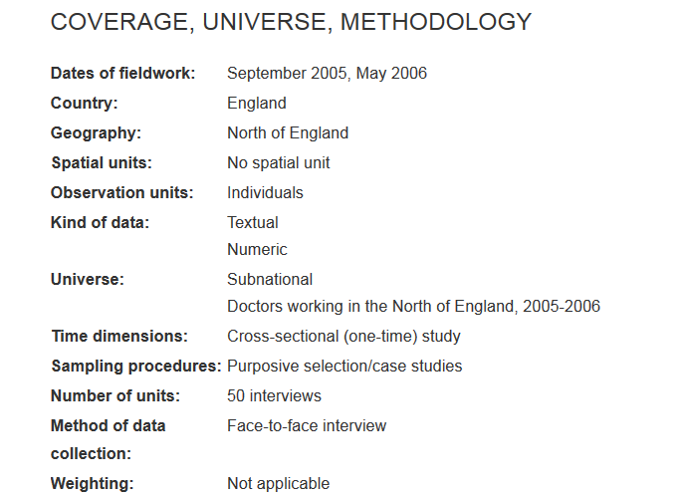
Finding & accessing qualitative data
Search for “health” in our data catalogue, Discover
Retrieve a study-level catalogue record
DDI 2.x very limited for describing file content: no var lists
View limited data list and user guide
Web download as RTF bundle (46 transcripts)

Slide 5
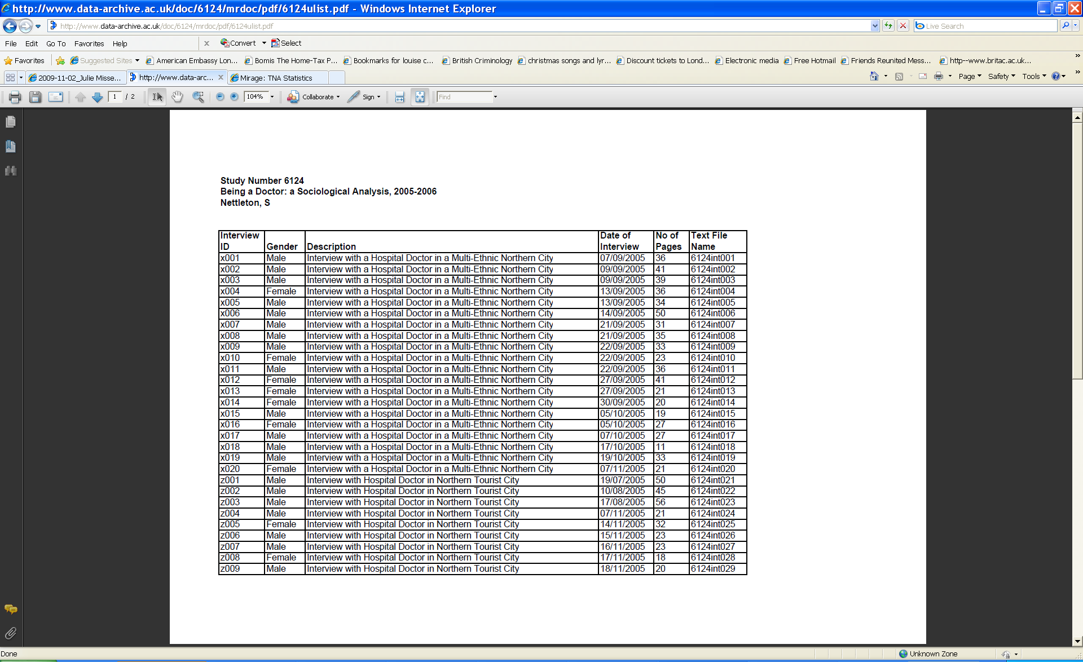
Data listing

Slide 6
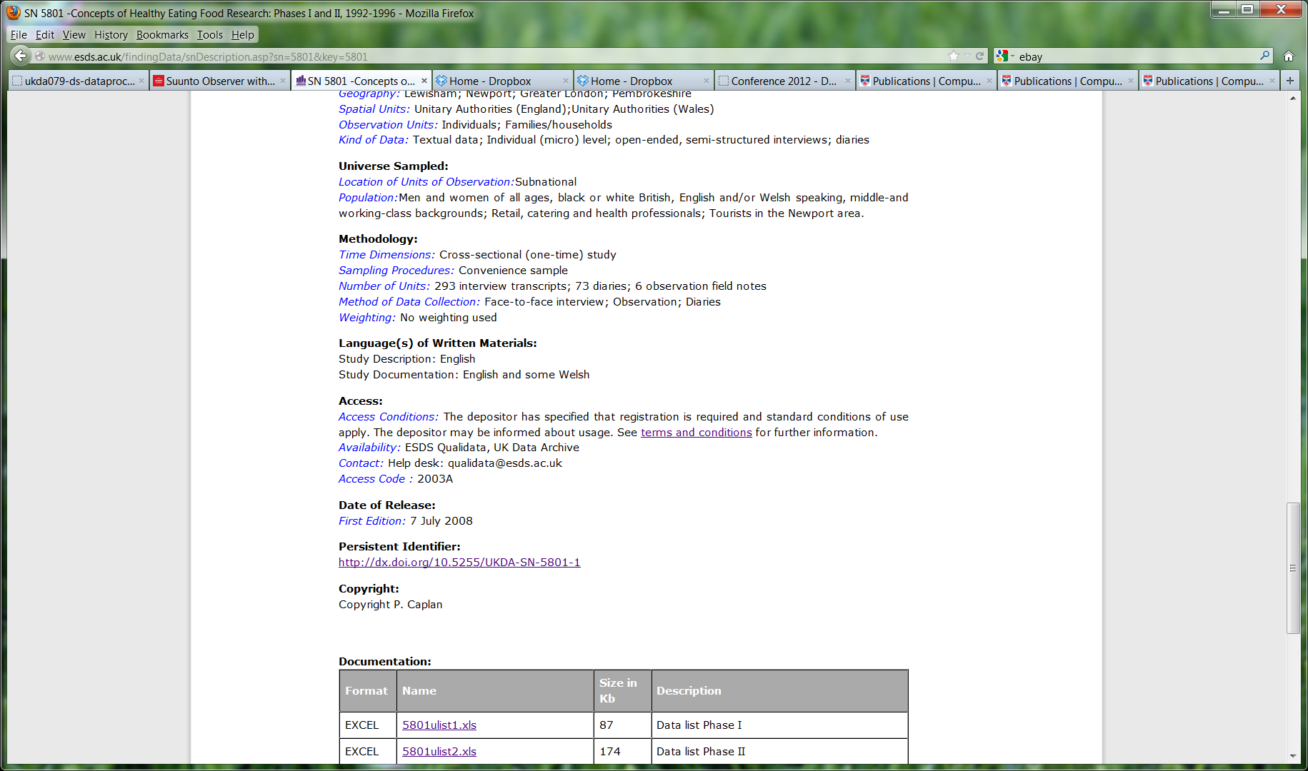
Complex data collections
SN 5801: Concepts of Healthy Eating Food Research: Phases I and II, 1992-1996
293 interview transcripts; 73 diaries; 6 field notes
Not represented well at all in a DDI 2.X catalogue

Slide 7
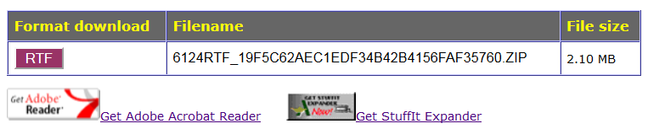
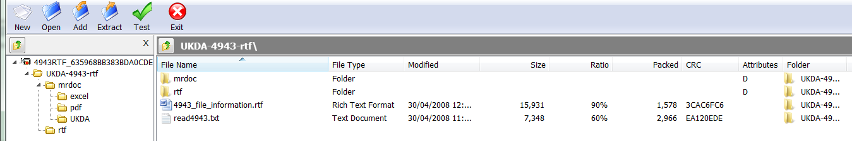
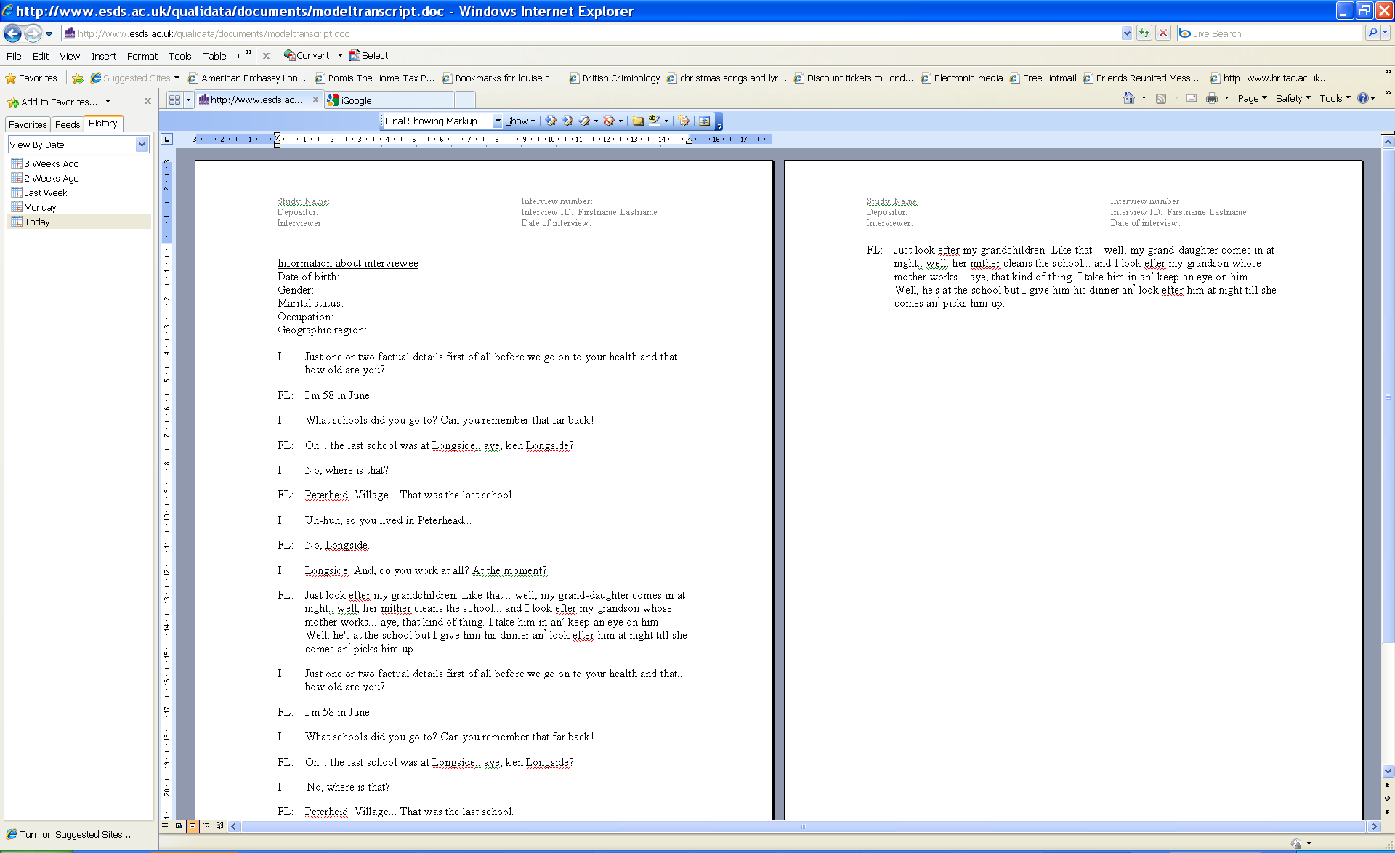
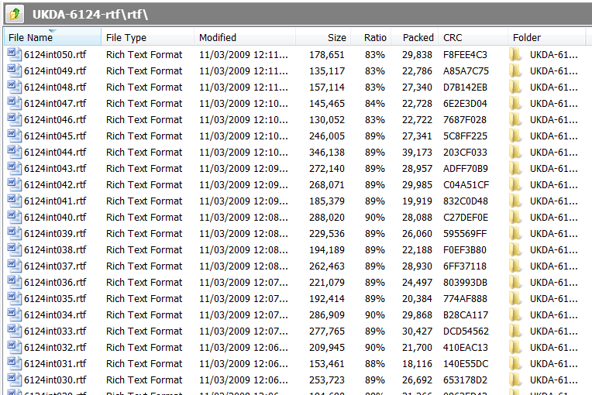
Download Zip of data and doc

Slide 8
Digitisation of key data sources
Selectively digitize paper-based materials:
original survey questionnaires; open ended questions
transcribed interviews
handwritten field notes, essays
diagrams
photographs
Destination formats:
all text files: XML
handwriting/photos/pictures: images as jpeg
multipage non-XMLable docs: images as PDF
audio: mp3

Slide 9
Metadata demands for UK Quali Bank
Discover, locate, retrieve, examine in context, cite
Requires rich descriptive metadata for files
Ability to display and link data objects: text to related audio, images, and other research outputs
Highly structured and consistently marked-up data
Use of common metadata elements enable federated catalogues across providers and borders

Slide 10
Description below the collection
DDI Codebook 2.5 for basic study-level catalogue metadata
QuDEx schema (Qualitative Data Exchange) for rich file-level description, document coding and annotation and intra-collection relationships
Limited use of TEI schema (Text Encoding Initiative) for mark-up of textual data items

Slide 11
QuDEx Overview
XML schema for documenting metadata for qualitative data collections
developed as part of the JISC 2007 Data Exchange Tools (DExT) project – UK Data Archive and MetadataTechnologies
QuDEx is intended to be used as a standard way of encoding metadata for qualitative collections
for exchange between CAQDAS packages
for use within data archives and libraries
for dissemination systems
Allow for describing complex collections of quali data
detailed description at the object level, e.g. interview characteristics, interview setting, type of object etc.
capture relationships between resources (files)
preserve references to annotations performed on data

Slide 12
QuDEx Structure
A qualitative study can be described using a single QuDEx instance (the XML document)
<resourceCollection>
<segmentCollection>
<codeCollection>
<categoryCollection>
<memoCollection>
<relationCollection>
Schema at: www.data-archive.ac.uk/create-manage/projects/qudex/

Slide 13
QuDEx – Resource Collection
Resource collection is broken into two sections, sources and documents:
a <source> describes a physical file of the qualitative data
a <document> is a file available to an application. It is typically a copy of a source, which might have been re-formatted, and it always references its <source>
Each data file included in a data collection has to be described as a pair of <source> and <document> within a study’s QuDEx instance

Slide 14
QuDEx – Category Collection
A <category> is a formal code applied to the qualitative data (usually documents or segments) by the researcher
usually taken from a formal classification or controlled vocabulary
can be applied to documents, segments, codes, memos, or other categories using a <relation>
can be used to group documents directly, by simply listing them
can be arranged in hierarchies

Slide 15
QuDEx – Memo Collection
A <memo> is used to store annotations of data files, e/g those produced by the researcher.
examples include: analytic notes, interview notes, or any richer descriptive information
can be held in the QuDEx document (inline) or stored in an external file (memo source)
can be associated with documents, segments, memos, categories, or codes using a <relation> element

Slide 16
QuDEx – Relation Collection
A <relation> element links a source and target, using a typed relationship
there is a fixed list of typical relationships (i.e. “isPartOf”, “isFormatOf”)
user-defined relationships are also allowed (i.e. by using “otherRelationName” element). E.g. “isTranscriptionOf”, “isAnnotationOf”…
optionally, the type of the relationship can be specified. E.g. “documentDocument”, “categoryDocument”, or “memoDocument”
source and target may be documents, segments, categories, memos, or codes

Slide 17
Use of QuDEx
QuDEx instance is central to the Quali Bank system. It provides:
access to study-level documentation by referencing existing DDI 2.5 documents
data listing for resources included in a collection (by using <sources> and <documents> elements)
attachment of categories to data resources and collection documentation files
specification of data relationships (by using <relation> elements)

Slide 18
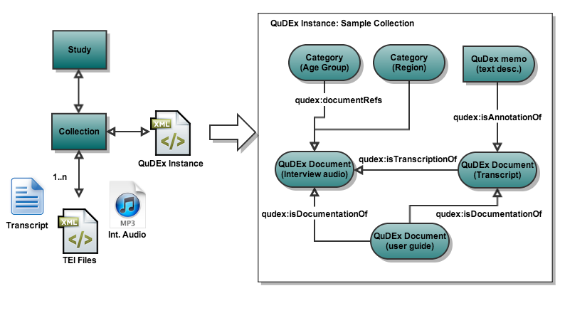

Slide 19
System expectations
Search/browse for data
Search /faceted browse of data - text; image/PDF, audio
Browse
Faceted browse by:
Collection level: title, date and openness
Object level: data type, interview characteristics, location
Search:
Display no. hits and minimal item metadata
Word in paragraph; thumbnail image/pdf; AV link
Context: other related objects, within system or external
Access full object
View data, key metadata and all related files and links
Link to download full collection and user documentation (UKDS)
Get citation for part of data

Slide 20
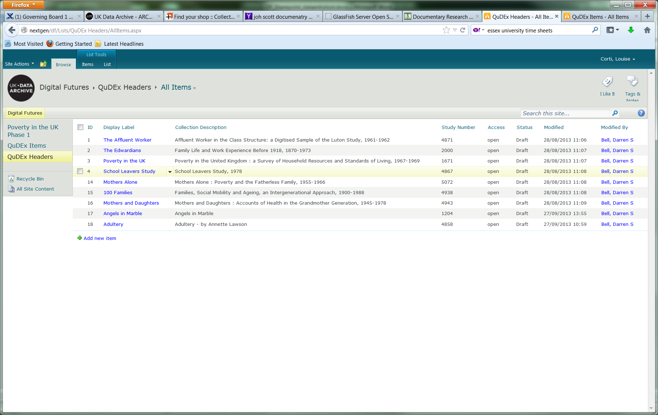
QuDEx collection level metadata
All other collection level metadata held in DDI
DDI references QuDEx file GUID as:
<othrStdyMat>
<relmat ype = “qudex”>GUID</relmat>

Slide 21
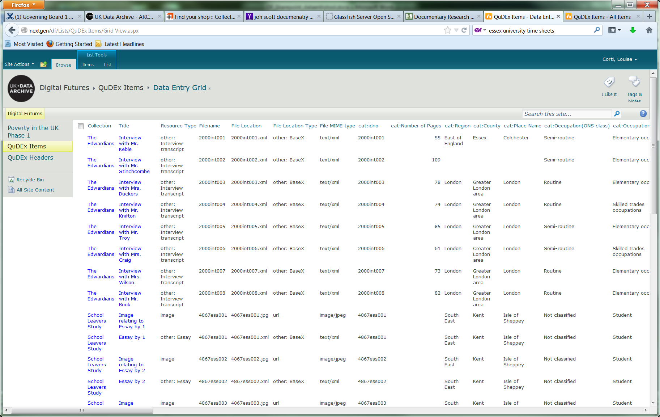
Within collection object metadata

Slide 22
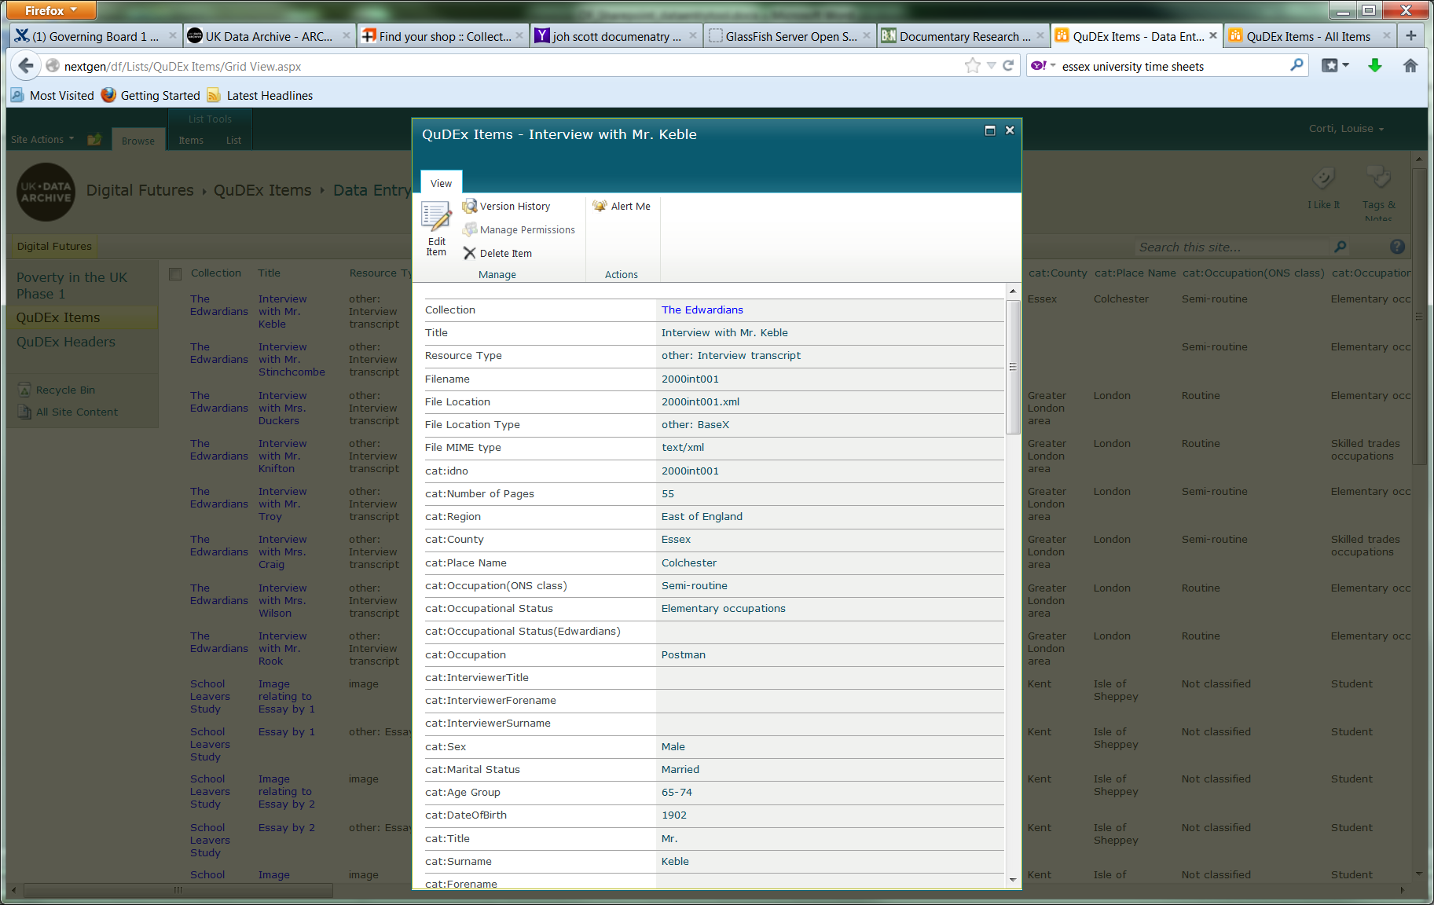
QuDEx Category schema
Available for all collections
Primary core metadata.
Can add to for additional (secondary) metadata
Metadata population - a lot of manual work!
Little that can be automated unless from a linked quant file
Object relations. AutoGenerates converse relation
isTranscriptOf - hasTranscription

Slide 23
Use of Text Encoding Initiative (TEI)
Bespoke TEI schema. Minimal use of TEI tags, from a massive profile
To denote structural mark-up
TEI header: 3 mandatory elements
Body elements: Turn takers, paragraphs, headers
Inline tags: Corrections, errors
Use of unique GUIDs to identify both TEI and QuDEx objects:
Collection, Files, Paragraphs

Slide 24
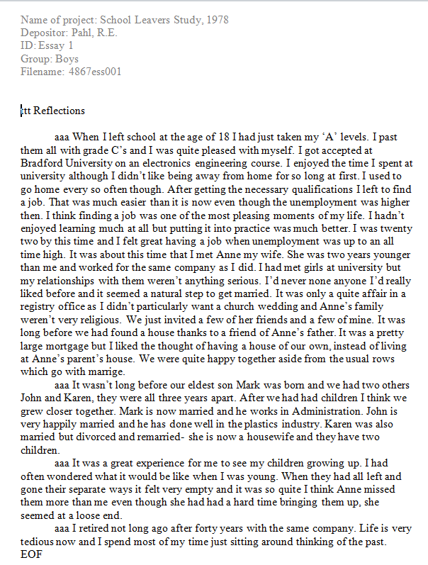
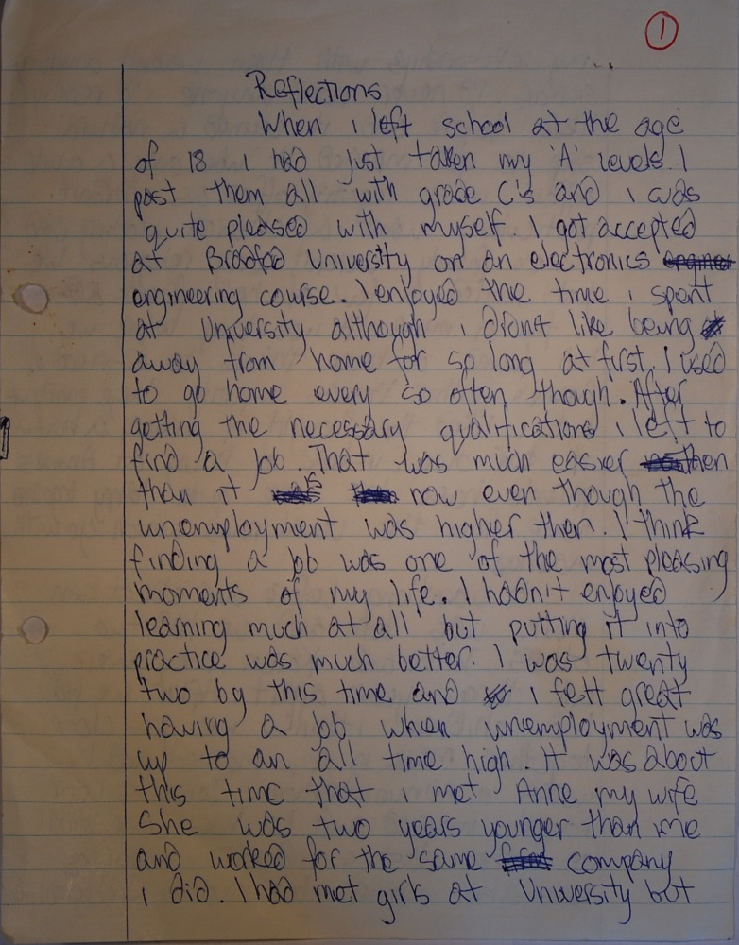
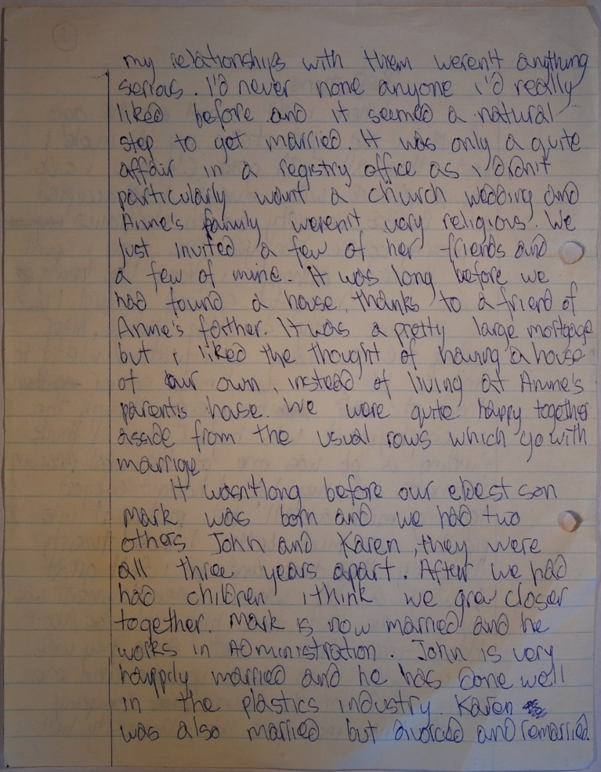
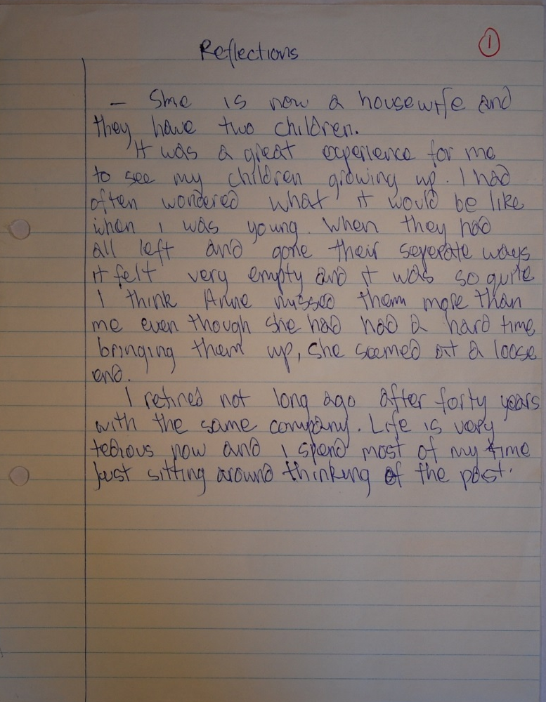
School Leavers on the Isle of Sheppey

Slide 25
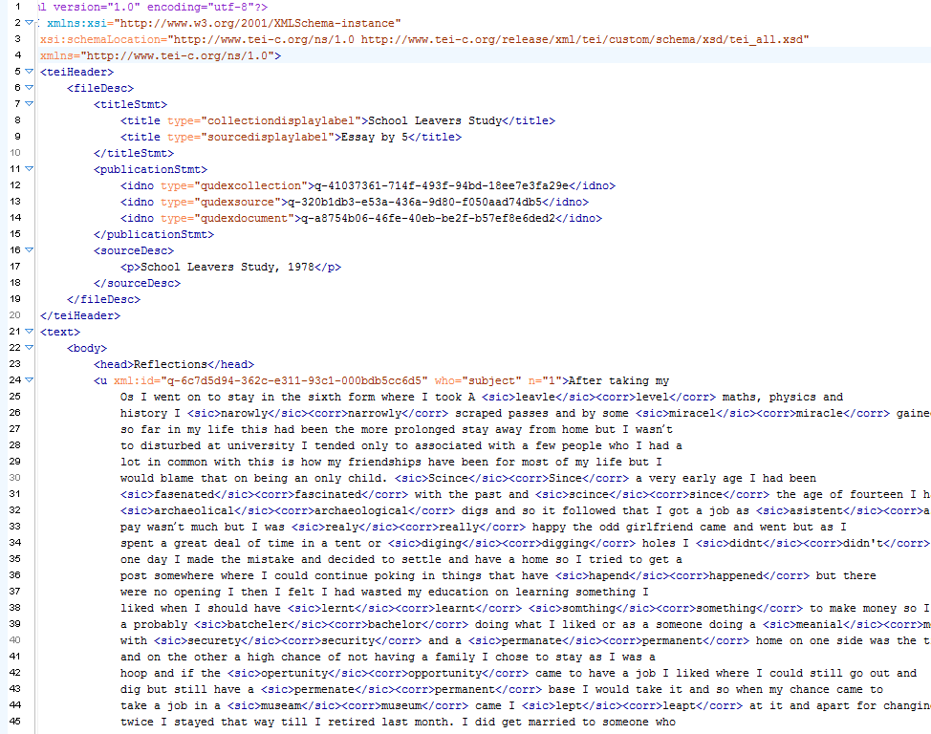
XML: School Leavers on the Isle of Sheppey

Slide 26
System tools
BaseX for metadata and textual data storage and retrieval
DDI 2.5/ DDI Codebook: collection level
QuDEx: Limited collection and object level
TEI: object level - text documents
File server for non-XML docs
Simple QuDEx metadata data entry tool: Sharepoint
C# scripts process and validate against XML schemas;
Oxygen for manual mark-up
Solr indexes used for faceted browsing and TEI text highlighting
Xquery on BaseX for object metadata, text utterances and related materials
GUID generator SQL database for QuDEx and TEI elements
UI in-house technologies .NET and RESTful web services/APIs

Slide 27
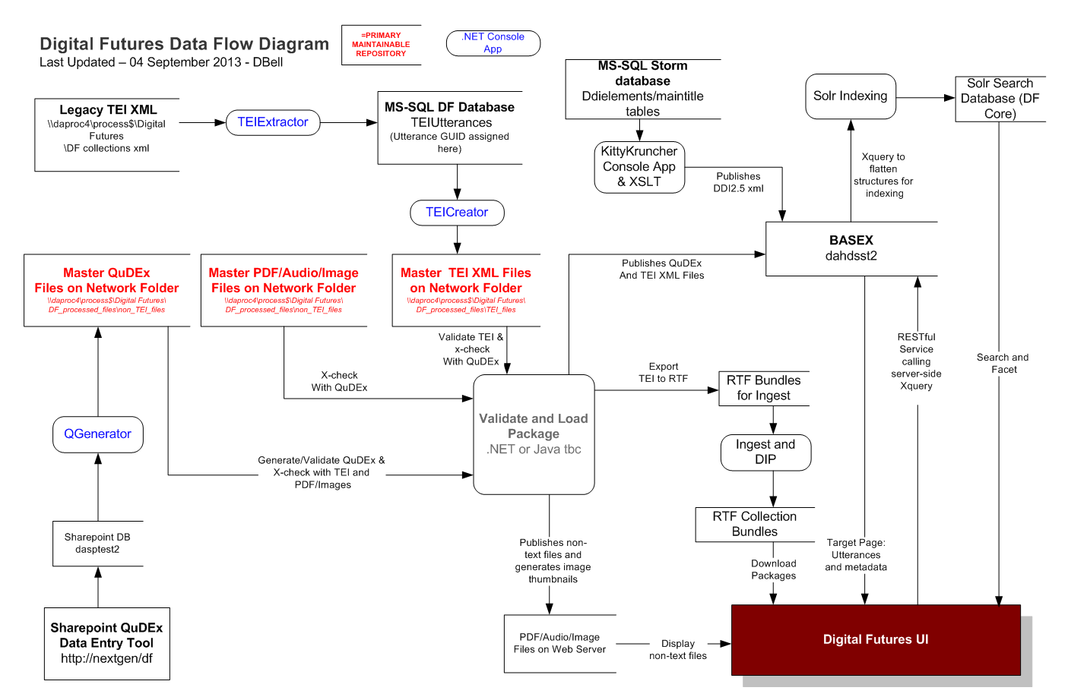
Need streamlined workflow!!

Slide 28
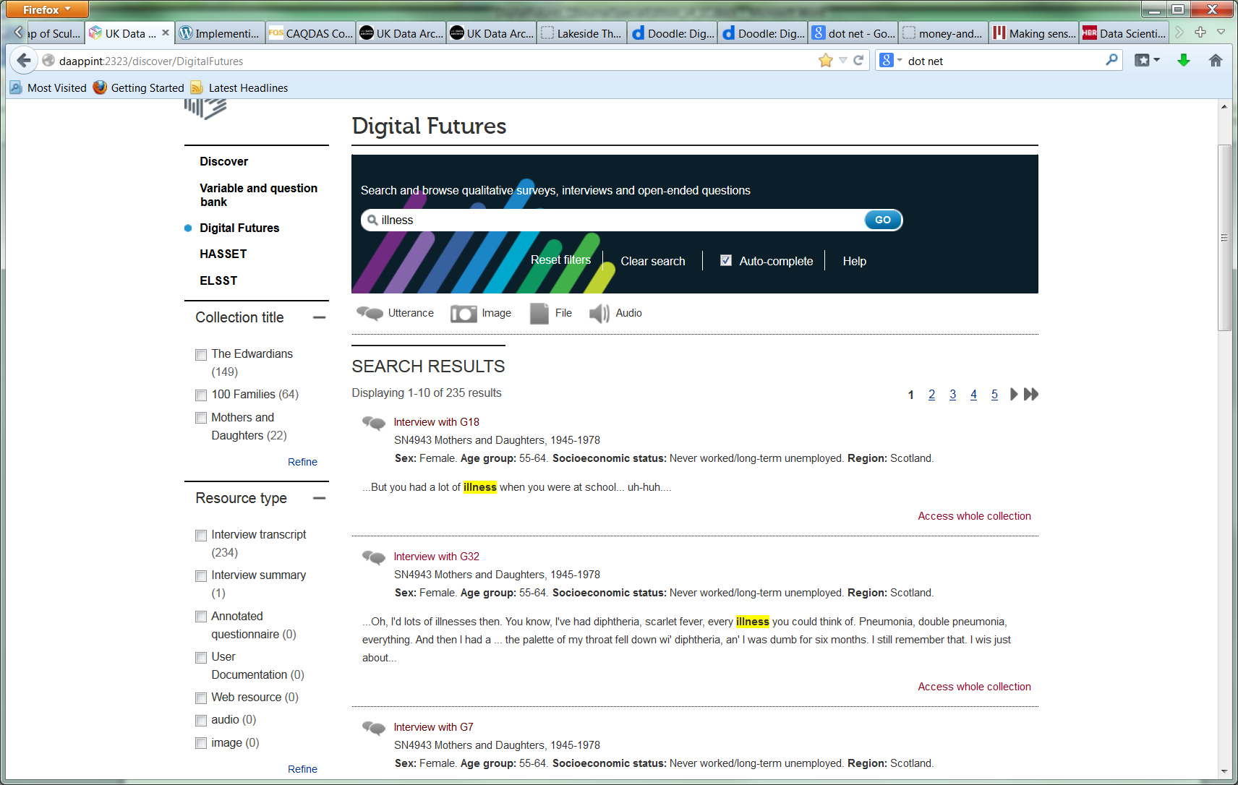
Search interface - hits

Slide 29
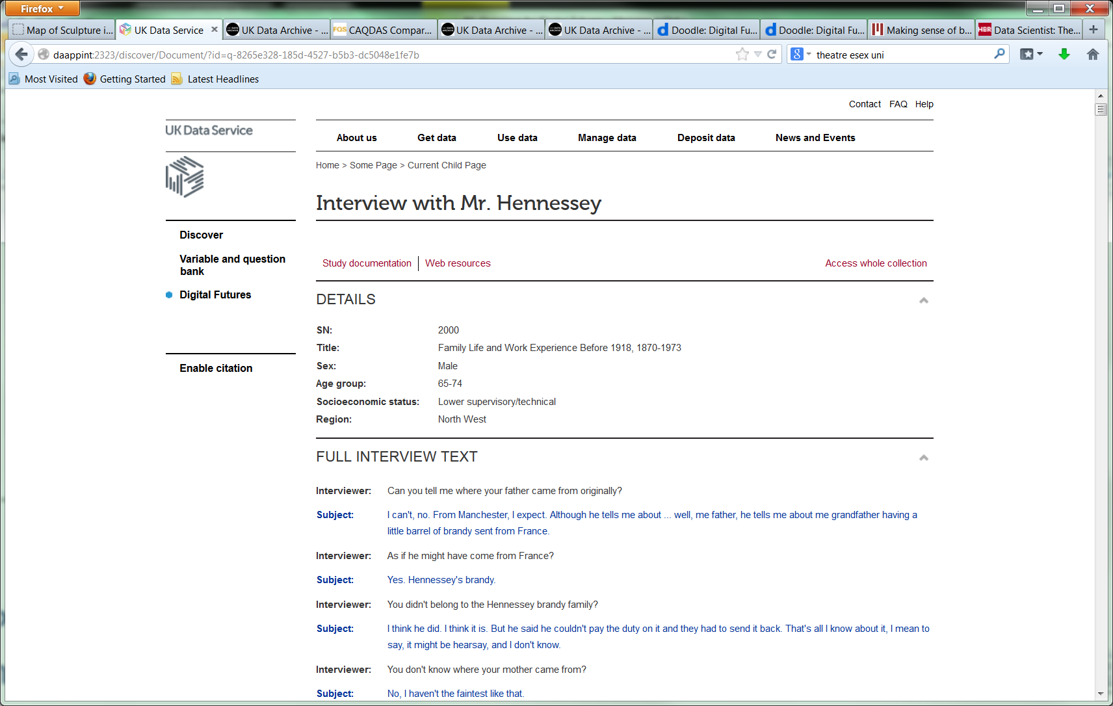
Target page for an interview

Slide 30
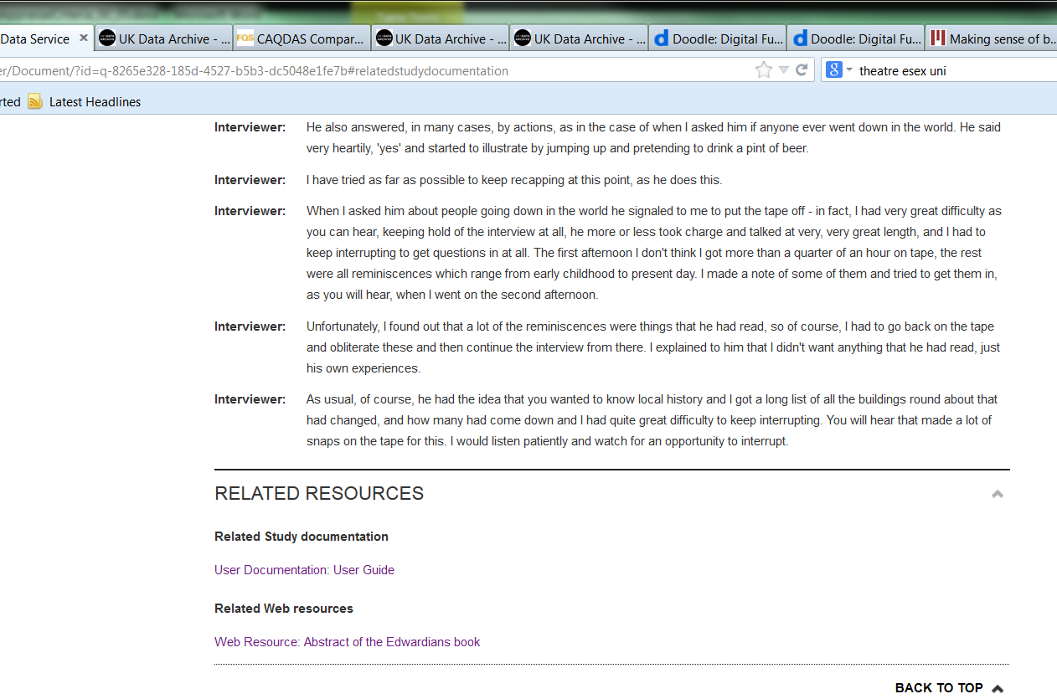
Target references

Slide 31
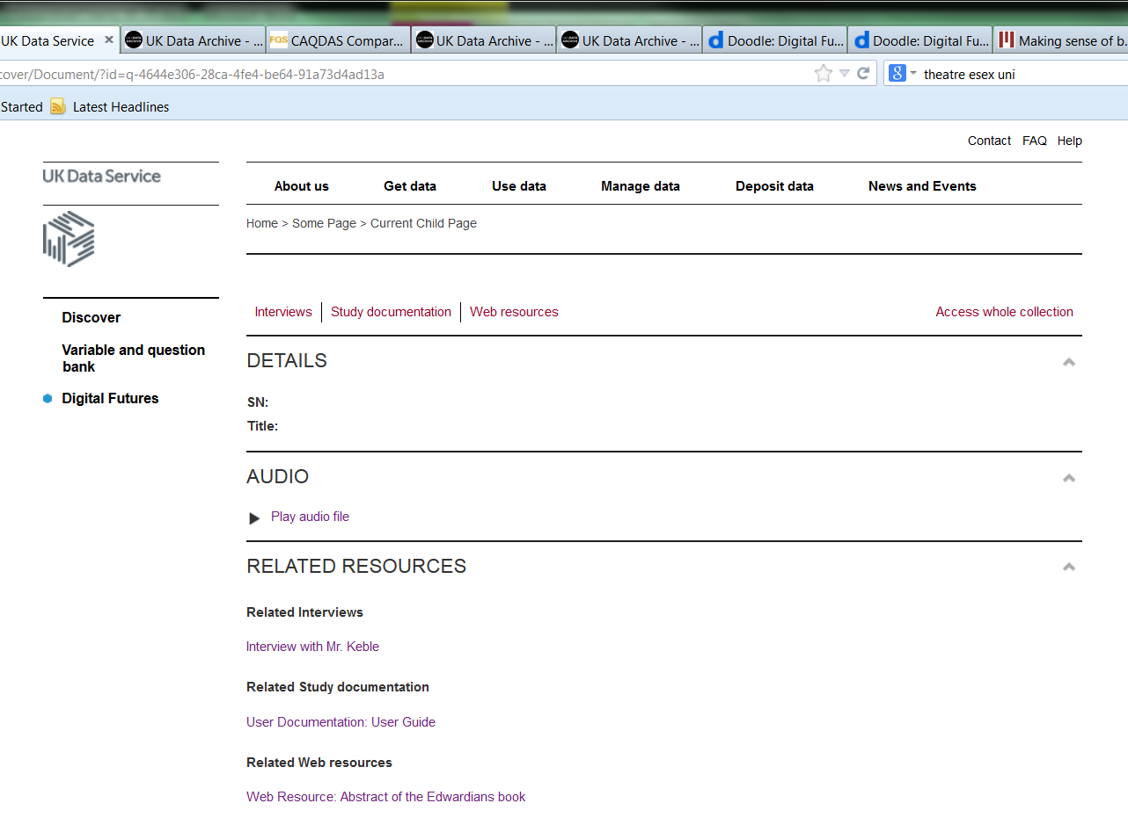
Audio file target page

Slide 32
Citation mechanism
System will enable extract/quotation level citation; 1 or more consecutive paragraphs
Citation object and citation format created on the fly – using GUIDs and system URI
URI resolves directly to the data extract
Some more sensitive collections will be closed, so cannot resolve to data
Will be related to our collection-level DOIs
 | 10.5255/UKDA-SN-6124-1

Slide 33

Citation

Slide 34
Contact details
Louise Corti, corti@essex.ac.uk
Agustina Martinez, a.martinez-garcia@ljmu.ac.uk

