Slide 1


EDDI 2013
5th Annual European DDI User Conference
December 3, 2013 – December 4, 2013
Paris, France
Metadata Technology North America
http://www.mtna.us
http://www.openmetadata.org
mtna@mtna.us

Slide 2
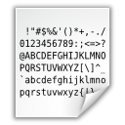



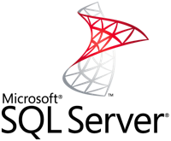









The <Meta>Data Dance

Slide 3

The <Meta/>Data Dance

Slide 4
The <Meta>Data Dance

Slide 5
Tools to facilitate statistical/scientific data management
Complement existing tools (not replace)
Facilitate adoption of standards and promote best practices
Alleviate the need to master complexities of metadata standards, technologies
Vision: web based services (cloud users), stand alone desktop /server products (agencies/enclaves), libraries (developers)
Broad Target audience: Data Producers / Manager / Researchers / Users
DataForge Today (lean model):
Simple desktop based tools
SledgeHammer - Data/metadata transformation
LavaCore - Java library
Caelum - Reporting / Publication
Asmurex: ASCII Multi-Record Exctraction tool
DataForge Tomorrow:
DataForge Online, Web Services, Desktop w/UI, Java Library

Slide 6

__ _ _
/ _\| | ___ __| | __ _ ___ /\ /\__ _ _ __ ___ _ __ ___ ___ _ __
\ \ | |/ _ \/ _` |/ _` |/ _ \/ /_/ / _` | '_ ` _ \| '_ ` _ \ / _ \ '__|
_\ \| | __/ (_| | (_| | __/ __ / (_| | | | | | | | | | | | __/ |
\__/|_|\___|\__,_|\__, |\___\/ /_/ \__,_|_| |_| |_|_| |_| |_|\___|_|
|___/
Data Liberation
Unlock from proprietary formats, turn into open data
Produce metadata + convert data into standard ASCII formats
Open <Meta>Data Integration
Generating scripts for loading into stats packages, databases, big data engines, cloud
Use with open systems / environments

Slide 7







script
triple-s

Slide 8
Challenges
Read proprietary formats
Data integrity
ASCII optimization
Cross package formatting issues
SQL Database limits (columns, indexes, views)
Performance (Timings, size, memory usage)
…

Slide 9
Key Features
Input: SPSS, Stata, SAS/Syntax+ASCII, ASCII+DDI-C / DDI-L, ASCII+SSS 1.1/2.0, ASCII+StatTransfer
Data Out: Fixed w/optimization, CSV, Delimited
Metadata Out: DDI-C 1.2.2/Nesstar/2.1/2.5, DDI-L 3.1-RP/3.1-SU/Colectica, DDI-L 3.2-RP, DDI-L 3.2 SU, Triple-S 1.1/2.0
Summary Stats: Min / Max /Valid/Invalid /Mean, StdDev /Variance / Frequencies, Weighted *, Save in CSV*.
Scripts Generators: SAS, SPSS, Stata, R, Mysql, Oracle*, MS-SQL*, HSQL*, Google BigQuery*, HP/Vertica* + dimension/lookup tables, indexes/foreign keys*
Command line interface
See User’s Guide at http://goo.gl/9xukB

Slide 10
Key changes since IASSIST 2013
Desktop User Interface
SAS (Win+DSRead), handling of missing values, DDI 3.2, lots of tweaks
Editions
Freeware
Community: 100 variables / 1,000 obs.
Registered (free): 500 variables / 5,000 obs. (or contact us)
Available today (Candidate Release)
Pro/Enterprise (1Q2014)
No data size limits
Weighted stats, save stats, classification auto-harmonizer, batch mode, add database formats & star schema
Subscription: $29/3-month or $99/year , Perpetual: $279
LavaCore:
Currently internal only, planning for OEM

Slide 11
Future Features (demand driven)
Support additional input/output formats
Additional ID generators
DataWeaver (data transformation)
Produce data subset
Synthetic data generators
Disclosure control
DataForge Online (2014)
Free and pay as you go services
DataForge Services (available today)
Community support in Google groups
MTNA: pay as you go / annual support, custom developments
IDMS: data/metadata management / processing

Slide 12
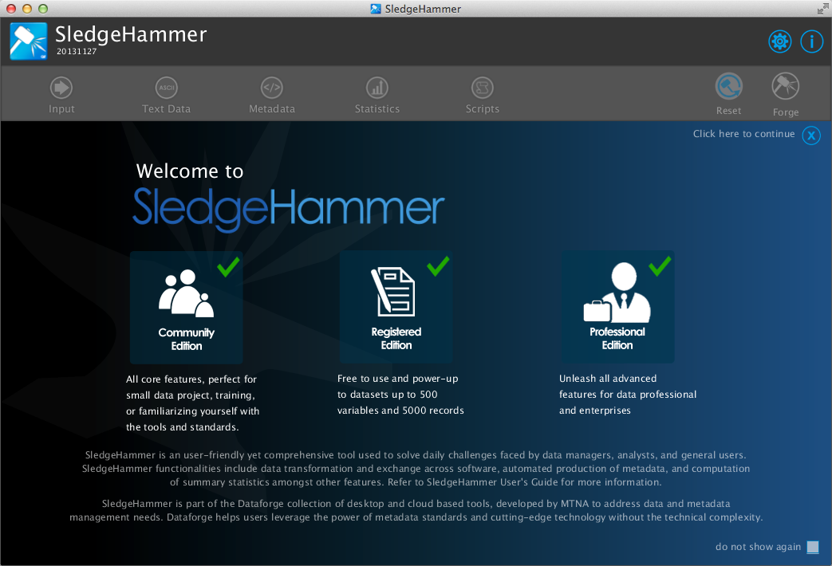
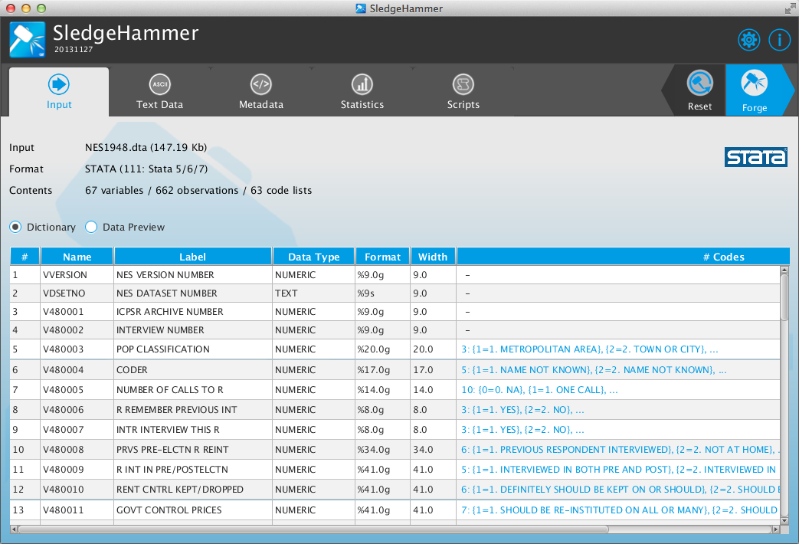
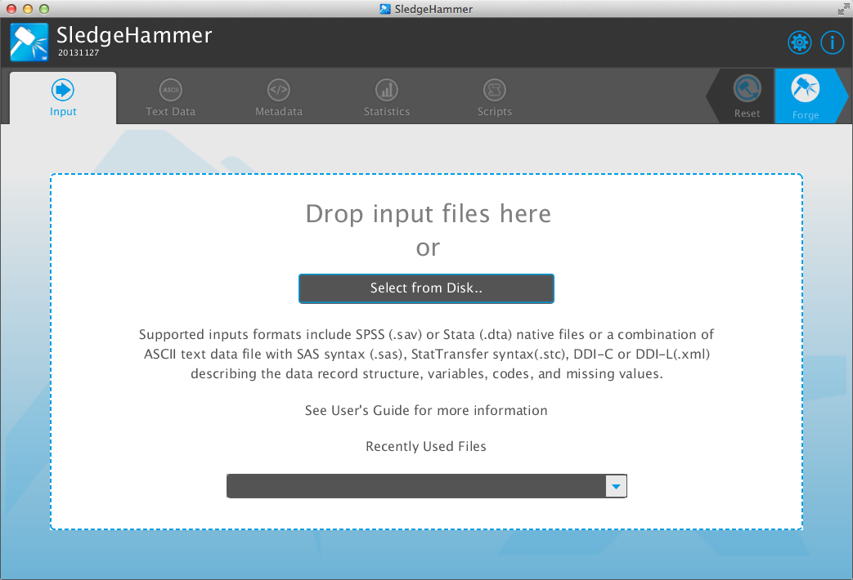
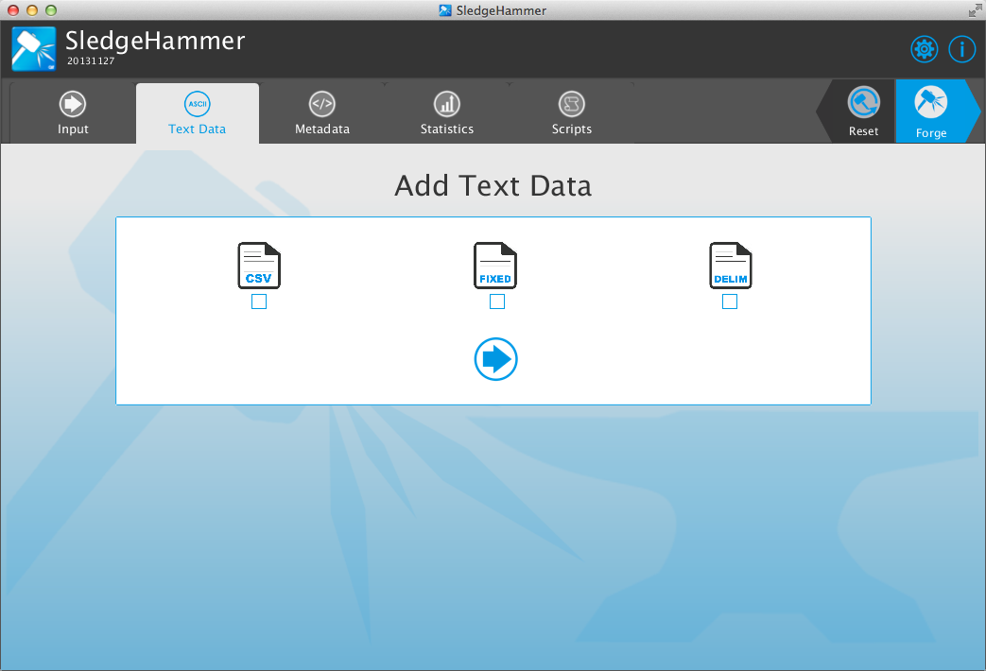
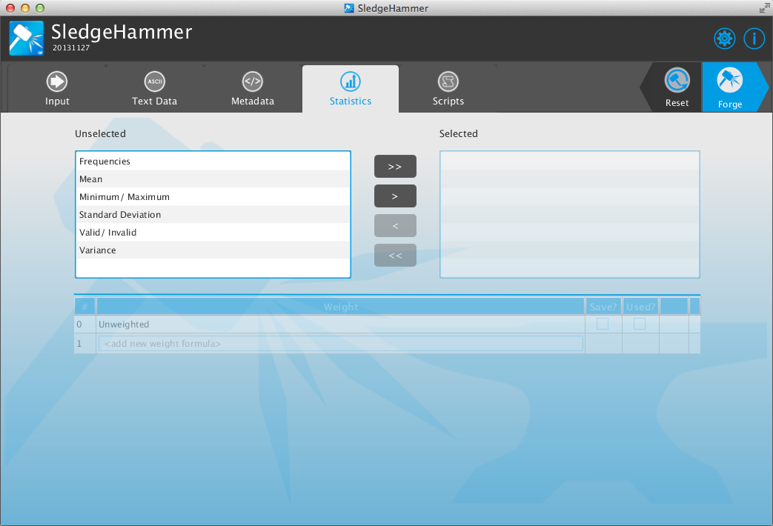
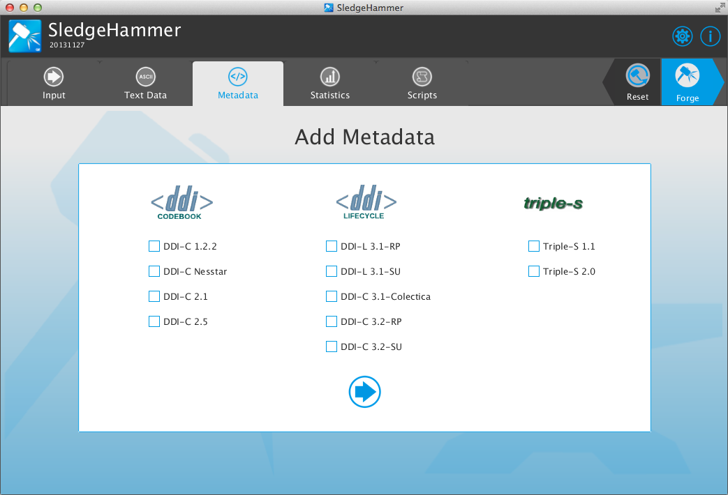
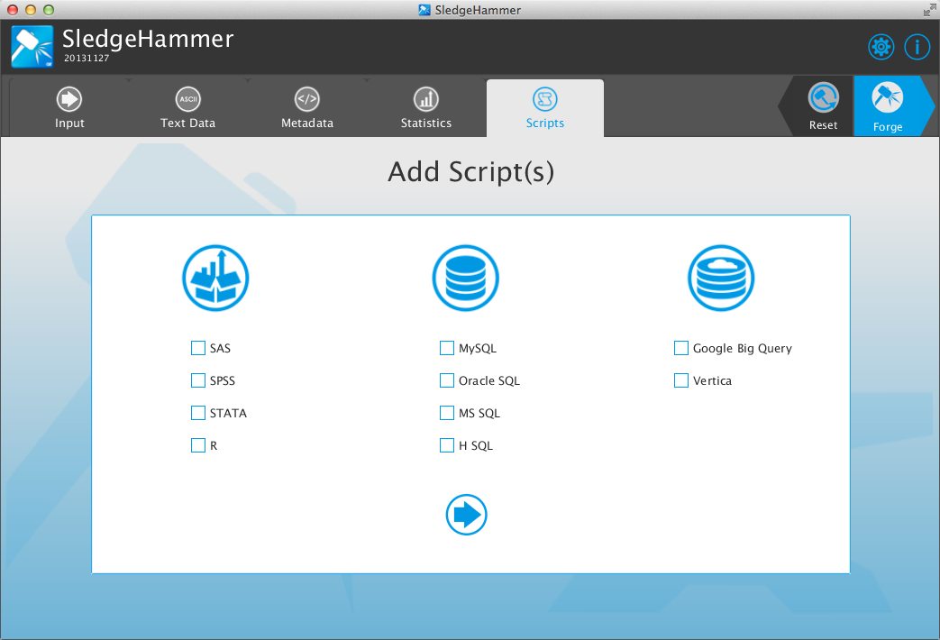

Slide 13





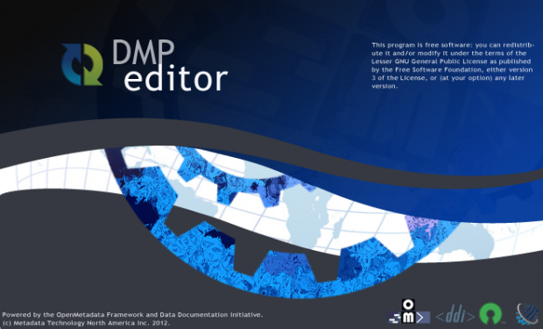

Products
SledgeHammer
Data/metadata
Management
(free/paid)
Caelum
Documentation
XML Transform
(free)
DataWeaver
Data subsets, derivation, transforms
(internal/project)
Asmurex
ASCII multi record
Extraction
(free)
SledgeHammer--BI
Integration with Business Intelligence
(internal/projects)
Survey Manager
DDI 3.1 Editor for simple projects or training
(OSS)
DMP Editor
Simple editor for Data Management Plan
(OSS)
CMS
Classification Management System
(2014Q3 / paid )

Slide 14




Services
Expertise
Development
Expert Advisory and Technical Assistance
Establishment of corporate data management strategies
Adoption of metadata standards and related best practices
Development of technical specifications for data management infrastructure
Statistical and scientific data management technologies
Application Development
Statistical and Scientific data management solutions
Solutions include production, archiving, dissemination, analysis
Web-based data delivery solutions (web services, portals, secure environments)
Standards-based data management tools/utilities
Training
Technologies
Training in and Support for:
Data Documentation Initiative (DDI)
Statistical Data and Metadata Exchange (SDMX)
Generic Statistical Business Process Model (GSBPM)
Generic Statistical Information Model (GSIM)
General data and metadata management support
Leverage New Technologies
Help introduce new state-of-the-art technologies to the community and customers
Deployment, hosting, and management of cloud-based infrastructures

Slide 15
http://www.openmetadata.org/dataforge/sledgehammer
DEMO

