Slide 1
Data and Metadata Management: A Business Perspective
Wendy Thomas – Minnesota Population Center
Marcel Hebing – German Socio-Economic Panel Study (SOEP), DIW Berlin
EDDI 2013
EDDI-2012_Business by Wendy Thomas and Marcel Hebing is licensed under a Creative Commons Attribution-NonCommercial\\\\-ShareAlike 3.0 Unported License.

Slide 2
Credits
Slides created by Wendy Thomas and Marcel Hebing
Slides footnoted with a deck number (i.e., S11):
The slides were developed for several DDI workshops at IASSIST conferences and at GESIS training in Dagstuhl/Germany
Major contributors
Wendy Thomas, Minnesota Population Center
Arofan Gregory, Open Data Foundation
Further contributors
Joachim Wackerow, GESIS – Leibniz Institute for the Social Sciences
Pascal Heus, Open Data Foundation
Attribute: http://creativecommons.org/licenses/by-sa/3.0/legalcode

Slide 3
PART I
Introduction to DDI

Slide 4
Welcome and outline
Introduction to DDI

Slide 5
Outline
Introduction to DDI
Welcome
DDI in 60 Seconds
Processes
DDI-Standard
Tools
Codebook and Lifecycle
Advanced Topics
DDI-L in Detail
Schemes and Reuse
Building a codebook
Capturing a process
Questionnaire
Discovery & Comparison
Questions & Conclusion

Slide 6
Introductions
Who are you?
What does your organization do?
Data collection
Data production
User access
Preservation
What is the scale of your operations?

Slide 7
Changes in the environment:
Expanded access to data
Data available through multiple portals
Cross portal access
Linking and layering of data from different sources and different disciplines
Cost of developing system specific software
Cost of non-interoperability over the life of the data

Slide 8
The Challenge
In a large organization, there are many different streams of data production
“Silos” tend to emerge, each with a different set of systems and processes
This makes the management of data, metadata, and the production process very difficult – the different systems/silos don’t interoperate easily
It is difficult to realize the vision of “industrialized” data production, with its attendant efficiencies

Slide 9
Why Such a Mess?
Everyone thinks their data are special
And they are right – they are special…
They’re just not as special as they think!
The point is that good IT solutions for data management can be built on the basis of the similarities across the silos
Computers can’t think!
They manipulate the structural aspects of data
The structural aspects of data are the same

Slide 10

Ddi 3 in 60 seconds
Introduction to DDI

Slide 11
using
Study
Survey
Instruments
measures
made up of
about
Concepts
Questions
Universes
Copyright © GESIS – Leibniz Institute for the Social Sciences, 2010
Published under Creative Commons Attribute-ShareAlike 3.0 Unported

Slide 12
Categories/
Codes,
Numbers
with values of
Questions
Variables
collect
made up of
Responses
Data Files
resulting in
Copyright © GESIS – Leibniz Institute for the Social Sciences, 2010
Published under Creative Commons Attribute-ShareAlike 3.0 Unported

Slide 13
processes
Introduction to DDI

Slide 14
Looking at your organization
What activities take place and what materials do they involve?
What specific processes take place and in what order?
Which processes produce metadata of what type?
What are the critical activities or processes?
What do you control?

Slide 15
Traditional Process Model
Environment
Process
INPUT
OUTPUT

Slide 16
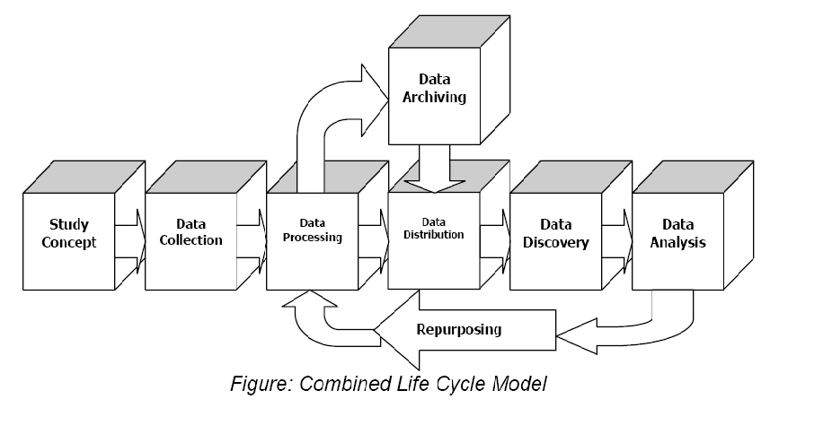
DDI Lifecycle Model
Metadata Reuse
Notes:
16

Slide 17
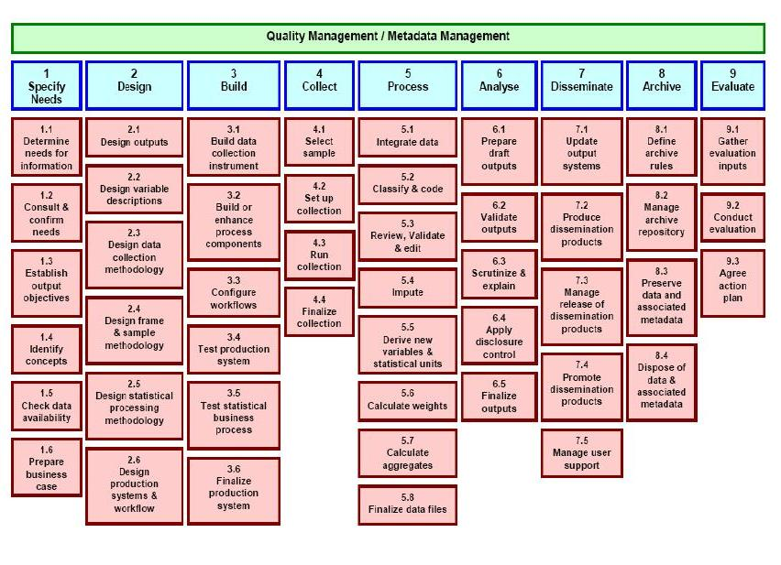

Slide 18
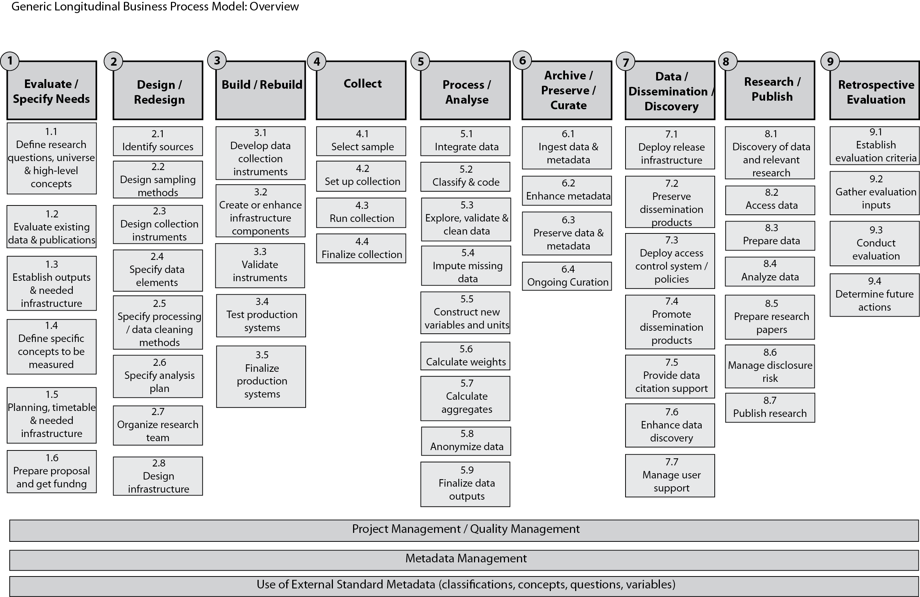

Slide 19
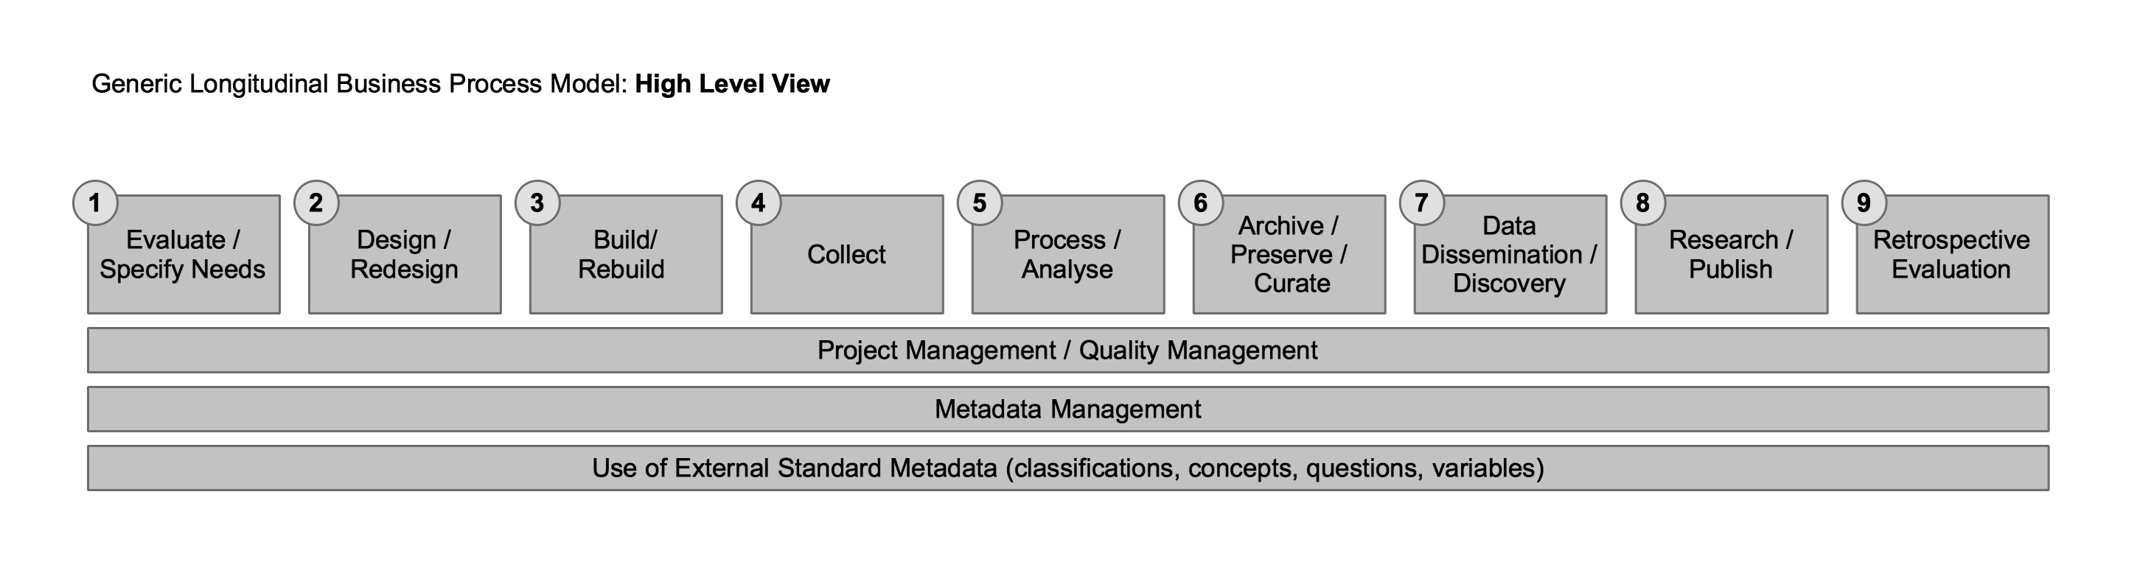
Note the similarity to the DDI Combined Lifecycle Model
and the top level of the GSBPM

Slide 20
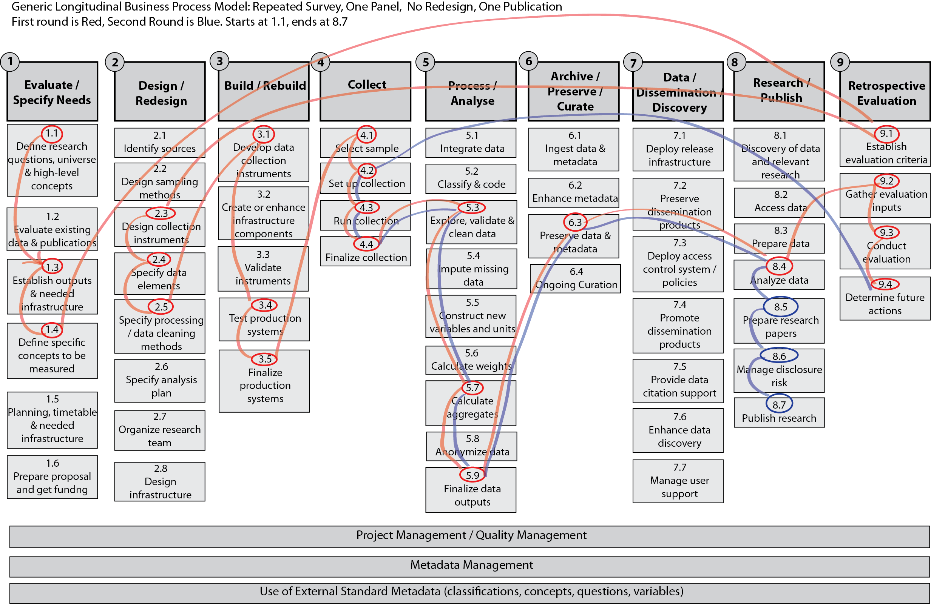

Slide 21
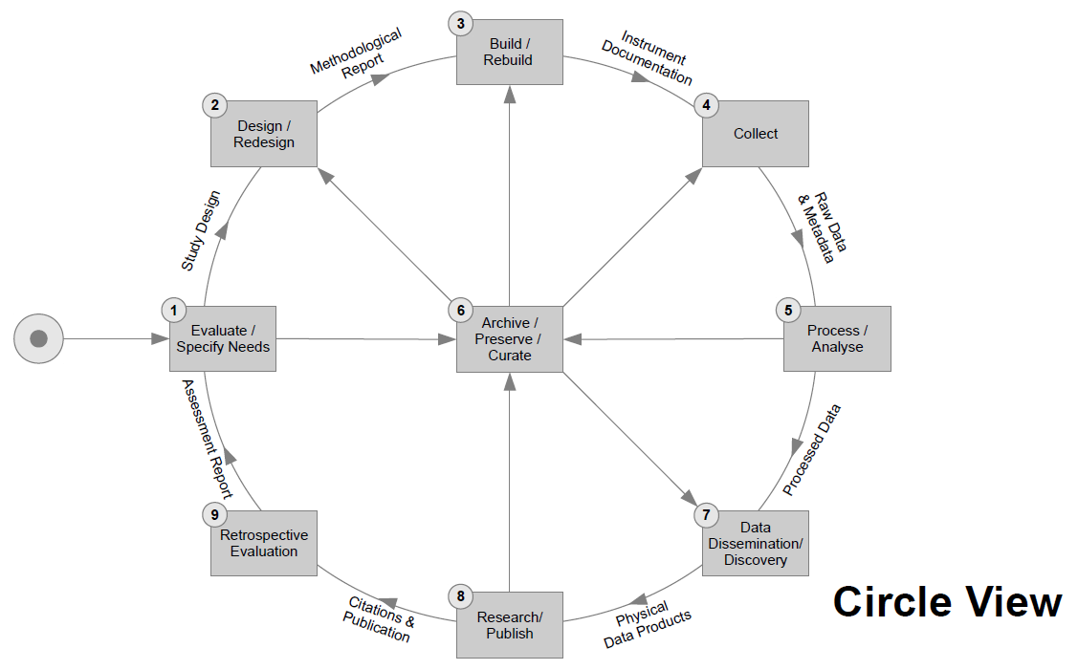

Slide 22
The ddi-standard
Introduction to DDI

Slide 23
What Is DDI?
An international specification for structured metadata describing social, behavioral, and economic data
A standardized framework to maintain and exchange documentation/metadata
DDI metadata accompanies and enables data conceptualization, collection, processing, distribution, discovery, analysis, repurposing, and archiving.
A basis on which to build software tools
Currently expressed in XML – eXtensible Markup Language

Slide 24
History
1995 -- First international committee established
2000 -- First DDI version published (aligned with codebooks, XML DTD-based)
2003 – DDI 2 published (support for aggregate/tabular data and geography added)
2003 -- Formation of the DDI Alliance, a self-sustaining membership organization
2008 – DDI 3 published (aligned with data lifecycle, XML Schema-based)
2010 – DDI rebranding – DDI Codebook (DDI 2 branch) and DDI Lifecycle (DDI 3 branch) development lines
Today – DDI Moving Forward

Slide 25
XML Elements
<Book>
<Title>
The Hitchhiker's Guide to the Galaxy
</Title>
<Author>
Douglas Adams
</Author>
<Year>
1979
</Year>
</Book>

Slide 26
XML Attributes
<Book language=“English”>
<Title>
The Hitchhiker's Guide to the Galaxy
</Title>
<Author>
Douglas Adams
</Author>
<Year>
1979
</Year>
</Book>

Slide 27
Conflicting Tag Names
<MyData>
<Table>
<Legs>4</Legs>
<Length units="feet">5</Length>
<Width units="feet">3</Width>
</Table>
<Table>
<Rows>4</Rows>
<Columns>3</Columns>
</Table>
</MyData>

Slide 28
<MyData
xmlns:kitchen=“http://www.example.org/kitchen”
xmlns:data=“http://www.example.org/data”>
<kitchen:Table>
<Legs>4</Legs>
<Length units="feet">5</Length>
<Width units="feet">3</Width>
</kitchen:Table>
<data:Table>
<Rows>4</Rows>
<Columns>3</Columns>
</data:Table>
</MyData>
<MyData
xmlns:kitchen=“http://www.example.org/kitchen”
xmlns:data=“http://www.example.org/data”>

Slide 29
DDI and XML
<DDIInstance>
<StudyUnit> ... </StudyUnit>
<ResourcePackage>
<QuestionScheme>...</QuestionScheme>
<VariableScheme>...</VariableScheme>
<ConceptScheme>...</ConceptScheme>
<PhysicalInstance>...</PhysicalInstance>
</ResourcePackage>
</DDIInstance>

Slide 30
tools
Introduction to DDI

Slide 31
Tools and Standards
Tool A
Tool B
Tool C
Tool D

Slide 32
Tools and Standards
Tool A
Tool B
Standard
Tool C
Tool D

Slide 33
Examples
Missy
IHSN (NADA)
Questasy
Nesstar
Colectica
Stat/Transfer
DDI on Rails

Slide 34
Codebook and lifecycle
Introduction to DDI
… and moving forward

Slide 35
Formerly known as…
DDI 2 → DDI Codebook → DDI-C
DDI 3 → DDI Lifecycle → DDI-L

Slide 36
DDI Codebook
Parts:
Document Description
Study Description
File Description
Variable Description

Slide 37
DDI Codebook
From a developer`s perspective:
Clear design
Easy to implement
Interoperability is realistic

Slide 38
DDI Lifecycle Model
Metadata Reuse
Notes:
38

Slide 39
DDI Lifecycle Features
Machine-actionable
Modular and extensible
Multi-lingual
Aligned with other metadata standards
Can carry data in-line
Focused on metadata reuse

Slide 40
DDI Lifecycle Features
Support for CAI instruments
Support for longitudinal surveys
Focus on comparison, both by design and after-the-fact (harmonization)
Robust record and file linkages for complex data files
Support for geographic content (shape and boundary files)
Capability for registries and question banks

Slide 41
DDI Codebook
Easy to implement

Slide 42
DDI Lifecycle
Framework

Slide 43
DDI Moving Forward
Model based design

Slide 44
PART II
Advanced Topics

Slide 45
DDI lifecycle in detail
Advanced Topics

Slide 46
DDI Objective: Organizing Information
Capture information at point of origin
Manage information of different types
Tie together related pieces of information and publish a coherent set of information about a data set, study, collection, or activity
Understand how information from different data sets relate to each other
Discover current and future relationships between data and metadata sources

Slide 47
Why am I doing this?
I need to manage my processes/activities
Quality control
Replicate processes
Tracking provenance
I need to help analysts locate and use my data accurately (What, who, why, and how of the data)
I need to interact with other statistical organizations; share metadata, data, and tools

Slide 48
Schemes and Reuse
Advanced Topics

Slide 49
DDI Schemes and Modules
DDI has two important structures:
“Schemes”
“Modules”
A scheme is a list of reusable metadata items of a specific type
A module is a package of metadata corresponding to a stage of the lifecycle or a specific structural function

Slide 50
Metadata Captured in Schemas
Foundational objects
Concepts
Universe (population)
Representations
Categories / Code Lists
Instantiations
Variables (logical content)
Physical structure
Questions
Instruments
Processes
Methodology
Data capture
Data processing
Management
Identification
Access / Ownership
Organization / Individual
Coverage (topical, spatial, temporal)
Lifecycle events
Quality assessment

Slide 51
Schemes
Concept
Universe
Conceptual Variable
Represented Variable
Geographic Structure
Geographic Location
Managed Representation
Category
Code List
Variable
NCube
Physical Structure
Record Layout
Question
Control Construct (flow)
Interviewer Instructions
Instrument
Processing Events
Processing Instructions
Organization
Quality Statement

Slide 52
Managed Content
Schemes are designed to manage content over time
Including full or partial schemes or individual objects in a study by reference has the following advantages:
Explicit comparability between multiple studies using the same object
Retention of the relationship of a set of objects to a larger structure (levels of a hierarchical classification, subsets of geography, etc.)
Retention of the information on how an object or set of objects changes over time

Slide 53
Managed Content (cont.)
Multiple copies result in multiple variations
Managed content within a registry can notify downstream users of coming changes
Change in a Question Response Domain in an economic survey could effect the aggregated data that is used by another process downstream
Early notification of the change allows evaluation and modeling of the impact the change may have on the data

Slide 54
Scheme structure
Name, label, description
Inclusion of another scheme by reference
List of included versionable objects (in-line or by reference)
Grouping of objects
Name, Label, Description, and Type
Concept / Universe associated with the group
Subject / Keyword classification of the group
Inclusion of objects or groups by reference
Can be ordered

Slide 55
Building a Codebook
Advanced Topics

Slide 56
Modules
Modules reflect the collection of metadata related to a specific stages of the lifecycle of a study or series of studies
Contain reusable metadata (schemes) in-line or by reference
Add information specific to the study
Identification, abstract, purpose, ownership, access
Lifecycle events, collection events, processing events (who, what, and when)
Descriptive content, summary statistics, internal relationships, external relationships

Slide 57
DDI Lifecycle Model and Related Modules
Groups and Resource Packages are a means of publishing any portion or combination of sections of the life cycle
Local
Holding
Package
Logical
Product
Physical
Data
Product
Study
Unit
Data
Collection
Physical
Instance
Archive
Notes:
57

Slide 58
Building from Component Parts
UniverseScheme
CategoryScheme
NCube
Scheme
CodeScheme
ConceptScheme
Variable
Scheme
QuestionScheme
ControlConstructScheme
RecordLayout
Scheme
[Physical Location]
Instrument
LogicalRecord
PhysicalInstance
Notes:
58

Slide 59
Module added content
Citation
Coverage
Abstract / Purpose
List of Resources Packages
Methodology
Data assessment
Data relationship
Collection content and relationships
Access / Restrictions
Archive / Library management details
Comparison
Other Material

Slide 60
Packaging in XML for Publication
There are five publication package modules in DDI and one exchange module
DDI Instance is the top level packaging modules and serves as a consistent wrapper for the other four publication packages
Study Unit, Group, Resource Package, Local Holding Package
Fragment Instance is the exchange module used to respond to a query (i.e., resolve an external reference

Slide 61
DDI Instance
Citation
Coverage
Other Material
Translation Information
Study Unit
Group
3.1 Local Holding Package
Resource Package

Slide 62
Study Unit
Citation / Series Statement
Abstract / Purpose
Coverage / Universe / Analysis Unit / Kind of Data
Other Material / Quality Statement
Funding Information / Embargo
Conceptual
Components
Data
Collection
Logical
Product
Physical
Data
Product
Physical
Instance
Archive
DDI
Profile

Slide 63
Group
Citation / Series Statement
Abstract / Purpose
Coverage / Universe
Other Material / Quality Statement
Funding Information / Embargo
Conceptual
Components
Data
Collection
Logical
Product
Physical
Data
Product
Sub Group
DDI
Profile
Study Unit
Comparison
Archive

Slide 64
Resource Package
Citation / Series Statement
Abstract / Purpose
Coverage / Universe
Other Material / Quality Statement
Funding Information / Embargo
Any Scheme:
Organization
Concept
Universe
Geographic Structure Geographic Location Question
Interviewer Instruction
Control Construct
Category
Code
Variable
NCube
Physical Structure
Record Layout
Quality Statement
Processing Instruction
Processing Event
Managed Representations
Any module
EXCEPT
Study Unit,
Group
Or
Local Holding Package

Slide 65
Local Holding Package (3.1 and later)
Depository Study Unit , Group Or Resource Package Reference:
[A reference to the stored version of the deposited study unit.]
Local Added Content:
[Study Unit, Group, or Resource Package content, plus a map relating new content to deposited content]

Slide 66
Capturing processes
Advanced Topics

Slide 67
Focusing on Processes
Frequently DDI is first used to document a specific process
A single process may be all that is under a users control
Processes are often repeated and benefit most from metadata reuse
Content generated by capturing a process can be used to “seed” the use of DDI both upstream and downstream from the initial area of use
You have to start somewhere

Slide 68
Creating a Questionnaire
Advanced Topics

Slide 69
Questions
DDI separates the questions themselves from the use of the questions in the questionnaire flow
This may seem odd, but there is a good reason for it!
Questions can be reused!
In DDI, the question itself is called a Question Item
Question Items are held in QuestionScheme
The QuestionScheme appears in the Data Collection module, inside of a Study Unit
Complex question structures include MultipleQuestionItem in DDI 3.1, and QuestionGrid and QuestionBlock in DDI 3.2

Slide 70
Questionnaires
Questions
Question Text
Response Domains
Relate to a Concept
Statements
Pre- Post-question text
Instructions
Routing information
Explanatory materials
Question Flow
Conditional logic
Question acquires a Universe
Instrument
Notes:
70

Slide 71
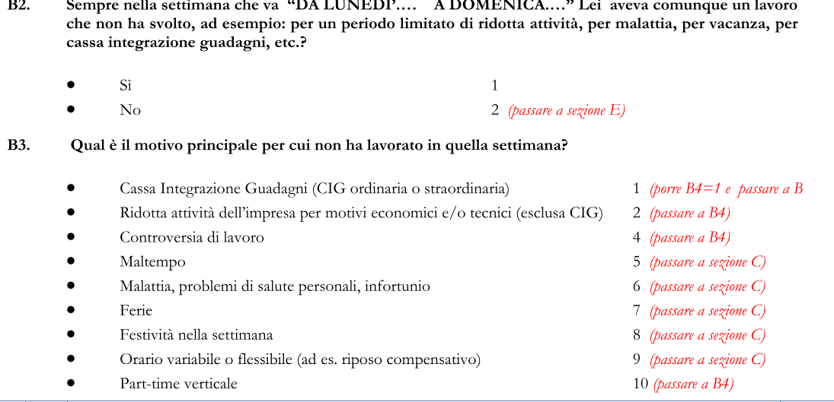
Question Scheme Example
Look at the following questions:

Slide 72
Question Item XML
<QuestionItem id="B2" version="1.0.0">
<QuestionText>
<Text>Sempre nella settimana che va “DA LUNEDI’ ... A DOMENICA..." Lei aveva comunque un lavoro che non ha svolto, ad esempio: per un periodo limitato di ridotta attività, per malattia, per vacanza, per cassa integrazione guadagni, etc.?</Text>
</QuestionText>
<CodeRespresentation blankIsMissingValue="true">
<CodeSchemeReference>
<ID>CodeSchemeYesNo</ID>
</CodeSchemeReference>
</CodeRespresentation>
<ConceptReference>
<ID>Concept_1</ID>
</ConceptReference>
</QuestionItem>

Slide 73
Response Domains
There are many possible types of response domains in the LFS:
Coded responses (as in the earlier example)
Date and Time responses
Numeric responses
Textual responses
Mixed responses (more than one type)
Additionally, DDI can describe others as well:
Geographic responses
Categorical responses
Scales, Distribution, Ranking, and more (DDI 3.2)

Slide 74
Interviewer Instructions
“RISERVATO ISTAT” is an instruction to the interviewer that they are asked to fill in the question, not the respondent.
This is an example of an Interviewer Instruction – text which tells the interviewer to do something, but which the respondent doesn’t know about
Interviewer Instructions are also used to express routing information, telling the interviewer or respondent which question to go to next
Interviewer Instructions are found in Interviewer Instruction Schemes, in the Data Collection module
DDI uses the term Instruction for the individual items in the scheme

Slide 75
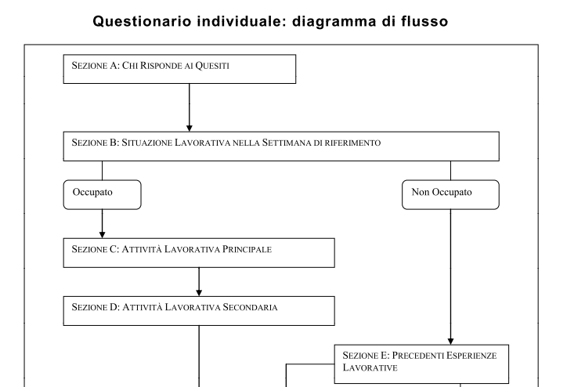
Flow Logic
If you are employed, you answer sections C and D
If you are unemployed, you go directly to section E

Slide 76
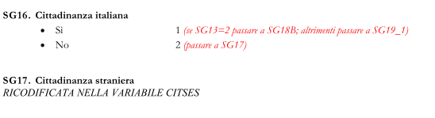
Flow Logic Example
Here, if you answer “No” to question SG16, you must answer question SG 17, but if you answer “Si”, you go directly to question SG19 (with some qualifications about earlier answers):

Slide 77
Flow Logic in DDI
Flow logic is described in DDI using Control Constructs, found in Control Construct Schemes in the Data Collection module.
Control Constructs can be of several different types:
Basic flow:
Sequence
Question Construct (the use of a Question Item)
Statement Item
Computation Item (for processing during administration)
Conditional logic:
If Then Else
Loop
Repeat Until
Repeat While

Slide 78
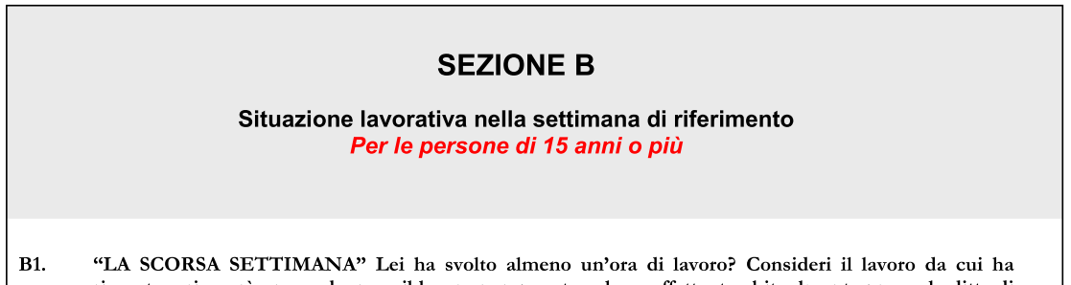
Sequences
Every questionnaire starts with a top-level sequence
It may begin to branch conditionally very quickly
Sequences reference other Control Constructs
LFS starts with a reference to a Statement Item:

Slide 79
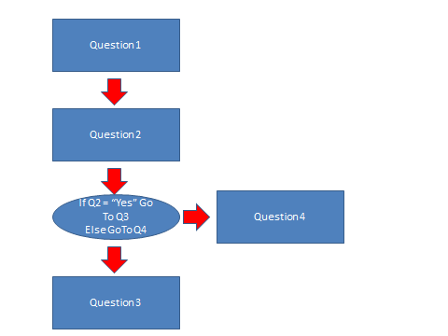
A Simple Example
Consider this simple example:

Slide 80
The Top-Level Sequence XML
<Sequence id="S1" version="1.0.0">
<ControlConstructReference>
<ID>Q1</ID>
</ControlConstructReference>
<ControlConstructReference>
<ID>Q2</ID>
</ControlConstructReference>
<ControlConstructReference>
<ID>ITE1</ID>
</ControlConstructReference>
</Sequence>
Q1 is a Question Construct
Q2 is a Question Construct
ITE1 is an IF Then Else construct

Slide 81
Conditional Logic
Conditional Control Constructs state the conditions which will determine the flow of the questionnaire
Conditions can be expressed using proprietary syntaxes, found in a Code element (ie, “if Q2 = 1”)
Users determine which syntax is needed
In our simple flow example, if the answer to Question 2 was “Yes”, you go to Question 3 – otherwise, you go to Question 4.
This is an If Then Else construct

Slide 82
Conditional Logic XML
<IfThenElse id="ITE1" version="1.0.0">
<IfCondition>
<Code>Q2="Yes"</Code>
</IfCondition>
<ThenConstructReference>
<ID>Q3</ID>
</ThenConstructReference>
<ElseConstructReference>
<ID>Q4</ID>
</ElseConstructReference>
</IfThenElse>

Slide 83
The Questionnaire
In DDI, the questionnaire itself is represented by the Instrument
This is found in the Data Collection module
Each Instrument references the top-level Sequence in the Control Construct Scheme
There will be a separate Instrument for each survey administration mode
But most of the other metadata will be reused

Slide 84
Instrument XML
<Instrument id="LFS" agency="ISTAT.IT" ↵
version="3.0.2">
<InstrumentName>
<Name>Labour Force Survey Questionnaire for ↵ 2012</Name>
</InstrumentName>
<Type>Print questionnaire form</Type>
<ControlConstructReference>
<Scheme>
<ID>ControlConstructScheme1</ID>
</Scheme>
<ID>Seq1</ID>
</ControlConstructReference>
</Instrument>

Slide 85
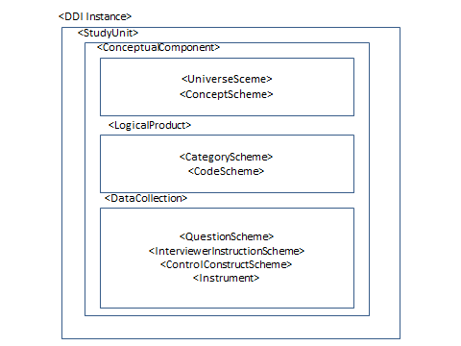
Bringing the Pieces Together

Slide 86
Document Data Processing and Life Cycle Events
Functional Task 5

Slide 87
Where does processing take place?
Data Collection
Validation of Response
Revised Data
Routing processes
Analysis
Raw Data
Validation
Final Data Set
Paradata (Process Data)
Confidentiality
Processes

Slide 88
How is this handled in DDI?
Processing Events
Processing Instructions
Generation Instruction
General Instruction
General descriptions
E.g. Collection Event/Action To Minimize Loss
Life Cycle Event
Provides Date, Actor, Event description, Relationship (links to a detailed event description, Other Material, Generation Instruction, etc.)

Slide 89
Processing Event
Processing Events bundle together information on a number of different events. These are bundled to reflect those activities which occur together:
Control Operation (type, description)
Cleaning Operation (type, description)
Weighting (description, standard weight factor)
Data Appraisal Information (Response, error, etc.)
Processing Instruction Reference
Quality Statement Reference
DDI currently does not have a structured process model so Processing Event is descriptive only

Slide 90
Processing Instructions
Processing Instructions are maintained in a scheme and are referenced from their point of use
Representation Map (comparative)
Processing Event
Variable Representation
Coverage / Restriction Process
Missing Values Representation

Slide 91
Command Code
Note that both General and Generation Instructions contain Command Code
Command Code is also available in:
Universe Generation Code
Computation Item
Condition for Continuation (of a loop or repeat)
Alternate Sequence
Conditions in routing with Control Constructs

Slide 92
<GenerationInstruction>
<ID>GI_5to10</ID>
...
<Description>Conversion of single year to 5 ↵
year cohorts. Ages 0 to 20 plus. Includes ↵
inline command code and reference to ↵
external SPSS program file.</Description>
<CommandCode>
<ProgramLanguage>SPSS</ProgramLanguage>
<CommandContent>IF (SOURCE LT 3) THEN 1; ↵
IF ((SOURCE GE 3) AND (SOURCE LT 4)) THEN 2; ↵
IF (SOURCE EQ 5) THEN 3;</CommandContent>
</CommandCode>
<CommandFile>
<ProgramLanguage>SPSS</ProgramLanguage>
<URI>../Program/AgeConvert_1_5.sps</URI>
</CommandFile>
</GenerationInstruction>

Slide 93
Life Cycle Event
Life Cycle Event is a very general structure that was intended to capture significant events in the life cycle of the data and metadata
It is currently the only place where we can capture the standard “process model” content of Object, Actor, and Event
Located in the Archive module

Slide 94
<LifecycleEvent>
<ID>LF_1</ID>
...
<Label>Ingest of SIP to Archive</Label>
<EventType>SIP.Validation</EventType>
<Date>
<SimpleDate>2012-07-06</SimpleDate>
</Date>
<AgencyOrganizationReference>
<ID>IND_34</ID>
...
</AgencyOrganizationReference>
<Description>Validation of data against metadata provided in ↵ SIP</Description>
<Relationship>
<RelatedToReference>
<ID>PROCEVENT_2</ID>
...
</RelatedToReference>
<RelationshipDescription>Process used to validate incoming ↵
data against provided metadata.</RelationshipDescription>
</Relationship>
</LifecycleEvent>

Slide 95
Discovery & comparison
Advanced Topics

Slide 96
Citation and Coverage
Five modules have citation and coverage sections
DDI Instance, Study Unit, Group, Resource Package and Physical Instance
The citation in Physical Instance is for the DATA FILE rather than the metadata
All citations can contain native Dublin Core elements
Coverage is assumed to be expressed in its broadest form at the highest level (e.g., Group) and restricted in contained modules
Example: A Study Unit has a coverage of Resident Persons in the United States, 2000-2010
A Physical Instance may restrict this to Female Resident Population of the United States in 2008

Slide 97
Coverage
Topical Coverage
Subject and Keyword
Temporal Coverage
Reference Date with optional Subject
Spatial Coverage
Description, Bounding Box, Country Code, Spatial Object, Geographic Structure Reference, Geographic Location Reference, Top and lowest level object, Geographic Structure Variable Reference, and Summary Data Reference

Slide 98
Discovery Metadata
Common Items
Specialized Items
Title
Author
Abstract
Ownership
Access requirements
Link to object
Topical Subject/Keyword
Geographic coverage
Temporal coverage
Format information
Restricted subject list
Information on the kind of data
Geospatial coordinates
Full variable/question description
Collection detail
Provenance chain

Slide 99
Common Metadata
Accurate linking in the Linked Open Data world is facilitated by the use of common metadata resources
There are DDI based RDF vocabularies for discovering datasets and describing statistical classifications
Fewer assumptions regarding the comparability of data objects from different sources
Clarifies relationships of two objects within a larger structure (Geography, Organizations, Standard Classifications, etc.)
Immediately identifies if two data sets are using the same or different resources

Slide 100
Comparison in DDI
Explicit comparison
Reuse of published common metadata
Grouping with inheritance
Assertions of comparison
Comparison maps
Harmonization

Slide 101
Reusable Study-independent Information in Resource Package
Study A
Study B
Study B
Ref=
“Variable X”
Ref=
“Variable X”
uses
uses
uses
re-uses by reference
Variable ID=“X”
Variable ID=“X”
Resource Package
published in

Slide 102
Longitudinal (repeated) Studies
The purpose of collecting the same data over time is to be able to make comparisons or evaluations of change
These studies make extensive reuse of concepts, variables, questions, instruments, and even physical storage structures
Rather than repeating content with each iteration, metadata is captured once and reused by each successive iteration. Reuse of an object implies comparability, changes are noted as they occur
Statistical production is a very similar case

Slide 103
Study A
Study B
Group
uses
Variable A
uses
uses
Variable B
Variable A
Variable A
Variable C
Variable B
Variable B
Variable C
Variable C
Variable D
Variable X
contains
contains
Study A
Study B
uses
uses
Variable D
Variable X

Slide 104
Where is comparison useful?
Describing differences between general or complex structures
Two concepts which are close but not exactly alike. Allows making assertions regarding the differences and similarities and lets the user decide if it is significant in terms of their research question.
Explaining changes between versions of the metadata
Can provide mapping in both directions (old-to-new as well as new-to-old) to assist users in managing the effect of a version change on data collected before and after the change.
Mapping representation changes between versions
Explaining series breaks between cycles of data collection
Harmonization
Mapping individual representation structures to a single unified structure (requires the creation of a unified structure which becomes the target structure of each map)

Slide 105
General Comparison
Concept Map, Universe Map, and Category Map normally express general comparisons (i.e. the comparison can be captured in a single mapping or at most a set of maps describing each direction of the comparison).
General comparisons identify the source and target objects being mapped and make assertions regarding the similarities and differences between them.
Comparisons are always Source to Target.
If the direction of the comparison is immaterial, simply assign one to the source and one to the target.
For bi-directional comparisons create two maps, one in each direction
Bi-directional comparisons may or may not be meaningful

Slide 106
<UniverseMap>
<ID>UniMap_1</ID>
<MapName>US Population Clarification</MapName>
<SourceSchemeReference>
<ID>US_1</ID>
</SourceSchemeReference>
<TargetSchemeReference>
<ID>US_2</ID>
</TargetSchemeReference>
<ItemMap>
<ID>UniMap_1_1</ID>
<SourceItem>
<ID>U_1</ID>
</SourceItem>
<TargetItem>
<ID>U_2</ID>
</TargetItem>
<Correspondence>
<Commonality>Both cover Population in the United States, ↵
Territories and Trust Lands</Commonality>
<Difference>The Source Universe explicitly states that it is ↵
the resident population. The Target Universe is unclear ↵
on this point.</Difference>
</Correspondence>
</ItemMap>
</UniverseMap>

Slide 107
Complex Comparisons
Comparing complex structures like Variables and Questions may require multiple maps
For example we will look at a comparison of a number of questions all related to Age but using different question text and/or different response domains. This example is in DDI 3.1.
DDI 3.2 allows comparison between different types of response domains (representations)
DDI 3.2 allows listing the related maps used to compare specific aspects of the content.

Slide 108
Detail of question comparability
Comparison Map | Textual Content of Main Body |  | Category |  | Code Scheme
 | Same | Similar | Same | Similar | Same | Different
Question | X |  | X |  | X
 | X |  | X |  |  | X
 | X |  |  | X | X
 | X |  |  | X |  | X
 |  | X | X |  | X
 |  | X | X |  |  | X
 |  | X |  | X | X
 |  | X |  | X |  | X

Slide 109
Harmonization
Harmonization is the process of creating a common structure for coding so that data sets can be merged and analyzed as a single structure
When harmonization results in a new data set with added “harmonized” variables the process is called “data fusion”
When harmonization provides the information required to create a harmonized data set but does not take the step of creating the file is a process called “semantic integration”

Slide 110
Publishing Comparison
Comparison can be published within a Group or Sub Group if it is related to a grouped set of studies (e.g. Waves in a longitudinal study)
Comparison can be published as part of a Resource Package if it is related to differences between separate studies or to the description of a “virtual” harmonized set of data
Systems, such as MISSY, capture the mapping between representations when a version change occurs. The mapping contains processing instructions which are “snippets” of statistical software programs used to create a harmonized variable.

Slide 111
conclusion
Advanced Topics

Slide 112
Points to remember
Few are starting from scratch
Ongoing processes cannot stop
You can only act in areas you control
DDI is not an all or nothing structure

Slide 113
Check list
Who do you need to interact with in your environment INPUTS and OUTPUTS?
Where is your focus (may be different for different parts of the organization)?
What do you control?
What is your process flow - how far upstream is it practical to insert DDI like structures?

Slide 114
Questions?
Advanced Topics

