Slide 1
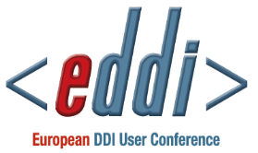
Using Extended Attributes in Data Analysis Software-
Controlled Vocabularies, Tools and DDI
Larry Hoyle
Institute for Policy & Social Research
University of Kansas
LarryHoyle@ku.edu

Slide 2
Custom, or Extended, Attributes
Excel with Colectica Plugin, R, SAS, SPSS, Stata all have something in common
User defined attributes for variables
(and sometimes datasets)

Slide 3
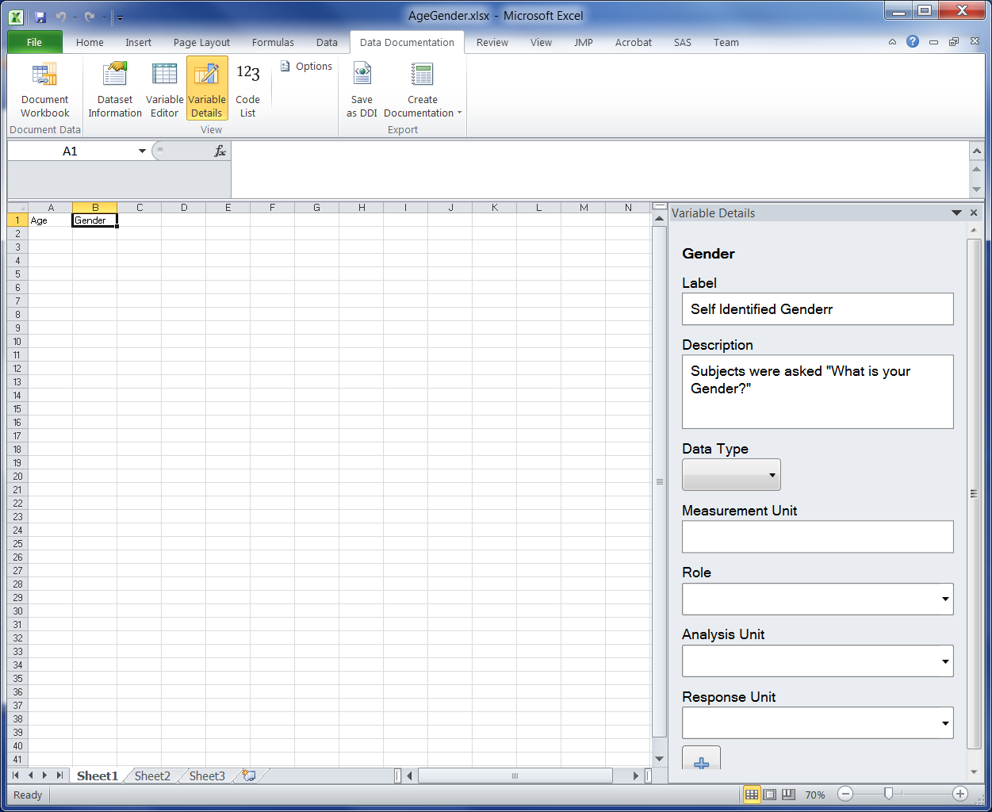
A Quick Tour – Excel with Colectica Plugin
Predefined
Attributes
User Defined
Attributes

Slide 4
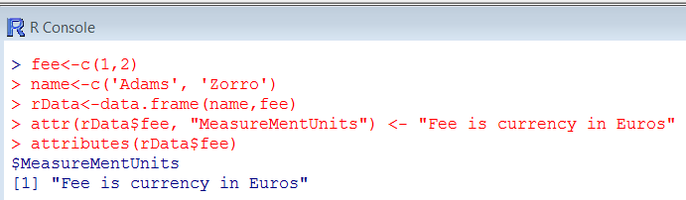
A Quick Tour – R

Slide 5
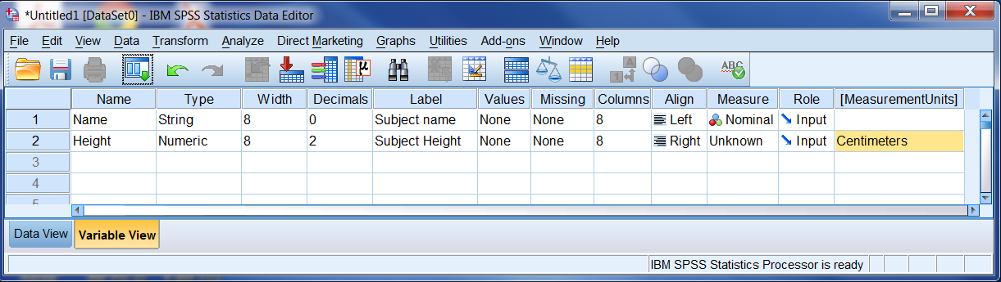
A Quick Tour – SPSS

Slide 6
A Quick Tour – SPSS

Slide 7
A Quick Tour – Stata
. char define Height[MeasurementUnits] "Centimeters"
. char define _dta[Universe] "Persons aged 65 and over"
. notes Height: First note on Height
. char list
_dta[Universe]: Persons aged 65 and over
Height[note1]: First note on Height
Height[note0]: 1
Height[MeasurementUnits]: Centimeters

Slide 8
A Quick Tour – SAS
proc datasets lib=work nolist ;
modify sales;
xattr set ds Concept="purpose" Description="Testing Extended Attributes";
xattr set var purchase ( Role="target" LevelOfMeasurement="nominal"
Description="A text description of the type of item purchased")
age ( Role="reject" Minimum="0" MeasurementUnits="years")
income ( Role="input“ LevelOfMeasurement="interval" );

Slide 9
Metadata in the Research Workflow, Goals
Capture metadata when generated
Recorded by those who understand the work
Recorded while still in mind
Minimize overhead to research
Burdensome procedures won’t get done
(or won’t get done well)
Part of regular workflow
See for example Iverson (2009) or Long (2009)

Slide 10
The Dilemma of Structure
Structure makes data and metadata easier to use
Searching
Machine actionability
Adding structure can be additional work for creators
Knowledge of structure scheme
Navigating large structures
Tools can help

Slide 11
Multiple Controlled Vocabularies
Agreed upon attribute names
Agreed upon values of some attributes
E.g. Attribute: “MeasurementUnits”
Values from International System of Units cf. http://physics.nist.gov/cuu/Units/current.html

Slide 12
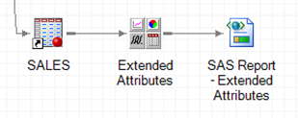
A Prototype Tool
Custom Add-in for SAS Enterprise Guide
Becomes a node in a process flow diagram

Slide 13
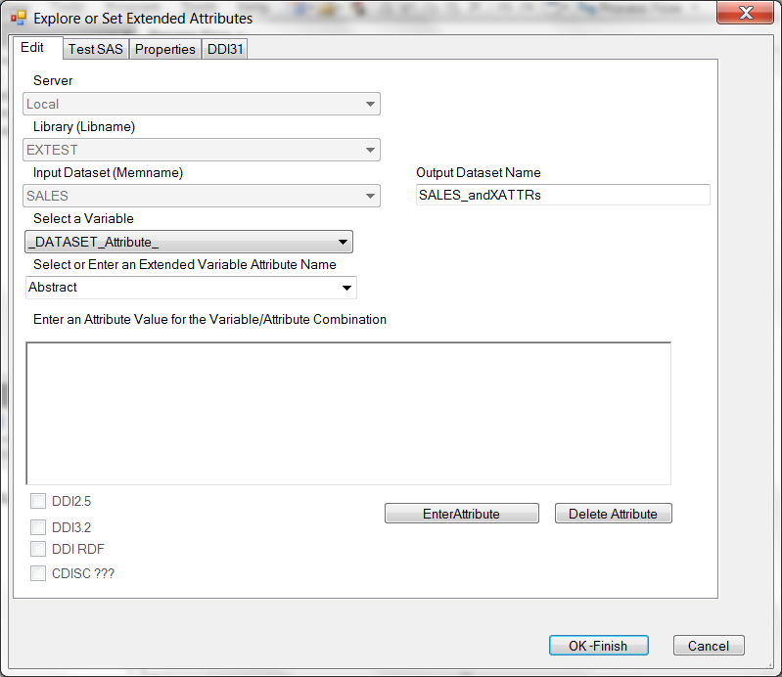
First Pass at a User Interface

Slide 14
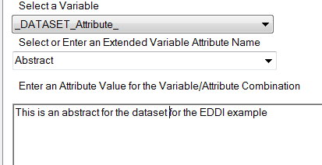
Enter, Change, or Delete Dataset Attributes

Slide 15
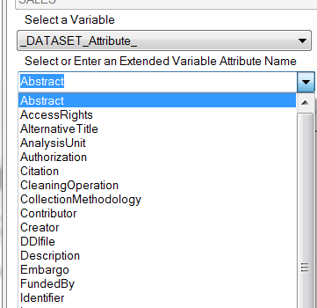
Attributes Prompted From a List
This list can be based on DDI or some other source (or both)

Slide 16
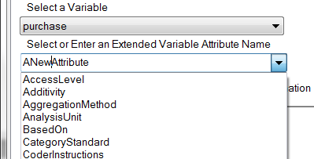
Or User Defined Attributes
A user can also enter a new attribute name.

Slide 17
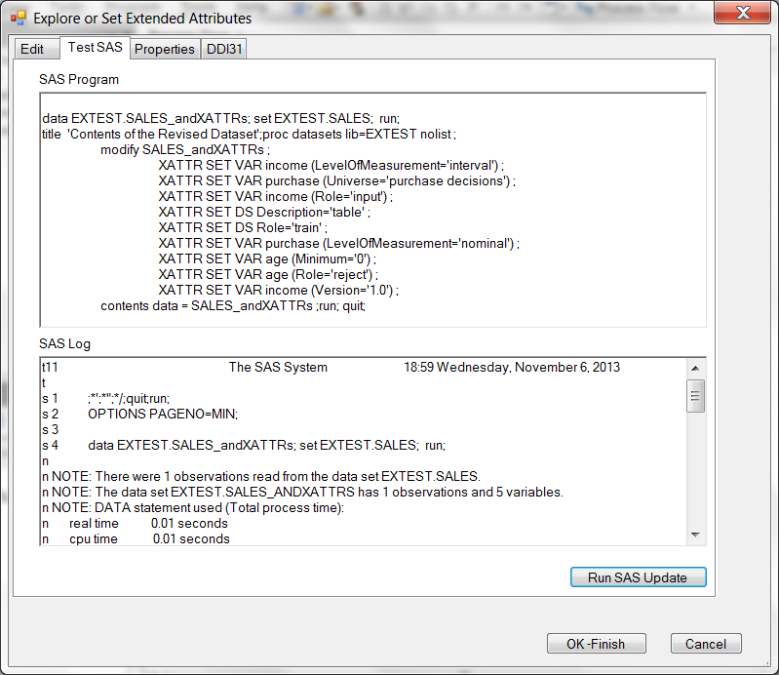
Runs SAS Procedure on Demand

Slide 18
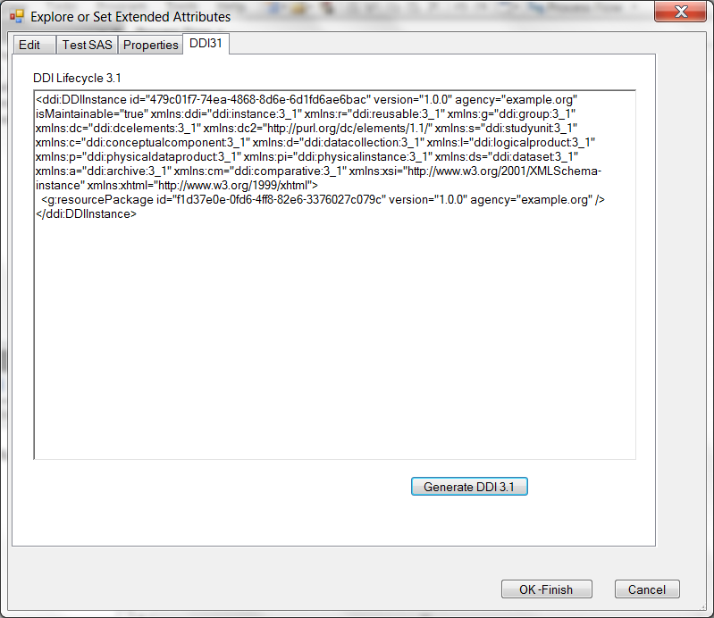
Generate DDI
Can contain Extended Attributes
Can also contain all other metadata extracted from the dataset and current SAS environment (e.g. categories and codes)

Slide 19
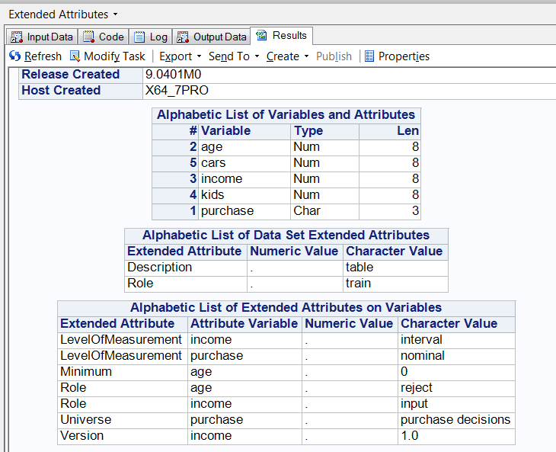
Finishes by Running SAS Program

Slide 20
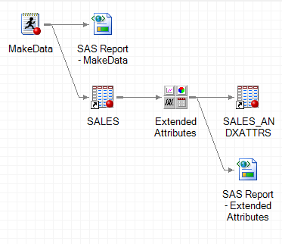
Updated Process Flow
Updated Dataset

Slide 21
Questions?
Full Paper and sample code are available at:
http://hdl.handle.net/1808/12488
(after 03-Dec- 2013)
Larry Hoyle
LarryHoyle@ku.edu

