Slide 1
DDI-RDF Discovery Vocabulary _ Use Cases and Vocabularies
5th European DDI User Conference
04 December 2013, Paris, France
Thomas Bosch
GESIS – Leibniz Institute for the Social Sciences, Germany
thomas.bosch@gesis.org
boschthomas.blogspot.com

Slide 2
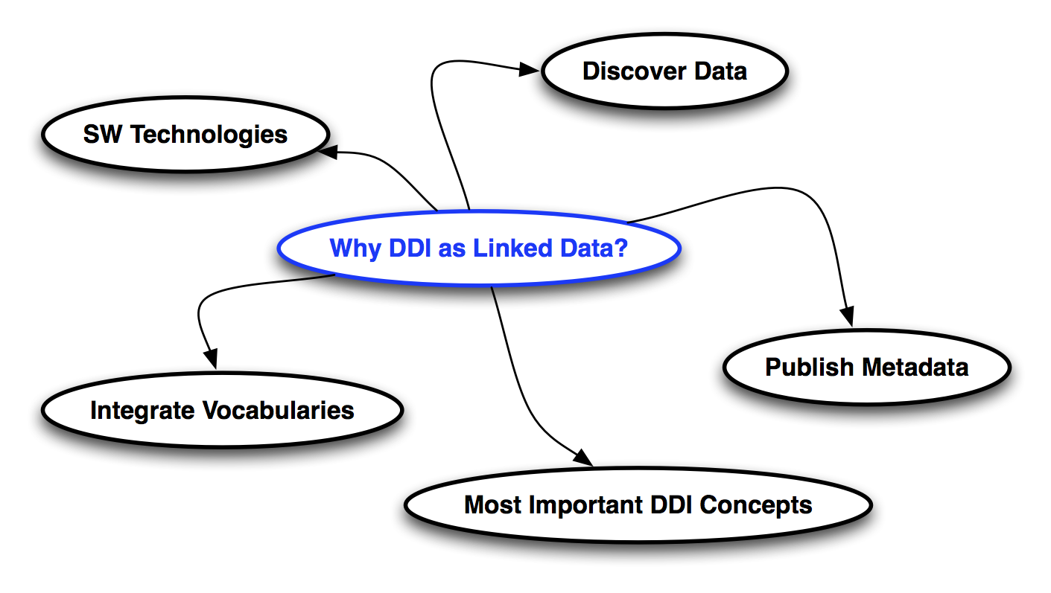
Why DDI as Linked Data?

Slide 3

Overview

Slide 4
Where to search for data?

Slide 5
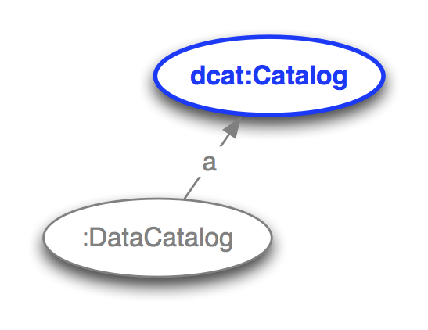
Notes:
Search for data in data collections / data catalogs

Slide 6
Which microdata does exist according to specific metadata?

Slide 7
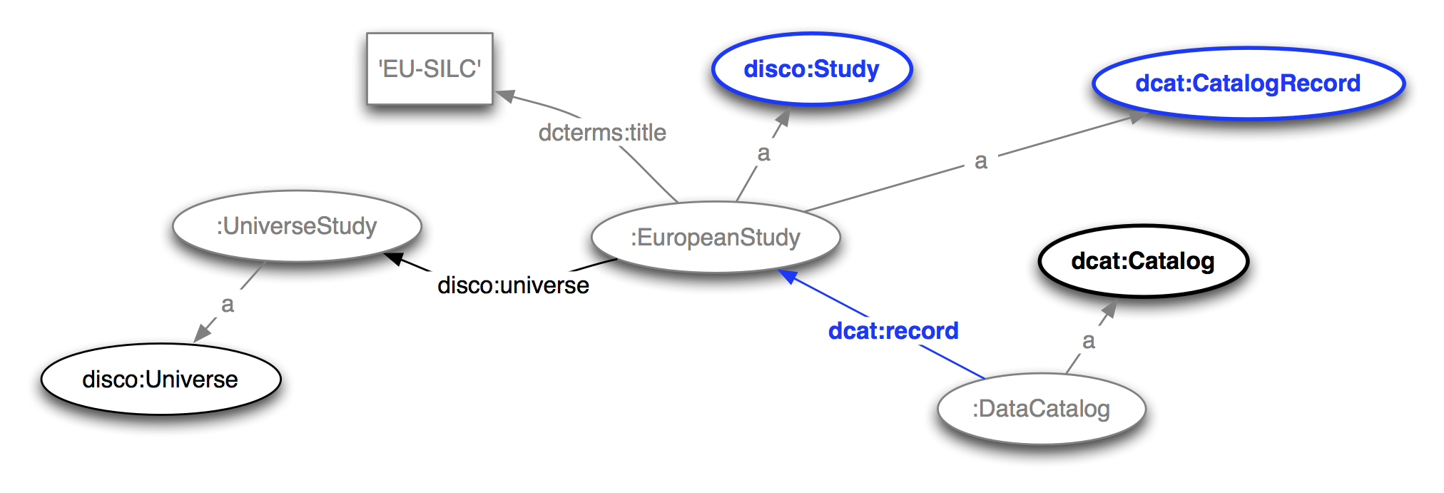

Slide 8
Which datasets are associated with the microdata?

Slide 9
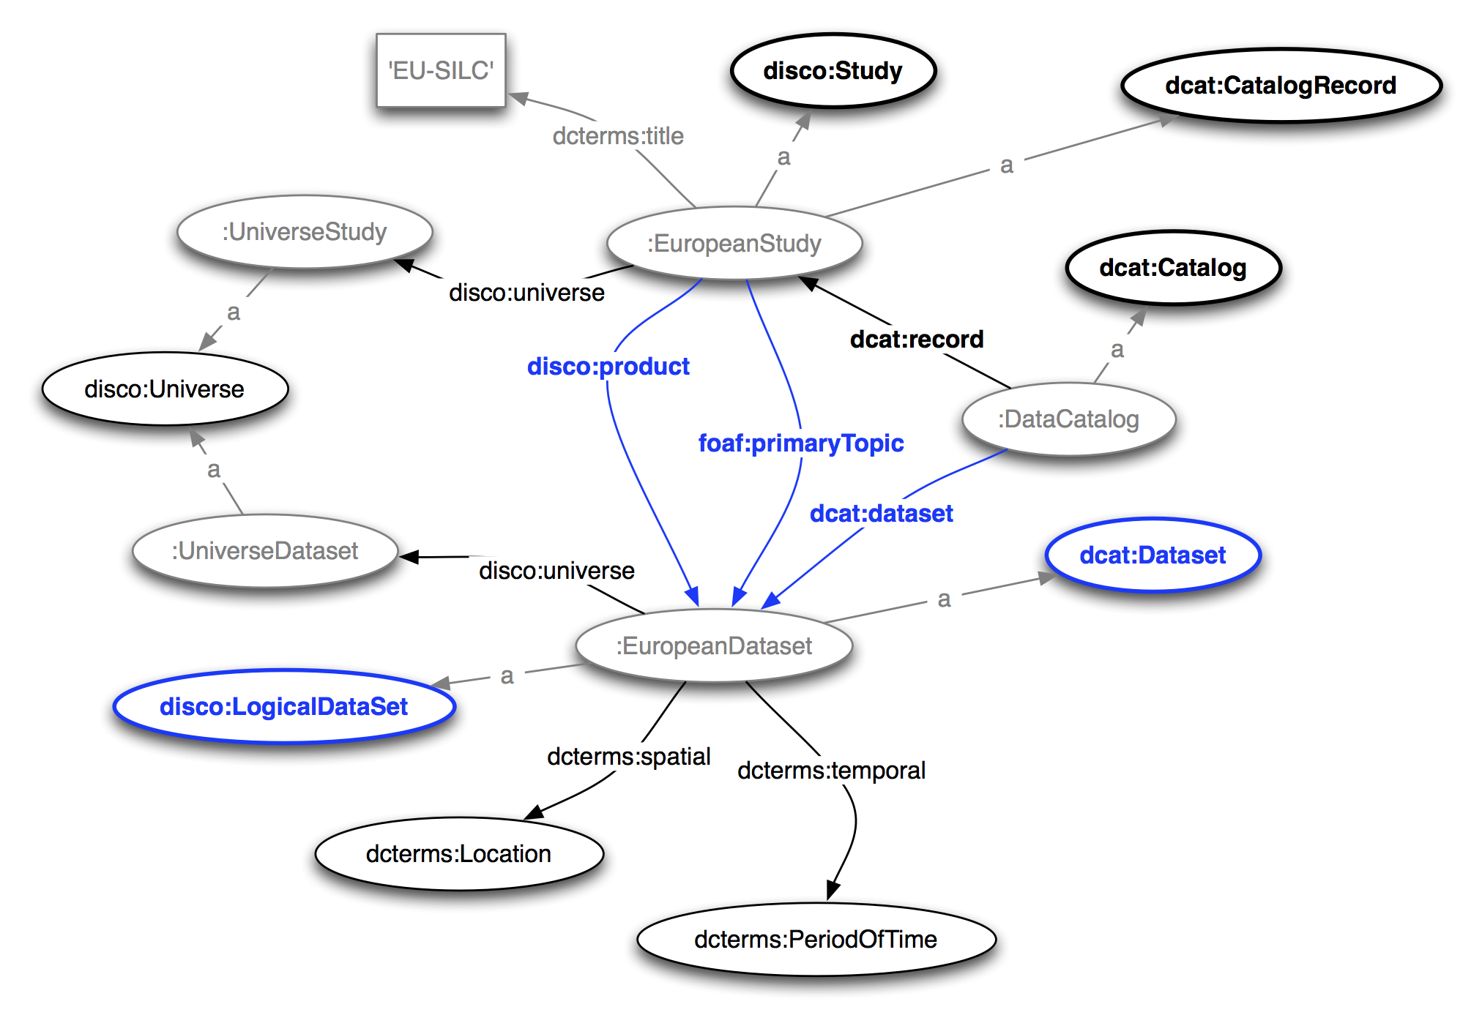

Slide 10
Which aggregated data according to specific metadata does exist?

Slide 11
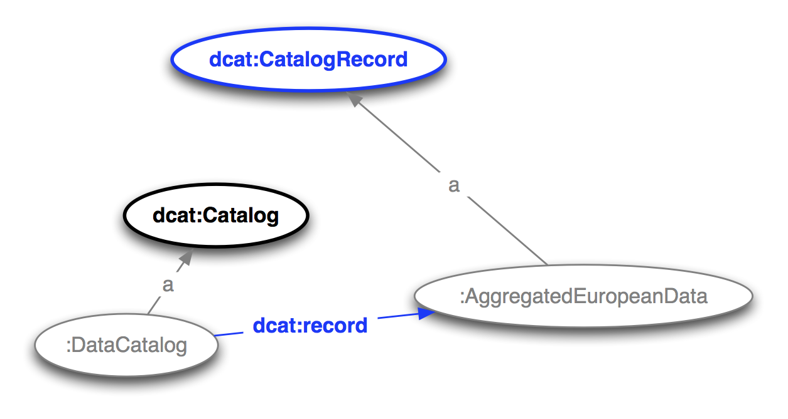

Slide 12
Which datasets are associated with aggregated data?

Slide 13
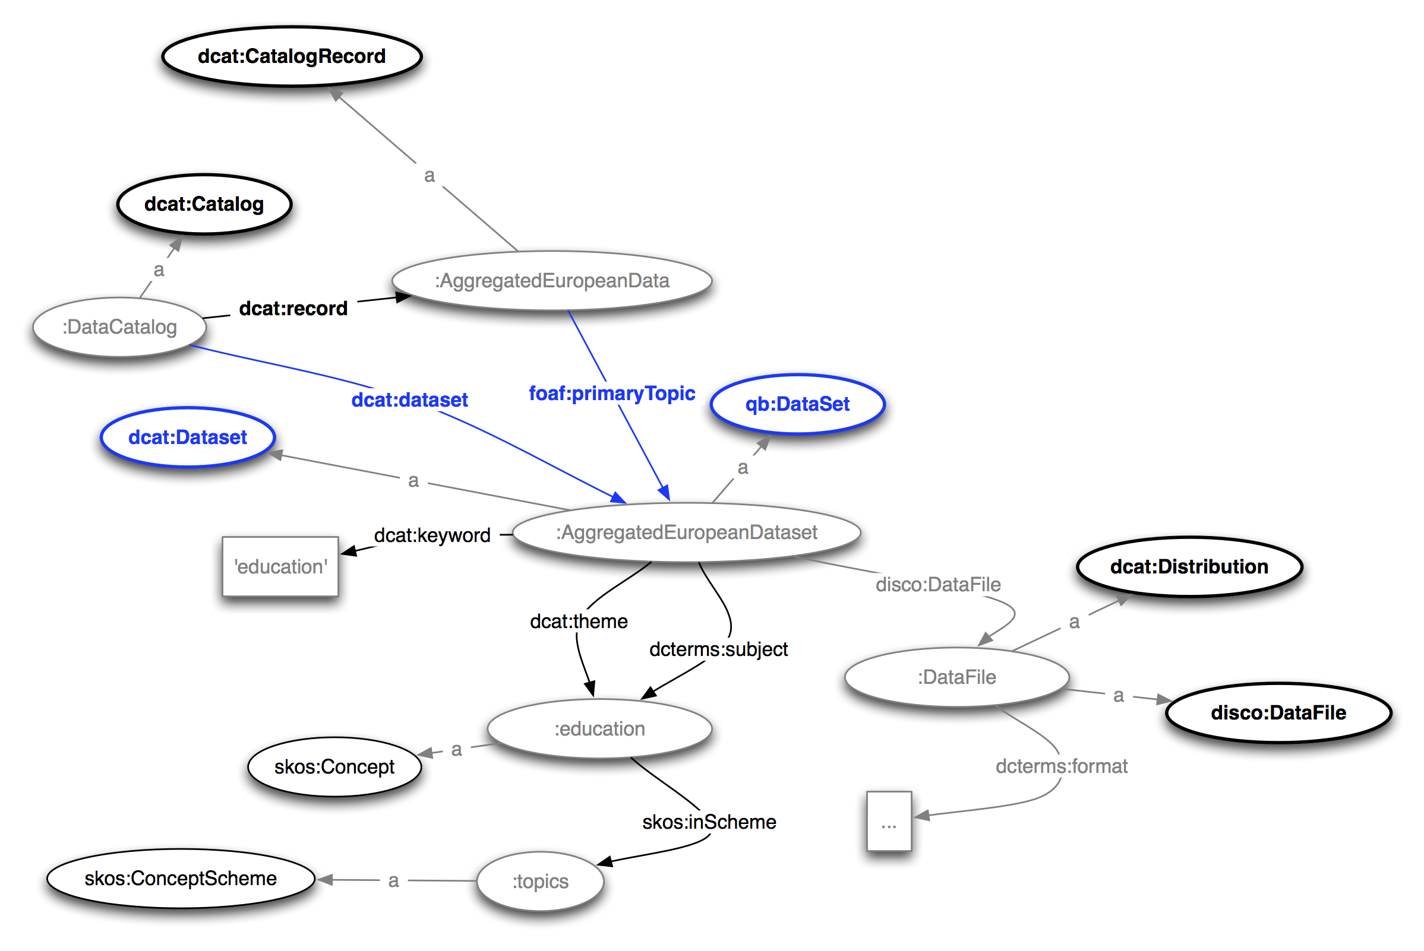

Slide 14
From which microdata datasets is the aggregated dataset derived?

Slide 15
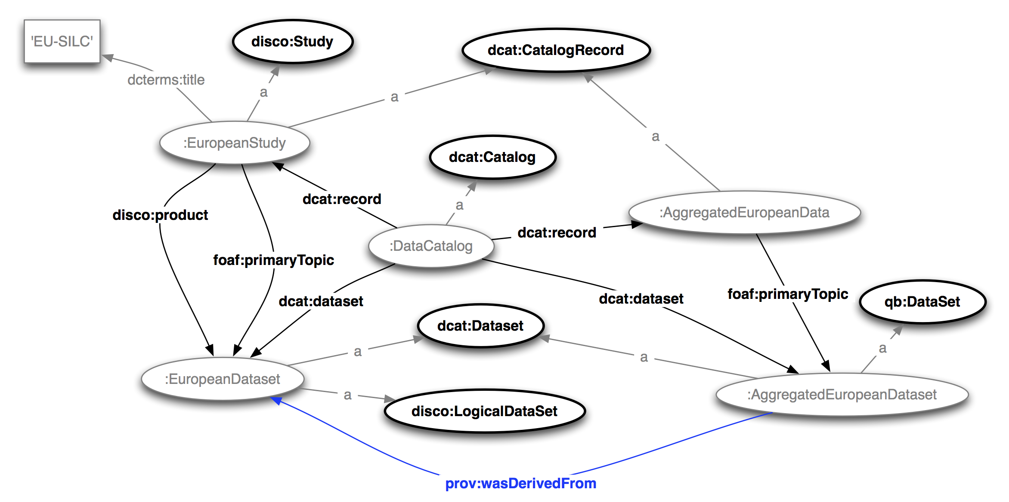

Slide 16
Which summary statistics does a variable have?

Slide 17
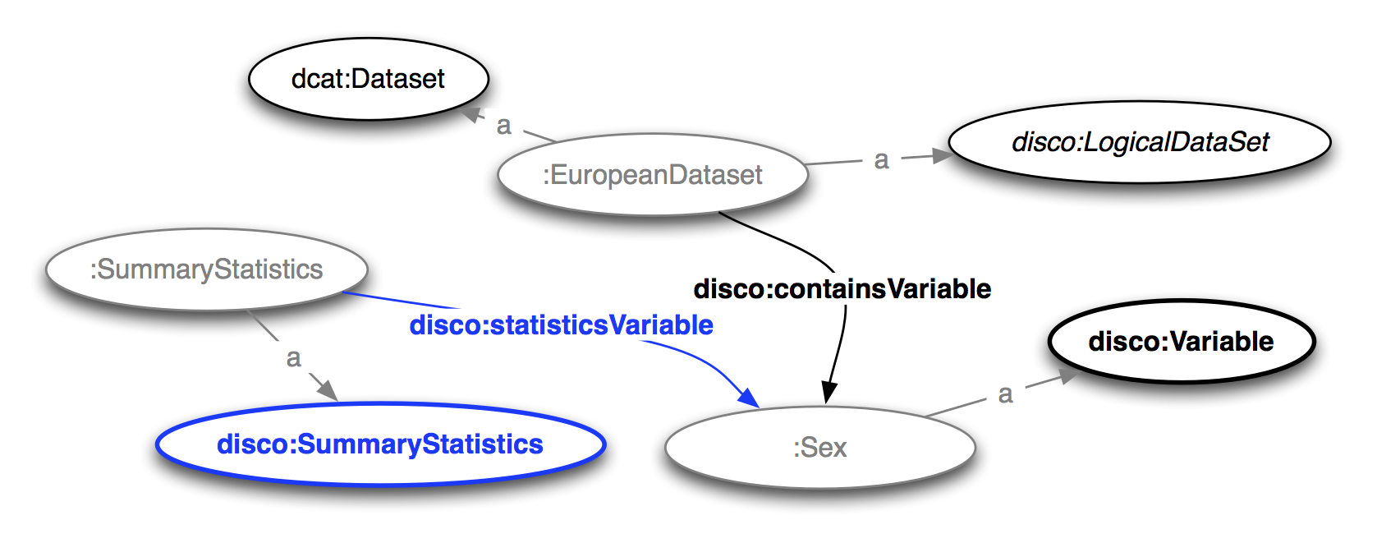

Slide 18
Which category statistics does a variable representation have?

Slide 19
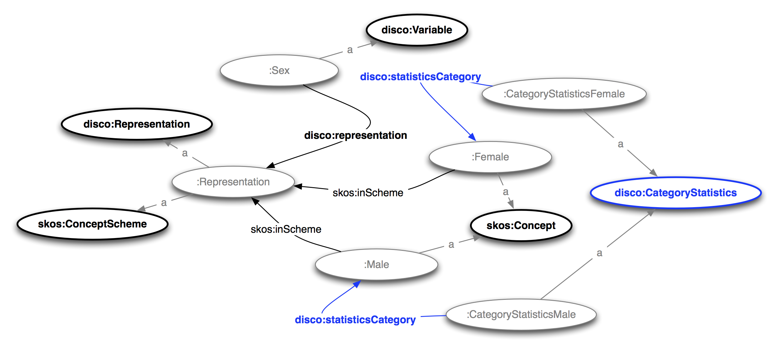

Slide 20
Which microdata datasets are created by the research institute 'GESIS'?

Slide 21
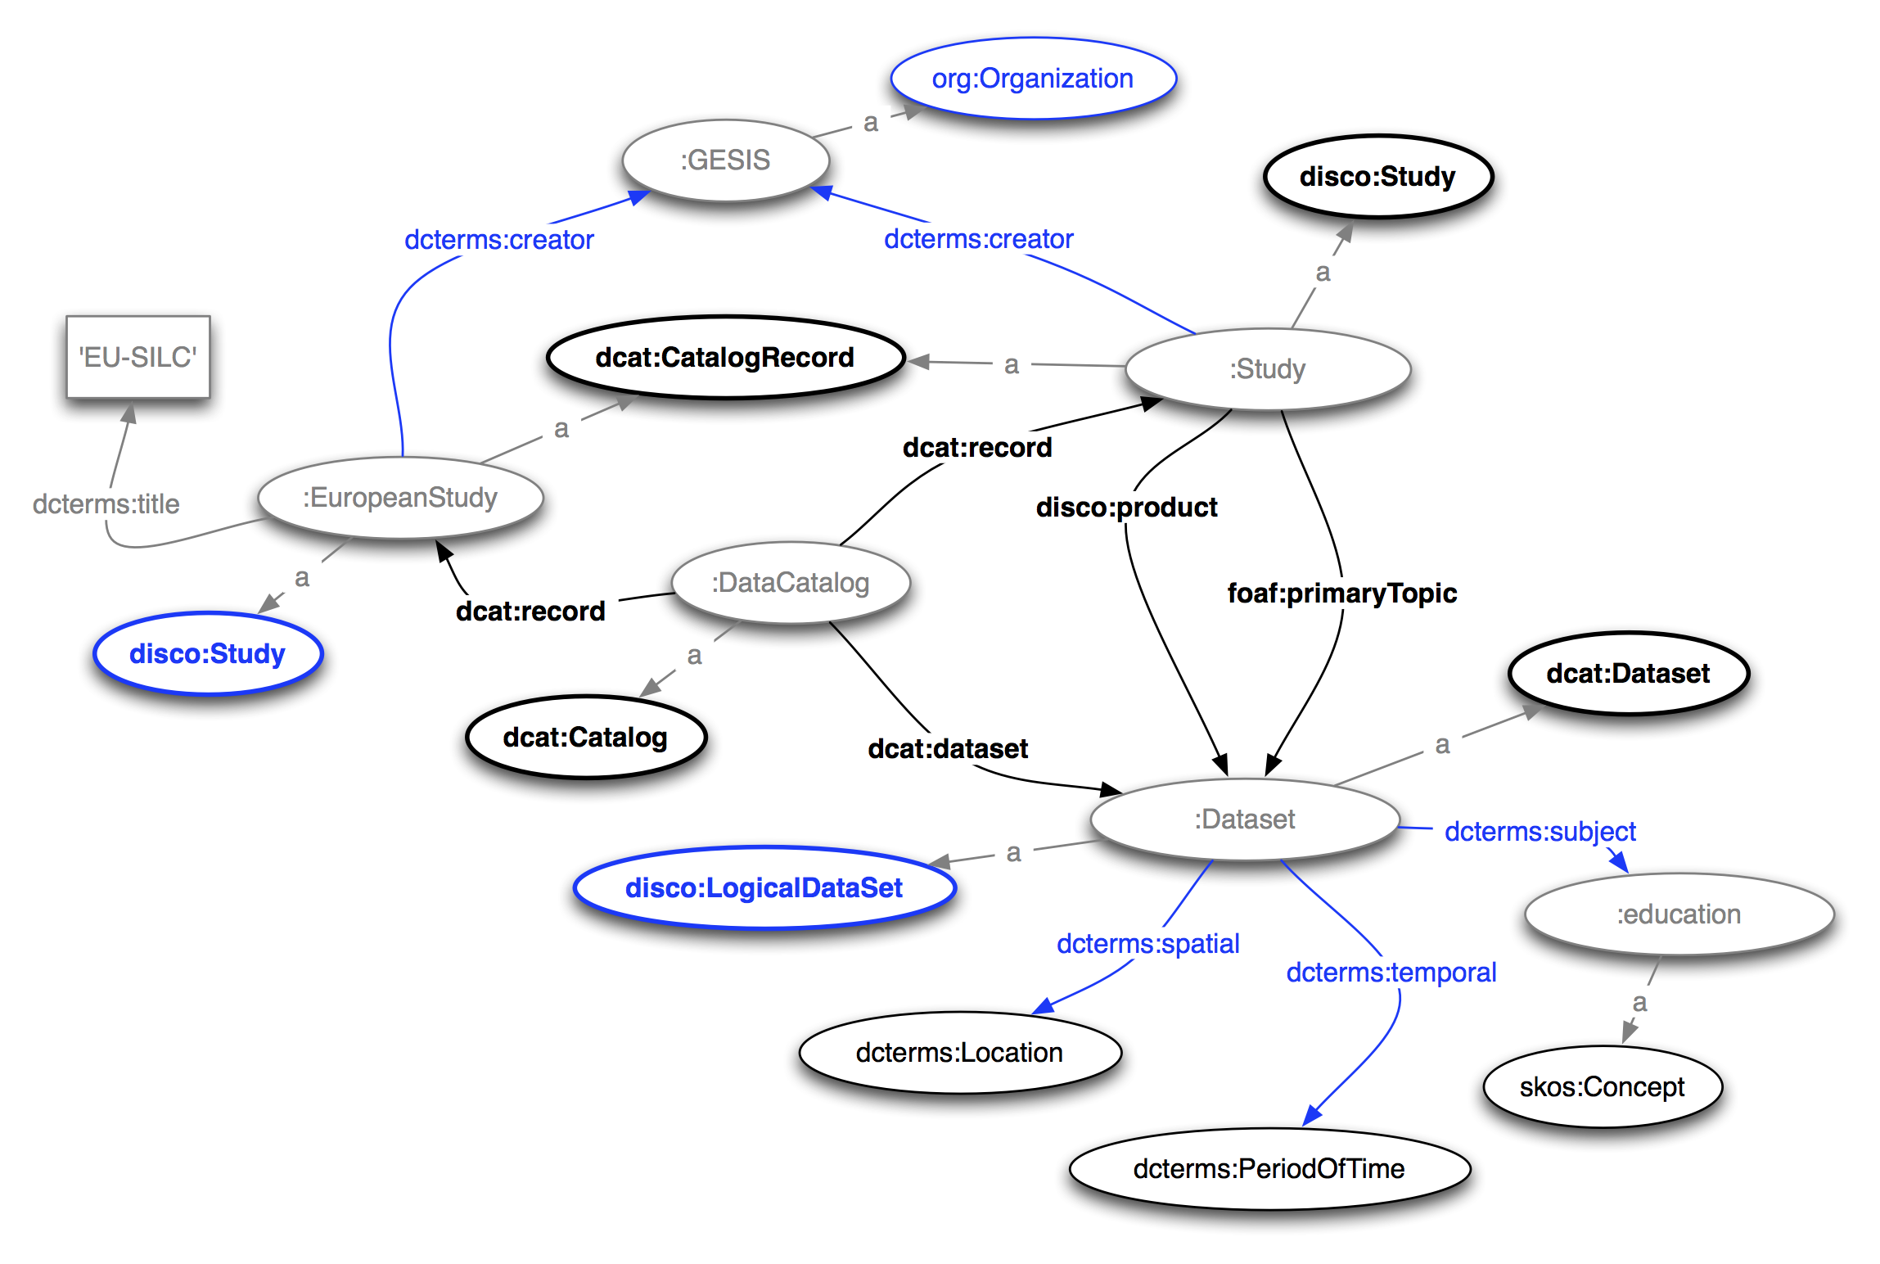

Slide 22
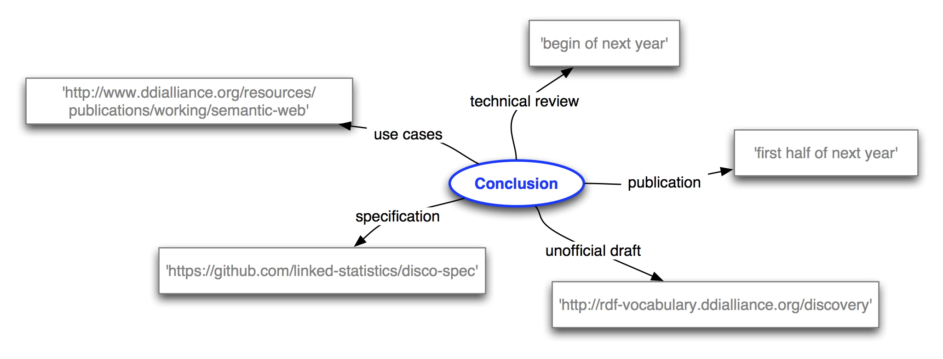
Conclusion

Slide 23
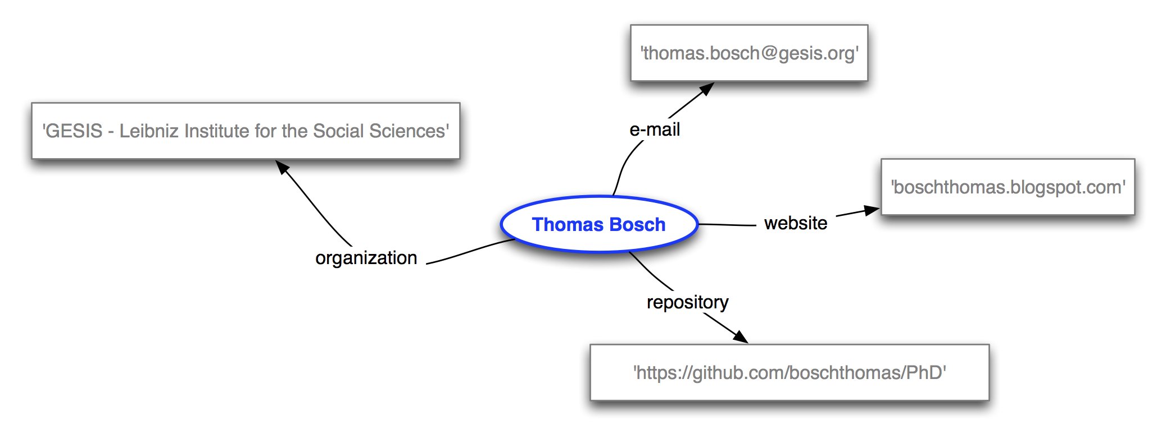
Thank you for your attention…

