Slide 1

The Next Generation of the Microdata Information System MISSY: An Integrated Solution for the Documentation of European Microdata
European DDI User Conference, Paris 2013
Jeanette Bohr, Alexander Mack, Thomas Bosch & Florian Thirolf
GESIS – Leibniz Institute for the Social Sciences, Mannheim

Slide 2
Overview
MISSY - Metadata for scientific research
Development as a DDI use case
MISSY III Project: Documentation of EU Data
MISSY & Data without Boundaries
The new MISSY-Editor

Slide 3

Scientific service for official microdata
Increasing accessibility of individual data from official statistics for scientific research
Scientific support for the use of official microdata is required
➲ Microdata Information System MISSY: provides structured metadata for official statistics

Slide 4
MISSY - Metadata for scientific research
Facilitates professional and efficient use of official microdata for the social sciences
Contains detailed metadata for all available German Microcensus Scientific Use Files (since 1973)
Documentation for integrated European microdata from official statistics is underway
➲ in cooperation with Data without Boundaries Project (WP5, Task 3)

Slide 5
MISSY – Scope of metadata
Detailed information on variable level
Comparability of variables over time
Study description and data collection materials
Concepts, classifications and definitions
Setups and program routines (‘microdata tools’)
Literature database

Slide 6
Development as a DDI use case
2003 |  |  |  |  |  |  |  |  |  |  | 2014
MISSY I
MISSY II
MISSY III
Pilot Project
German
Microcensus
European Microdata
<DDI 2.1>
<DDI 2.1>
<DDI 3.0>
<DDI RDF Discovery>
⇨ DDI-L & DDI-C Export

Slide 7
Project MISSY III
Central, systematic and user-friendly access to information about official EU microdata via MISSY
Potential to conduct thematic searches over multiple studies
Support for cross-cultural and inter-temporal analysis
Re-use of metadata in other systems (export to multiple formats such as DDI-L, DDI-C, DDI-RDF)

Slide 8
MISSY III – Back-End
Implementation of the new MISSY-Editor (Web-Application)
Metadata import (from SPSS, XML, .csv)
Documentation of EU microdata via MISSY-Editor
Open source software https://github.com/missy-project/

Slide 9
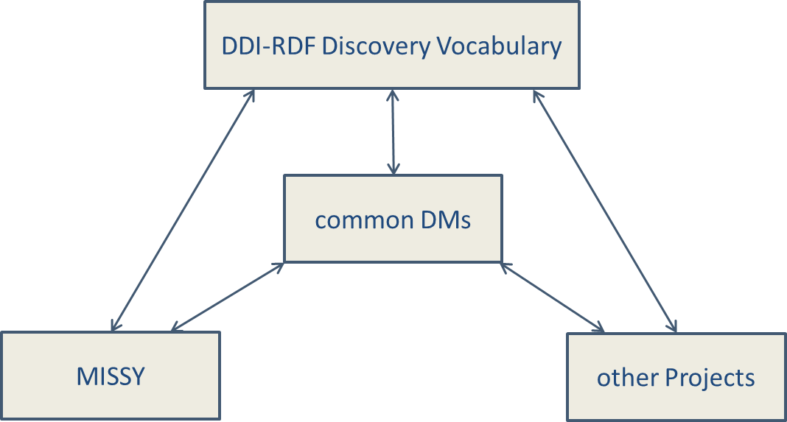
MISSY III – Data model architecture

Slide 10

Cooperation DwB - MISSY
Metadata schema and controlled vocabularies (WP5)
Data documentation of SILC and LFS covered by GESIS; AES, SES and CIS by DwB partners (WP5)
The new web-based MISSY III-Editor was implemented as a web application in order to allow external users
Data export from MISSY into DwB Portal in DDI 3.2 format (WP8/12)

Slide 11

Steps in Metadata Preparation
Read variable information into system from SPSS files
Customize data input forms and controlled vocabularies for each series
Structure variables according to thematic classification
Manually input and/or import metadata at variable and study level

Slide 12
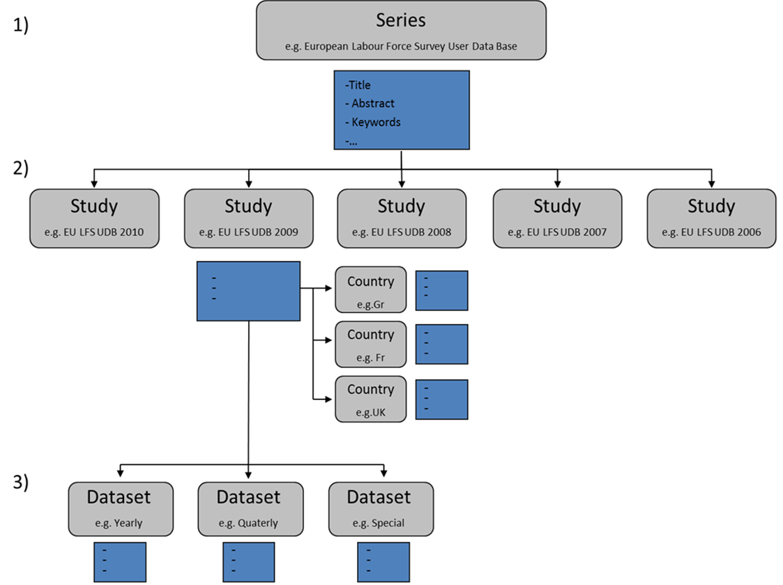
Metadata Scheme – Study level

Slide 19


Poster Presentation with live demo of the new MISSY Editor
for more information…
please visit our
www.gesis.org/missy
www.dwbproject.org

