Slide 1



Building a Harmonized Data Market for Longitudinal Data with MIDUS and DDI (3.2)
European DDI Conference
Notes:
Project that MIDUS is working on with Colectica using DDI 3.2 to deliver harmonized datasets.

Slide 2
Overview of Presentation
Background on MIDUS
Importance of DDI for
Harmonization
Facilitating complex analysis
Current Project’s Goals
Implementation of Project Goals
Creating MIDUS DDI 3.2 Instances
Upgrading MIDUS-Colectica Repository/Portal

Slide 3
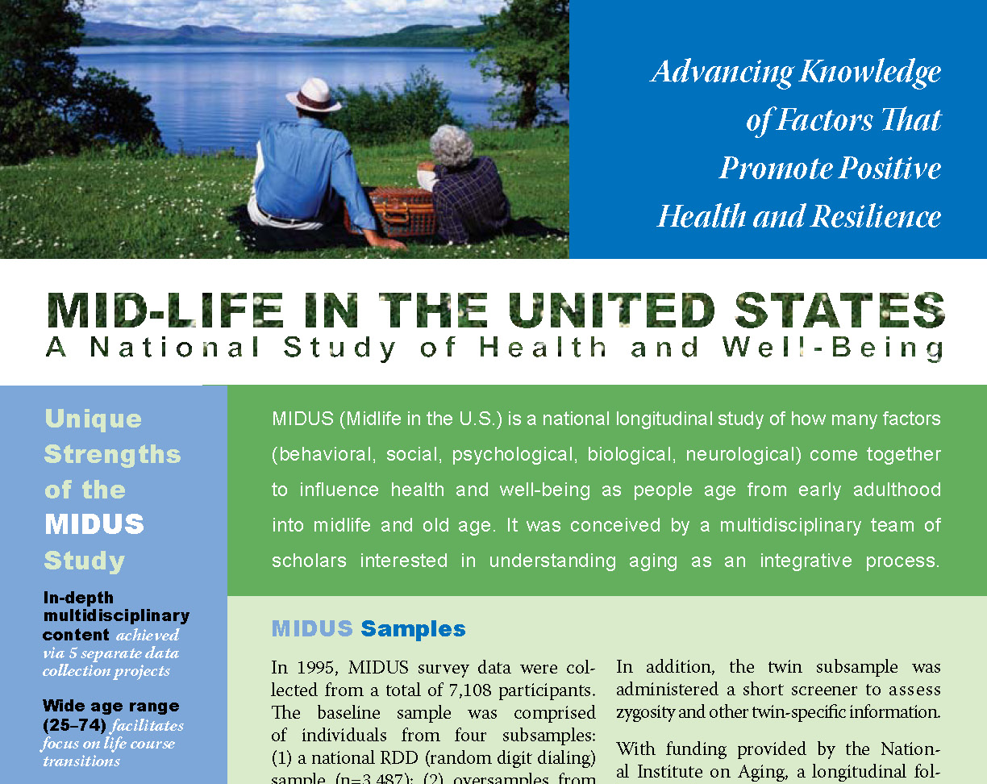
MIDUS
Baseline: 1995-96
Harvard
MacArthur Found.
N=7,108
Ages 25-74
Twins/Siblings
Notes:
MIDUS acronym.
Read Green text.
MIDUS began in 1995 with funding from the MacArthur Foundation.

Slide 4
MIDUS: Strengths and Complexities
Multiple sample waves (longitudinal)
Notes:
Since its inception, it has expanded considerably and become much more complex.
MIDUS is a unique study – what are it’s strengths to researchers are at the same time it’s complexities to data managers. Make it a good case study for Data Management in general, and DDI Lifecycle in particular. We’re unlike many NSAs or archives that are implementing DDI, but we need good documentation and can be more nimble and demonstrate DDI’s capabilities.
In 2004 MIDUS received funds from National Institute on Aging to conduct a followup study of the original respondents, transforming it into a longitudinal study with a 9-10 year interval between waves.

Slide 5
MIDUS 1
Sample
(N=7,108)
Main RDD
Siblings
Twins
MIDUS Samples
and Timelines
2015
1995
2005
Notes:
This series of slides show the MIDUS samples and timelines.
Baseline.

Slide 6
MIDUS 1
Sample
(N=7,108)
MIDUS 2
Main RDD
Siblings
Twins
Main RDD
Siblings
Twins
MIDUS Samples
and Timelines
2015
1995
2005
Notes:
Followed by 2nd wave in 2004.

Slide 7
MIDUS: Strengths and Complexities
Multiple sample waves (longitudinal)
Multiple cohorts
Notes:
At the same time in 2004-05, MIDUS expanded to include multiple cohorts.

Slide 8
MIDUS 1
Sample
(N=7,108)
MIDUS 2
Main RDD
Siblings
Twins
Main RDD
Siblings
Twins
Milwaukee
(N=592)
New
MIDUS Samples
and Timelines
New
Midlife in Japan
(N=1,032)
2015
1995
2005
Notes:
MIDUS fielded new cohorts in Milwaukee, WI (a racially specific sample of African Americans) and Japan (nationally, ethnically specific).

Slide 9
MIDUS 1
Sample
(N=7,108)
MIDUS 2
MIDUS 3
(2013)
Main RDD
Siblings
Twins
Main RDD
Siblings
Twins
Main RDD
Siblings
Twins
Milwaukee
(N=592)
?
New
MIDUS Samples
and Timelines
New
Midlife in Japan
(N=1,032)
MIDJA 2
(2013)
2015
1995
2005
Notes:
Most recently, a 3rd wave of the original MIDUS cohort and a second wave of MIDJA has been fielded.

Slide 10
MIDUS 1
Sample
(N=7,108)
MIDUS 2
MIDUS 3
(2013)
Main RDD
Siblings
Twins
Main RDD
Siblings
Twins
Main RDD
Siblings
Twins
Milwaukee
(N=592)
?
New
MIDUS Samples
and Timelines
New
Midlife in Japan
(N=1,032)
MIDJA 2
(2013)
Refresher
Sample
(N≈2,659)
New
RDD
(N≈2,152)
Milwaukee
(N≈507)
2015
1995
2005
Notes:
We also added 2 new cohorts since 2012 , a new national “Refresher” cohort and a new sample of Milwaukee African Americans.

Slide 11
1
MIDUS 1
Sample
(N=7,108)
MIDUS 2
MIDUS 3
(2013)
Main RDD
Siblings
Twins
Main RDD
Siblings
Twins
Main RDD
Siblings
Twins
2
Milwaukee
(N=592)
?
Multiple
Longitudinal
Sample
Cohorts
3
Midlife in Japan
(N=1,032)
MIDJA 2
(2013)
Refresher
Sample
(N≈2,659)
4
RDD
(N≈2,152)
Milwaukee
(N≈507)
5
2015
1995
2005
Notes:
So there are 5 distinct cohorts or samples proceeding longitudinally into the future (every 9-10 years if the funding gods will it). Each of these cohorts receives a survey protocol, but there are differences in the data collection mode and fielding operations (MKE is CAPI interview, MIDJA is truncated mail survey).

Slide 12
MIDUS: Strengths and Complexities
Multiple sample waves (longitudinal)
Multiple cohorts
Multidisciplinary design
Aging as integrated bio-psycho-social process
Notes:
Another unique characteristic of MIDUS is its focus on aging as an integrated process.

Slide 13
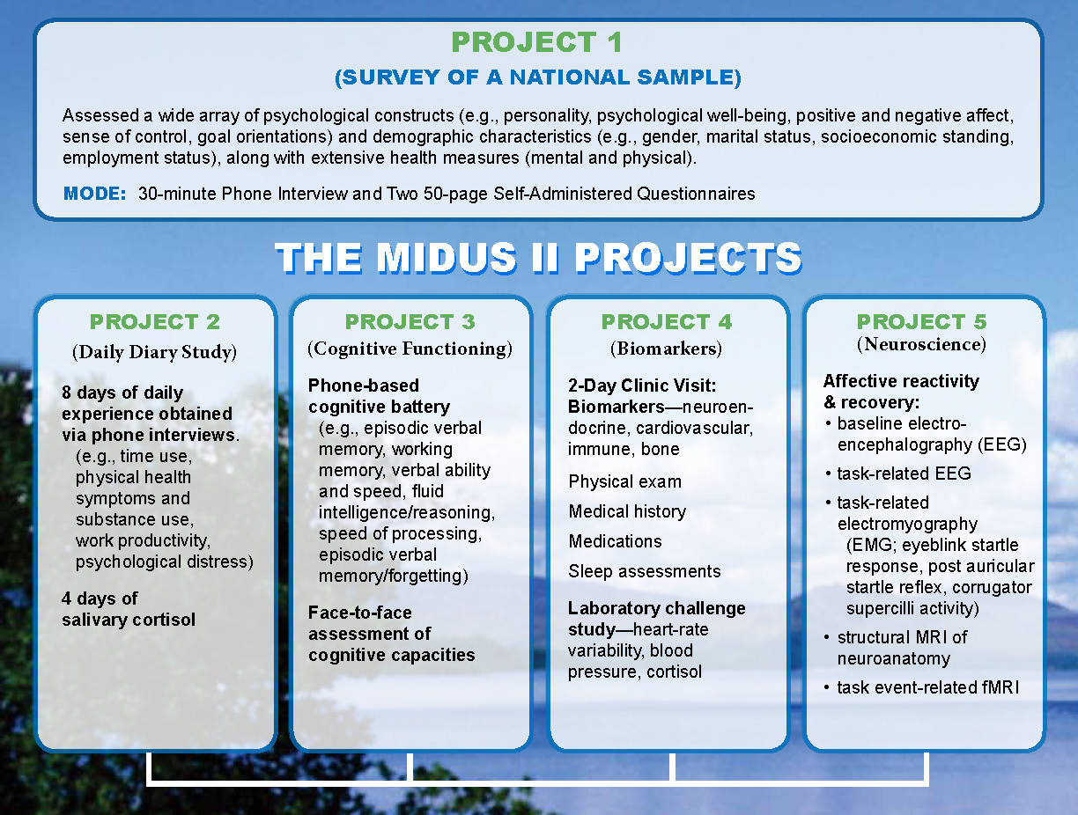
Notes:
To accomplish this, MIDUS includes multiple research protocols designed to obtain different types of data on our participants. This entails separate data collection sites and results in separate datasets; a situation which greatly benefits from a standard documentation system.
MIDUS is organized around survey project at UW-Madison. All respondents participate in survey: socio-demographics, psycho-social constructs, mental and physical health.
Participants then become eligible for participation in satellite projects.

Slide 14
M1 Survey
N=7,108
MIDUS Core
-
Longitudinal
Multi-project
Participation
M2 Survey
N=5,555
Cognition
N=4,512
n=1,152
Biomarker
n=1,255
Daily
Stress
N=2,022
n=1,011
Neuroscience
n=332
Notes:
This Venn diagram just illustrates the complexity of longitudinal multi-project participation; each of the circles represents its own dataset and they are related at the case and variable level. This illustrates only 2 waves of the Core MIDUS sample/cohort. Imagine how complex it can get with multiple longitudinal cohorts/samples.

Slide 15
MIDUS: Strengths and Complexities
Multiple sample waves (longitudinal)
Multiple cohorts
Multidisciplinary design
Aging as integrated bio-psycho-social process
Wide use of MIDUS – Open Data philosophy
#1 data download at NACDA
Top 10 data download at ICPSR
500 publications
Notes:
Finally, MIDUS is NIA-sponsored and we are mandated to share MIDUS data publicly.
We embrace an Open Data philosophy
Resulted in widespread secondary usage of MIDUS
#1 data download at aging archive in ICPSR (our official archive)
Single dataset (M2 P1) is one of the most popular data downloads at ICPSR.
Recently 500 pubs
This widespread secondary use of the data requires clear documentation for secondary researchers.

Slide 16
Current DDI Efforts
MIDUS Metadata Repository/Portal
http://midus.colectica.org/
Notes:
All of these characteristics required a robust documentation system, one we found in DDI and one that Colectica helped us create and organize [CLICK ON LINK]
Result of our current efforts is a Colecitca-supported metadata repository using DDI 3.1.
All e-codebooks in 3.1
Same place
Searchable

Slide 17
Current Project goals
Under a DDI rubric…
Harmonization (internal)
Clarify related nature of longitudinal and cross-cohort variables (improving search function)
Provide information/procedures for reconciliation
Customized Data Extract (CDE)
Allow researchers to focus on variables of interest
Facilitate accurate merges across numerous datasets
Notes:
I was recently awarded a grant to improve the repository and accomplish two primary goals to that end.
BTW, the audience that I am addressing with these efforts is a researcher one, not a librarian, nor a data manager, nor a programmer.
I use DDI to help researchers use MIDUS data.

Slide 18
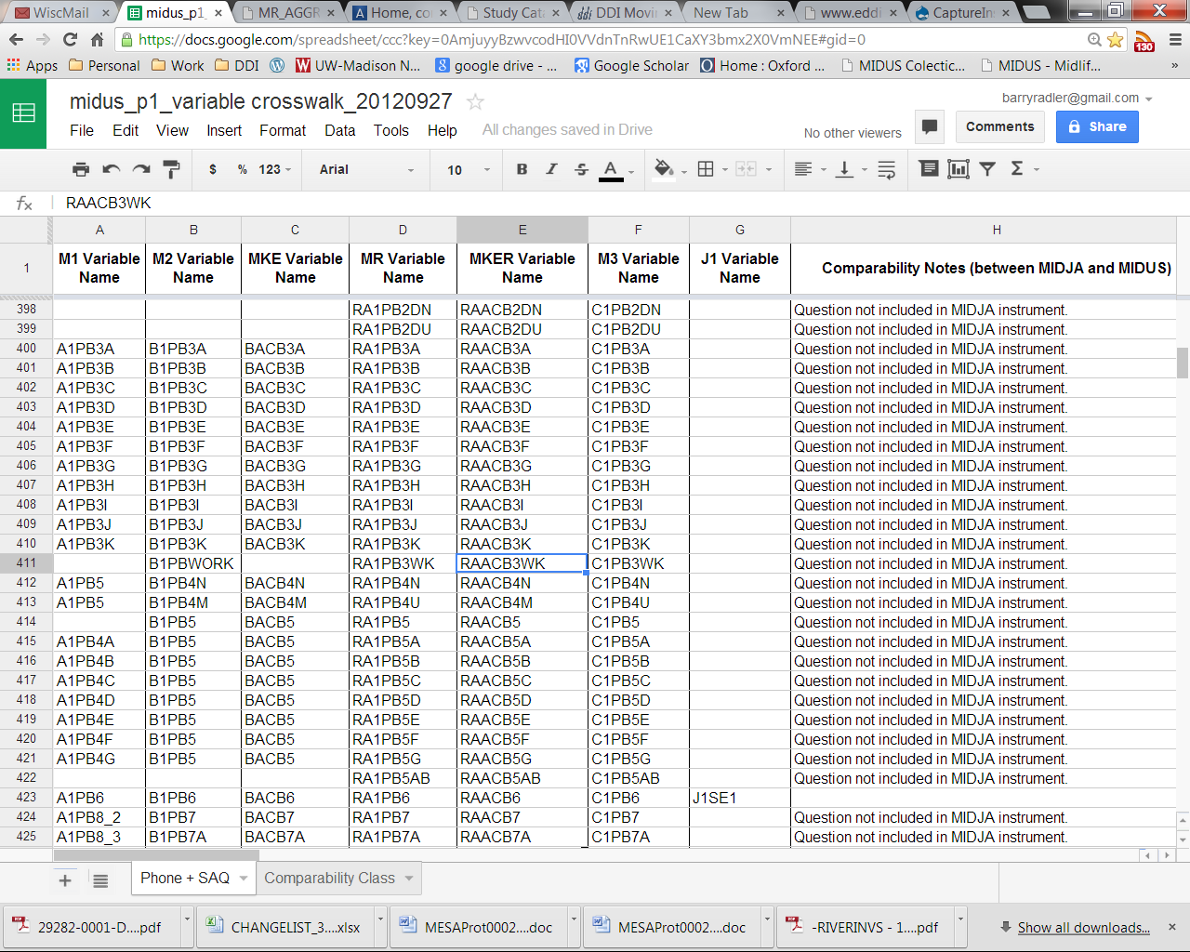
Harmonization
Notes:
Harmonization efforts will be largely informed by a Concordance table that has a record of each survey variable and it’s longitudinal and cross-cohort versions.
Also includes notes and descriptions of how the variables differ.

Slide 19
Harmonization
Concordance table
Includes “Comparability notes” and “Comparability class”
Example: Variable A1PA30 “time since last BP test”
“M1 is not directly comparable with M2, MKE, MR, MKER, M3: M1 responses were coded as number of months, while other waves broke out number and unit separately.”
Offer code/algorithm for reconcilation
Notes:
READ example.
Point will be to integrate this information in DDI codebooks.

Slide 20
Custom Data Extract
Customized dataset
Search variables, use shopping basket
Allow variables from across MIDUS
Merge different datasets
Different formats (csv, SPSS, SAS, Stata)
Associated DDI codebook
Notes:
Ultimate deliverable/output from CDE: ability to create custom datasets across multiple waves, projects, cohorts.
Again, my audience is Researchers – they love this capability! Finding and merging variables across multiple datasets can be very time-consuming and difficult. This function will result in a tighter relationship between data and metadata.
The DDI piece: Document the custom dataset (source data files, dates, programming syntax or code, harmonization information or algorithms, etc.) via DDI.

Slide 21
Development Milestones
1. Metadata Quality Report
2. Harmonization
3. Web-based Discoverability
4. Data Extraction

Slide 22
Step 1. Metadata Quality Report
Compare the harmonization spreadsheet to the Repository
Check for:
Missing information
Inconsistent labels
Inconsistent data types
Update the metadata to improve quality

Slide 23
Step 2. Harmonization
Use the harmonization spreadsheet
Create a RepresentedVariable for each row
Store these in the repository

Slide 24
Step 3. Web-based Discoverability
Build on top of Colectica Portal
Searching and information retrieval out-of-the-box
Add cross-reference tables for easy discoverability
Choose variables or groups of variables to include in the data extract

Slide 25
Step 4. Data Extraction
Store master data in Colectica Repository
Based on a user’s selected variables, generate:
Datasets
CSV, R, SAS, SPSS, Stata
HTML and PDF codebooks
DDI XML

Slide 26
Progress
 ✓ Complete | Metadata Quality Report
In Progress | Harmonization
Upcoming | Web-based Discoverability
Upcoming | Data Extraction

Slide 27
Thank you
Barry Radler – UW-Madison (bradler@wisc.edu)
Jeremy Iverson – Colectica (jeremy@colectica.com)
Dan Smith-Colectica (dan@colectica.com)
midus.wisc.edu
www.colectica.com

