Slide 1

Colectica 5 A New Generation of Open Metadata Tools

Slide 2
Colectica Overview
Standards-based metadata management
Survey design
Data documentation
Data lifecycle documentation

Slide 3
The Colectica Platform
Colectica Designer
Create, ingest, manage, and edit metadata
Colectica Repository
Centralized, authoritative, metadata store built on DDI 3, ISO 11179, and Web Service standards
Colectica Portal
Search and browse metadata from Colectica Repository
Usable DDI 3 for end-users

Slide 4
The Colectica Platform
Colectica SDK
Allows programmers to work with DDI 3 and interact with Colectica Repository
Colectica Toolkit
Command line utilities to perform specific tasks

Slide 5
New in Colectica 5
1. Aggregate data
2. Surveys and data collection
3. Eurostat data quality reporting
4. DDI 3.2
5. Translatable user interface
6. Addins

Slide 6
Aggregate Data

Slide 7
Microdata
Case ID | Gender | Married | Has Car
1 | M | Yes | Yes
2 | M | Yes | No
3 | M | No | Yes
4 | M | No | No
5 | F | Yes | Yes
6 | F | Yes | No
7 | F | No | Yes
8 | F | No | No

Slide 8
Aggregate Data
Dimensions
Measure
Gender | Is Married | Has Car | Count()
M | Yes | Yes | 15
M | Yes | No | 12
M | No | Yes | 20
M | No | No | 5
F | Yes | Yes | 16
F | Yes | No | 13
F | No | Yes | 22
F | No | No | 6
Footnotes

Slide 9
Aggregate Data (NCubes)
Two approaches
Describe an existing aggregate dataset
Create an aggregate dataset from microdata
Automatically link back to microdata

Slide 10
Presentation of Cubes
Normal
Gender | Is Married | Count()
M | Yes | 27
M | No | 25
F | Yes | 29
F | No | 28
Tabular
 | Married | Not Married
M | 27 | 25
F | 29 | 28

Slide 11
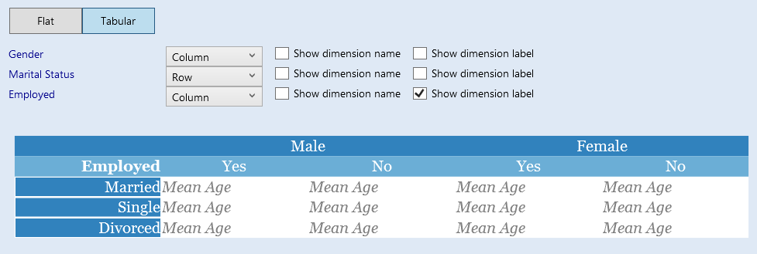
Previewing Cubes in Colectica 5
Tabular

Slide 12
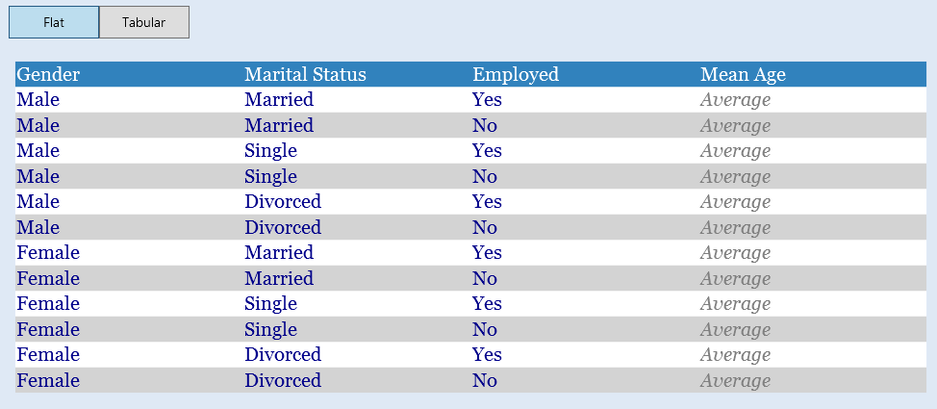
Previewing Cubes in Colectica 5
Flat

Slide 13
Surveys and Data Collection
New Question Types
Surveys with Data Flows
DDI Parameters and Bindings

Slide 14
New Question Types
Question Grids
Dynamic Rosters or Predetermined
Rankings
Distributions
Question Blocks
Other – Specify (AttachmentLocation)
Scales

Slide 15
Surveys with Data Flows
What is your name? Jeremy .
How did you get to EDDI?
Plane
Train
Automobile
Thanks for taking the survey, Jeremy.

Slide 16
DDI Parameters and Bindings
What is your name?
Output: Name
Binding
Source: Name (above)
Target: Name (below)
Input: Name
Thank you, {Name}.

Slide 17
Survey Visualizations
Live question preview
Flowcharts

Slide 18
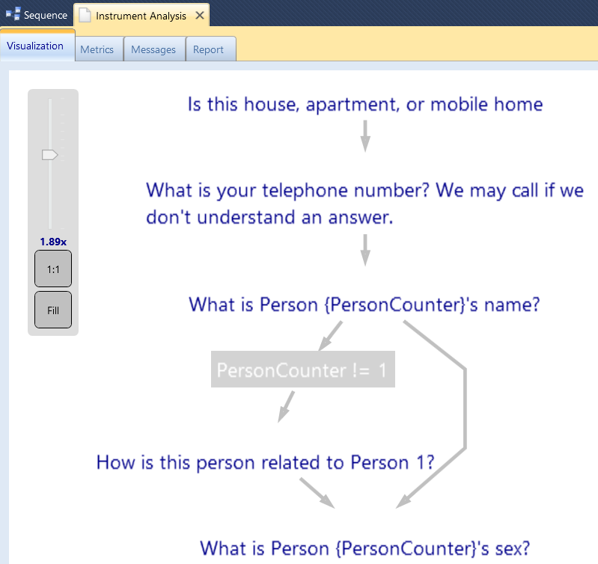
Flowchart Visualization

Slide 19
Data Collection System Integration
Deep integration with data collection systems
SPSS Dimensions
Blaise
CASES
CSPro
REDCap
QueXML
LimeSurvey
More…

Slide 20
Eurostat Quality Reporting

Slide 21
Eurostat Data Quality Reporting
DDI 3.2 QualityStatements
Export Eurostat-compliant SDMX reporting formats

Slide 22
DDI 3.2

Slide 23

Colectica and DDI 3.2
Support DDI 3.1 and DDI 3.2 simultaneously
Import and export both versions
(DDI 2 and other formats, too)

Slide 24
DDI 3.2 Advantages
Improved packaging for Web Services
The simple things are simple
Data flows for surveys/data collection instruments
Improved semantics for modeling data
Quality statements

Slide 25
Translatable User Interface

Slide 26
Translatable User Interface
750+ pieces of text
Until now, all of this is English-only
Solution: User-driven translation

Slide 27
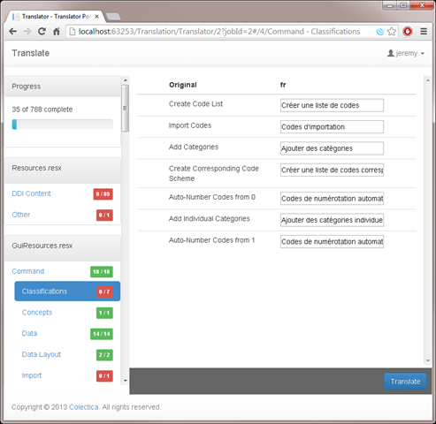
Translator Web Application

Slide 28
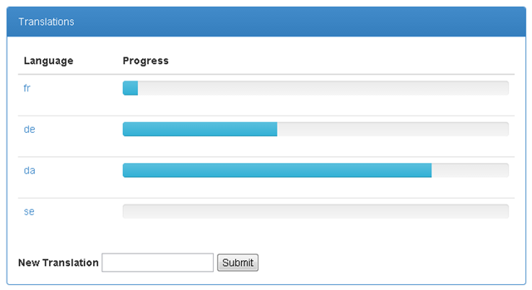
Translator Web Application

Slide 29
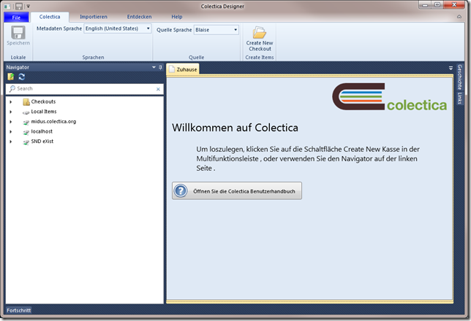
Translated User Interface

Slide 30
Addins

Slide 31
Colectica Addins
Customize Colectica’s appearance and behavior
Add new functionality

Slide 32

Colectica Addins
https://github.com/Colectica/ColecticaSampleAddins

Slide 33
Availability

Slide 34
Colectica 5 Availability
After official DDI 3.2 approval

Slide 35
See More
Stop by our Poster Session for more information and demonstrations

Slide 36



Thank you
 | Web | colectica.com
 | Blog | blogs.colectica.com
 | Twitter | @Colectica
 | YouTube | youtube.com/colectica

