Slide 1

Generating Blaise Surveys from DDI Lifecycle using Colectica
EDDI 2013

Slide 2

In This Talk
Overview of DDI Survey Documentation
DDI 2
DDI 3.0, 3.1
partial OWL-S process model
DDI 3.2
complete OWL-S process model

Slide 3
In This Talk – II
Use Cases
Specifying Survey Instruments in DDI-L
Mapping DDI-L to Blaise
Generating Blaise Source Code

Slide 4
Use Case #1
Wisconsin Longitudinal Survey in 2006
Jeremy Iverson – WLS
Dan Smith – IBM AdTech
Create Flow Charts for documentation
Parse CATI Code
Automate Manual Flowchart Drawing
Store information in some standard format

Slide 5
DDI 2
Documents variables in a dataset
Question text from a survey is associated with a single variable
No detailed description of the question or response options
No question flow, only simple forward and backward links

Slide 6
DDI 2
DDI 2 fails
Not descriptive enough for creating flow charts (use case #1)
Need flow control logic

Slide 7
DDI 3.0
Join DDI Instrument Documentation Committee
Recommend OWL-S process model to describe instrument flow
Only import control flow portion, to meet use case #1

Slide 8


OWL-S – Part 1
Sequence A
Question 1
Question 2
Question 3
Sequence B
If Then
Question 4
Question 5
Question 6

Slide 9
DDI 3.0 and 3.1
DDI 3.0 a success
Flow model stays the same in DDI 3.1
Describes instrument flow
Textual description of conditions for if/then, loops, and dynamic text
Use case #1 is implemented

Slide 10
Use Case #2
Create surveys using a Question Bank and Generate Blaise from DDI
DDI 3.0 and 3.1 are not enough
Can not share questions and sequences across surveys due to lack of scope

Slide 11
OWL-S – Part 2
Sequence A
FNAME
OUTPUT : FNAME
What is your first name?
Binding
AGE
INPUT: personName
What is {personName}’s age?
OUTPUT : AGE
TRANSPORT
How did you arrive?
OUTPUT : TRANSPORT

Slide 12
DDI 3.2
DDI 3.2 includes full OWL-S process model
Questions and sequences can be reused directly across studies
Scoping is well defined
No longer a monolithic instrument
Use case #2 is achievable

Slide 13
Creating DDI 3.2 instruments
Full support in Colectica Designer
Drag and Drop Questions and Sequences from repository onto new instruments
Automatically create Out-Parameters
Show all possible in scope In-Parameters, add them along with parent bindings when used

Slide 14
Generating CATI Code
Colectica Generates CATI Code
Blaise
SPSS Dimensions
Cases
CS Pro
QueXML
LimeSurvey
REDCap

Slide 15
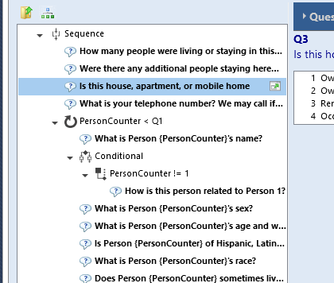
Generate Blaise Code

Slide 16
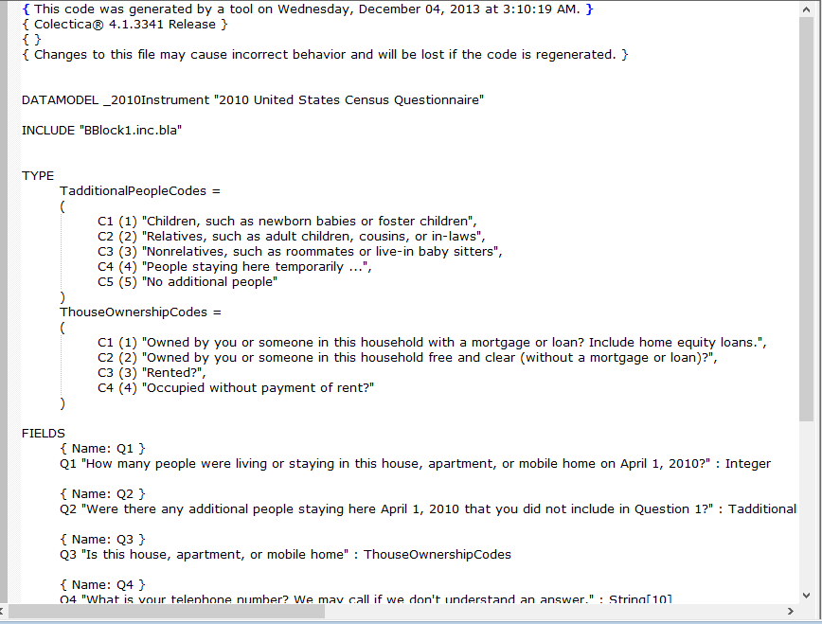
Generate Blaise Code

Slide 17
Main Take Away
Use DDI 3.2
Generate your CATI code
Eliminate errors, save time, and enable harmonization
Get in touch with us for Collaboration Opportunities

Slide 18



Thank you
 | Web | colectica.com
 | Blog | blogs.colectica.com
 | Twitter | @Colectica
 | YouTube | youtube.com/colectica

