Slide 1
Nesstar REST-API
Ørnulf Risnes
Norwegian Social Science Data Services (NSD)
EDDI 2013 Paris, 3 December

Slide 2
Nesstar – From Tool to Toolkit
API plan presented in IASSIST 2011:
API to focus on:
Max ROI on DDI2-investments (DDI-C)
Flexibility
Usefulness!

Slide 3
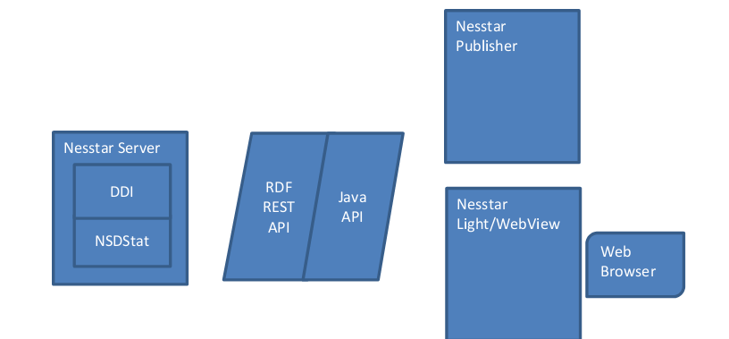
1.0) Nesstar Software Suite (current version 4.0.6.1)

Slide 4
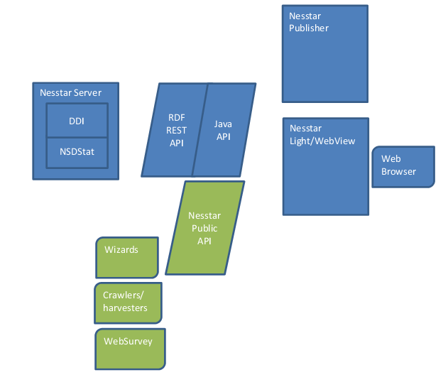
2.0) The Java API (current version 0.6.5)

Slide 5
3.0) The REST API (current version 0.3.0)

Slide 6
Great things about the Nesstar REST-API
Simple, easy to use
Self-contained, no dependencies
Platform agnostic
Clientside/serverside agnostic
It’s open source

Slide 7


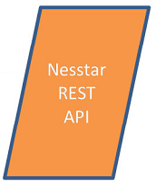
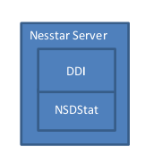
Architecture
Standalone server
Runnable «fat jar»
Dropwizard
Embedded Jetty
1:1 relationship with Nesstar Server
URL in config-file

Slide 8
What can you do with the Nesstar REST-API?
Enrich your webpages
European Social Survey
New applications
NSD Touch
Embeddable widgets
Download interfaces
Online command line stat tool

Slide 9
How to begin?
Clone it from NSD’s GitLab
Build and run
Use Gitlab wiki for documentation
https://prosjekt.nsd.uib.no/gitlab/nesstar/nesstar-rest-api/wikis/home
????
Success!!

Slide 10
REST API + Tutorial available
REST API https://prosjekt.nsd.uib.no/gitlab/nesstar/nesstar-rest-api
REST API Tutorial
https://prosjekt.nsd.uib.no/gitlab/rfm/rest-tutorial

Slide 11
Thank you

