Slide 1

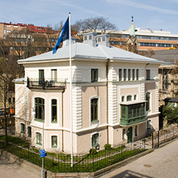

DDI at the Swedish National Data Service

Slide 2
Agenda
About SND
Current capturing of metadata
Metadata flow within SND – Today
Metadata flow within SND – Future plans
XSLT Stylesheets for creation of codebooks
Using DDI for metadata harvesting from external agencies
2010-12-08
www.snd.se

Slide 3
About SND
SND is an initiative of the Swedish research council, it is situated at University of Gothenburg and financed jointly by the research council and the university
SND focuses on:
Data collection and dissemination
Data protection, documentation and availability
The development of standards and tools used for documentation and making data available
Legal and ethical aspects when databases are established and also in the management of data and its availability
Support and guidance during the research process
Participation in and support for the establishment of competence within secondary analysis of the data
2010-12-08
www.snd.se

Slide 4
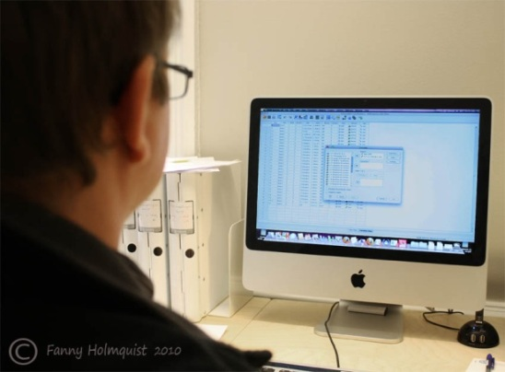
Current capturing of metadata
Study level documentation
SIMS – SND’s Internal Management System
In-house developed system
DDI based (combination of versions 2 and 3)
Exports and imports DDI 2, Exports parts of DDI 3
Contains documentation of study and variable level elements, other materials, publications, projects, series, contacts, organisations, disseminations and more
Drawback. Can’t import metadata from SPSS
Variable level documentation
Nesstar
2010-12-08
www.snd.se

Slide 5
Metadata flow within SND – Today
Nesstar
SIMS
DDI2
DDI3 (Resource package)
eXist
wsdl
SND Online Catalogue
SND Question Bank
2010-12-08
www.snd.se

Slide 6

Some info about eXist
Open source database management system built using XML technology.
Stores XML data according to the XML data model.
Features efficient, index-based XQuery processing.
Easy to access using wsdl
Good base for building web services
2010-12-08
www.snd.se

Slide 7
Metadata flow within SND – Future plans
Nesstar
SIMS
DDI2 (DDI3?)
DDI3 (Resource package, Study Units)
DDI2
eXist
xForms
xForms
Dataverse
SND Online Catalogue
SND Question Bank
2010-12-08
www.snd.se

Slide 8

XSLT Stylesheets for creation of codebooks
Currently only DDI2
Planned for DDI3 first half 2011
2010-12-08
www.snd.se

Slide 9

Using DDI for metadata harvesting from external agencies
SND’s mission
SND should have a overview of which research materials that are available for researchers in Sweden
Project with Statistics Sweden
Mapping ISO 11179 to DDI3
Plans to also include other organisations, e.g. Board of Health
2010-12-08
www.snd.se

Slide 10
Contact
http://www.snd.gu.se
Hans Jørgen Marker – h.j.marker@snd.gu.se
Iris Alfredsson – iris.alfredsson@snd.gu.se
Johan Fihn – johan.fihn@snd.gu.se
Olof Olsson – olof.olsson@snd.gu.se
2010-12-08
www.snd.se

Slide 11
Questions?
2010-12-08
www.snd.se

