Slide 1
DataCite: Making Data Citable
Jan Brase (DataCite/TIB Hannover)
Brigitte Hausstein (GESIS)
Wolfgang Zenk-Möltgen (GESIS)

Slide 2
Introduction: Where do we stand?
  Data is difficult to manage after project funding ends
  No direct access to data
  No widely used method to identify datasets
  No widely used method to cite datasets
  No effective way to link between datasets and articles
  Datasets are not included in impact analysis

Slide 3
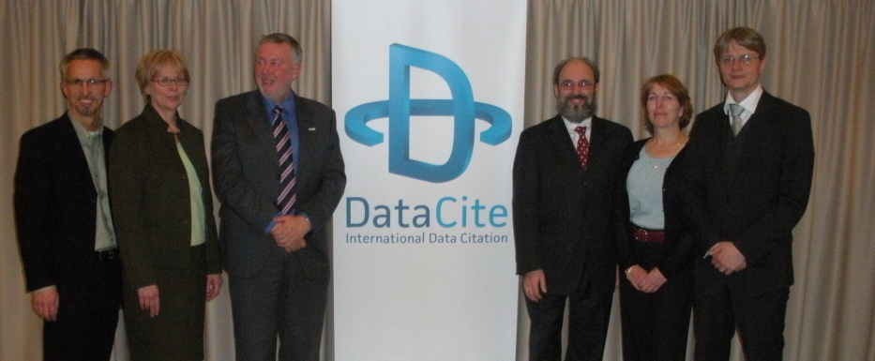

DataCite
Establishes easier access to scientific research data
Increases acceptance of research data
Supports persistent identification of data using the DOI system
Supports archiving of data for verification and re-use
DataCite is global consortium founded in London 1 Dec 2009
Copyright picture: Jan Brase, Irina Sens, Michael Lautenschlager: The Tenth Anniversary of Assigning DOI Names to Scientific Data and a Five Year History of DataCite. In: D-Lib Magazine, January/February 2015, Volume 21, Number 1/2, DOI:10.1045/january2015-brase https://www.dlib.org/dlib/january15/brase/01brase.html, Figure 5: The first board of DataCite on December 1st, 2009: Alfred Heller (DTIC), Pam Bjornson (CISTI), Uwe Rosemann (TIB), President Adam Farquhar (BL), Patricia Cruse (CDL) and Jan Brase (TIB) as the managing agent.

Slide 4

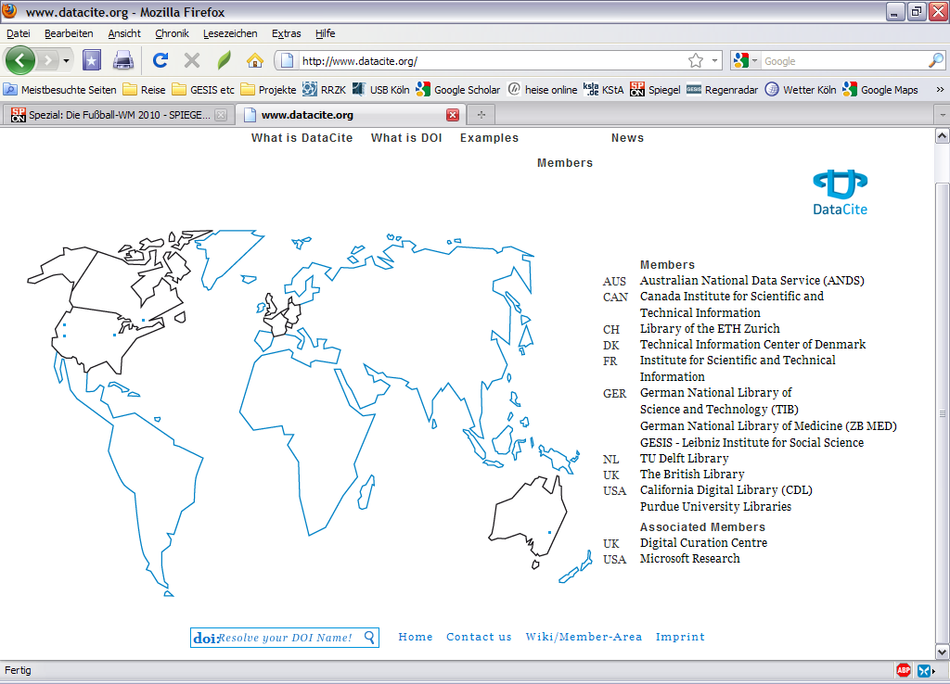
Membership
Fifteen members across ten countries
Over 800,000 records registered with DOI names so far

Slide 5
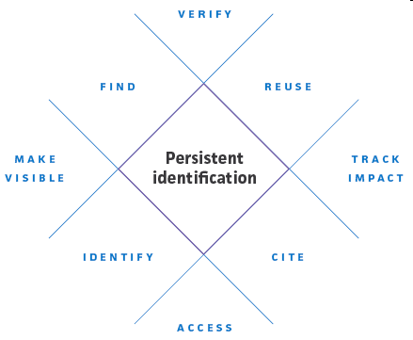
Supporting the community
Researchers by enabling them to locate, identify, and cite research datasets with confidence
Data centres by providing workflows and infrastructure to identify and cite datasets
Publishers by enabling research articles to be linked to the underlying data

Slide 6
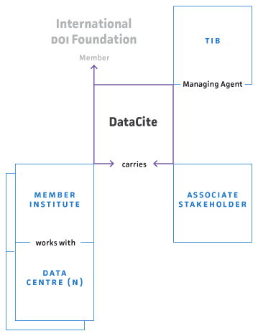
Structure and responsibilities
DataCite (registration agency):
Maintains the resolution infrastructure
Maintains a searchable database of metadata
Manage DOI over the long term
Establishes best practice
Allocation agencies (DC member institutes)
Creating the identifier
Quality assurance
Maintains a searchable database of metadata
Establishes best practice
Publishing agents (data centers, data publishers):
Data storage and access
Creating and updating metadata

Slide 7
Registration agency for social science data: da|ra
since February 2010 GESIS member of Datacite
Pilot project March - December 2010
  Technical and organisational concept
  Meta data schema
  Technical implementation and registration of data sets (GESIS data archive: EVS, Eurobarometer etc.)
  2011-2013 Implementation of a registration portal for social and economic data; including upgrade of services

Slide 8
Technical system (SOA)
USER
PUBLICATION
AGENT
RESOLVING
SERVICE
DOI
FOUNDATION
search
edit/import
DataCite
INDEXING
SERVICE
INDEXING
SERVICE
da|ra
INFORMATION
SYSTEM
REGISTRY
SERVICE
REGISTRY
SERVICE
METADATA
STORRAGE
DDI
SERVICE
DDI
SERVICE

Slide 9
da|ra policy framework
da|ra policy
General policy for the assignment of Digital Object Identifiers (DOI)
Service Level Agreement (SLA)
Basis for the cooperation with publication agents
Guidelines & Best practices

Slide 10

Register: Who & what?
Who?
  Data Archives
  Research Data Centers
  Service Data Centers
Future: individual Researchers (via self archiving)
What?
  survey data
  aggregate data
  micro data
  qualitative data
Future: pictures, further data formats, scales

Slide 11
DataCite metadata kernel
Goals
  Recommend a citation format for datasets
  Provide the basis for interoperability
  Promote dataset discovery
  Lay the groundwork for future services
Status
  August 2010: Draft kernel available for community review
  September 2010: Comment period ended
  Comments from 37 individuals, 24 outside of DataCite institutions
  Until 1st quarter 2011: Publish final metadata kernel

Slide 12
DataCite metadata properties
Mandatory properties
  Identifier (currently DOI)
  Creator (repeatable)
  Title (Subtitle, Alternative Title, Translated Title - repeatable)
  Publisher
  Publication Year
Optional properties (all repeatable)
  Discipline
  Contributors (of several types, like Contact Person, Data Collector etc.)
  Dates (of several types, e.g. Available, Created, Accepted etc.)
  Resource Types, Descriptions, AlternateIdentifiers
  Format, Version, Size, Language
  Relationship to other resources

Slide 13
DataCite mandatory metadata properties I
(work in progress)
ID | Property Name | Definition | Occ
1 | Identifier | A globally unique persistent identifier associated with a resource. This is the primary identifier of the resource, and the one that will be used in any citation of the resource. | 1
1 .1 | identifierScheme | The name of the persistent identifier scheme. | 1 | Controlled List Allowed values: DOI
2 | Creator | The main researchers involved in producing the data, or the authors of the publication in priority order. | 1-n | The personal name format may be distinguished by using the namePart attribute.
2.1 | nameIdentifier | Uniquely identifies an individual or legal entity, according to various schemes. | 0-1 | The format is dependent upon scheme.
2.2 | nameIdentifierScheme | The name of the name identifier scheme. | 1 | Examples are ORCID, ISNI
2.3 | namePart | The parts of a personal name. | 0-1 | Allowed values: family, given

Slide 14
DataCite mandatory metadata properties II
(work in progress)
ID | Property Name | Definition | Occ
3 | Title | A name or title by which a resource is known. | 1-n | The format is open.
3.1 | titleType | The type of the title. | 0-1 | Controlled List Allowed values: AlternativeTitle Subtitle TranslatedTitle
4 | Publisher | A holder of the data (including archives as appropriate) or institution which submitted the work. Any others may be listed as contributors. This property will be used to formulate the citation, so consider the prominence of the role. In the case of datasets, "publish" is understood to mean making the data available to the community of researchers. | 1
5 | PublicationYear | The year when the data was or will be made publicly available. If an embargo period has been in effect, use the date when the embargo period ends. | 1 | Format: YYYY

Slide 15
da|ra metadata schema
Goals
  Support the DataCite metadata kernel
  In addition: Domain specific possibilities for retrieval and discovery
    Social sciences
    Economics
  Support German and English metadata
  To be further developed with publication agents

Slide 16
da|ra metadata properties
Mandatory properties
  All DataCite mandatory properties
  Dates of Data Collection
  Topic Classification
  Language, Last Edition, Availability Status
  Other internally required properties
Optional properties
  All DataCite optional properties
  Universe, Selection Method
  Area of Collection (repeatable)
  Collection Mode
  Publications (repeatable)
  Links (repeatable)

Slide 17
da|ra mandatory metadata properties
(work in progress)
ID | Property Name | Mapping to DataCite | Definition | Occ
1 | Title | Title | Title of the dataset. | 1
3 | DOI | Identifier (type = DOI) | Persistent Identifier (DOI) assigned to the resource. | 1
4 | URL |  | Uniform Resource Locator that will be registered with the DOI. | 1-n
6 | Internal ID | AlternateIdentifier | Internal ID for the da|ra-System | 1 | Assigned by the da|ra-System
7 | Publisher | Publisher | Name of the publication agency for the resource. | 1
8 | Registration Agency (Homepage, Contact, E-mail) | Contributor (type = Registration Agency) | Name of the registration agency (“GESIS da|ra”). | 1
9 | Dates of Data Collection | Date (type = Start/End) | Description of the time the data was gathered. | 1-n
10 | Principal Investigator (Name and/or Institution) | Creator (type = Data Collector) | Name and/or Institution of the Principal Investigators. | 1-n
17 | Topic Classification | Description (type = Keywords) | Classification of the datasets topics covered. | 1-n
19 | Language | Language | Language of the dataset. | 1
20 | Last Edition | Version | Version description of the dataset. | 1
21 | Publication Date | Publication Year | Date the dataset was made publicly available. | 1
29 | Availability Status | Rights | Description under which conditions the data is available. | 1

Slide 18
da|ra mandatory metadata properties in DDI 3
<s:StudyUnit id="GESIS1234_SU">
<r:UserID type="da|ra internal ID">internal ID</r:UserID>
<r:Citation>
<r:Title xml:lang="en"> English Title </r:Title>
<r:Title xml:lang="de"> German Title </r:Title>
<r:Creator affiliation="Principle Investigator Institution"> Principle Investigator Name </r:Creator>
<r:Publisher> Publisher </r:Publisher>
<r:Contributor role="Registration Agency"> Registration Agency </r:Contributor>
<r:PublicationDate>
<r:SimpleDate> Publication Date </r:SimpleDate></r:PublicationDate>
<r:Language> Language </r:Language>
<r:InternationalIdentifier type="DOI"> DOI </r:InternationalIdentifier>
</r:Citation>
<s:Abstract id="">
<r:Content>Study Description</r:Content></s:Abstract>
<r:UniverseReference><r:ID>UNIVERSE_REF</r:ID></r:UniverseReference>
<s:Purpose id="">
<r:Content>Study Documentation of GESIS1234</r:Content></s:Purpose>
<r:Coverage>
<r:TopicalCoverage id=""><r:Subject> Topic Classification </r:Subject>
</r:TopicalCoverage></r:Coverage>

Slide 19
da|ra mandatory metadata properties in DDI 3 (cont.)
<dc:DataCollection id="">
<dc:CollectionEvent id="">
<dc:DataCollectionDate>
<r:StartDate>Start Date</r:StartDate>
<r:EndDate>End Date</r:EndDate>
</dc:DataCollectionDate></dc:CollectionEvent></dc:DataCollection>
<pi:PhysicalInstance id="“version="1.0.0">
<r:VersionRationale>Last Edition (Version Description not in Format n.n.n)</r:VersionRationale>
<pi:RecordLayoutReference><r:ID>RecLayRef</r:ID></pi:RecordLayoutReference>
<pi:DataFileIdentification id="“>
<r:UserID type="DOI"> DOI </r:UserID>
<pi:URI>URL</pi:URI></pi:DataFileIdentification></pi:PhysicalInstance>
<a:Archive id="">
<a:ArchiveSpecific>
<a:ArchiveOrganizationReference>
<r:ID>ArchiveOrg</r:ID></a:ArchiveOrganizationReference>
<a:Item>
<a:Access id=""><a:AccessConditions>Availablity Status</a:AccessConditions>
</a:Access></a:Item></a:ArchiveSpecific>
<a:OrganizationScheme id="">
<a:Organization id="ArchiveOrg"> <a:OrganizationName>GESIS</a:OrganizationName></a:Organization>
</a:OrganizationScheme></a:Archive>
</s:StudyUnit>

Slide 20
Metadata interoperability
Conclusions
  DDI 3 can hold DataCite mandatory metadata properties
  DDI 3 can also hold da|ra mandatory metadata properties
  Mapping for optional properties has to be done
  Increased visibility for research data from social science and economics

Slide 21
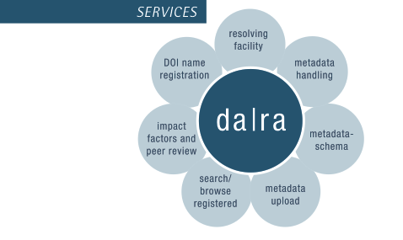
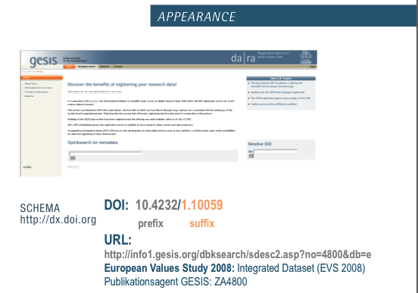
www.gesis.org/dara
da|ra: 4465 registered studies

