Slide 1
Keeping Up With Questasy
Alerk Amin
Notes:
Because some people in the audience are more familiar with Questasy than others, I'll start
off by overviewing the issues Questasy solves, then talk more specifically about how the
product works and show a demo.

Slide 2
CentERdata
Research institute
Tilburg University, Netherlands
Data collection
Manage several panels
Quantitative Analysis
Software solutions
Notes:
Non-profit organization founded in 1997
Manage panels including the LISS Panel of the MESS Project, the CentERpanel, the DHS Panel, and more
Software solutions
Several tools for data collection and dissemination for major research projects including
LISS panel in Netherlands
Understanding Society in UK
European Values Study & SHARE project across Europe
DDI tools include Questasy and DatapluS project

Slide 3
Questasy
Web application based on DDI 3
Manages data & metadata
Administrator Interface
Data entry without DDI knowledge
Live in January 2009
Researcher Interface
Browse/search metadata, download data
Live in March 2009
Notes:
Questasy is a web application
Manages the metadata and data files, primarily for longitudinal panels
The admin interface went live in January 2009, and that’s when metadata entry started.
The researcher interface went live 2 months later for researchers to access the data/metadata

Slide 4
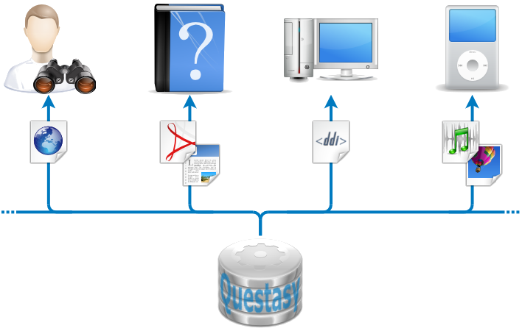
Questasy - Dec 2009

Slide 5
Questasy Releases
3.3 – March 2010
3.3.1 - August 2010
SSL for login & change password pages
Edit contact info & passwords
Enter publications
Publications
Related to Study Units
Moderated
RSS feed for notifications
Database constraints
For valid DDI 3.1 export
User Profiles

Slide 6
Questasy 3.4 – January 2011
Multiple panel support
Agency-wide application
DDI ResourcePackage support
Question bank

Slide 7
Questasy 3.4 – January 2011
Multiple panel support
XHTML+RDFa support
Dublin Core metadata
Study Units & Publications

Slide 8
Questasy 3.4 – January 2011
Multiple panel support
XHTML+RDFa support
Docbook XML
HTML/Word & PDF
Paper codebook output

Slide 9
Questasy 3.4 – January 2011
Multiple panel support
XHTML+RDFa support
DDI 3.1 XML Output
Paper codebook output
Output Study, Panel, or Project

Slide 10
Questasy 3.4 – January 2011
Multiple panel support
ddiPodcast support
XHTML+RDFa support
DDI 3.1 XML Output
Podcasts for questionnaires & datasets
Subscribe with iTunes
Paper codebook output

Slide 11
Questasy (January 2011)
Notes:
Web interface, search, download statistics, RSS feeds are in production.
DDI & iPod output are currently in development
Word/PDF output is planned for this year

Slide 12
Licensing
License agreement available
Available for non-profit scientific & government institutes
Provided “as-is” for free
including source code

Slide 13
For More Information
Speak
with Eric Balster or me
See
The live website at www.lissdata.nl
Read
The Questasy Use Case at www.ddialliance.org
The documentation at www.centerdata.nl/link/questasy

