Slide 1

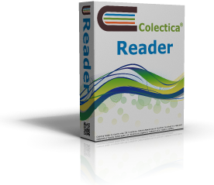


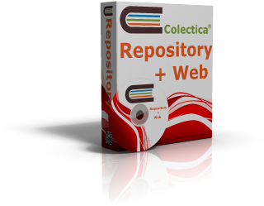

Colectica: A Platform for DDI 3 based Metadata Management
Design. Collect. Share.

Slide 2


Slide 3

Introduction

Slide 4
Colectica Designer and Repository
Colectica Reader – Free DDI 3 Viewer
Creating and Managing DDI3
Importing into DDI3
Generation from DDI3
Demonstration

Slide 5

Colectica Reader – Free DDI 3 Viewer
View DDI 3
Survey Flow Visualizations
All DDI 3 items
Validate DDI
Second Level Validation
XML View
Free!

Slide 6
Creating and Managing DDI3
Survey Instruments
Classifications
Concepts
Universes
Questions
Variables
Studies
Datasets
etc.

Slide 7
Import into DDI 3
Colectica can import/convert into DDI 3
Survey instrument source code
Blaise, CASES
DDI 2 / Nesstar
SPSS Statistical .sav data files
Delimited metadata
More

Slide 8
Generation from DDI 3
Use the DDI 3 metadata to generate everything you need
Survey instruments (Blaise, CASES, CSPro)
Paper questionnaires
Statistical source code (R, SAS, STATA, SPSS)
Codebooks / Paper documentation
Web documentation
More

Slide 9
Colectica Designer Walkthrough
Importing / Converting existing sources into DDI 3
Survey Designer
Repository
Multiple users / simultaneous editing
Version history
Checkout and Syncronization

Slide 10
Thank you
Dan Smith
dan@colectica.com
http://www.colectica.com/

