Slide 1
DDI + API
Building services on top of
your existing DDI holdings
Ørnulf Risnes
Norwegian Social Science Data Services
EDDI2010, Utrecht, 9 December 2010
<ornulf.risnes@nsd.uib.no>

Slide 2
Agenda
Introduction
Perspective: Metadata reuse. Existing holdings and technology
New NSD-tools – a quick glance
ESS Multiwave Download Wizard
Metadata-harvester/indexer (Nesstar2Solr)
Nesstar API overview
The new tools revistited
How do they use the API?
Notes:
We have a lot to go through today.
First, I will demonstrate and talk you through the use of Nesstar Publisher v. 4.0
Then we have a look at WebView 4.0 and a quick glance at the Server itself.
These ”component” sessions will be separated by 5-minute Q&A-sessions.
At the end, you will be given some hands-on tasks.
The hands-on tasks will be WebView-only.
A beta-version of Nesstar Publisher will be made available at the end of the workshop. You can test it out for 60 days (a period which can be pro-longed if necessary).
You will be able to use the hand-outs you have received as a quick-reference ”manual” when using the new Publisher. The current draft of the complete documentation will also be included.
The reason for NOT going hands-on with Publisher here today, is that we try to cover most of the new features in three hours. This cannot be done in a hands-on-session – for that we would need two days IMHO.

Slide 3
Perspective
NSD/ESS-team:
Wanted to document/publish data in Nesstar
Needed another client than WebView for multiwave-file
NSD/Survey-archive-team:
Wanted to repurpose Data/Metadata already in Nesstar to build a searchable question (and study) database for >200k variables
Generalized:
Building new services on existing holdings is a great idea, that can...:
save time
save work
reduce errors/duplication
be phased in incrementally

Slide 4

Perspective cont.
Hard VS Soft reuse
Hard reuse:
Build solid relations between metadata-”atoms” from the start.
Build services to join and use related materials
Soft reuse:
Publish what you’ve got
Add an API on top
Index everything
Add APIs to your index too
Infer new ”relations” not built into the system
  Information retrieval/”metadata mining”

Slide 5
New tools
ESS Multiwave Download Wizard
Metadata-harvester/indexer

Slide 6
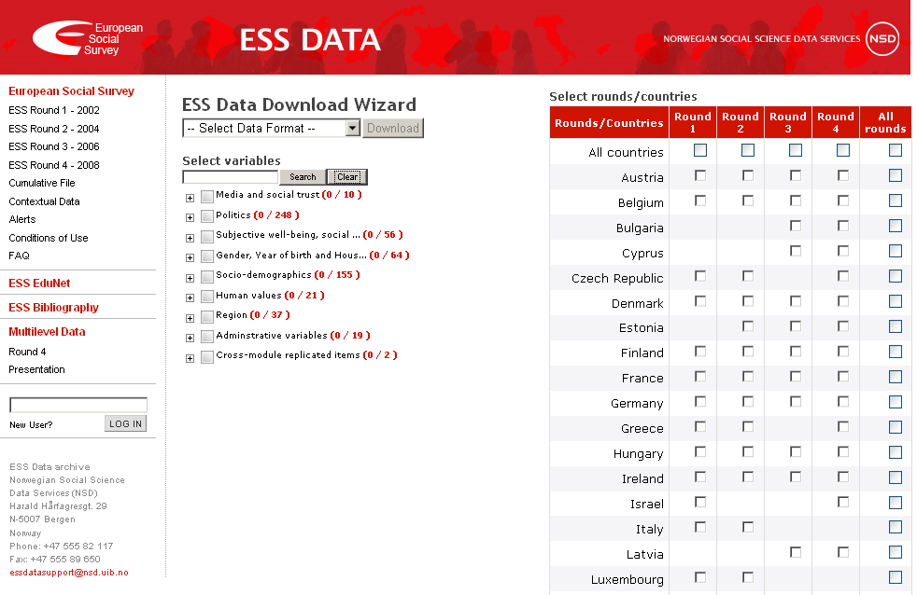
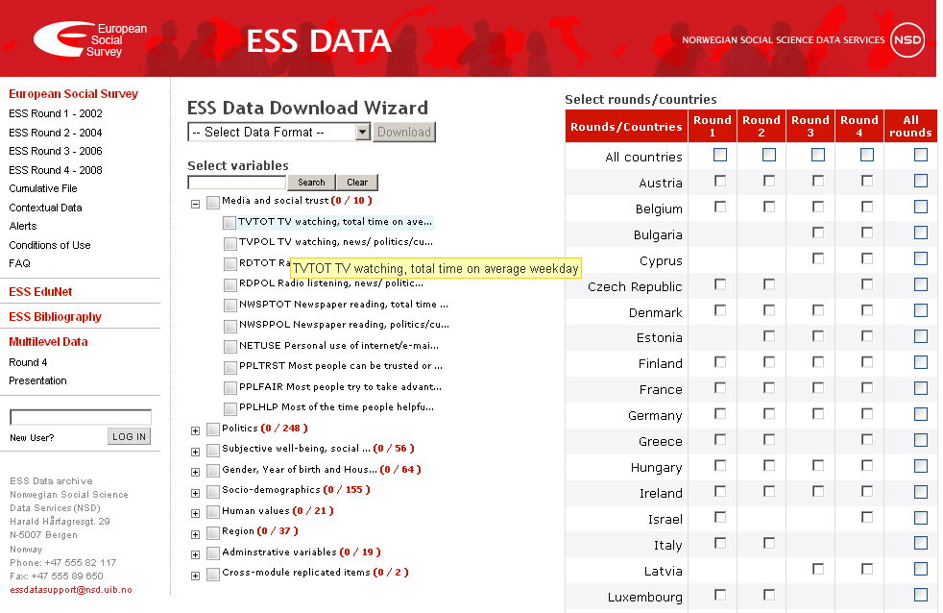
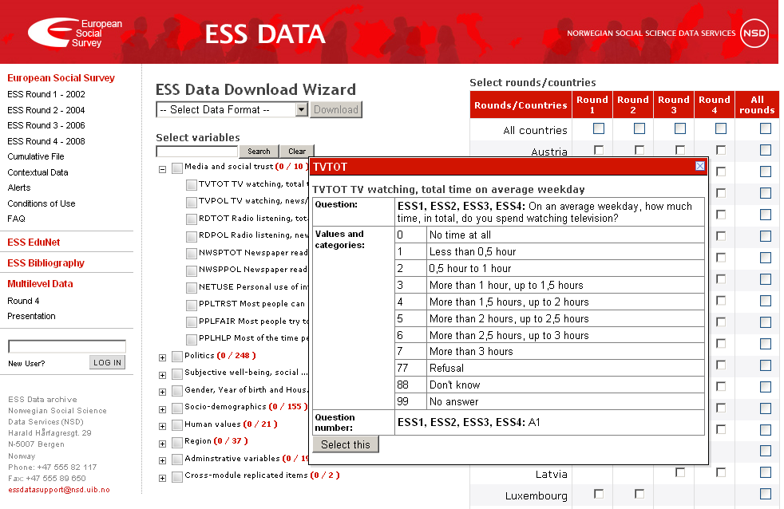
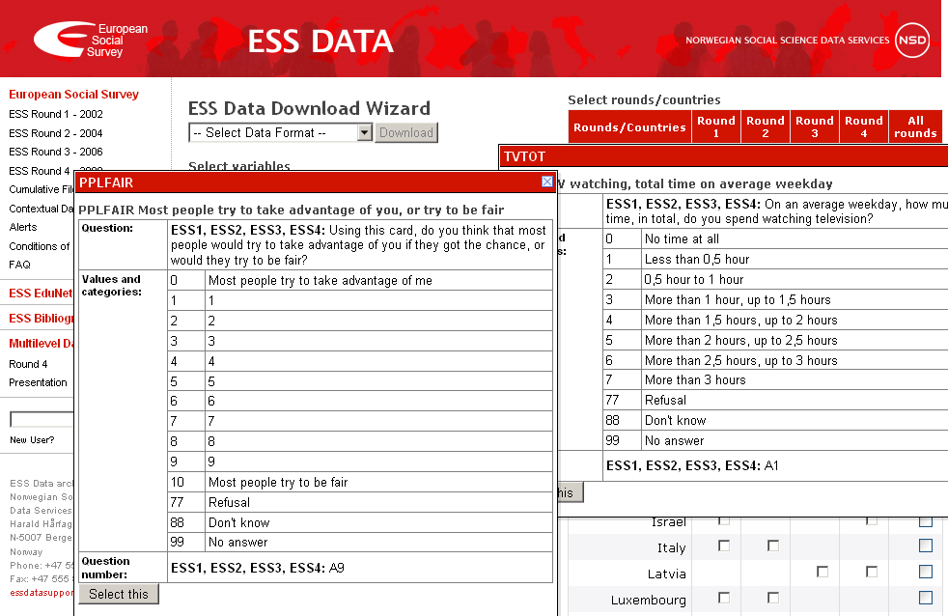
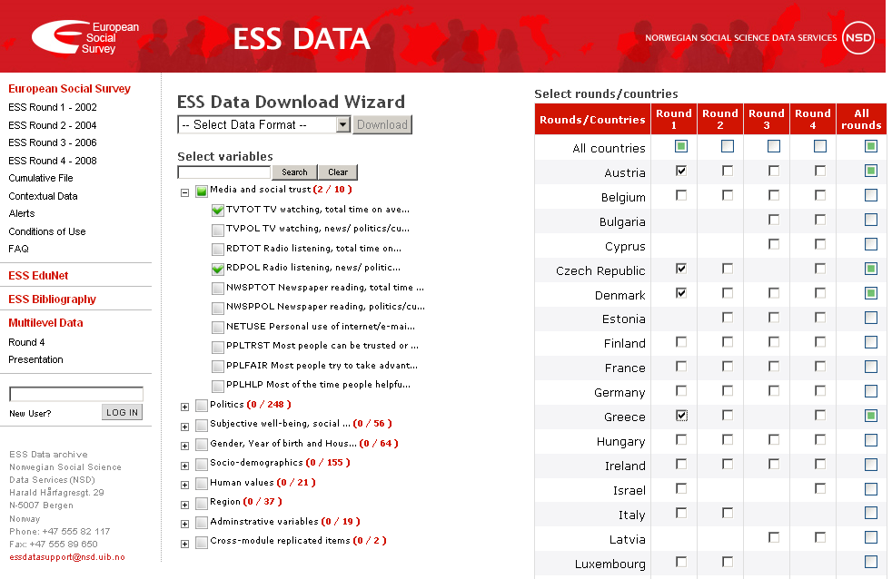
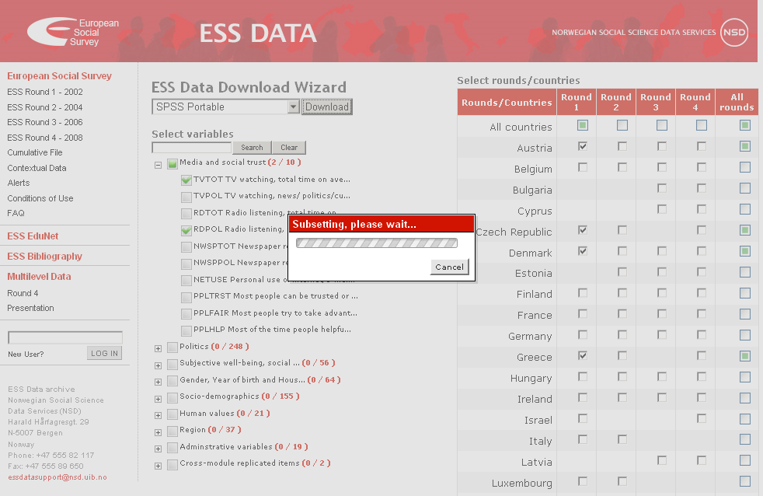
ESS Multiwave download wizard

Slide 7
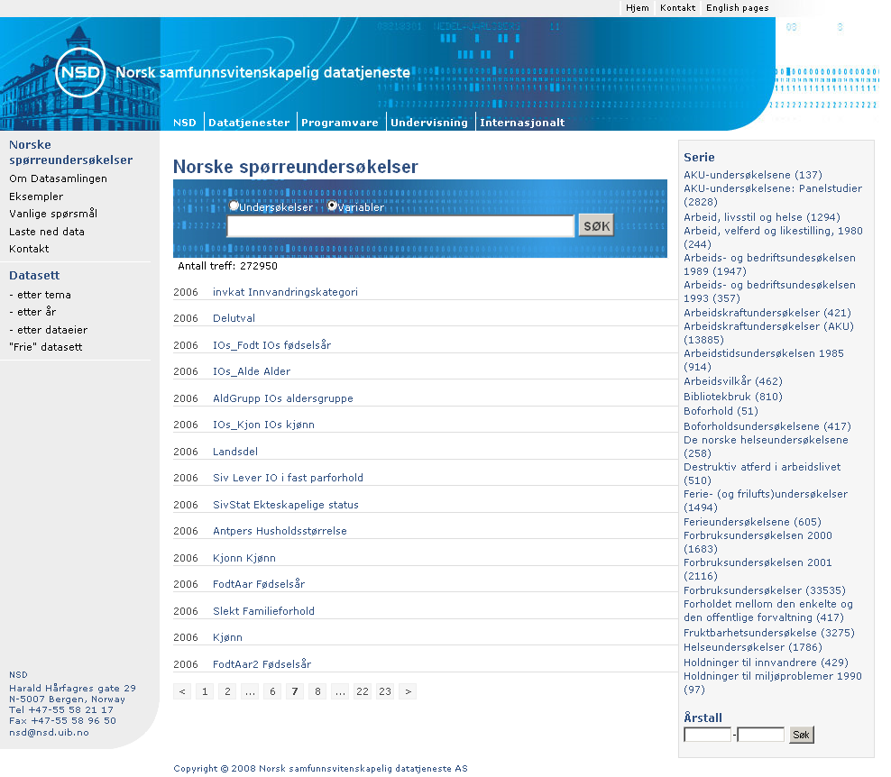
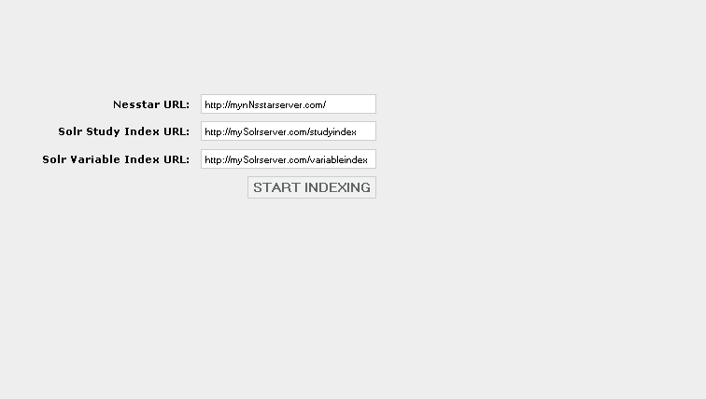
Metadata harvester/indexer
Nesstar2Solr
Start page
273 000
variables
Filtering
”facets”

Slide 8
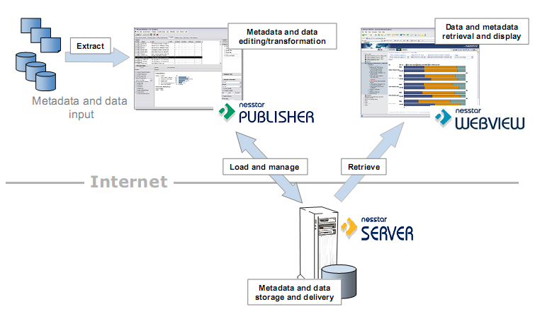
Nesstar API overview
Third party
clients,
harvesters,
download wizards

Slide 9
Nesstar Server as a platform
Nesstar Server
Data
file
DDI
Data
file
API
DDI
Data
file
DDI
Clients

Slide 10
Nesstar API overview cont.
Object oriented
Web-based (http/REST)
A server is a traversable collection of objects
Barebone (http+RDF) or
Java-implementation available (nesstar-api.jar)
Cached
Domain classes
Variable
Study
VariableGroup
Support classes
Server
Catalog
Banks (Homes)
ServerHome
CatalogHome
StudyHome
VariableHome

Slide 11
Nesstar API overview cont.
Domain classes
Study
Variable
Properties
aVariable.getLabel()
aVariable.getQuestionText()
Behaviour
aStudy.download(..)
aStudy.tabulation(V1 by V2)

Slide 12
Nesstar API overview cont.
Support classes
Server
Catalog
Initialization
Server aServer =
new Server(”http://...”);
Traversal
aServer.getChildren()
aServer.getCatalogs()
aCatalog.getDatasets()

Slide 13
Nesstar API overview cont.
Object banks (Homes)
ServerHome
CatalogHome
StudyHome
VariableHome
Lookup
aStudyHome.findByKey(”xyz”)
aVariableHome.findByKey(”xyz_v343”)
List all
aCatalogHome.findAll()
aStudyHome.findAll()
aVariableHome.findAll()

Slide 14
Nesstar API overview cont.
Proxy classes, cache
HEAD
Nesstar Server
API client
Study
Label
Abstract
Study
Label
Abstract
Universe
CollMeth
Embargo
ObscureProp
Universe
CollMeth
Embargo
ObscureProp
BODY
- fetched on demand
HEAD and
BODY cached
client side

Slide 15
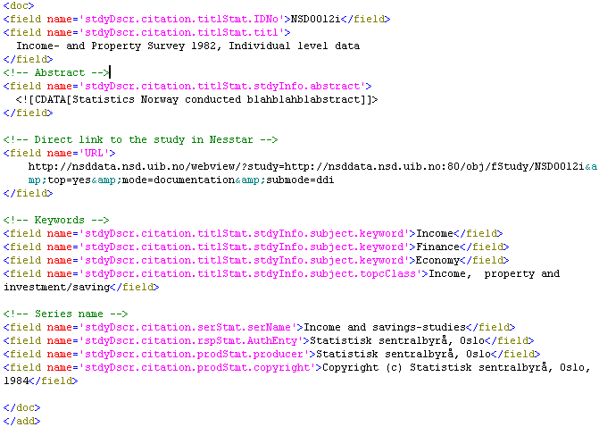
Coding the study harvester
//NOTE: Syntax is a bit simplified.
//Initialize the Nesstar And Solr Servers
nesstar.api.Server nesstarServer = new Server(”http://mynesstarserver.com”);
SolrServer solrStudyServer = new SolrServer(”http://mysolrserver.com/study”);
SolrServer solrVariableServer = new SolrServer(”http://mysolrserver.com/var”);
//Obtain list of all published studies
List allStudies = nesstarServer.getStudyHome().findAll();
//Traverse it
for(Study study : allStudies){
//Create the solr-document containing study metadata
SolrStudyDocument solrStudyDoc = new SolrStudyDocument(study);
//Add it to the Solr-index
solrStudyServer.add(solrStudyDoc);
}
//Finally, commit the index into effect
solrStudyServer.commit();
SolrStudyDocument =
Study metadata
key/value pairs

Slide 16
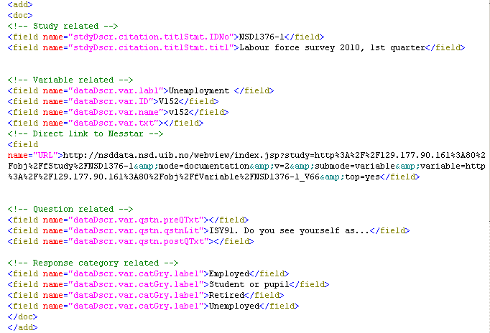
Coding the variable harvester
//NOTE: Syntax is a bit simplified.
//Initialize the Nesstar And Solr Servers
...
SolrServer solrVariableServer = new SolrServer(”http://mysolrserver.com/var”);
...
//Traverse all studies
for(Study study : allStudies){
//Find all variables for the study
List allVariables = study.getVariables();
//Traverse the list of variables
for(Variable variable : allVariables)
//Create the solr-document containing study metadata
SolrVariableDocument solrVariableDoc = new SolrVariableDocument(variable);
//Add it to the Solr-index
solrVariableServer.add(solrVariableDocument);
}
//Finally, commit the index into effect
solrVariableServer.commit();
SolrVariableDocument =
Variable metadata
key/value pairs

Slide 17
Coding the ESS data download wizard
//NOTE: Syntax is a bit simplified.
//Initialize the Nesstar Server
nesstar.api.Server nesstarServer = new Server(”http://mynesstarserver.com”);
//Obtain available download formats
List downloadFormats = nesstarServer.getStatFormatHome().findAll();
//Obtain the multiwave ESS-instance of all published studies
Study theStudy = nesstarServer.getStudyHome().findByKey(”ESSMultiwave”);
//Find all variable groups for the study
List allVariableGroups = study.getSections();
//Traverse the sections, then the variables, and build the GUI-checkbox-tree
for(Section variableGroup : allVariableGroups){
//List variables in this group
List allVariablesInGroup = variableGroup.getVariables();
for(Variable variable : allVariablesInGroup){
...
}
}

Slide 18
Coding the ESS data download wizard cont.
//NOTE: Syntax is a bit simplified.
//Creating variable panels
String variableName = variable.getName();
String variableLabel = variable.getLabel();
String preQuestionText = variable.getPrequestionText();
String literalQuestion = variable.getQuestionText();
//Response categories and frequencies
List categories = variable.getStatistics();
====
//Starting the download
theStudy.download({case-subset}, {FORMAT}, {variable-list});
e.g.
theStudy.download(”V1 = ’WAVE1’ AND V3 = ’DK’”, ”SPSS_portable”, ”V1, V5-V7”);

Slide 19
Questions
Q&A

