Slide 1





Controlled vocabularies for DDI3
2nd Annual European DDI Users Group Meeting
Utrecht, 8-9 December 2010
Taina.Jaaskelainen@uta.fi (DDI-CVG)
Meinhard.Moschner@gesis.org (DDI-CVG)
Joachim.Wackerow@gesis.org (DDI-TIC)
Notes:
DDI-CVG = DDI Controlled Vocabularies Group
DDI-TIC = DDI Technical Implementation Committee

Slide 2


Controlled vocabularies
Organized list of subject terms for indexing and retrieval
(Ideally) exhaustive list of terms
Mutual exclusive terms (no overlapping)
Clearly defined subject terms
The only choice for usage in a specific context
Scope notes to avoid misunderstanding if needed
From a short flat list to a hierarchical thesaurus,
including relationships between terms (e.g. ELSST)
As comprehensive and complex as necessary,
but as simple as possible!
Notes:
ELSST: European Language Social Science Thesaurus (= topical classification)

Slide 3
Importance of CVs
Optimizing indexing and searching
Language control (synonyms and lexical anomalies)
Consistency and efficiency in the production of metadata
Semantic/technical interoperability between organizations
Semantic/technical interoperability between systems
Precision of data retrieval
CVs usually do not replace textual description!

Slide 4
CVs and DDI3 (1)
Code values for computer processing & human readable descriptions
Metadata formats:
  machine readable (structured or semi-structured text)
  → free text search, e-documents
  machine interpretable (DDI2)
  → field search, interface independent, exchange format
  machine actionable (DDI3)
  → supported search, multilinguality, access control, interactivity

Slide 5
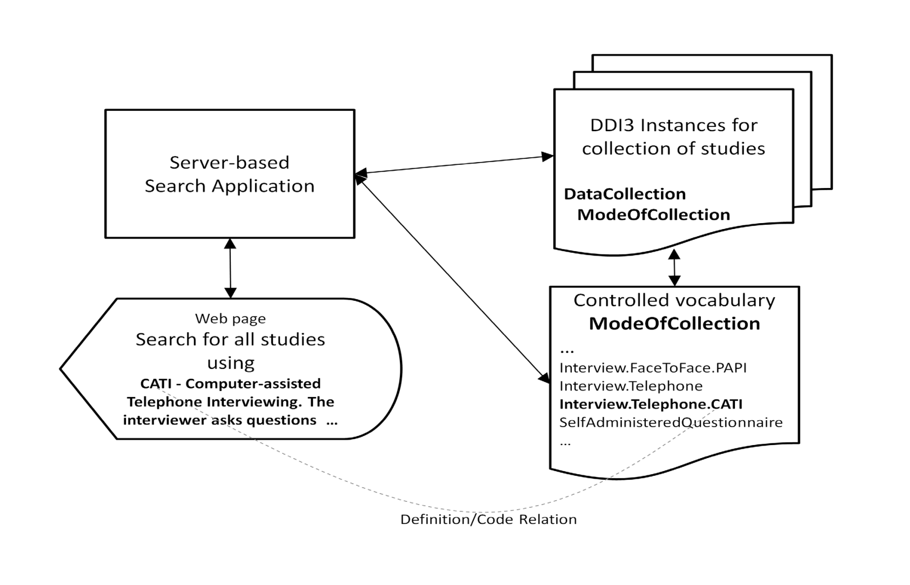
Supporting a search application…

Slide 6
...further application examples
Multilingual access and documentation
  translation of CVs
  ISO 639 language codes
Authentication and authorisation procedures
  ISO country codes → country of data / end user origin
  ...
...
Temporal, spatial and topical comparability
  concept (e.g. ELSST) + universe + geographical coverage
  time method, sampling, mode of data collection, ...
Notes:
→ CHARMCATS (Cessda HARMonisation of CATegories and Scales) about the use of DDI3 for publishing harmonisation routines

Slide 7
CVs and DDI3 (2)
Embedded controlled vocabularies (very general and relative static)
→ logical operators, …
Well-established external vocabularies
→ ISO country code, ISO language code, …
CVs for DDI3 and other metadata structures!
  Publication forthcoming 1/2011
  currently under revision
  still to be developed (e.g. for qualitative data types)

Slide 8
Available CVs in 1/2011
LifeCycleEvent /EventType
DDI3.1: reusable.xsd
AnalysisUnit
DDI3.1: reusable.xsd; DDI2: 2.2.3.8 anlyUnit & 4.3.7 var:/nCube: anlysUnit
SoftwarePackage
DDI3.1: reusable.xsd; DDI2: 3.1.11
TimeMethod → see example!
DDI3.1: datacollection.xsd; DDI2: 2.3.1.1
ModeOfDataCollection → close to be fished!
DDI3.1: datacollection.xsd; DDI2: 2.3.1.6

Slide 9
Available CVs as of 12/2010
ResponseUnit → for survey type data!
DDI3.1: datacollection.xsd; DDI2: 4.3.6
CommonalityType
DDI3.1: comparative.xsd
SummaryStatistic
DDI3.1: physicalinstance.xsd; DDI2: 4.3.14
CategoryStatistic → close to be fished!
DDI3.1: physicalinstance.xsd; DDI2: 4.3.17.2
CharacterSet
DDI3.1: physicaldataproduct.xsd; DDI2: 3.1.5

Slide 10
Publication
DDI CVs are a separate product from the DDI Alliance
Published independently from the DDI XML Schemas
  Intended for the usage with DDI, but can be used by other systems as well
  Creative Commons License
Expressed in a tabular model:
  columns define type of data (= meta data) in the code list
  rows define actual values (= meta data) in the code list
  code + term + conceptual description/definition + translations
  entry tool as Excel spreadsheet, readable visualization as HTML
Genericode is a generic format for code lists
  XML standard from OASIS (Organization for the Advancement of Structured Information Standards)
Name and version number
  Version structure can have major, minor, and sub-minor version

Slide 11
Example: TimeMethod
DDI3: datacollection.xsd / DDI2: 2.3.1.1 (Study Description → Data Collection Methodology)
Longitudinal
  Longitudinal.CohortEventBased
  Longitudinal.TrendRepeatedCrossSection
  Longitudinal.Panel
  Longitudinal.Panel.Continuous
  Longitudinal.Panel.Interval
TimeSeries
  TimeSeries.Continuous
  TimeSeries.Discrete
CrossSectional
  CrossSectionalAdHocFollowUp
Other
Notes:
Longitudinal
Data collected repeatedly over time to study change in a population.
Longitudinal.CohortEventBased
Data collected over time about a group of individuals that are connected in some way or have shared some significant experience within a given period. Examples: birth, disease, education, employment, family formation, participation in an event.
Longitudinal.TrendRepeatedCrossSection
Studies different samples/different groups of people from the same population at several points in time, using the same set of questions/variables. Conclusions are drawn for the population. Examples: public opinion polls, elections studies, etc.
Longitudinal.Panel
Data collected over time from, or about, the same sample of respondents.
Longitudinal.Panel.Continuous
Reports from the panel are collected on a regular basis.
Longitudinal.Panel.Interval
Measurements are taken only when information is needed.
TimeSeries
Data collected repeatedly over time to study change in observations. These are typically "objective" measurements of phenomena that can be observed externally, as opposed to attitudes/opinions or feelings. Examples may include economic/financial indicators, natural/meteorological phenomena, vital statistics, etc.
TimeSeries.Continuous
Phenomena are measured at every instant of time. Examples: lie detectors, electrocardiograms, etc.
TimeSeries.Discrete
Measurements are taken at (usually regularly) spaced intervals. Examples:macroeconomics (weekly share prices, monthly profits, sales); meteorology (hourly temperature); measurements of individuals (blood pressure, weight, height); sociology (crime figures, employment figures), etc.
CrossSectional
Data about a population are obtained only once.
CrossSectionalAdHocFollowUp
Data collected at one point in time to complete information collected in a previous cross-sectional study; the decision to collect follow-up data is not included in the study design.

Slide 12
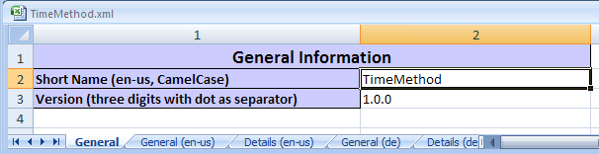
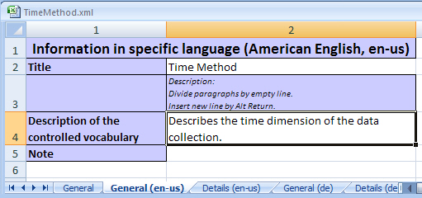
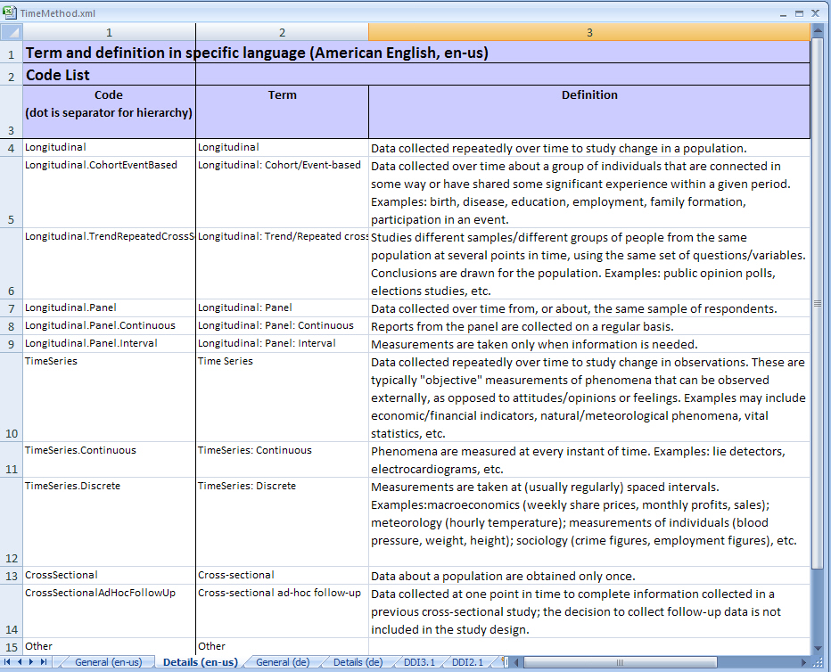
Example: TimeMethod

Slide 13
Genericode Example
DDI_3.1_Part_I_Overview.pdf → Appendix 5
<?xml version="1.0" encoding="UTF-8"?>
<gc:CodeList xmlns:xsi="http://www.w3.org/2001/XMLSchema-instance" xmlns:gc="http://docs.oasis-open.org/codelist/ns/genericode/1.0/" xmlns:xhtml="http://www.w3.org/1999/xhtml" xsi:schemaLocation="http://docs.oasis-open.org/codelist/ns/genericode/1.0/ http://docs.oasis-open.org/codelist/cs-genericode-1.0/xsd/genericode.xsd">
…
<xhtml:p class="ModuleName">datacollection</xhtml:p>
<xhtml:p class="Title">Time Method</xhtml:p>
<xhtml:p class="XPath">/n1:DDIInstance/s:StudyUnit/d:DataCollection/d:Methodology/d:TimeMethod</xhtml:p>
<xhtml:p class="Description">Controlled vocabulary for time method</xhtml:p>
…
<LocationUri>http://www.ddialliance.org/ControlledVocabularies/TimeMethod_gc.xml</LocationUri>
<Agency> <LongName>DDI Alliance</LongName> </Agency>
…
<Row>
<Value ColumnRef="Code„> <SimpleValue>Longitudinal.RepeatedCrossSection </SimpleValue> </Value>
<Value ColumnRef="ParentCode"> <SimpleValue>Longitudinal </SimpleValue> </Value>
<Value ColumnRef="LevelSpecificCode„> <SimpleValue>RepeatedCrossSection </SimpleValue></Value>
</Row>
…
<Row>
<Value ColumnRef="Code"> <SimpleValue>Longitudinal.Panel< /SimpleValue></Value>
</Row>
…
</Row>
</SimpleCodeList>
</gc:CodeList>
… can be referenced and processed by software applications!
http://www.oasis-open.org
Notes:
OASIS (Organization for the Advancement of Structured Information Standards)
to be replaced by up to-date example!

Slide 14

Management and Maintenance
DDI Controlled Vocabularies Group (DDI-CVG)
Forthcoming implementation experiences
  different data holdings (heterogeneity of DDI user community)
  review of ”other” entries (missing terms)
  institution specific revisions and/or extensions
Current focus on the quantitative data type
Institutionalisation of the CESSDA research infrastructure
  mandatory or recommended use of controlled vocabularies
  translation of definitions to respective local languages (unclear definitions?)
  migration from DDI2 to DDI3
Notes:
CESSDA (Council of European Social Science Data Archives)
http://www.cessda.org/

Slide 15
Acknowledgements
DDI Controlled Vocabularies Group (CVG):
  Atle Alvheim, NSD, Bergen
  Sanda Ionescu (chair) , ICPSR, Ann Arbor MI
  Taina Jääskeläinen, FSD, Tampere
  Chryssa Kappi, EKKE, Athens
  Fredy Kuhn, FORS, Lausanne
  Ken Miller, UK-DA , Essex (retired)
  Meinhard Moschner, GESIS, Cologne
DDI Technical Implementation Committee (TIC)
  Pascal Heus (ODaF), Wendy Thomas (MPC), Achim Wackerow (GESIS), ...
Review participants at ...
  ABS (AU), ADP (SI), CentERdata (NL), DDA (DK), FSD (FI), GESIS (DE), ICPSR (US), SND (SE), UK-DA (GB), ...
Notes:
NSD: Norwegian Social Science Data Services (Bergen)
ICPSR: Inter-university Consortium for Political and Social Research (Ann Arbor, MI)
FSD: Finnish Social Science Data Archive (Tampere)
EKKE: National Center for Social Research / Greek Social Data Bank (Athens)
FORS: Swiss Foundation for Research in Social Sciences (Lausanne), formerly SIDOS
UKDA: UK Data Archive (Essex)
GESIS – Leibnitz Institute for the Social Sciences (Data archive for the Social Sciences, Cologne)
ODaF – Open Data Foundation
MPC – Minnesota Population Center
ABS - Australian Bureau of Statistics
…

Slide 16
Resources and contact
Controlled Vocabularies on the DDI Alliance website:
http://www.ddialliance.org/controlled-vocabularies
CVG Contact:
ddi-cvg@ddialliance.org
sandai@umich.edu
IASSIST Quarterly Spring-Summer 2009
http://www.iassistdata.org/iq/issue/33/1
Notes:
http://www.ddialliance.org/cv forthcoming January 2011!
DDI CVG chair since Fall 2010: Sanda Ionescu, ICPSR
Taina Jääskeläinen, Meinhard Moschner, Joachim Wackerow:
Controlled Vocabularies for DDI 3: Enhencing Machine-Actionability.
In: IASSIST Quarterly Spring-Summer 2009
<http://www.iassistdata.org/iq/issue/33/1>

