Slide 1

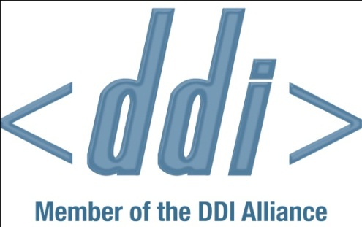
Development of the next DDI Tools Catalog
Stefan Kramer
Research Data Management Librarian
Cornell Institute for Social and Economic Research (CISER)
2nd Annual European DDI Users Group Meeting, Dec. 8-9, 2010

Slide 2
Background
Assumptions:
  Adoption of the DDI metadata standard by a broader community of users can and will only happen through good tools that support the standard
  Potential and actual users need to be able to easily find and identify DDI-supporting tools for their needs – requires being able to select them using relevant attributes
  Developers need to have a way to submit and update information on DDI tools they are working on
The present DDI Tools catalog (http://www.ddialliance.org/resources/tools) is a flat web page … listing also things that may not be considered “tools”

Slide 3
Background
At its annual meeting on May 31, 2010, the DDI Alliance Expert Committee agreed to charge a newly formed group with the revision of the DDI Tools Catalog
Current members of the Tools Catalog Group (under http://www.ddialliance.org/alliance/working-groups):
  Stefan Kramer, Cornell U. (Chair)
  Katherine McNeill, MIT
  Jannik Jensen, Danish Data Archive

Slide 4
Approach to developing new catalog
Desirable to keep the new catalog within DDI Alliance web site (Drupal-based), rather than external, given desired functionalities
  Design idea influence by former IMAP Products Database (http://web.archive.org/web/19991013070236/imap.org/products.html)
DDI Tools Catalog working group used Google Group and Google Docs to develop and discuss needed fields and field values for new catalog
Developers will be able to request Drupal accounts to submit/edit info on their tools
Catalog editors will review before publication

Slide 5
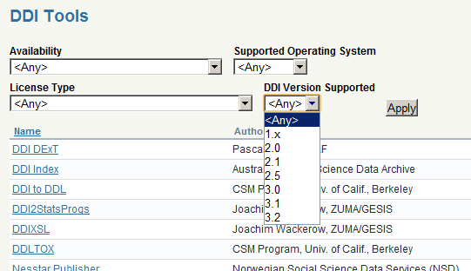
The new DDI Tools Catalog: preview
  In following slides, [M] marks mandatory fields to be completed in catalog records, [F] marks fields by which a catalog user can filter (narrow) search results

Slide 6
Fields for the new DDI Tools Catalog
Tools catalog record last updated - date [M]
Tools catalog record last updated – by who [M]
Name (of tool) [M]
Description
Purpose [M] [F]
  Group was originally disinclined to have this field for reasons of maintainability, but now intends to include it, with a controlled vocabulary – examples: editor, converter (between DDI versions), creator (from software to DDI), transformer (from DDI to other display formats)

Slide 7
Fields for the new DDI Tools Catalog
External URL [M]
  of web site describing tool, maintained by creator
Creator(s) [M]
  Name(s) and contact info of author(s), programmer(s), institution(s) developing the tool
Availability [M] [F]
  Unknown, Planned, In development, Alpha release, Beta release, In production, No longer developed, but still available, No longer available
Latest version

Slide 8
Fields for the new DDI Tools Catalog
Operating system requirements [M] [F]
  Win32, Win64, Linux, Macintosh, Other: describe
Other system requirements
  e.g., Apache web server, STATA, C-compiler, Java ver. N.N, SPSS, .NET framework
Programming/scripting languages used
License [M] [F]
  Freeware, GNU Lesser General Public License (LGPL),
  Commercial, Other, Unknown

Slide 9
Fields for the new DDI Tools Catalog
Available support from Creator(s)
  None; Free, to any user; Free, to paying users;
  For-fee (separate from any product cost)
DDI version(s) supported [M] [F]
  1.x, 2.0, 2.1, 2.5 (future), 3.0, 3.1, 3.2 (future)
Exports DDI XML
  Yes, No, Unknown
Imports DDI XML
  Yes, No, Unknown

Slide 10
Questions for the community
Will this proposed structure for the catalog be useful for end users?
Will developers be (sufficiently) motivated to submit information about their tools, and update it?
Any volunteers to help edit and maintain the catalog’s contents?

Slide 11


Mary Vardigan & Justin Todd
Bill Block
Jannik Jensen & Kate McNeill
the DDI tools developers

Slide 12


Thank you for your time & attention!
The End
Stefan Kramer
stefan.kramer@cornell.edu

