Slide 1
Metadata Driven Survey Research
Jeremy Iverson

Slide 2


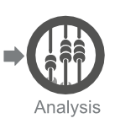
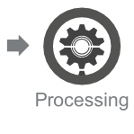
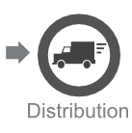

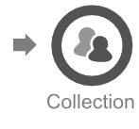

Open Standards

Slide 3
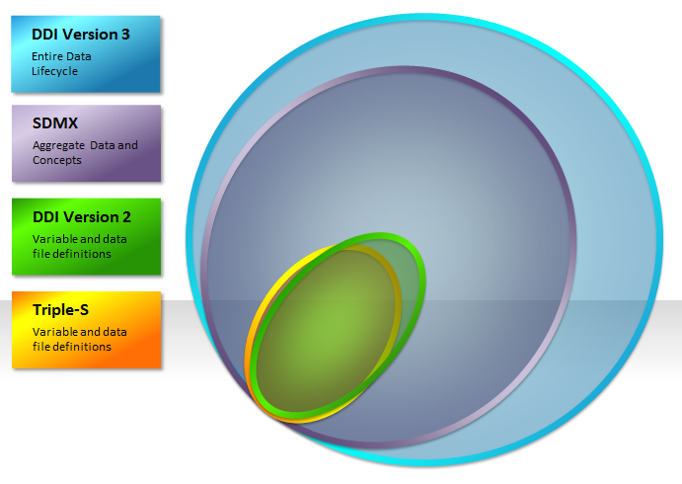
Open Standards

Slide 4
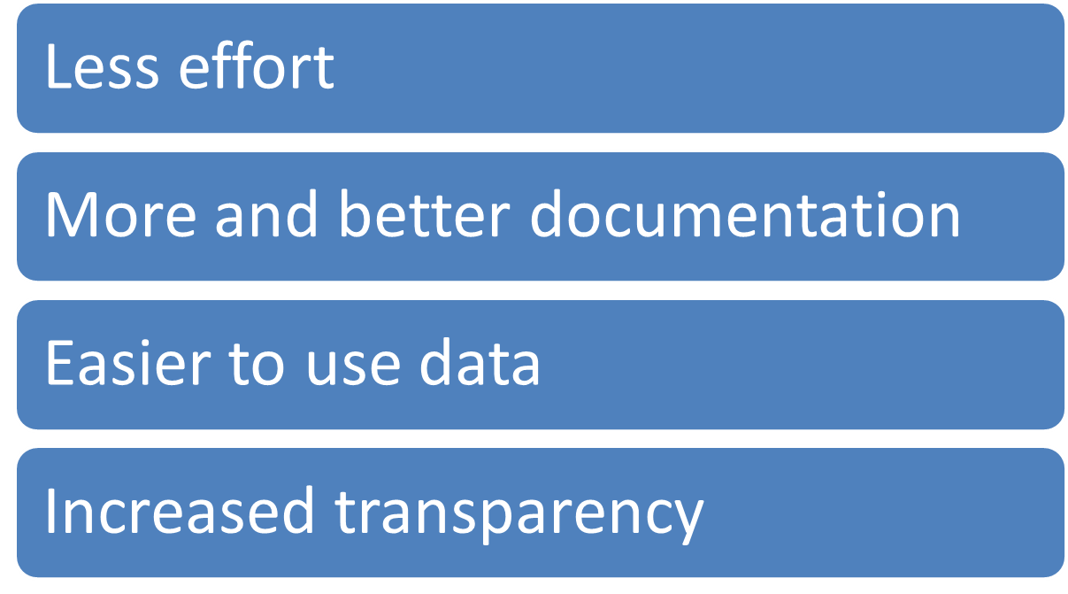
Open Standards

Slide 5
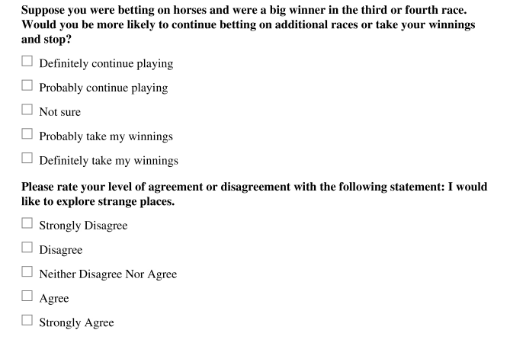
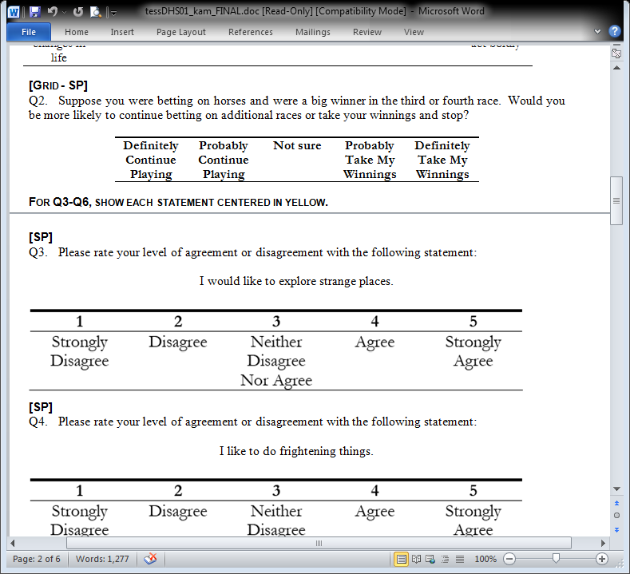
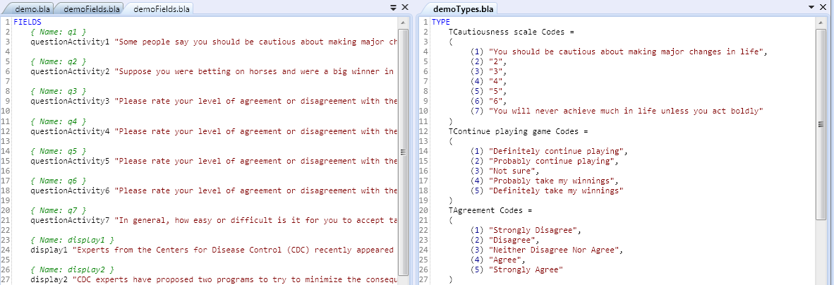
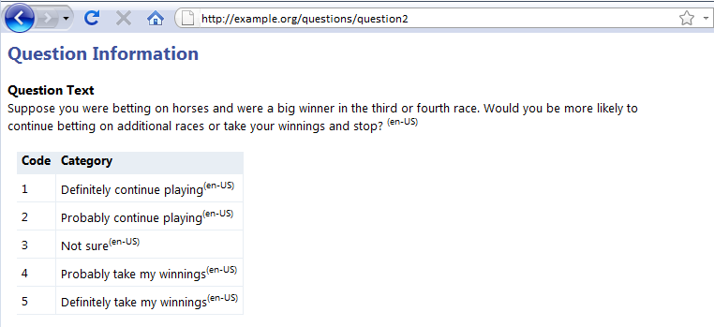

Slide 6
1. Don’t Repeat Yourself

Slide 7
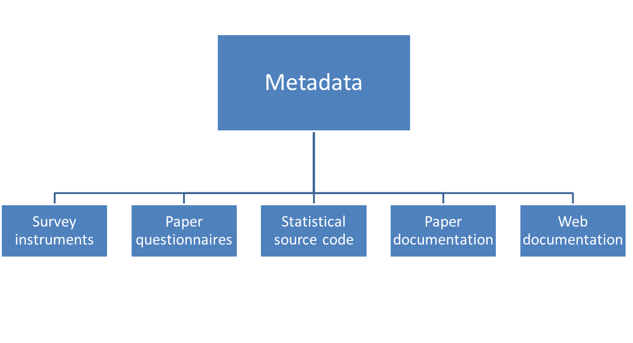
Metadata Driven Survey Design

Slide 8
The Data Lifecycle
Documentation
Lost

Slide 9
2. Make documentation a byproduct of the process

Slide 10
3. Make Metadata Accessible

Slide 11

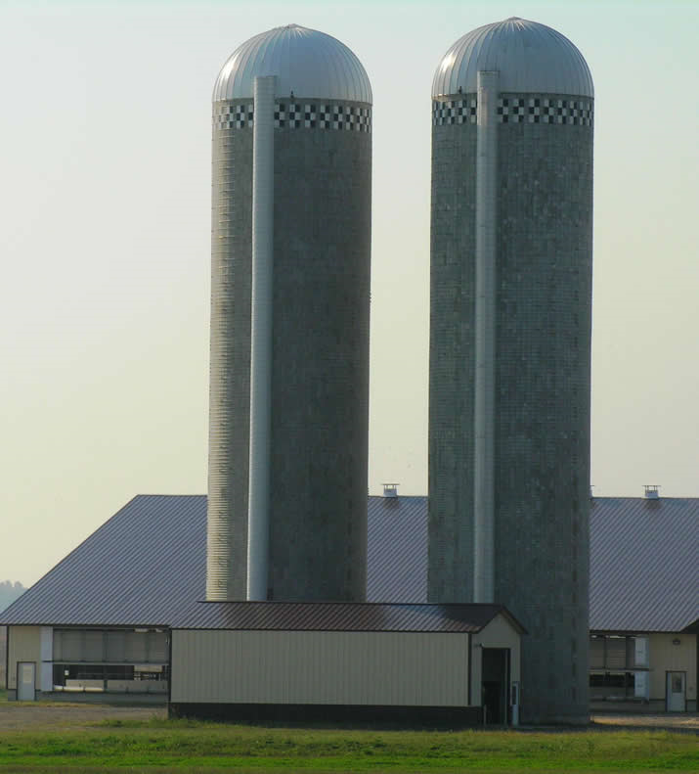
Metaphors

Slide 12
Repositories
Question Banks
Classification Banks
Variable Banks
Concept Banks

Slide 13
Harmonization
Share items across multiple waves of a study
Or across multiple studies
Easily discover and compare studies or datasets that use the same elements

Slide 14
Answerable Questions
What studies explore these concepts?
What questionnaires use this question?
What datasets have this variable?

Slide 15
3. Make Metadata Accessible

Slide 16
4. Increase Transparency

Slide 17
Social
Science
Scientific processes should be reproducible.

Slide 18




Slide 19
"It is the policy of the American Economic Review to publish papers only if the data used in the analysis are clearly and precisely documented and are readily available to any researcher for purposes of replication."

Slide 20
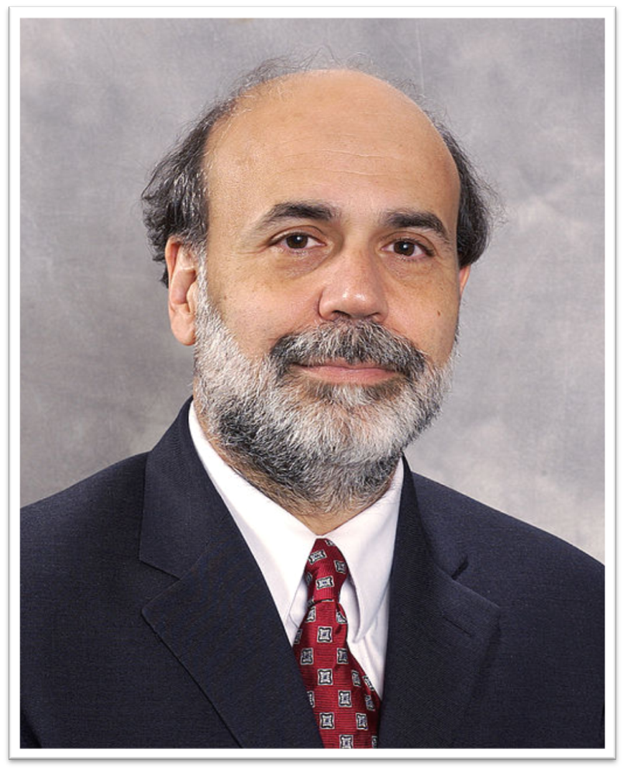
By Federal Reserve [Public domain], via Wikimedia Commons

Slide 21
“Materials sufficient for replicating results reported in this article will be [have been] deposited with the ICPSR publications-related archive”
- Gary King’s replication standard

Slide 23
4. Increase Transparency

Slide 24
5. This is Possible Today

Slide 25

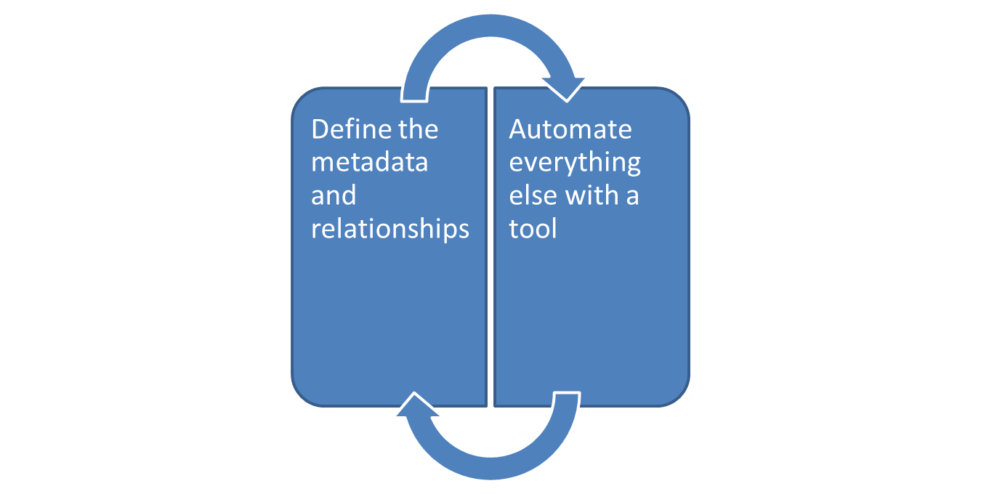

Slide 26
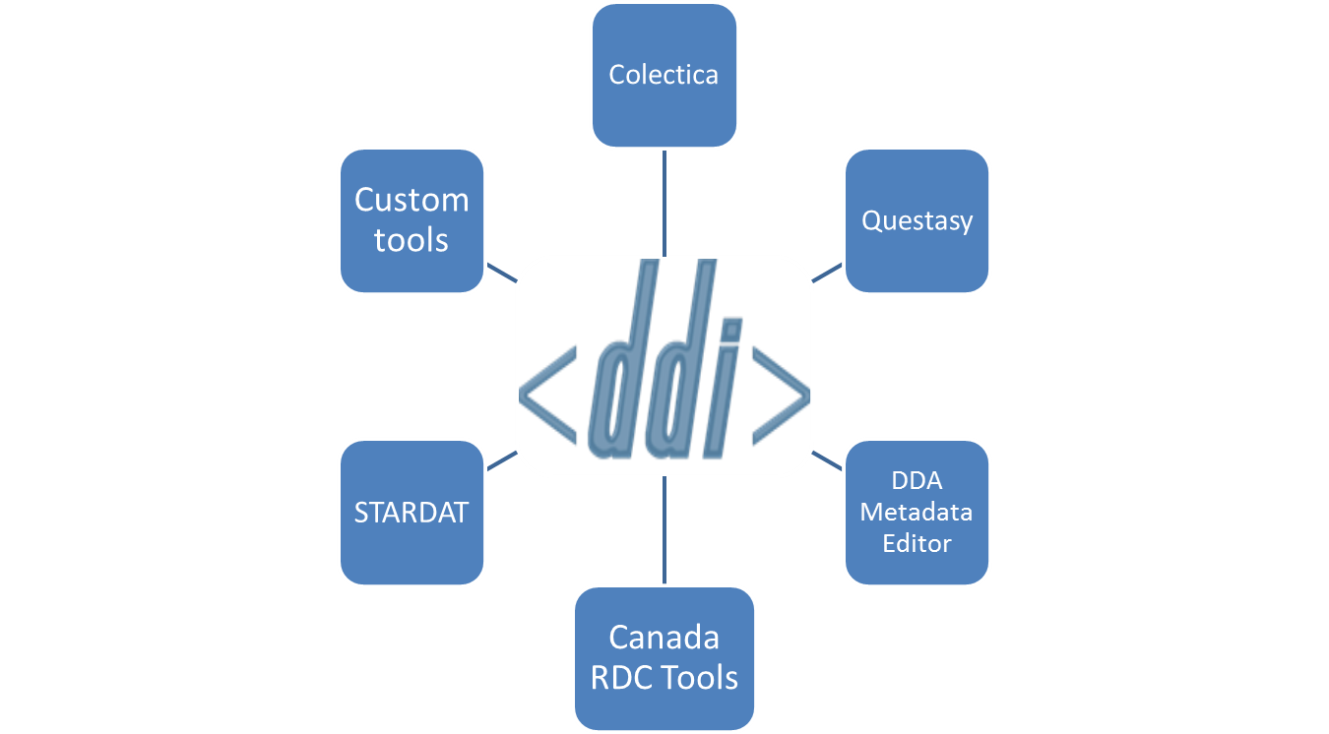
DDI 3 Tools

Slide 27
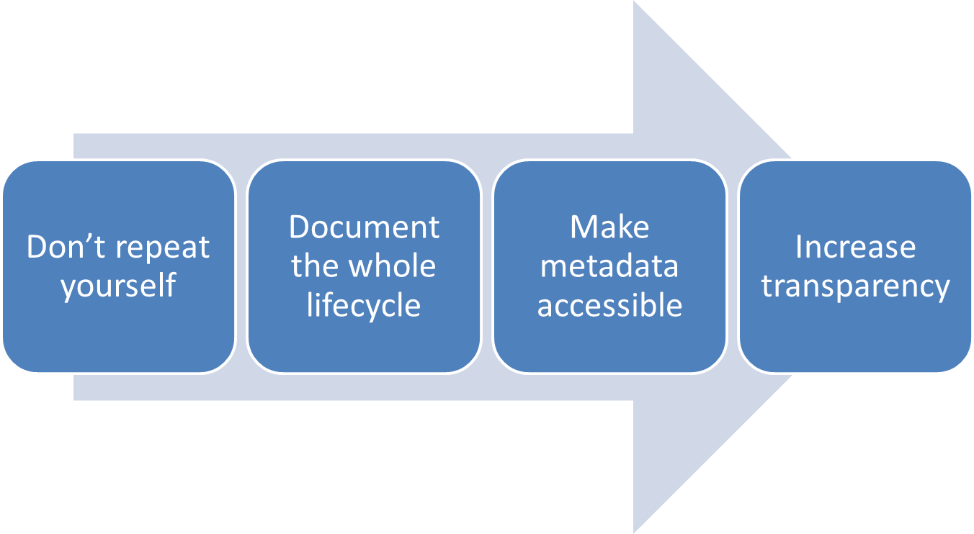
Metadata Driven Survey Research

Slide 28

Thank you
Jeremy Iverson
jeremy@colectica.com

