Slide 1

An update on Rogatus
Supporting the survey workflow with open standards and tools
Ingo Barkow (DIPF) – Senior Researcher, Data Manager
David Schiller (IAB) – Senior Researcher
Notes:
DIPF PowerPoint-Präsentation

Slide 2
An update on Rogatus
Agenda
Introduction to Rogatus QMMS
The Generic Longitudinal Business Process Model (GLBPM)
Example workflow
Improvements since ESRA 2013
  Improved CMS
  Mbee / Rogatus Portal
  Web Qbee
Roadmap
Q&A
Paris, 03.12.2013 | Ingo Barkow and David Schiller | EDDI 2013
Notes:
DIPF PowerPoint-Präsentation

Slide 3
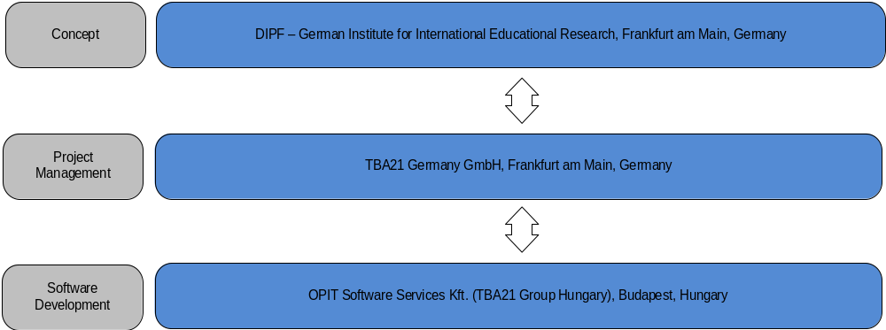
An update on Rogatus
Introduction to our organization
Paris, 03.12.2013 | Ingo Barkow and David Schiller | EDDI 2013
Notes:
DIPF PowerPoint-Präsentation

Slide 4
An update on Rogatus
Definition
Rogatus (Latin = to be asked) Questionnaire and Metadata Management System (QMMS)
Design ideas:
  Framework consisting of several tools for survey design (Qbee, Mbee, Tbee)
  Support for metadata standards (DDI, SDMX)
  Support for PAPI, CAPI, CATI and online tests
  Bases on work on previous projects (NEPS, DaQS, QDDS, Austrian CMS)
  Compatibility to existing DDI tools (e.g. Colectica, Questasy)
  Whole toolset is split into two perspectives
    Researcher creating a study (survey management)
    Researcher working in data center (data management)
Paris, 03.12.2013 | Ingo Barkow and David Schiller | EDDI 2013
Notes:
DIPF PowerPoint-Präsentation

Slide 5
An update on Rogatus
Partners
GESIS – Leibniz Institute for the social sciences (consultancy, funding,
software exchange)
IAB – Institute for Employment Research (consultancy, funding)
Colectica (consultancy)
Statistics New Zealand (software exchange)
Swedish National Data Service (software exchange)
Alerk Amin (consultancy)
Sam Spencer (consultancy, software exchange)
Currently negatiations with other partners around the world
Paris, 03.12.2013 | Ingo Barkow and David Schiller | EDDI 2013
Notes:
DIPF PowerPoint-Präsentation

Slide 6
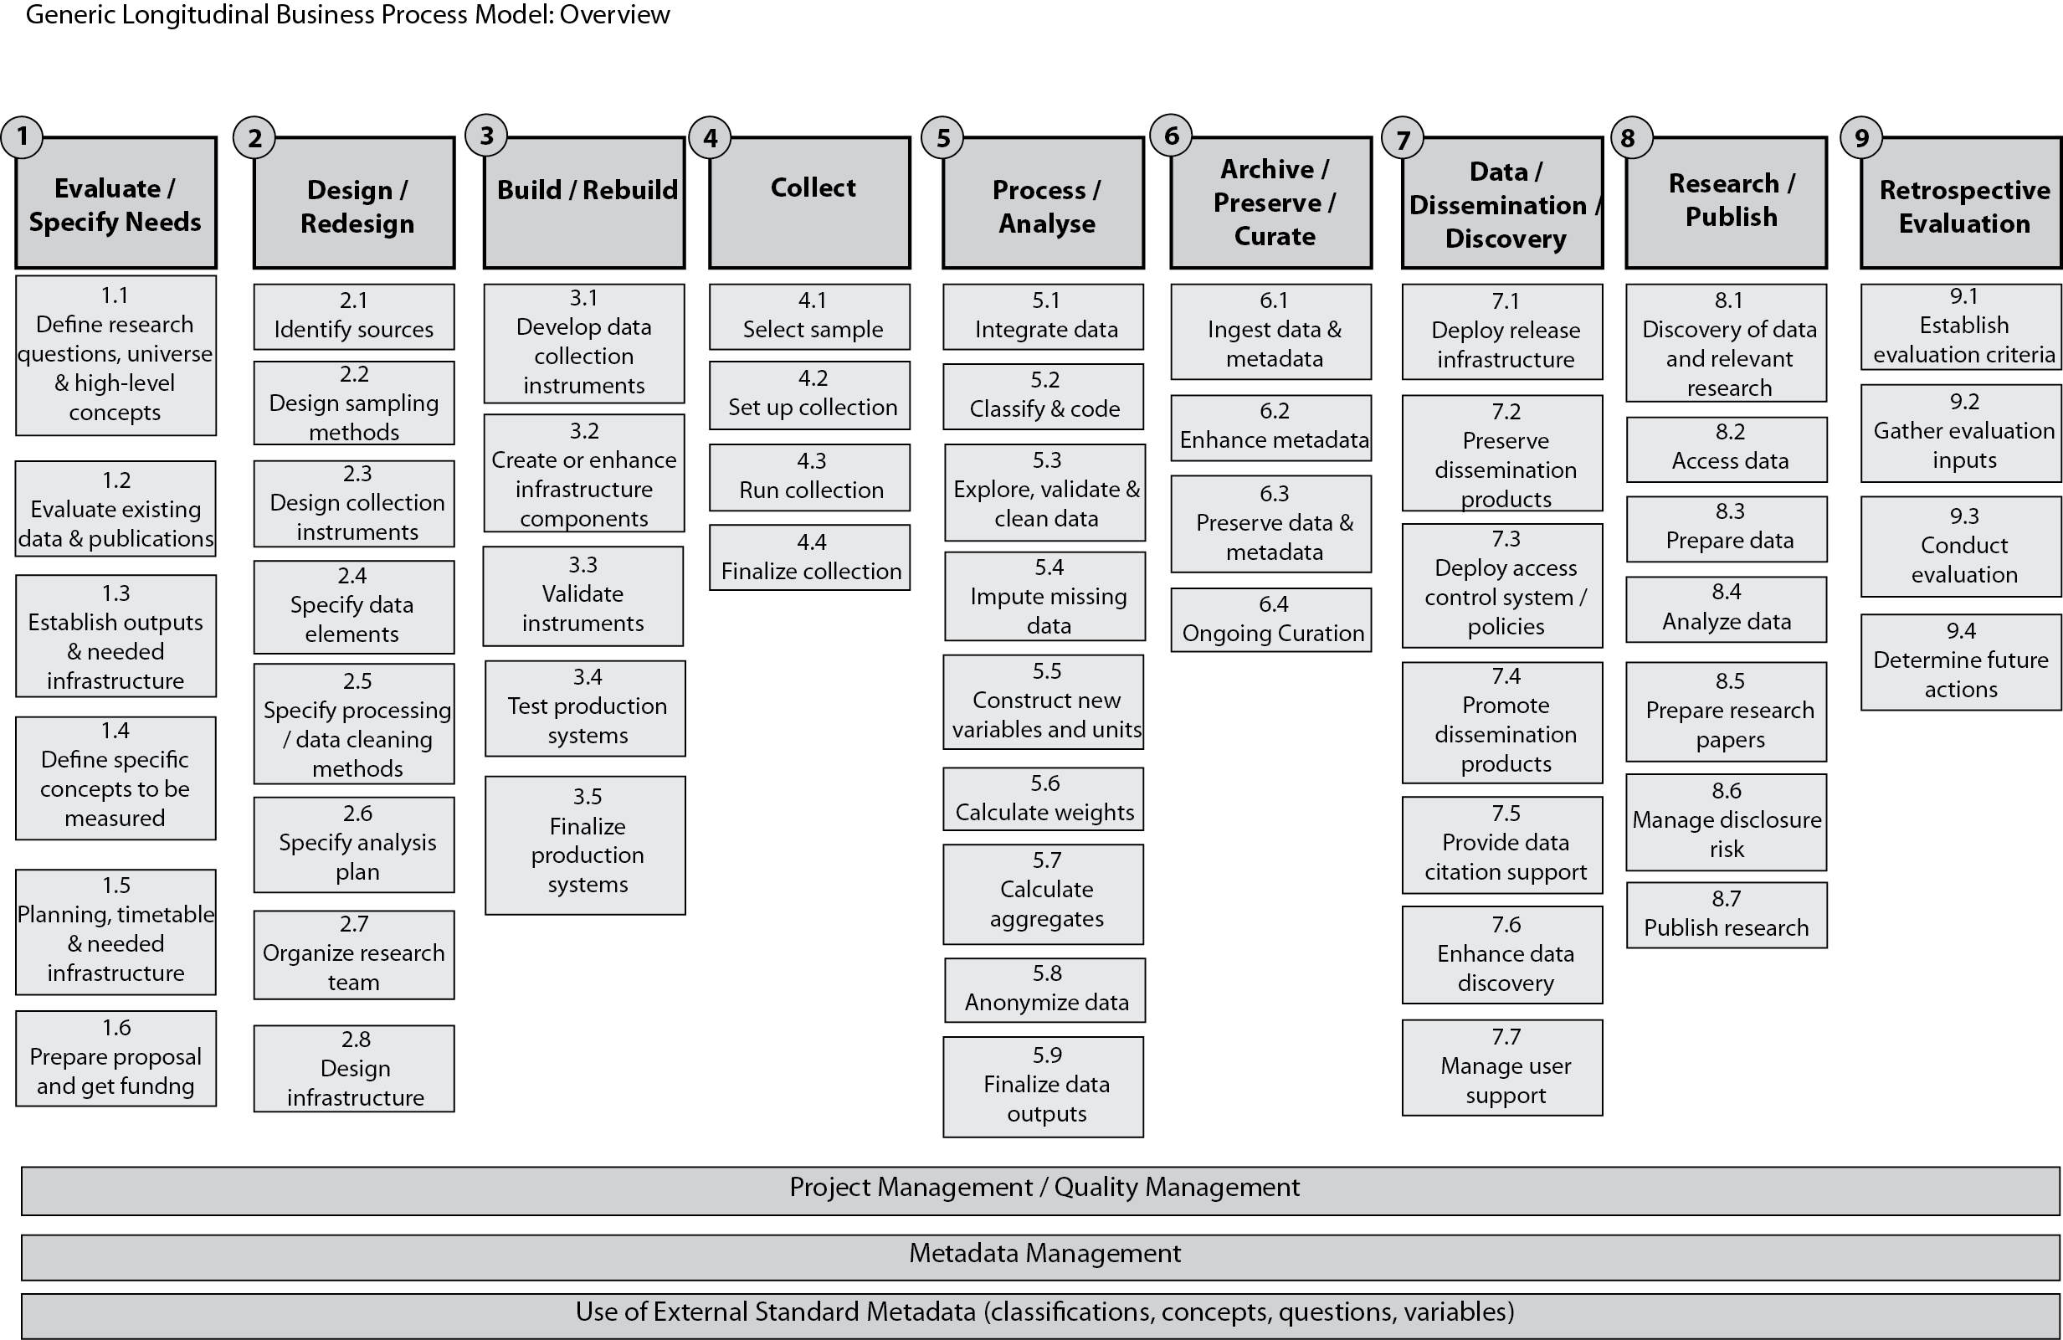
The Generic Longitudinal Business Process Model (Barkow et al., 2013)
Notes:
DIPF PowerPoint-Präsentation

Slide 7
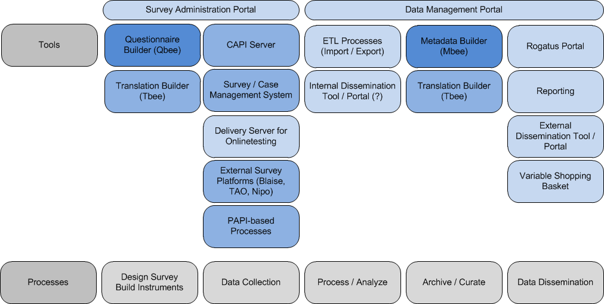
Original long term vision of Rogatus
Notes:
DIPF PowerPoint-Präsentation

Slide 8
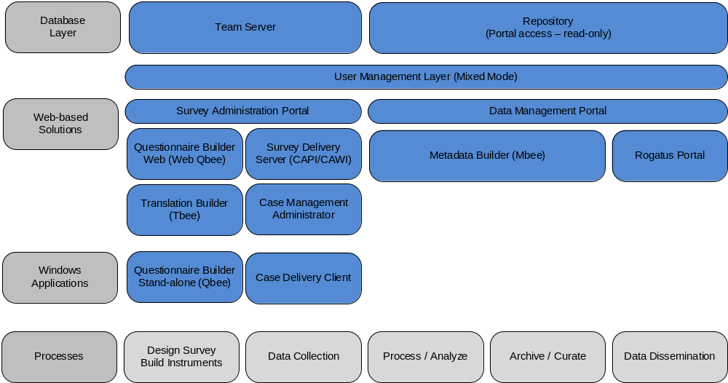
Rogatus – Release version (Q1/2015)
Notes:
DIPF PowerPoint-Präsentation

Slide 9
An update on Rogatus
Example Workflow
To demonstrate the possibilties of a complete survey design and delivery workflow here some screenshots:
  Creation of DDI-based questionnaire (Qbee – Questionnaire Builder)
  Translation of Questionnaire (OLT, predecessor of Translation Builder)
  Delivery of questionnaires/cases to interviewers (Rogatus CMS)
  Overview of paradata (Rogatus CMS)
  Dissemination of metadata and data (Mbee – Metadata Builder)
Paris, 03.12.2013 | Ingo Barkow and David Schiller | EDDI 2013
Notes:
DIPF PowerPoint-Präsentation

Slide 10
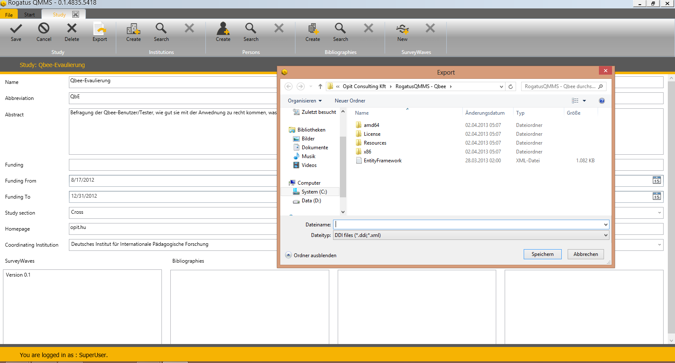
An update on Rogatus
Example Workflow – Creation of DDI-based Questionnaire
Paris, 03.12.2013 | Ingo Barkow and David Schiller | EDDI 2013
Notes:
DIPF PowerPoint-Präsentation

Slide 11
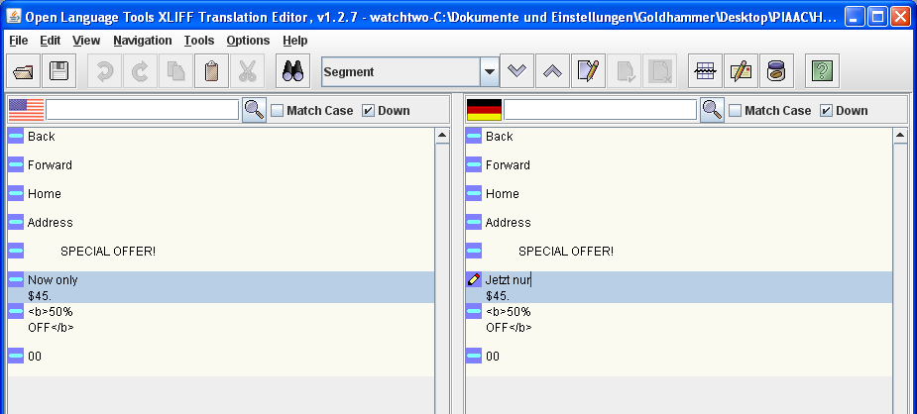
An update on Rogatus
Example Workflow – Translation of DDI-based Questionnaire
Paris, 03.12.2013 | Ingo Barkow and David Schiller | EDDI 2013
Notes:
DIPF PowerPoint-Präsentation

Slide 12
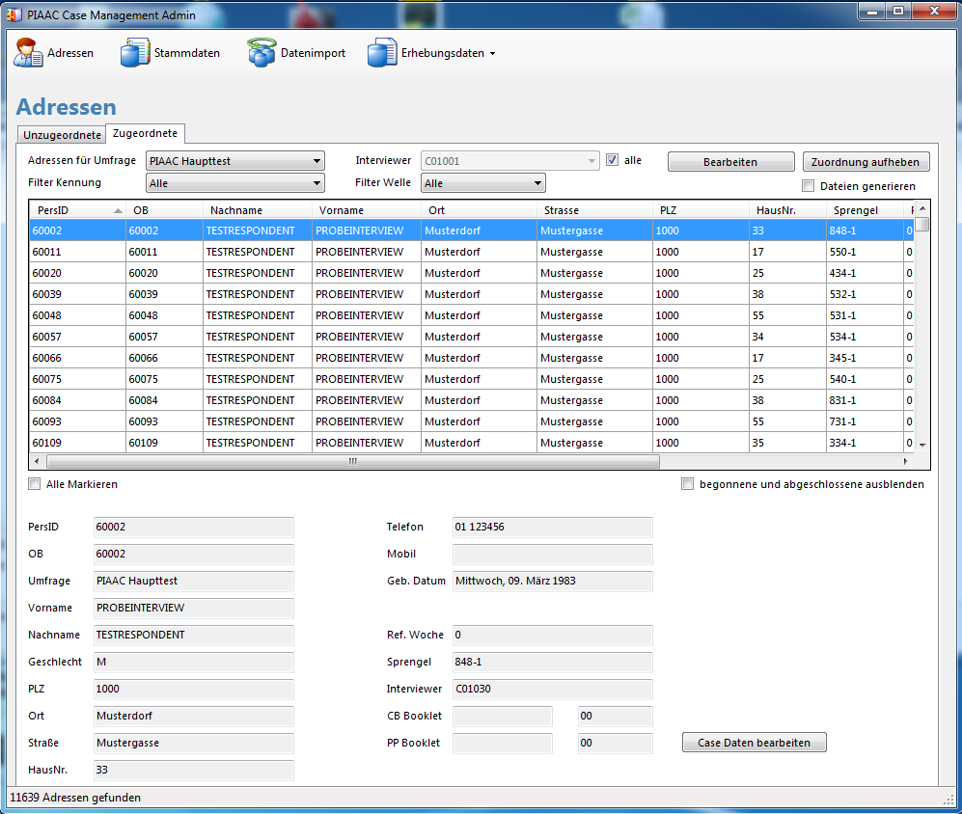
An update on Rogatus
Example Workflow – Delivery of Questionnaires to Interviewers
Main Menu
Show Cases
(un-/assigned)
Assign
Filters
Case list
Case details
Paris, 03.12.2013 | Ingo Barkow and David Schiller | EDDI 2013
Notes:
DIPF PowerPoint-Präsentation

Slide 13
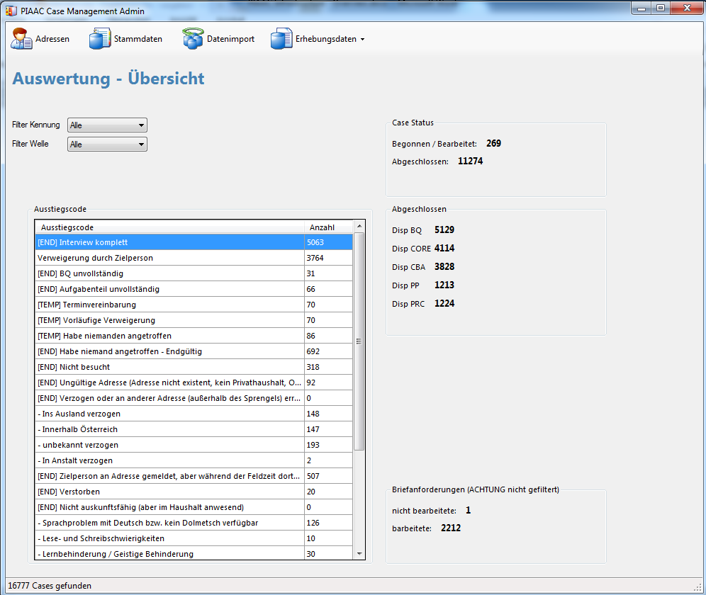
An update on Rogatus
Example Workflow – Overview of „paradata“ during survey
Filters
Status information
Disposition code
detailed information
Paris, 03.12.2013 | Ingo Barkow and David Schiller | EDDI 2013
Notes:
DIPF PowerPoint-Präsentation

Slide 14
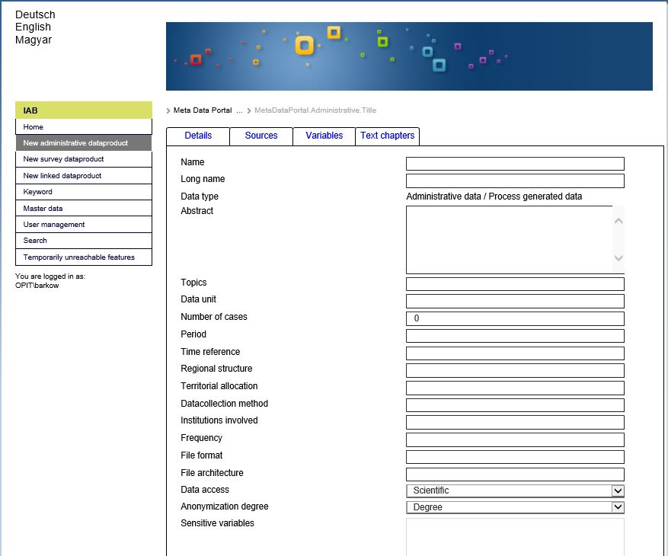
An update on Rogatus
Example Workflow – Dissemination within portal solution
Paris, 03.12.2013 | Ingo Barkow and David Schiller | EDDI 2013
Notes:
DIPF PowerPoint-Präsentation

Slide 15
An update on Rogatus
Improvements since ESRA 2013
Case Management System
  Complete new code basis (for generic version / DDI compliance)
  House-hold based sampling
  Interviewee selection by algorithm (kish grid, last birthday method)
  Data transfer via web services (no MSMQ anymore)
  Improved reporting functionality
Metadata Builder / Rogatus Portal
  Beta release for IAB
  Support for administrative metadata and survey metadata in mixed mode
  Support for accessibility options
Paris, 03.12.2013 | Ingo Barkow and David Schiller | EDDI 2013
Notes:
DIPF PowerPoint-Präsentation

Slide 16
An update on Rogatus
Improvements since ESRA 2013
Questionnaire Builder (Qbee)
  Idea – derive Qbee from Mbee tool (Web Qbee)
  User Interface in ‚Canard‘ / Sam Spencer style
  Support for DDI 3.2 questionnaire elements
Paris, 03.12.2013 | Ingo Barkow and David Schiller | EDDI 2013
Notes:
DIPF PowerPoint-Präsentation

Slide 17
An update on Rogatus
Additional planned features
Full DDI 3.2 compliance (including DDI Profiles)
Blaise import / export
Nipo import / export
Additional CAWI server (web-based delivery)
Web template for mobile clients
Support for semi-automatic coding of ISCED levels
Qualitative Extensions (Rogatus Qualidat including Quedex as second standard)
Mobile client for sampling, followed by
‚Real‘ mobile client for iPhone, Android, Windows Phone
CATI Server (telephone surveys)
Your ideas?
Paris, 03.12.2013 | Ingo Barkow and David Schiller | EDDI 2013
Notes:
DIPF PowerPoint-Präsentation

Slide 18
An update on Rogatus
Any Questions?
barkow@dipf.de
http://www.dipf.de
Paris, 03.12.2013 | Ingo Barkow and David Schiller | EDDI 2013
Notes:
DIPF PowerPoint-Präsentation

