Slide 1
Nesstar – Tool to Toolkit
A Programmable DDI-based Platform
Ørnulf Risnes
Ricco Førgaard
Archana Bidargaddi
Norwegian Social Science Data Services
EDDI-2012, Bergen, 4 Dec 2012

Slide 2
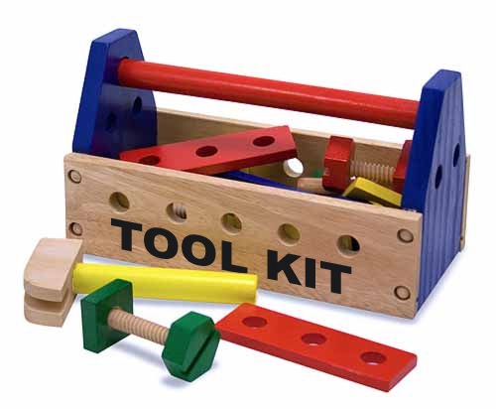


The Vision
To

Slide 3
The Vision : Tool to Toolkit
IASSIST 2011, Vancouver
What to optimize for?
  Predictability
  Max ROI on DDI2-investments (DDI-C)
  Flexibility
  Usefulness!

Slide 4
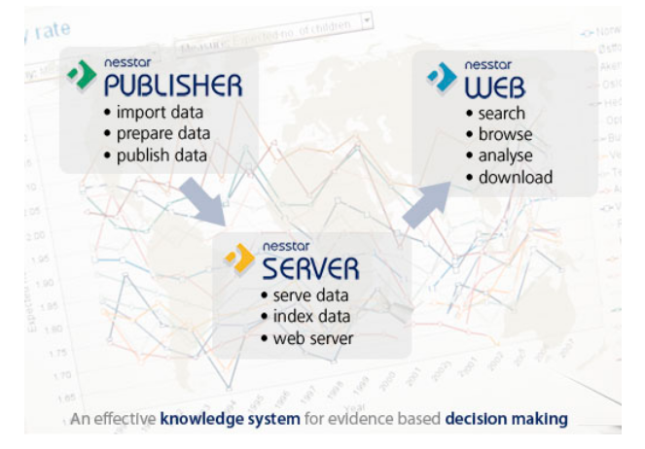
Nesstar - A DDI Based Dissemination Tool

Slide 5
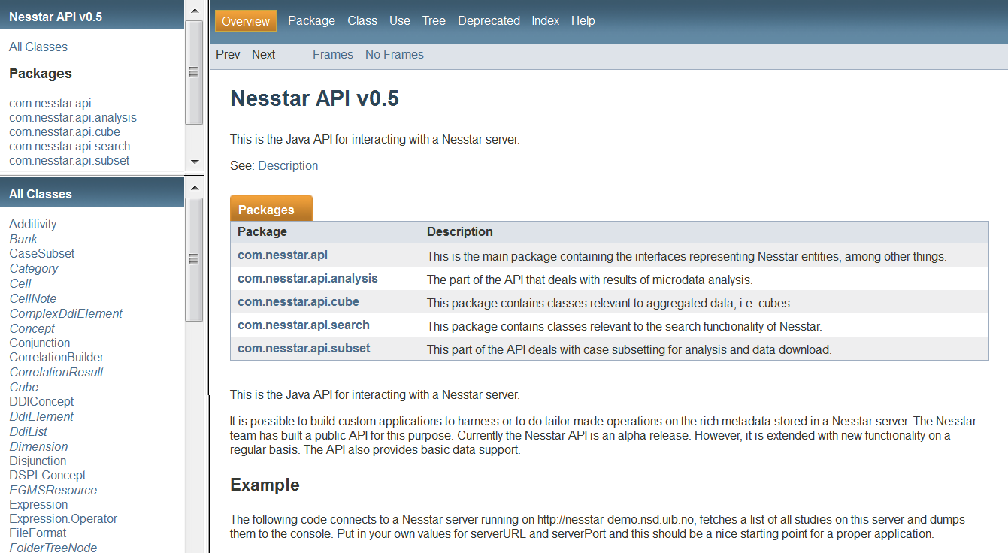
Nesstar Public API

Slide 6
Development Motto: Lean & Clean
Upgrade Software Infrastructure
  Maven, Git,...
Imbibe Quality Assurance
  Sonar (Code review, coverage, complexity,..)
Refine Development Processes
  Agile, TDD, Clean code concepts,...
Enhance Domain Expertise
  DDI, Qualitative Data, Series, NSI Data,...

Slide 7
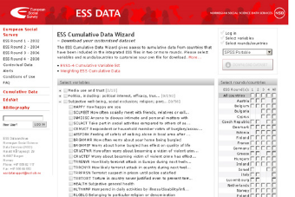
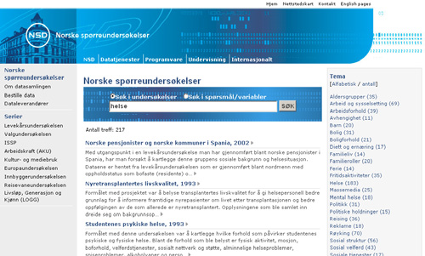

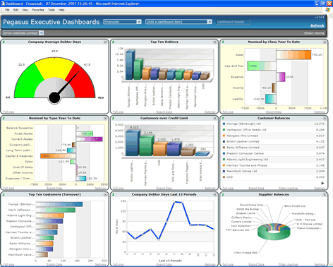





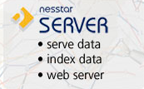

Nesstar - A DDI Based Toolkit
Nesstar Public API
Clients
VCS as
Data+Metadata
Management System
Nesstar Public API
Server as
Dissemination System

Slide 8
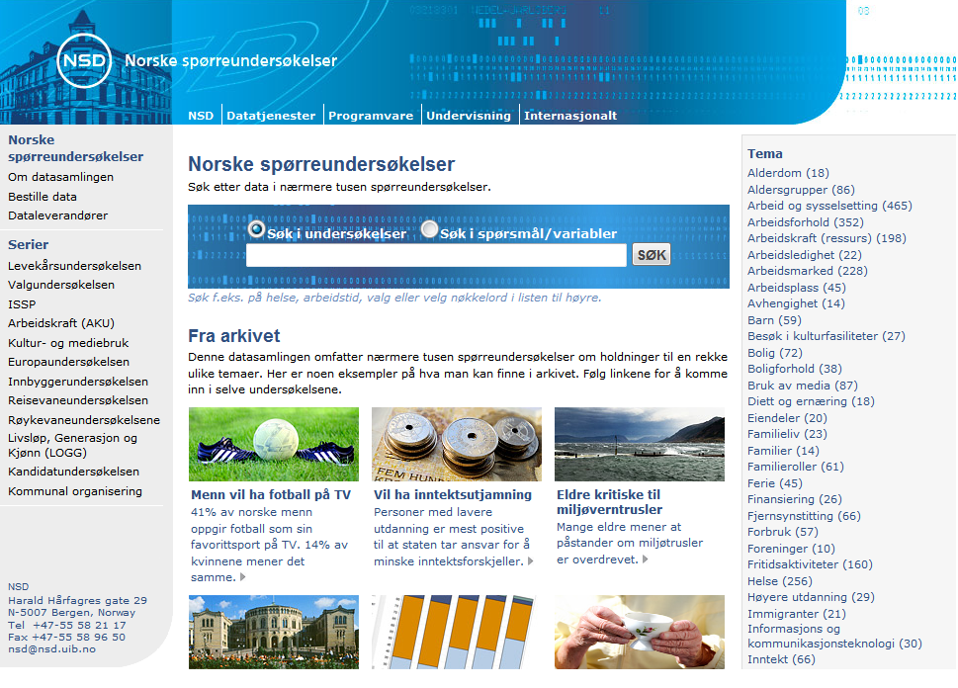
Norwegian Surveys
Notes:
Data collection consists of
surveys conducted in Norway to research by Statistics Norway, Nova and TOI
surveys conducted in Norway by researchers from universities and colleges
the Norwegian part of the multi-national surveys Eurobarometer and the International Social Survey Programme (ISSP)
All the studies in data collection are documented in both Norwegian and English. Some data sets can be analyzed online or downloaded directly from the web. Other data sets are available (for researchers and students) upon application and signed confidentiality agreement.

Slide 9
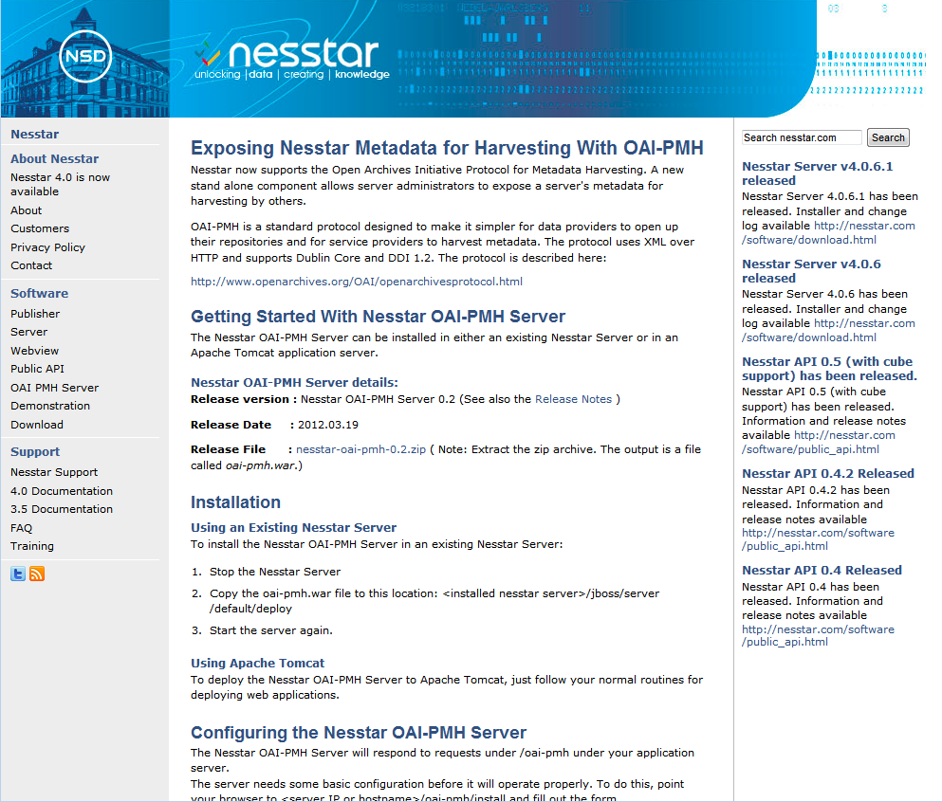
Nesstar OAI-PMH Server

Slide 10
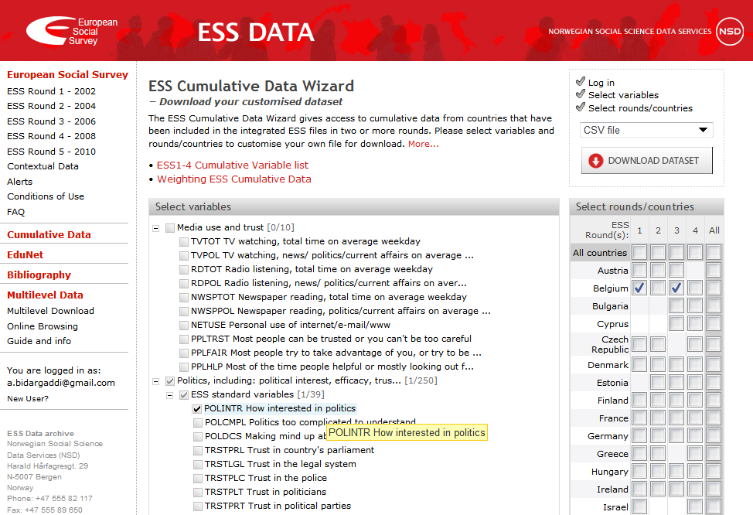
ESS Cumulative Data Download Wizard
Notes:
Sources
The repository contains variables collected from:
Eurostat, OECD , UN, UNESCO, World Bank, Freedom House, World Health Organization, Transparency International
The ESS Cumulative Data Wizard gives access to cumulative data from countries that have been included in the integrated ESS files in two or more rounds.
In the ESS Cumulative Data Wizard you can generate and download a customised subset of the ESS cumulative file by selecting rounds, countries and variables. The data file can be downloaded in SPSS, Stata, SAS and other formats. A Study Description and documentation of the selected variables is generated for each customised data file and is included in the download.

Slide 11
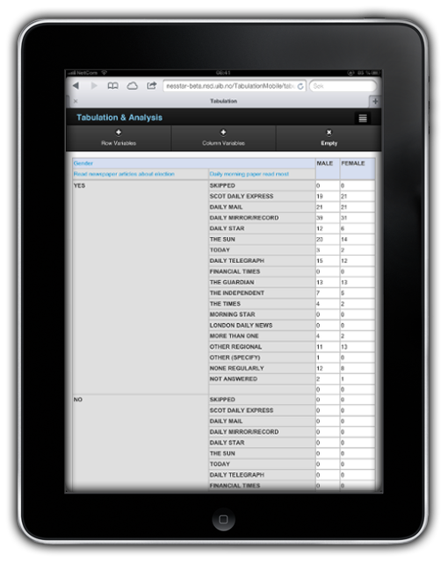
Analysis App for Mobile Devices

Slide 12
Publish Data + DDI to Nesstar Server
StudyPublishingBuilder builder = new StudyPublishingBuilder();
InputStream ddiFile = getResourceAsStream("metadata.xml");
InputStream csvFile = getResourceAsStream("data.csv");
builder.addDDI(ddiFile);
builder.addData(csvFile);
Study study = server.publishStudy(builder);

Slide 13

Promised TODO
Domain classes
Support classes (for navigation)
Lookup-indexes
Object ”banks”
Freetext/structured search/query methods
Statistical methods
Download/subset data
Cube slicing/dicing
DDI snippet delivery for reuse
Upload
User management
Visualization engine API
Subscription methods

Slide 14
Future Roadmap
DDI 2.5
DDI (4)
Longitudinal Data
Qualitative Data

Slide 15




Stay updated + interact
nesstar-support@nesstar.com
@nesstar
http://nesstar.com/rss

