Slide 1

DDI Resource Packages
and how they can be used
in the data production process
Hilde Orten
NSD - Norwegian Social Science Data Services
Joachim Wackerow
GESIS - Leibniz Institute for the Social Sciences
4th Annual European DDI Users Group Meeting, Bergen, Dec 3/4 2012

Slide 2
Outline
DDI Resource Packages
Two examples of DDI usage, Resource Packages:
- The International Standard Classification of Education (ISCED)
- example related to ongoing work
- The Background Variables of the International Social Survey Programme (ISSP BV)
- ideas for a possible RP
How can Resource Packages be used in the data production process?
Management rules

Slide 3
DDI Resource Packages
Structures study-independent material relevant for reuse by
projects, departments, institutions, network of institutions and in public
Exactly the same metadata element is repeated in a new environment, which
implies comparability when it comes to the reused object
    - Reuse ensures that objects are identical across environments
- Reproduction of objects is error prone and takes time
Houses Concept, Question, Interviewer Instructions, ControlConstruct, Variable,
Category, Code, Comparison and more
Typical content: Standard classifications, gold standard survey questions
and variables
Tailored software programmes that understand DDI can be built on the top of
an RP to retreive it and make it available for different purposes
Resource Package can be useful in the day-to-day work throughout
the data production process of an institution or project

Slide 4
The International Standard Classification of Education (ISCED) - Purpose
System on an abstract level
Captures the variance of national educational programmes and qualifications
Goals:
  Comparability between countries
    Heterogenity of programme systems and measurement systems between countries
  Comparability within countries over time
    Heterogenity of programme systems and measurement systems over time

Slide 5
ISCED 2011 Classification-
Complete Standard
Three components:
  Classification (and related classification rules)
    Two parallel coding schemes
    - educational programmes (ISCED-P)
    - educational attainment (ISCED-A)
    Numeric coding framework
    Strictly hierarchical - 3 hierarchical levels
  Operational concepts and definitions as structured text
  Mappings of national programs to classification

Slide 6
ISCED 1997 Classification, some differences compared to ISCED 2011
Former version of ISCED, still in use in official statistics and in surveys
No detailed code scheme available
    alpha-numeric codes can be constructed according to the documentation
    we have made numeric code list
No separate coding for attainment
Mappings of national educational programmes into ISCED exist

Slide 7
DDI usage Resource Package for ISCED 2011
Programme and Attainment
  as two variables (or codes and categories)
Relationship between programme and attainment variant
  with comparison module
Operational concepts and definitions
  as structured text in definition of category and possibly as notes
Outlook: Future mappings from national variables to ISCED11
  comparison module and as generation instruction

Slide 8
DDI Usage II
Resource Package for ISCED 1997
  ISCED97 as variable (or categories and codes)
    ISSUE: code/category scheme not well formalised
  National variables based on the ISCED mappings
  Mappings from national categories to ISCED97, realised in comparison

Slide 9
Structural Outline of Resource Package
DDIInstance
ResourcePackage
Purpose
ConceptualComponent
ConceptScheme
Concept Education
DataElementScheme
DataElement ISCED-P
ConceptReference
CategoryReference
DataElement ISCED-A
LogicalProduct
OtherMaterial
Note
CategoryScheme ISCED-P
CodeScheme ISCED-P
VariableScheme
Variable ISCED-P
CodeSchemeReference
Variable ISCED-A
DDI 3.2
DataElementReference
ConceptReference

Slide 10
Structural Outline of Resource Package Detail
CategoryScheme ISCED-P
Category 1
Label
Description
...
CodeScheme ISCED-P
Code
CategoryReference
Value 1
Code
CategoryReference
Value 11
...
Nested codes / Hierachy

Slide 11
Reuse of Resource Package
Which item should be referenced?
ISCED Resource Package
Study 1
DataElement (3.2)
Variable
CodeScheme
CategoryScheme
Study 2

Slide 12
International Social Survey Programme (ISSP)
Programme:
Annual cross-national social survey programme
Covers important topics for social research
Repeated modules
Focus on research methodology
Development of questions of relevance for all countries
and how they can be expressed
Organisation:
48 member countries from all continents
Secretariat
ISSP Archive – GESIS
Drafting groups for modules
Methodology research groups

Slide 13
ISSP
Rotating modules - examples
Role of Government
Social Networks
Social Inequality
Family and Changing Gender Roles
Work orientation
…..
Background Variables (BVs) - examples
Age
Education
Sex
Work situation
Religion
Social class
…….

Slide 14
DDI usage:
A Resource Package for the ISSP BVs
  Target harmonised cross-national variables (BVs)
      as variables (or categories and codes)
  Country-specific variables
  - as variables (or categories and codes)
  - applies for some but not all countries
  Category/code map
- country-specific variables vs. cross-national variables
- background variables with changes over time
  Generation instruction element
    - where more than one country-specific variable is used to create the
      harmonised measure
  Questions
    - with interviewer instructions, filter instructions, (universe, control construct)

Slide 15
Commonalities and differences between ISCED and ISSP BV Resource Packages
Concept
Hiearchy/Levels
GenerationInstructions
DDI
Resource
Package
Education/
ISCED 2011
DDI
Resource
Package
ISSP
BV
Variable/
DataElement 3.2
Questions
Multiple
languages
Codes
Instructions
OtherMaterial
Categories
ControlConstruct
Notes
Comparison Maps
CodeMap/CategoryMap
Universe

Slide 16
RP: What is challenging, what is easy and straightforward I
Variable
Codescheme/code
Is generated
Not generated
generationinstruction
has
software specific
syntax
Is simple
Is complex
Straightforward
Challenging

Slide 17
RP: What is challenging, what is easy and straightforward II
codescheme
categoryscheme
formalised
not formalised
has
hierarchical levels
formalised
not formalised
are strict
are imperfect
Straightforward
Challenging

Slide 18
RP: What is challenging, what is easy and straightforward III
Straightforward relationship
between source/target
Coparison
codemap
source /target not generated
Relationship possible
with some additions
categorymap
Relationship not possible
source /target
generated
Straightforward
Challenging

Slide 19
RP: What is challenging, what is easy and straightforward IIII
question
study specific element
has
is
Not well defined/structured/
instructions
is
Well defined/structured/
concept
language
Straightforward
Challenging
DDI issues (3.1)

Slide 20
Tools, some examples
Coding tool
Command Setups for Statistical Packages
DDI
Resource
Package
Translation tool
Enhanced Publication /
Web Information System
Question development software
Question delivery system
CAPI/Web Survey

Slide 21
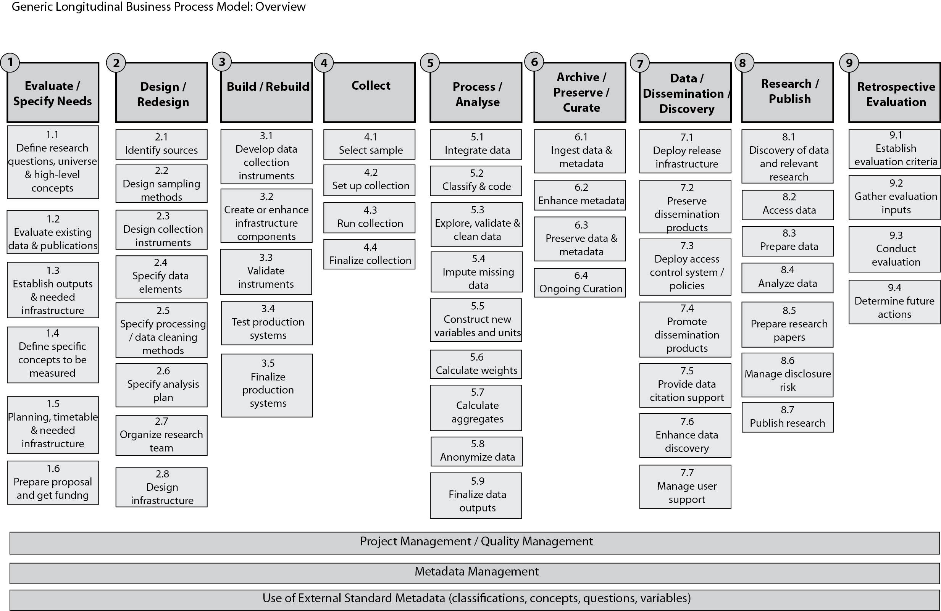
Generic Longitudinal Business Process Model

Slide 22
Possible usage of ISCED 2011 RP in survey production processes
9.4 Determine future actions
If measure successful, consider to
construct a DDI Resource Package
for the new measure, for the
benefit of reuse
1.2 Evaluation
of existing data and publications
based on tailored report from
ISCED RP
DDI
Resource
Package
Education/
ISCED 2011
2.3 Design collection instrument
Use tailored report from RP to make
sure concept is covered in cross-national
source question.
Consider reusing ISCED-A codes and
categories in response domain,
or customise
9.3 Evaluation
of resulting data and publications
based on tailored report from
ISCED Resource Package
7.2 Prepare dissemination product
Consider use of ISCED-A codes
and categories in cross-national
target variable, or customise.
Document any differences
from official ISCED-A metadata
components. Reuse of ISCED-A
categories in comparison map
2.4 Specify data elements
Consider use of ISCED-A codes
and categories in cross-national target
variable specifications and guidelines,
or customise
5.2 Classify and code
Consider use of ISCED-A codes
and categories in cross-national
target variable, or customise.
[Lists of educational programmes could
be used for coding tool]
6.2 Enhance metadata
Document any differences made
from official ISCED-A metadata
components. Reuse of
ISCED-A categories
in comparison map
5.5 Construct new variables and units
Consider reuse of ISCED-A or
customised codes and categories
in cross-national variable
(for coding into new target variable)

Slide 23
Possible usage of a ISSP BV RP in survey production processes
9.3 Evaluation
of resulting data and publications
based on tailored report from
ISSP BV guidelines?
2.3/3.1 Design collection instrument
Consider reuse of questions from
ISSP ’Master’ BV questionnaire,
or country- specific ISSP questions (incl.
translations, instructions, control construct,
question intent etc. )
Input to question development, delivery,
translation tools
DDI
Resource
Package
ISSP
BV
7.2 Prepare dissemination product
Consider use of ISSP BV (cross-
national harmonised BVs ,
country-specific variables) or
or codes and categories.
Document any differences from
ISSP BV metadata components,
and differences between
components over rounds.
Reuse of categories in comparison
map
2.4 Specify data elements
Consider use of ISSP BV variables (cross-
national harmonised BVs, country-specific
variables) or codes and categories, in
variable specifications and guidelines.
5.2 Classify and code
Consider reuse of categories and codes for
cross-national country-specific variables.
Tailored report with comparison maps
between country-specific and
cross-national categories can be used as
basis for encodings or harmonisations.
Consider to reuse of generation
instructions for complex cases.
6.2 Enhance metadata
Document any differences made
from ISSP BV metadata
components. Reuse of
ISCED BV categories
in comparison map, for
- target harmonised BVs
- country-specific variables
Comparison with earlier rounds.
5.5 Construct new variables and units
Consider reuse of cross-national
variables, or codes and categoriest
(for coding into new target variable)

Slide 24
Managements rules, Resource Package I
RP structures material for reuse by multiple studies, projects, or communities
Material should have relevance, as well as a certain degree of stability
Reuse of common material provides implicit comparison possibilities when it comes to the material that is reused
RP may be published for internal use within organizations or externally for use by the broader community.
RP should be published and maintained by a persistent organization
The publisher of the RP should preferably be the owner and maintainer of its content

Slide 25
Managements rules, Resource Package II
RP should be updated when updates of content intended for inclusion is made.
When deciding to publishing an RP, identify potential user groups (internal/external) and liaise to identify possible needs for content and structuring of content
Consider web services/tool that can optimise usage of RP, based on identified needs of internal/external usage

Slide 26
Thank you for your attention!
hilde.orten@nsd.uib.no
joachim.wackerow@gesis.org

