Slide 1

DDI-L in the Production of Official Statistics
EDDI-2012, Bergen
3 December 2012
Jannik Jensen (Danish Data Archive) &
Mogens Grosen (Statistics Denmark)

Slide 2
Agenda
Background
Purpose and needs
Scope for 2013-project
Standards
Reuse of metadata including demo
Moving forward

Slide 3

Background #1 : ”The role of the NSI’s and metadata needs to change … ”
200 years ago: “statistics as state secrects”
Today: “handling complexity”
A lighthouse in the turbulent sea of information
Focus on metadata to support knowledge processes
Metadata must give user exact knowledge on products – ”Information at your fingertips”

Slide 4
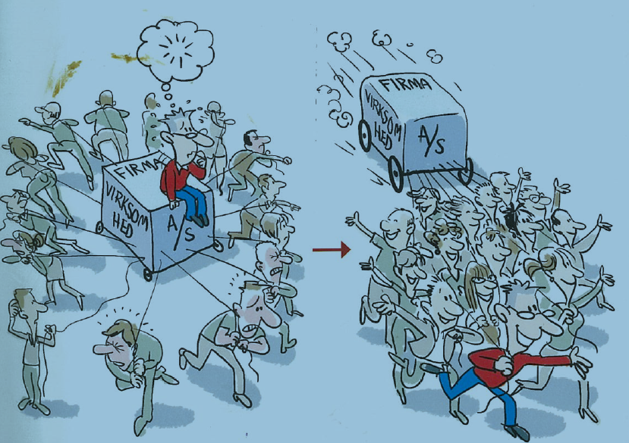

Background #2
”… towards focus on user needs”

Slide 5
Background #3:
“Challenges on metadata … ”
Metadata are not reused and often only linked to final data
No link to GSBPM processes
Parallel systems with tight links to DBMS-systems
Presentation of metadata on Internet is fragmented and incomplete
Concepts database incomplete with no hierarchy (Super-, sub- and synonym-concepts)
Classifications and code-lists in many places
No clear awareness of populations and units

Slide 6

Background #4:
”Metadata must be connected and reusable ”
StatBank
Methods/ ”Survey”
Methods papers
Quality declaration
Concept
Variable/dataset
Concepts database
Variable database
Hvad betyder
Classifications
Klassifikationsdatabase
Class database

Slide 7
Purpose and needs
Purpose
to fulfil needs of external users for metadata related to their desired use of statistics in their processes
to achieve internal efficiency via integrated use/reuse and production of metadata guided by GSBPM-processes
Needs
Fulfilment of requirement from Eurostat (SIMS, QAF etc.)
Detailed requirements based on additional user-consultations
  ”Information at your fingertips”
  ”We want integrated metadata”

Slide 8
Scope for 2013 project #1
Pilot study using DDI, GSBPM and parts of GSIM
  DDI as common model with reuse of concepts, variables, categories and codes
  Fulfilment of Code of Practice (CoP) and Quality Assurance Framework (QAF) using Single Integrated Metadatastructure (SIMS)
  Thesaurus with concepts that links micro and macro (on selected areas)
  Common categories and codes
  “Information at your fingertips” via metadata on Internet
  GSBPM-processes and external-user processes established

Slide 9
Scope for 2013 project #2
”What-documentation” – content of statistics
  Quality-declarations
  Concepts
  Variables
  Categories and codes (classifications)
B. ”How-documentation” – how we produce the statistics
  1) Management : Business Case, Project plan, Status, Evaluation etc
  2) Work-processes: (workflow, user-guides, process descriptions etc.)
  3) IT: Requirement-, Design-, Test-, Maintenance-documents etc
Focus in 2013: user-directed ”What –documentation”
Notes:
Fokus på A, (men alligevel ikke helt glemme B, som også er vigtig)

Slide 10
STANDARDS

Slide 11
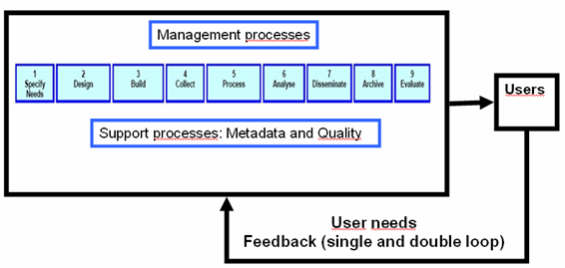
Standards #1: GSBPM with feedback

Slide 12
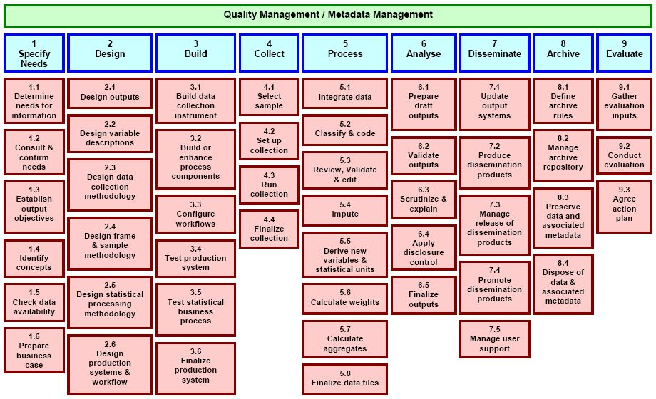

Standards #2: GSBPM combined with DDI AND SDMX
DDI
SDMX
DDI

Slide 13
Standards #3
Expected benefits using DDI
Fast and safe integration and reuse of concepts, variables, classifications via international standard-model and standard-software
Integration with Statistics Denmark's process model
Versioning and multi-langugage
Implementation of thesaurus
Synergy due to national and international cooperation and experience (Australia, New Zealand, France etc.)
25. oktober 2011

Slide 14
REUSE OF METADATA AND DEMO

Slide 15
Reuse of metadata #1 Concepts,
Categories and Codes etc
Subject-matter area: Education
(e.g. higest education atttained)
Concept in final statistics - cubes, thesaurus etc
(e.g. higest education attained)
Subject-matter area: Income
(e.g. higest education attained)
Common concepts
(e.g. higest education attained)
etc.

Slide 16
Reuse of metadata #2
Test-DDI-model
Population
Subject matter area
Domain with common metadata
Version / wave (quality and reference to variables)
Concept
Category
Code
Variable (linked concept, category and code)

Slide 17
Reuse of metadata #3
Test-DDI-model
Population
Persons with competence-
giving education
Subject matter area
Education of persons in DK
Domain with common metadata
Version / wave (quality and reference to variables)
Concept
Higest education attained
Education of
persons in DK
2011
1-year high-school
Categori
Code
”1423”
Variable (linked concept, category and code)
ALMAUDD

Slide 18
Reuse of metadata #4
Test: Metadatabase og software
Colectica Designer)
Web-application
Web-services and data-access funktioner
Colectica SDK (Software Developmen Kit)
Metadatabase (Colectica repository)

Slide 19
Reuse of metadata #5
Test: DDI-structure – using Colectica
A. Population:
- Universe-scheme → Universe
B. Common pool:
- DDI-instance (In Colectica: a project for each maintopic)
- Ressource-package
- Conceptscheme → Concept
- Categoryscheme → Category
- Codescheme→ Code
- Variablesheme → Variable
C: Studies
- Group (in Colectica: a serie for each survey )
- Study unit (a study-unit for each wave)
- Universe-reference
- Ressource-package
- Variable-scheme → Variable-reference

Slide 20
DDI – in practice using Colectica
25. oktober 2011

Slide 21
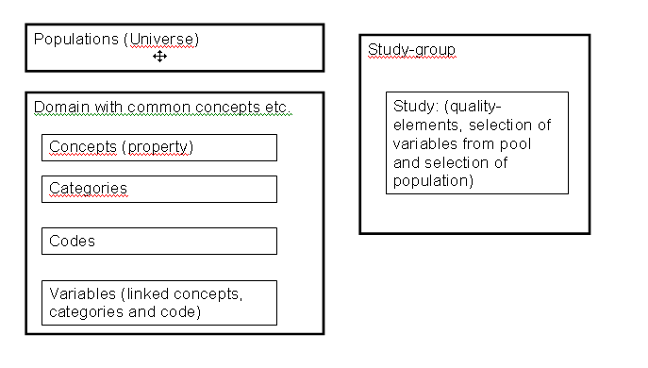
Reuse of metadata #6
scenario 1
Scenario 1 (test-DDI). Reuse of universe, concepts, categories and codes and variables. No inheritance used on the study-side

Slide 22
Reuse of metadata #7
scenario 2
Scenario 2. Reuse of universe concepts, categories and codes and variables. Inheritance used on the study-side

Slide 23
Reuse of metadata #8 Subject Domains
Structured in domains with sub levels
  Example: Geography, environment and energy->Infrastructure->Harbor
Studies
  StudyGroup and contained studies are structured by the domain hierarchy
Variables
  The variables in the pool are structured by the domain hierarchy
  A variable can belong to one or many domain/ levels in the domain hierarchy

Slide 24
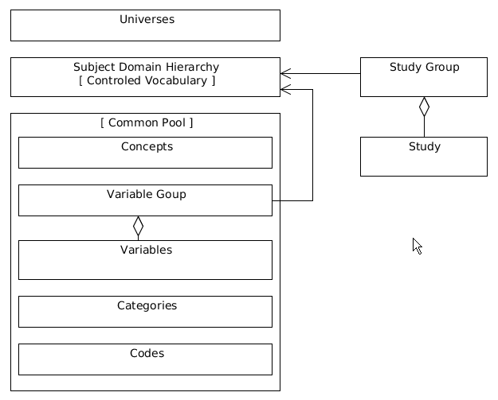
Reuse of metadata #9 Scenario 3
Scenario 3. DDI-model with subject - domains

Slide 25
MOVING FORWARD
Scenario 3
DDI 3.2
Detailed user-consultations
Colectica
  Get the right DDI-model
  Customized user interface
  Setup to ensure quality assurance
User groups: DK and international

Slide 26





The End!

