Slide 1
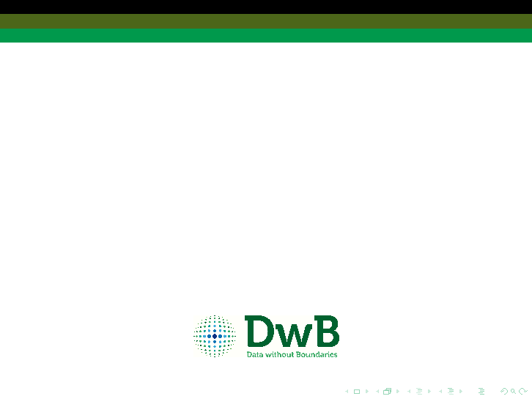


A Resource Discovery Service for OS Microdata
Arofan Gregory, Metadata Technologies
Marion Wittenberg & Mike Priddy,
Data Archiving and Networked Services (DANS)
Notes:
This presentation is about the current work of DwB work package 8 “Improving Resource Discovery for Official Statistical Data”
& is in two parts
I’ll start with what the users want! and I’ll keep it brief…
as Arofan will talk about the more interesting part: the current metadata model and architecture.

Slide 2
The DwB OS Microdata Resource Discovery Portal
The DwB metadata model encompasses metadata from a number of sources.
  The aim is to provide access to metadata on OS microdata from NSIs & data archives & other sources
  Plus integrate DwB collected, structured & coded metadata on Eurostat micro-datasets & a catalogue of national surveys
But we also want to know how all this metadata might be used.
  For researchers to find relevant OS micro-datasets
  And beyond findability
Notes:
Christof’s Work package 5 is currently gathering
SILC, LFS & AES Statistics on Income and Living Conditions, Labour Force Survey, Adult Education Survey
It’s one thing having all this lovely metadata in DDI & SDMX, but what do researchers want?

Slide 3
Researcher Requirements: Example Issues
You have to browse all the various PDF documents to get the information you need. It is not possible to search through the PDFs.
…OECD and Eurostat both would need some improvement at their websites. Actually, it is quite hard to find the desired data searching in these portals. Even taking into account that I usually search aggregate data in such Internet portals.
…would be really important that the site had a set of search criteria sufficiently large to let to the user a search as concrete as possible. In particular, the possibility for entering criteria of comparability would be really necessary.
Notes:
We have been interviewing (+ focus group on search + browse preferences) for user requirements for official statistics. Apparently this is not a common thing to do - and it wasn’t in our work-plan either
We still have a few more to complete, so this from our work in progress.
Some are happy with the status quo - they have access to what they need & that’s fine
But there have also been some frustrations & clear wants/needs that goes further than the just a resource discovery portal - a Virtual Research Environment maybe more suitable.

Slide 4
Advanced Searching & Browsing
I would like to have a portal with really specific search criteria, such us geographical area (countries, regions, etc.), topics, time interval, comparability, type of data (microdata, aggregate data, etc.).
Need for high-quality & extensive metadata in DDI
Must be able to store both search results and search query.
Consistent & unique identification of both metadata record & dataset is essential
  Must be citable (persistent)
  Organisational & access information is needed from all agencies
Notes:
Complex & comparison searches required by a number of interviewees
- DDI can do this. but the metadata must be there.
Also essential to ensure that all MD related to a study or dataset can be presented together for the user. We will have metadata from various sources that is related to one microdata set.

Slide 5
Evaluating the Value of the Resource with External Context
Comparability is important. For cross-national research you have to know exactly how a concept in measured in the different countries.
It is important that information about trend breaks is available for researchers. At the moment they have to figure it out by themselves, that shouldn’t be the case.
For some concepts researcher need additional context information to identify if variables are usable
  Locate & link to other resources
  Search more than just metadata - literature, citations, etc.
  Requires community engagement
Notes:
If a variable measured cross-sectional & then sudden changes to panel, or if face to face & then change to online or a change law etc. Within in one study this is fine, but longitudinally the researcher needs to understand the trend break & why this has happened. Need knowledge that describe the changes. This maybe done by the NSI but it may not be clear - links to where other researchers describe the trend is important.
Also the differences in concepts between countries need detailed information on how these are measured.
Language difference & difficulties

Slide 6
Sharing & Collaborating
In an ideal situation you have user groups around specific data or specific topics. These user groups share expert knowledge, literature, journal papers, sometimes even syntax of the analyses
It would be great if there were a possibility to share the work on harmonisation.
Users should be able to set up their own virtual research environment (VRE).
Share their VRE with a group of other researchers
  Or can even make it available to the wider community
But needs a form of single sign-on (AAI)
And needs to generate provenance metadata.
Notes:
But at the moment there is a lack of openness to share ideas. Researchers are sometimes afraid; they look like more as competitors rather than collaborators.
VRE can be temporary for a single project or need, or possibly set up for a long period of time.

Slide 7
Communities
…[an] advantage of a kind of Wikipedia structure is the binding of the community
Because of competitiveness, researchers could hesitate to share their knowledge. On the other hand if you post your findings it could boost your reputation.
  Communities should be able to build their own specialised portal
Communication & social media tools could help build knowledge bases & communities
  But must be part of researchers normal daily working methods.
Notes:
If you use email it should be simple for you to send email to the VRE or if you use twitter then that should post to you VRE & vice versa.
One size doesn’t fit all.

Slide 8
Feedback and Sharing Experiences of Datasets
[I] would like to have the possibility to add comments. This can also help other researchers.
There is a lack of information about microdata matrices, lack of correspondence between microdata columns and questionnaire, lack of detailed information in some fields, such us, recoded variables, stratification method, weights…
Annotation functionality
  Making notes & sharing in a VRE group
  Noting errors & issues - feedback to the data creators & holders
  Rate the dataset and documentation
Enrichment of the metadata (?)
Notes:
dataset rating is something we encourage users of data at DANS to do.

Slide 9
Tools & Services in the VRE
For cross-national research you have to know exactly how a concept in measured in the different countries.
…the possibility for entering criteria of comparability would be really necessary.
Need for tools for comparison in a number of ways at concept, variable & other levels. Cross-boundaries and languages are the key challenges here.
Can the DDI developer community help?
Knowledge of tools usage, methodologies & workflows could also be shared.
Notes:
completeness of metadata again
tools registry - we are working on this in another EC project called DASISH

Slide 10
Looking Forward
The VRE functionality requires additional information & metadata that is not necessarily in DDI or available from agencies
  Annotation & provenance (+ other user generated data) metadata is currently external to the portal content model (DDI/SDMX).
  Linking to external resources such as literature.
But there is a clear requirement for a more advanced environment to discover, comment, and share knowledge, information & tools.

Slide 11
The DwB Metadata Model
Arofan Gregory, Metadata Technologies

Slide 12
The DwB Metadata Model
This is a union model of the two standards widely used by archives and data producers (including statistical agencies) in Europe:
  DDI (both Codebook and Lifecycle)
  SDMX (for official aggregates and administrative register data)
  Aggregate data is used to provide context for searches for microdata
It is limited to discovery, but includes additional metadata used by WP 5 and elsewhere in DwB.

Slide 13
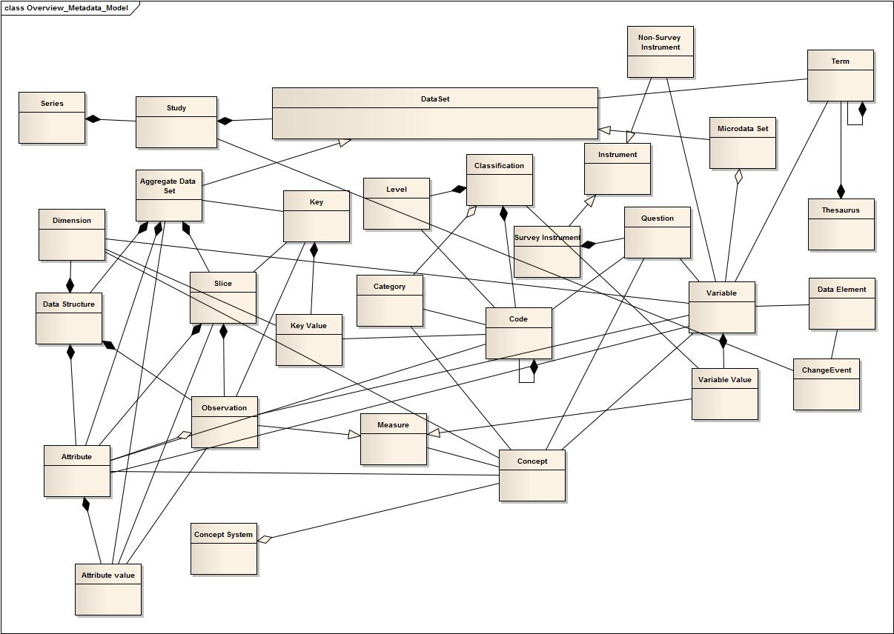

Slide 14
SDMX-Based Portions of the Model
Part of the model is based on SDMX, which provides context for searches for microdata
  Example: I find a table of literacy rates and I want to see the microdata and how the literacy rates were calculated
Note that although the data values are not indexed in the portal, the presence of specific indicators within an aggregate data set are
  Official statistics are often “sparse” cubes

Slide 15
Based on SDMX description of Data Structures

Slide 16
DDI-Based Portion of the Model
Series, Studies, Data Sets (for Microdata)
Concepts, Codes, Categories, Variables, Data Elements
Questions, Survey Instruments
  Flattened: no flow logic
Controlled Vocabularies
Change Events
Note that there is overlap with SDMX in core areas (codes/categories, concepts)

Slide 17
DDI-based portions of the model

Slide 18
Property Sets
Relationships between classes are shown on the diagrams in the model (aggregation, composition)
Literal properties of objects in the model are a sub-set of the properties found in the standards

Slide 19
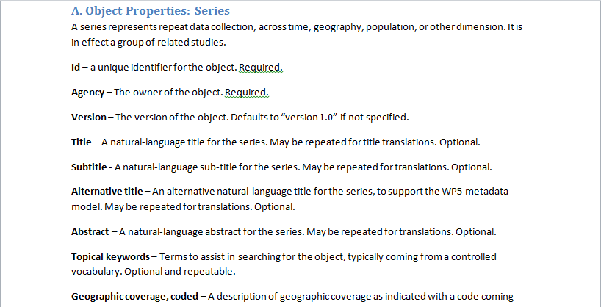
Example: Series

Slide 20
Using the Metadata Model
The WP 8 Model is a “pure” metadata model – it does not include details for the implementation of the WP 12 portal
  We expect WP 12 to add more specific information to support implementation
  WP 12 is a prototype, so we may find that not everything in the requirements and metadata model of WP 8 is implemented

Slide 21
Workflows for Gathering Metadata for Indexing
The WP 12 portal will index all data available from archives, research centers, and statistical agencies across Europe
  This means having an efficient way to gather metadata for indexing
We need to lower the barriers to entry for organizations with data holdings
  We cannot integrate with each organization separately – standards based
  But we want to demand as little as possible for organizations to become part of the network

Slide 22
Range of Workflows
To meet these requirements, seversal profiles have been defined for providing metadata to the portal
Some approaches are only at the study level
Some approaches are at the variable level
Some rely on using a harvesting technique (like the CESSDA portal)
Some rely on using registrations at a central registry (similar to the SDMX model)
The next WP 8 deliverable will detail these approaches – still a work in progress

Slide 23
Scenarios for Metadata Acquisition
(1) Harvesting study-level metadata expressed as DDI – Codebook
(2) Harvesting study-level metadata expressed as DDI - Lifecycle
(3) Harvesting variable-level metadata expressed as DDI-Codebook
(4) Harvesting variable-level metadata expressed as DDI-Lifecycle
(5) Harvesting metadata for aggregate data sets expressed as SDMX
(6) Registration of metadata for study-level descriptions expressed as DDI-Codebook
(7) Registration of metadata for study-level descriptions expressed as DDI-Lifecycle
(8) Registration of metadata for variable-level descriptions expressed as DDI-Codebook
(9) Registration of metadata for variable-level descriptions expressed as DDI-Lifecycle
(10) Registration of metadata for aggregate data described in SDMX

Slide 24
Implications for WP 12
WP 12 will be prototyping several pieces of technology
  The portal itself (to find official microdata)
  Tools for providing metadata for gathering/indexing by the portal (including a registry for some workflows)
  Documentation about how to deploy these tools
WP 12 has not yet started, so we don’t know exactly what will be implemented
  The goal is to show that this type of infrastructure could be built and operated in production

Slide 25
Thank you for your attention.
Questions?

