Slide 1

Modelling DDI-L into a combination of tools
Notes:
DIPF PowerPoint-Präsentation

Slide 2
Modelling DDI-L into a combination of tools
Agenda
The current tool situation in DDI-L
The Generic longitudinal business process model (GLBPM)
Software tools deriving from the models
Example tool chain
Upcoming activities
Q&A
Bergen, 03.12.2012 | Ingo Barkow | 4th Annual European DDI User Conference (EDDI 2012)
Notes:
DIPF PowerPoint-Präsentation

Slide 3
Modelling DDI-L into a combination of tools
Current tool situation for DDI-L
A lot of metadata editing tools:
  Questasy (CentERdata)
  Colectica (Algenta = Colectica)
  DDIEditor (Danish Data Archive)
  EDO - Easy DDI Organizer (University of Tokyo)
  NEPS Metadataeditor (DIPF)
  IAB Metadata Management System (TBA21/DIPF/OPIT/Colectica/Amin)
  Qbee - Questionnaire Builder (DIPF/GESIS/TBA21/OPIT)
  Metadata Tools by Metadata Technologies USA
  DesignQuest (GESIS)
  And a lot more (sorry if I forgot your particular tool)
Bergen, 03.12.2012 | Ingo Barkow | 4th Annual European DDI User Conference (EDDI 2012)
Notes:
DIPF PowerPoint-Präsentation

Slide 4
Modelling DDI-L into a combination of tools
Current tool situation for DDI-L
DDI Tools catalog lists additional tools for conversion of different formats to DDI-L (e.g. Blaise) or other small support tools
No Nesstar-like dissemination tool for analysis
Currently much more DDI-C users than DDI-L users due to tooling (?)
Question for DDI-L -> which tools does the user really need?
Answer might be derived from well-known models regarding DDI-L
  DDI Lifecycle Model itself
  Generic Statistical Business Process Model (GSBPM)
  Generic Longitudinal Business Process Model (GLBPM)
DDI-L might need a complete tool chain for future success
Bergen, 03.12.2012 | Ingo Barkow | 4th Annual European DDI User Conference (EDDI 2012)
Notes:
DIPF PowerPoint-Präsentation

Slide 5
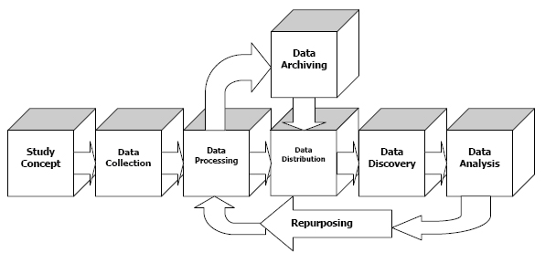
The DDI3 Combined Lifecycle Model (DDI 2009)
Notes:
DIPF PowerPoint-Präsentation

Slide 6
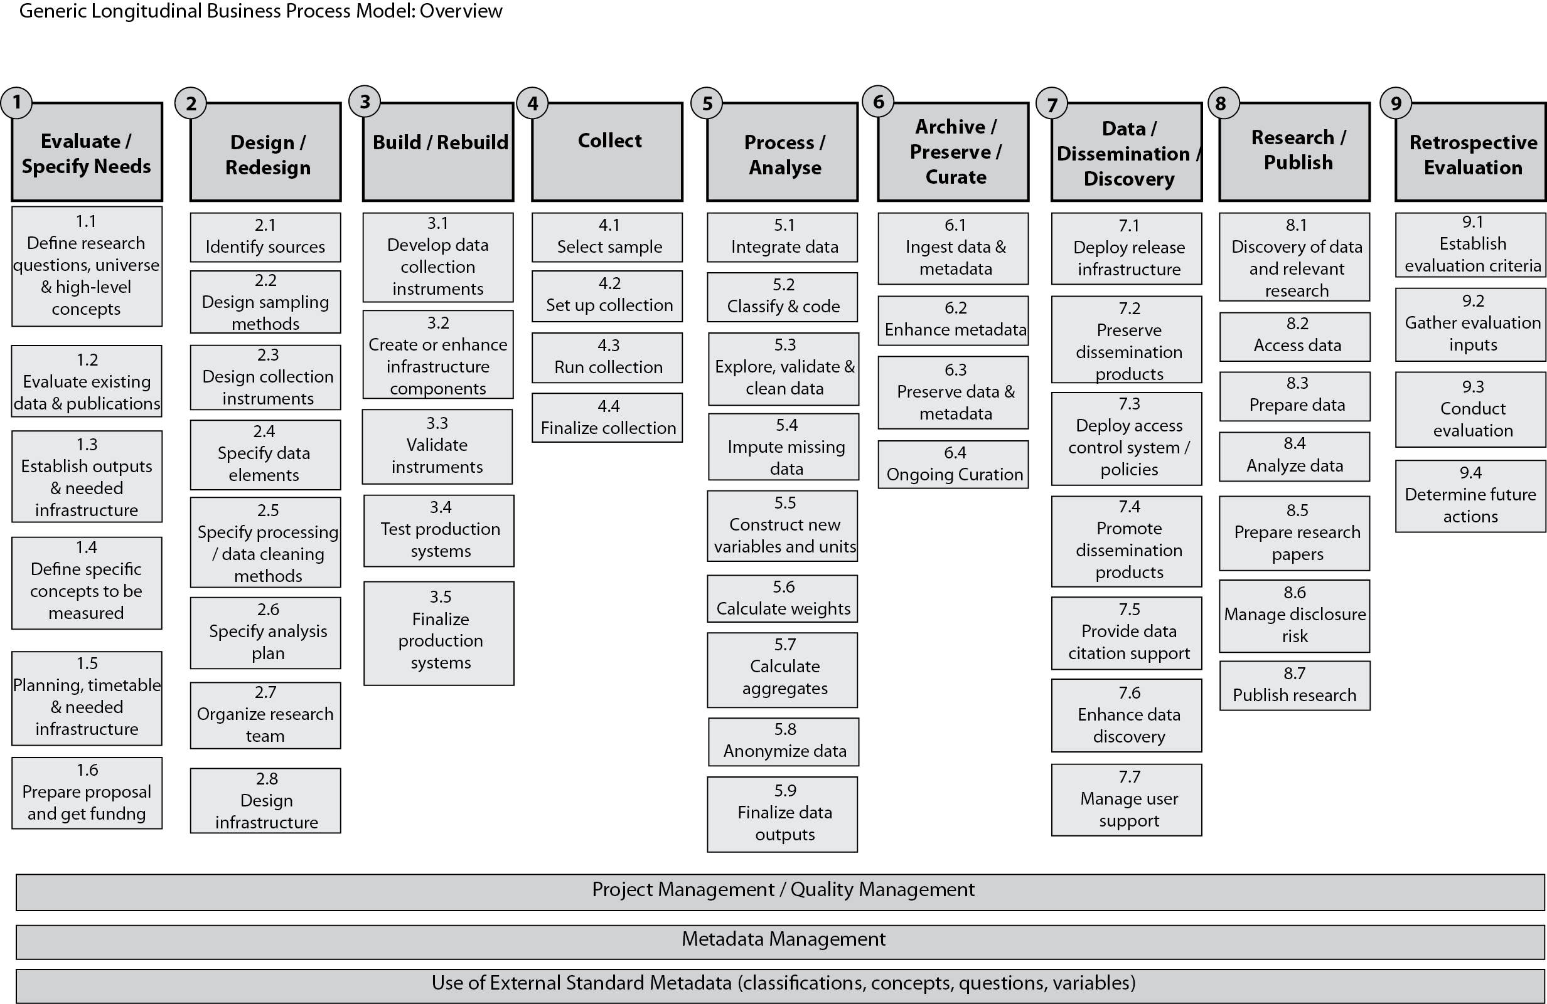
The Generic Longitudinal Business Process Model (to be published)
Notes:
DIPF PowerPoint-Präsentation

Slide 7
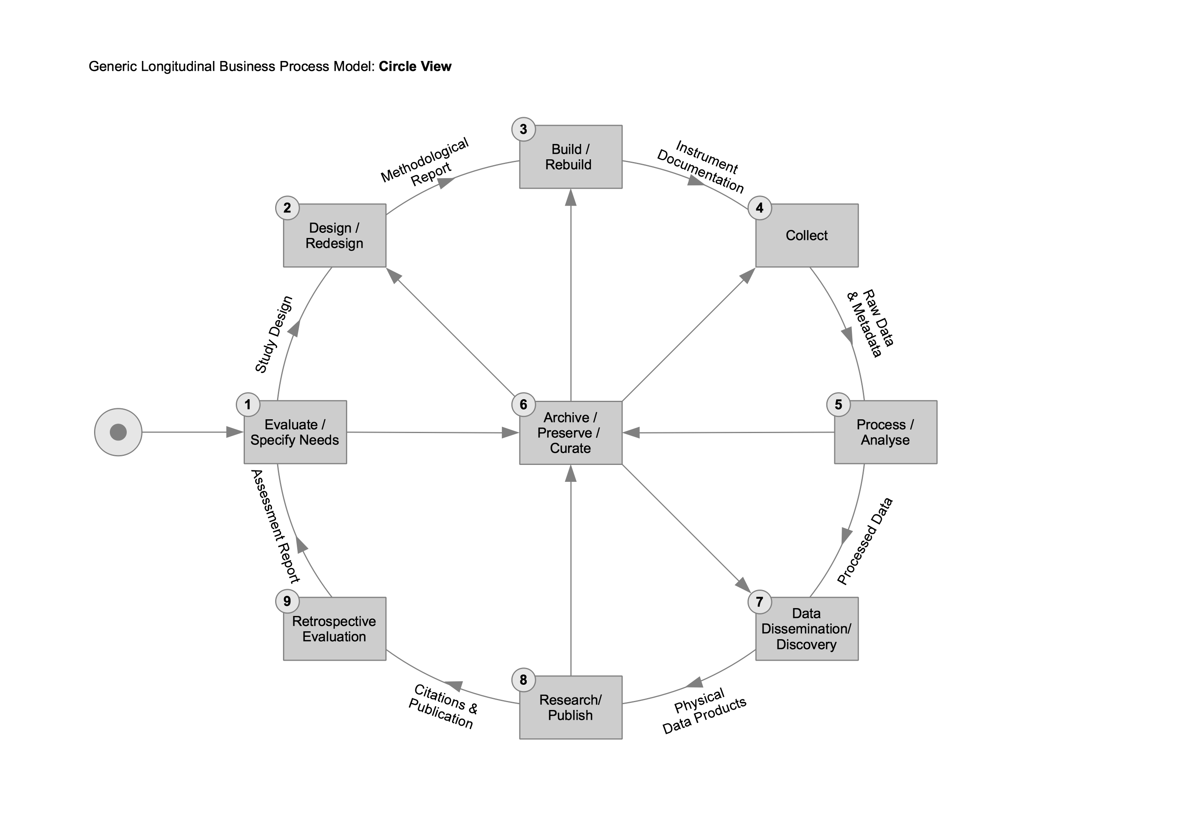
The Generic Longitudinal Business Process Model (to be published)
Notes:
DIPF PowerPoint-Präsentation

Slide 8
Example Tool Chains (with 3rd party tools)
Problem: No tool chain currently complete and working seamlessly
Notes:
DIPF PowerPoint-Präsentation

Slide 9
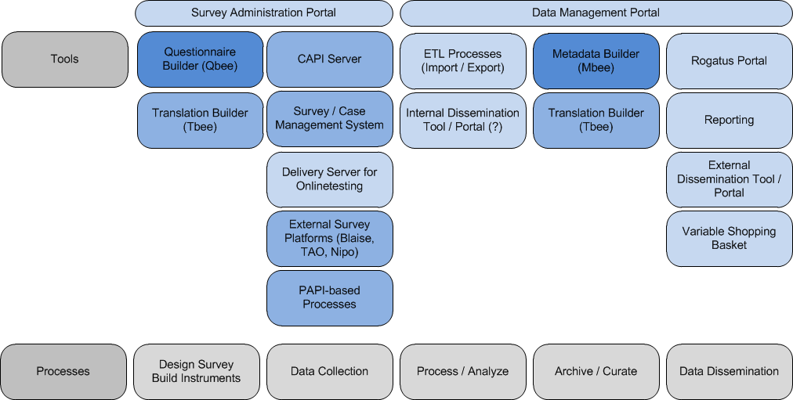
Vision from our side (our planned tools)
Notes:
DIPF PowerPoint-Präsentation

Slide 10
Modelling DDI-L into a combination of tools
Some involved partners supporting us
DIPF – German Institute for International Educational Research (funding, consultancy)
GESIS – Leibniz Institute for the Social Sciences (consultancy)
OPIT Consulting Kft. (software development)
TBA21 Assessment Systeme GmbH (DIPF spin-off company)
(project management)
IAB – Institute for Employment Research (funding, consultancy)
Algenta Technologies / Colectica (consultancy)
Alerk Amin – formerly CentERdata (consultancy)
Looking for further contributors or partners
Bergen, 03.12.2012 | Ingo Barkow | 4th Annual European DDI User Conference (EDDI 2012)
Notes:
DIPF PowerPoint-Präsentation

Slide 11
Modelling DDI-L into a combination of tools
Upcoming activities
Further development of
  Qbee – Questionnaire Builder
  Mbee – Metadata Builder / IAB Metadata Management System
Conversion of Statistics Austria – Case Management System (CMS) into delivery platform (Project „Cbee - Case Builder“)
Ex- and Import filters for several questionnaire systems
  Blaise / Nipo / CASES / TAO
Development of a Data Management Platform
Hopefully new systems will emerge so we do not have to develop everything on our own
Bergen, 03.12.2012 | Ingo Barkow | 4th Annual European DDI User Conference (EDDI 2012)
Notes:
DIPF PowerPoint-Präsentation

Slide 12
Modelling DDI-L into a combination of tools
Any Questions?
barkow@dipf.de
http://www.dipf.de
Bergen, 03.12.2012 | Ingo Barkow | 4th Annual European DDI User Conference (EDDI 2012)
Notes:
DIPF PowerPoint-Präsentation

