Slide 1
The MRC Research Data Gateway
Phil Curran
Medical Research Council
Notes:
Seconded part-time to work for MRC Data Support Service on the development of the Gateway. My other role is as Head of Data Services for the MRC Lifelong Health & Ageing Unit at UCL
I am also a member of the Technical Committee for the CLOSER USP

Slide 2
Goals of the Data Support Service Project
Project Overview:
  To provide researchers with a web-based data discovery “catalogue” of research datasets of potential value for new research – the MRC Gateway
  To provide a web-based library of standards and good practice materials for data management and curation
  To gather intelligence on data sharing to inform decision making and guidance for policy makers and researchers
  To gather quantitative data to help assess the benefits and costs of supporting data discovery services

Slide 3
MRC Gateway
Population Health Sciences Metadata Repository
Part of a larger project – “Data Support Service”
Longitudinal and Cohort Studies
Study level metadata on 34 studies
Variable level metadata on 5 of the 34 studies
Metadata on > 45K variables from the 5 case studies
Programme to add “variable level” metadata on the other 29 studies
This presentation is about experiences gained with the first 5 case studies
Notes:
The Gateway is not a finished system; it is still under active development
As of now the Gateway metadata repository contains records on 34 studies with variable level metadata on 5 of the 34
We have already been through a phase of evaluating the core metadata model and eliciting user feedback on using the Gateway. The feedback has highlighted several areas where the user interface could be improved. We are also aiming to add variable level metadata on more of the 29 studies which currently have only study level information.
By Spring 2015 our aim is to continue to add variable level metadata for more studies and to provide mechanisms for ingesting and exporting study metadata in a form conforming to the DDI-L international standard. This will ensure interoperability with the CLOSER USP and probably, all future systems that provide data discovery facilities for longitudinal or cohort studies.

Slide 4
First Five Case Studies
Avon Longitudinal Study of Parents and Children (ALSPAC)
National Survey of Health and Development (NSHD)
Southampton Women’s Survey
West of Scotland Twenty-07
Whitehall II

Slide 5
Gateway Platform
  Underlying database is ISO/IEC 11179 Metadata Registry
  Search Technologies used:
    Drupal
    Apache Solr
    Linux
  Design started in 2009
  Prototype went live in 2010

Slide 6
Key Gateway Metadata Elements
Study
Data Collection Event
Time Period
Variable
Subject Category
Attachments (e.g. Questionnaires, Forms, etc.)
(All these map onto DDI-L concepts)

Slide 7
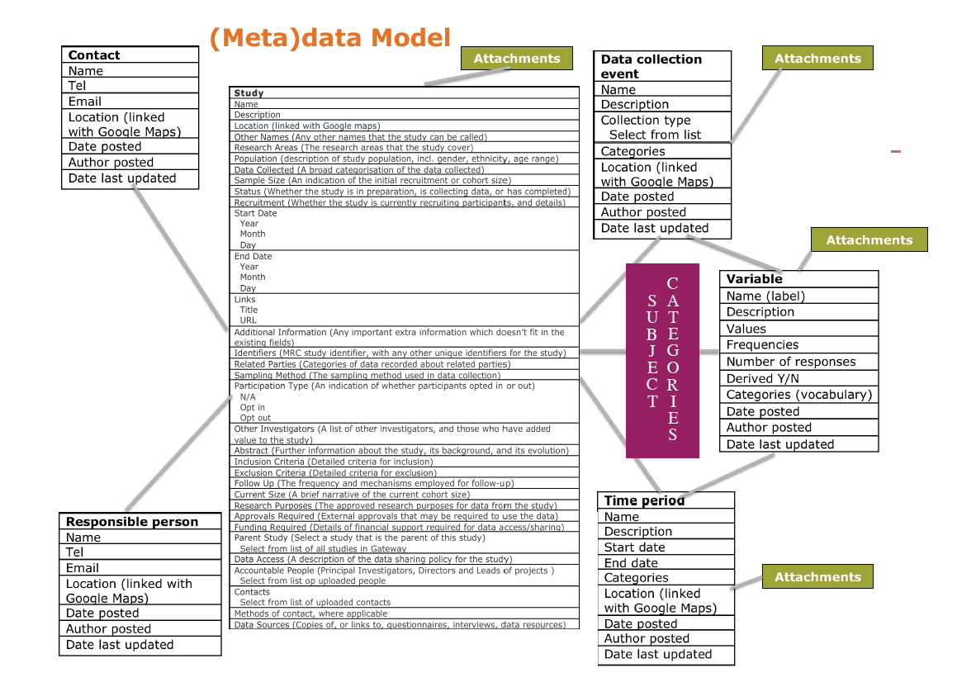
Gateway Data Model

Slide 8
Gateway Security Model
3 levels of User Access Permissions
  Unregistered user – can search for and browse study level information.
  Registered user – can search for and browse study level and variable level information. Can create lists of “interesting” variables across all studies and export them as CSV files.
  Administrative user – can edit their study's metadata content in the directory.

Slide 9
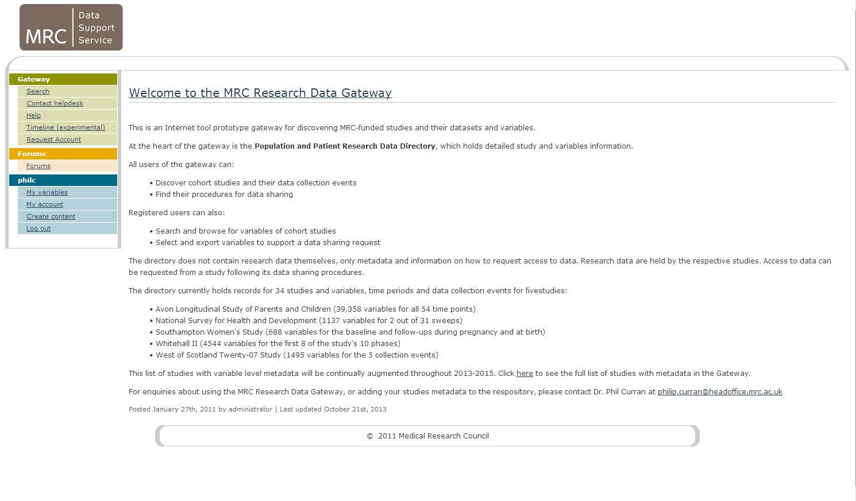
Gateway User Interface

Slide 10
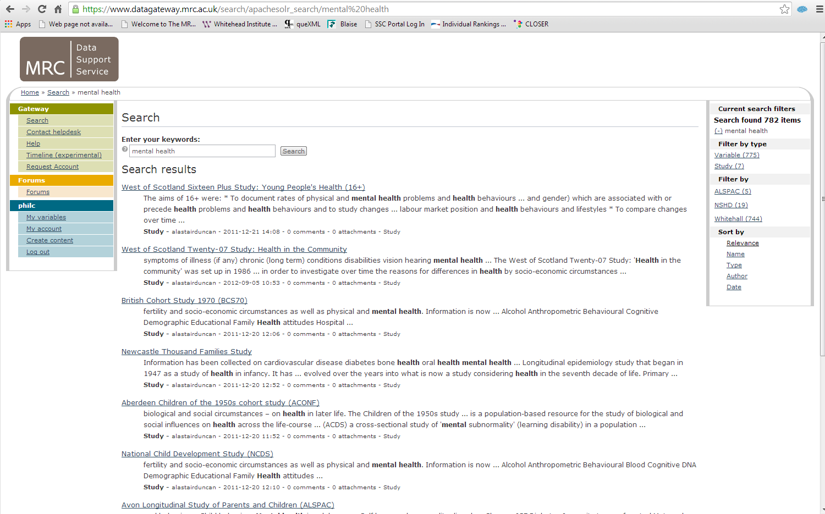
Gateway Search

Slide 11
Experience of Ingesting Metadata from the 5 Case Studies
Each of the five case studies had its own data infrastructure.
Consequently initial ingestion of metadata from studies was via bespoke scripts. This was time consuming and costly.
Considerable effort required by study data managers to support metadata ingestion and maintenance.
Result = initial metadata ingestion was not scalable.
DDI3 arrived just in time!
NSHD was first study to provide metadata in DDI-L form.

Slide 12
Plans for Gateway use of DDI-L
The Gateway development plans include:
  A DDI-L import and export facility;
  The use of commercial and open source tools for harvesting metadata from studies in DDI-L form.
Use of DDI-L will:
  Ensure the interoperability of the Gateway with other data discovery services;
  Protect the investment of the study teams and their funders in the construction of metadata;
  Enable federated structures of metadata maintenance and publishing;
  Increase the choice of systems and tools for data management teams.

Slide 13
Conclusions
Metadata production/maintenance is the most resource intensive process in providing data discovery systems.
Study data managers will increasingly need to publish metadata to a number of directory services.
DDI-L has the potential to protect investment in metadata from the inevitable obsolescence of directory and other search platforms.
Better tools are required to map metadata from relational databases to DDI-L.
The complexity of DDI-L is a barrier to widespread adoption amongst the data management community.
More data is needed on the resource requirements of metadata production/maintenance to inform funders.

Slide 14

Acknowledgements
Medical Research Council
Peter Dukes and Caroline Shriver
Science and Technology Facilities Council
Catherine Jones and Alastair Duncan
The Gateway
https://www.datagateway.mrc.ac.uk/

