Slide 1


Slide 2
Aim:
“to support the enhancement and implementation of the standards needed for the modernisation of statistical production and services”

Slide 3
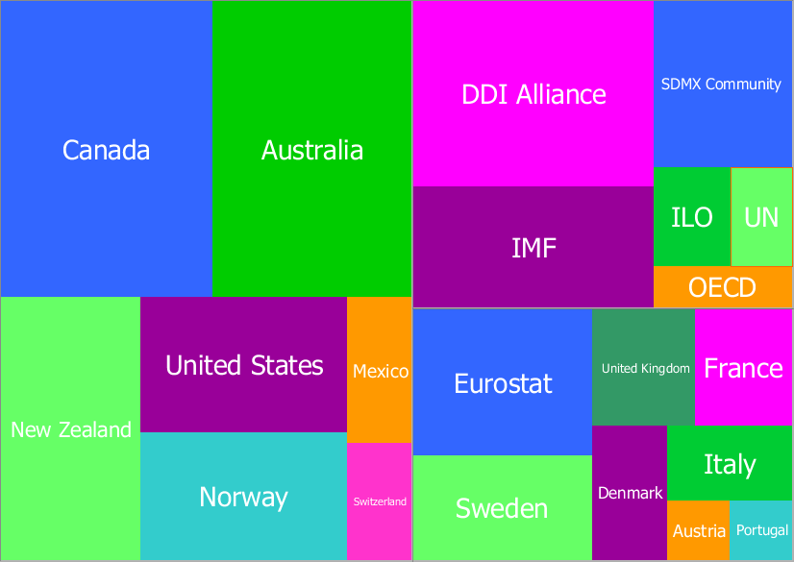





7 Task Teams
60 individuals
~960 hours of effort

Slide 4
GSIM

Slide 5
GSIM Review
GSIM v1.0 was released in December 2012
  First version was produced by an accelerated process.
  Influenced by existing frameworks and standards and previous experience of participating agencies

Slide 6

DDI
GSIM v1.0
Neuchâtel
SDMX
Notes:
GSBPM v4.0: existed, but had been static for 4 years
Geospatial: it was something we should think about, but were not sure about
GSIM v1.0: Just released, knew it was about 80%, needed implementation experience

Slide 7
GSIM Review
To reach the maturity required to support statistical modernisation practical testing against real-world applications in statistical agencies was required

Slide 8

GSIM v1.1 (2)
“If I had more time I would have written a shorter letter”
Anon

Slide 9
GSIM v1.1
Easier to understand
Clearer terminology
Fewer objects
Improved definitions and relationships
Consistent and high quality documentation

Slide 10
Implementing GSIM

Slide 11
GSIM implementation
GSIM is a conceptual model, it can’t be directly implemented in a system. The industry needs to do more than align conceptual frameworks.
To support modernized statistical production a technical implementation must also be standardised – e.g. XML, RDBMS, Java/.NET objects
This is required to support GSIM implementation in CSPA

Slide 12
Using other standards to implement GSIM
GSIM can be implemented by using existing standards to provide technical representation
Detailed mapping and gap analysis between GSIM and the information models of DDI and SDMX

Slide 13
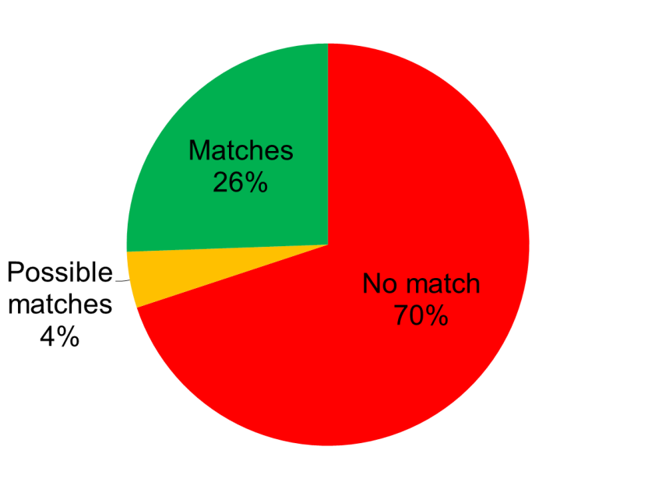
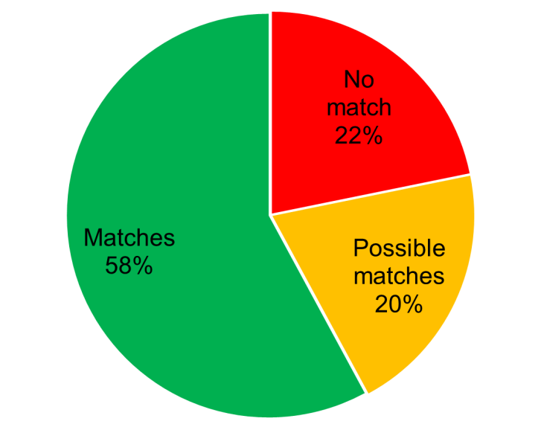
Mapping SDMX and DDI to GSIM
SDMX
DDI

Slide 14
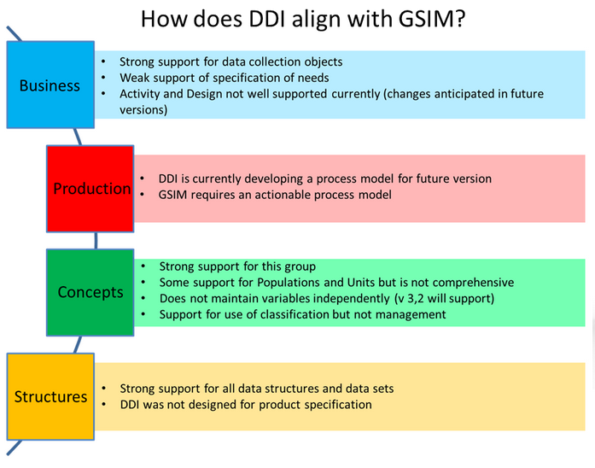

Slide 15


SDMX
GSIM v1.1
DDI
Profiles
Neuchâtel
Notes:
GSBPM: shiny new version
Geospatial: know what is out there and what is needed, how it links to GSBPM, GSIM
GSIM: shiny new version, more concrete link to implementation standards, neuchatel completely aligned

Slide 16
DDI Profiles
Best practice for using DDI to represent GSIM objects
5 profiles have been agreed to date
  Codelist
  Variable
  Represented Variable
  Base
  Questionnaire
Continuing work required

Slide 17
What is a DDI Profile? What for?
It « describes the subset of valid DDI object used by an agency for a specified purpose ».
Once the GSIM-DDI is done…
…Need for a more detailed and « actionable » output.
A common tool for standardising the use of DDI amongst the implementers.
In the end, DDI profiles were the answer.

Slide 18
GSIM and DDI profiles
One strong constraint: each GSIM area must be covered by a GSIM-centric DDI profile whenever possible.
The modular approach is preserved.
Define a subset of DDI elements that map GSIM information objects.

Slide 19
How are profiles created?
Consists of DDI elements which are allowed and forbidden (« Used » and « NotUsed » in DDI terms)
« NotUsed » element to be used only when specific object are not applicable.
Object not noted in the profiles are intended to convey local information and to be not interoperable.
XML profiles are seen as vehicles for harmonisation of the use of DDI in statistical activities

Slide 20
The work done
A sub-team of the larger GSIM-DDI mapping group tackled those points.
First, stocktake of GSIM objects needed for each group (ie. GSIM Variable, Concept, Populations, etc.).
Some ground rules considered:
  DDI based on DDI 3.1 (except for questionnaire based on 3.2)
  As for « classification » profile, only CodeList and CategorySets were included
  InstanceVariables left aside (to be worked out in a future dataset profile)
Already existing material considered: profiles samples and examples from the ABS, StatCan and Insee.

Slide 21
Realisation
From the input material, DDI profiles elaborated outlining the content that DDI requires for its equivalent objects, such as the minimum requirements of DDI.
Then content mapping to GSIM
Result: creation of a DDI profile for a set of GSIM objects.

Slide 22
Further actions required
Around the existing questionnaire profile:
  need to be mapped to GSIM objects
  Soundness of 3.1 version must be explored and assessed.
Finalise and publish profiles
Produce more profiles for other GSIM object groups?

