Slide 1



How Do We Manage Complex Questions on a Large Scale?
Sub-brand to go here
Claude Gierl
Jon Johnson
CLS is an ESRC Resource Centre based at the Institute of Education

Slide 2
How Do We Manage Complex Questions in the Context of the Large-Scale Ingest of Legacy Paper Questionnaires into DDI-Lifecycle?
Context:
Centre for Longitudinal Studies
The new CLOSER Project
DDI3.2 QuestionGrid
Examples

Slide 3
Centre for Longitudinal Studies
Funded as an ESRC Resource Centre since 2004
Manages three of the UK’s national birth cohort studies
1958 Birth Cohort (National Child Development Study)
1970 Birth Cohort Study
Millennium Cohort Study
Anonymised data available via the UK Data Service
www.esds.ac.uk

Slide 4
CLOSER
Launched 2012 for 5 Years
9 Participating UK Studies
200 Paper Questionnaires
100,000 Questions
Ingest via in-house CADDIES Editor

Slide 5
DDI3.2 QuestionGrid
QuestionGrid
GridDimension
Choice CodeDomain
Roster
Choice ResponseDomain
StructuredMixedGridResponseDomain
Choice NoDataByDefinition
GridResponseDomain
CellLabel

Slide 6
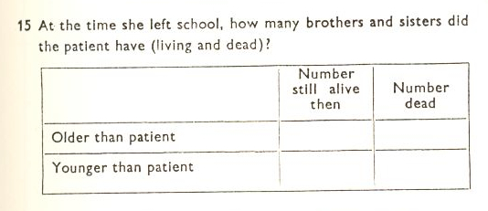


Slide 7
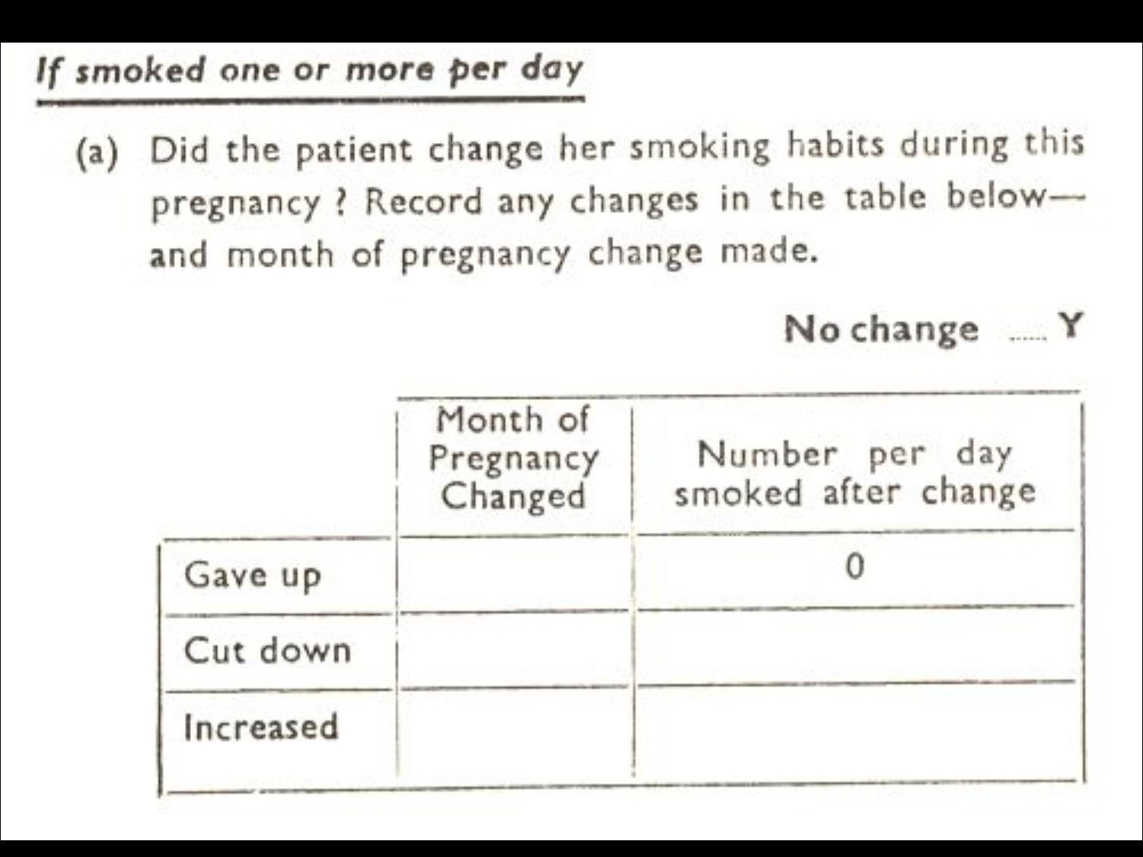

Slide 8
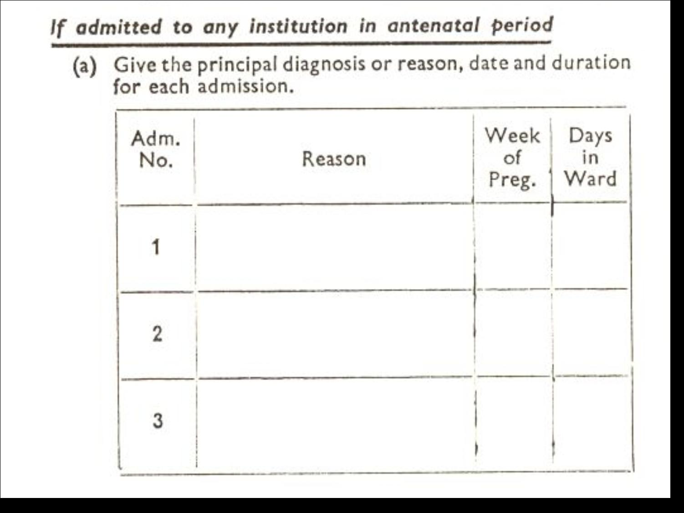

Slide 9
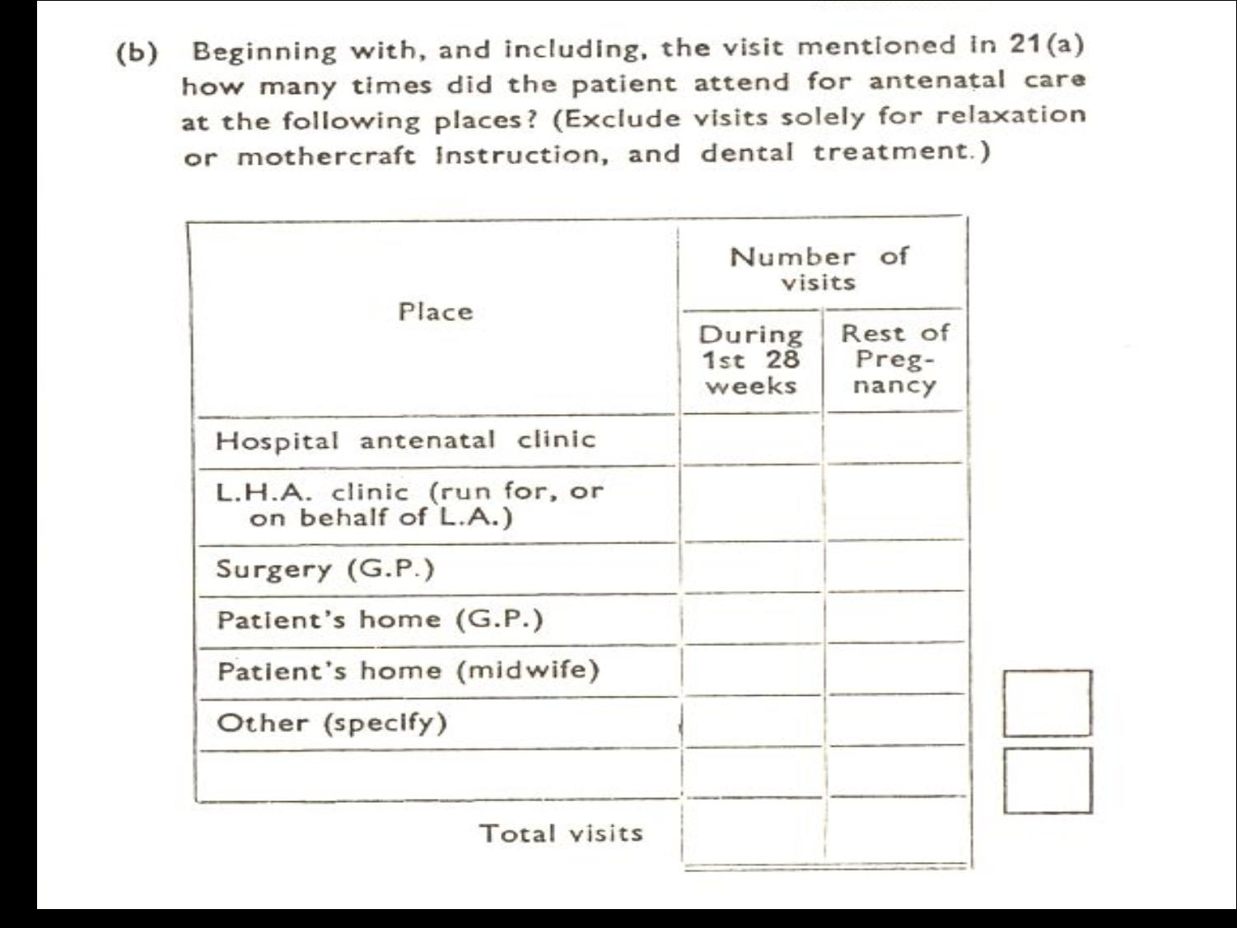

Slide 10
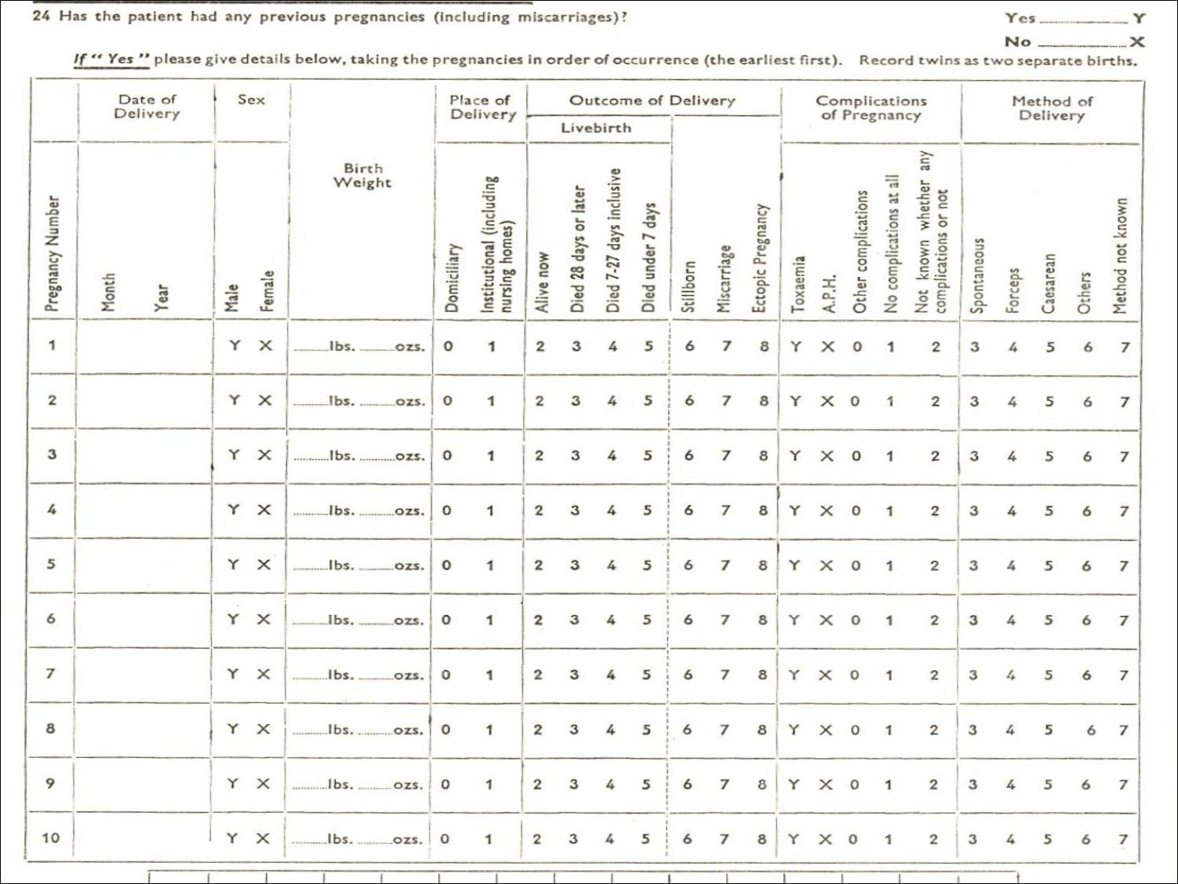

Slide 11


Any questions?
www.cls.ioe.ac.uk
www.closer.ac.uk
Institute of Education
University of London
20 Bedford Way
London WC1H 0AL
Tel +44 (0)20 7612 6000
Fax +44 (0)20 7612 6126
Email info@ioe.ac.uk
Web www.ioe.ac.uk

