Slide 1
Implementing DDI Profiles at a National Statistical Office: Experiences at INSEE and ABS
Simon Wall (Australian Bureau of Statistics)
Guillaume Duffes (Institut National de la Statistiques et des Etudes Economiques

Slide 2
Insee: Several DDI Profiles
Insee
Questionnaire
Concept & Variable
ABS
RepresentedVariable
Value Domain

Slide 3
Insee: Two profiles presented here
The ABS (Simon Wall) is going to present the ABS profile for Variable
Insee (Guillaume Duffes), the profile for questionnaire
Both profiles were agreed by the Profile sub-team…
However, some differences remain

Slide 4
Insee: Profile for Survey Instrument at Insee (1/3)
Survey instrument generic term. Survey questionnaire more NSI-oriented terminology.
Implementing questionnaires using DDI-L for more than two years.
Started with version 3.1.
Now, Insee has decided to move integrally to 3.2.

Slide 5
Insee: Profile for Survey Instrument at Insee (2/3)
The profile is a set of critical DDI elements and attributes used to build survey questionnaire
The content has not been mapped to GSIM yet.
  Need to be done for harmonisation purposes.
Intensive use of the DDI schemas: no extension made.
The profile generation was based on modelisation of a DDI 3.2 survey instrument.

Slide 6
Insee: Profile for Survey Instrument at Insee (3/3)
Theortically, a DDI profile is composed of DDI elements which are allowed and forbidden (« Used » and « NotUsed » in DDI terms)
Insee questionnaire profile forbids nothing (no « NotUsed » elements)
Object not noted in the profiles are intended to convey local information and to be not interoperable.
The profile was partially created by hand (definition of terms), very time-consuming task. Hence, the need to share the burden internationally with the GSIM as a common framework.

Slide 7
Insee: Future
DDI profiles are seen as vehicles for harmonisation of the use of DDI within and between statistical organisations.
Plan to use and share this profile in tools (possibly Colectica, etc.)

Slide 8
ABS: Why is ABS using profiles?
Enable consistent use of DDI
Remove excessive flexibility from DDI
Retrofit DDI to support GSIM
Extend use of DDI to new purposes
Tell others how we are using DDI
Notes:
Start by acknowledgin the work of Max Hale and Heather Riley
Mostly these are about Overcoming perceived limitations of DDI
These mostly won’t be fixed by DDI 3.2
Same DDI for several objects (consulted Wendy)
Promote interoperability in the absence of DDI being clearer

Slide 9
ABS: How is ABS using profiles?
Based on GSIM business objects
  e.g. Codelist, Unit data structure
Breaks DDI 3.1 into manageable pieces
  KB not MB
Assumes a registry is available
Extensions used sparingly
Starting with local solution
Notes:
Might split into 2?
Lots of profiles
Sometimes closely related groups
Manageable pices, instead of monster packets
E.g. 45MB for health survey -> 5MB by stripping out 2 classifications.
KB not MB for concepts
Local solution for now – may suit others
Governance process to review

Slide 10
ABS: Several flavours of GSIM variables
data structure
data set
record relationship
logical record
data record
data point
identifier
measure
attribute
datum
unit
value domain
represented
variable
instance variable
concept
variable
Notes:
Mostly these are about Overcoming perceived limitations of DDI
These mostly won’t be fixed by DDI 3.2
Same DDI for several objects (consulted Wendy)
Promote interoperability in the absence of DDI being clearer

Slide 11
ABS: Several flavours of GSIM variables
GSIM
DDI profile based on…
variable
representedVariable
valueDomain
instanceVariable
dataElementConcept
variableScheme
variableScheme
variableScheme

Slide 12
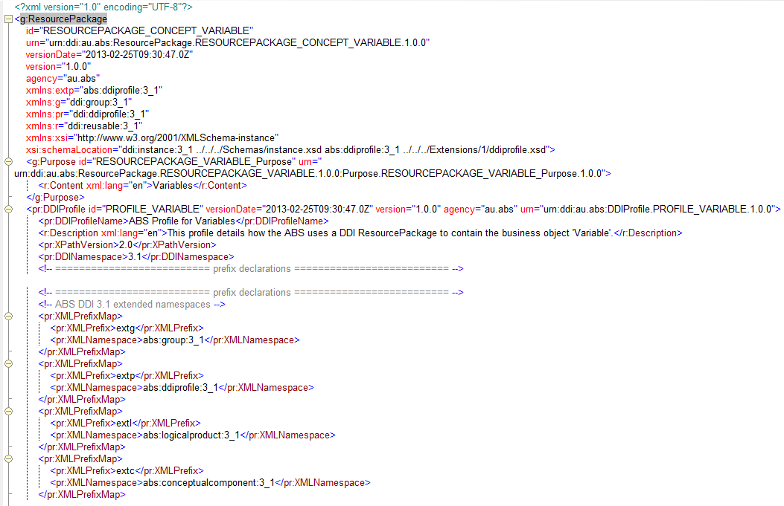
ABS: variable 1
Notes:
No EDDI presentation complete without actual DDI…
You will notice that we have a profile for profiles…

Slide 13
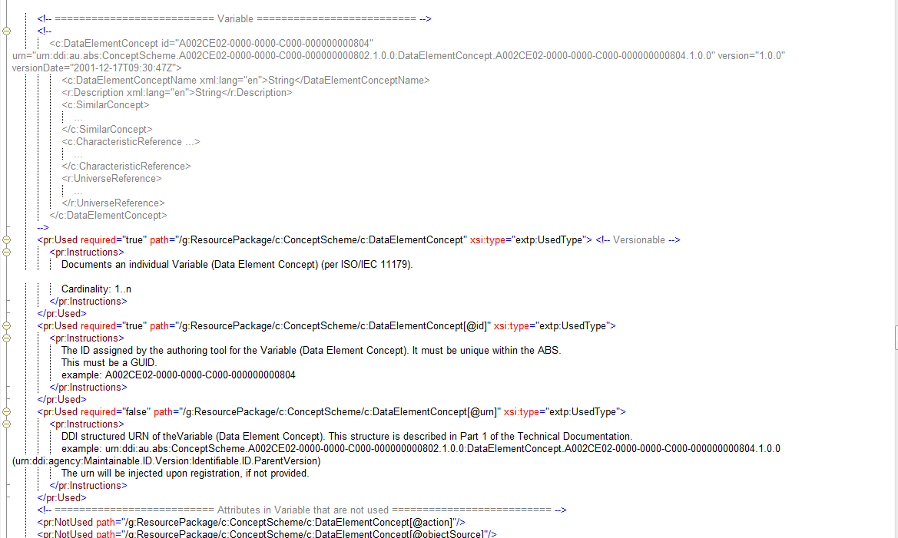
ABS: variable 2
Notes:
No EDDI presentation complete without actual DDI…
You will notice that we have a profile for profiles…

Slide 14
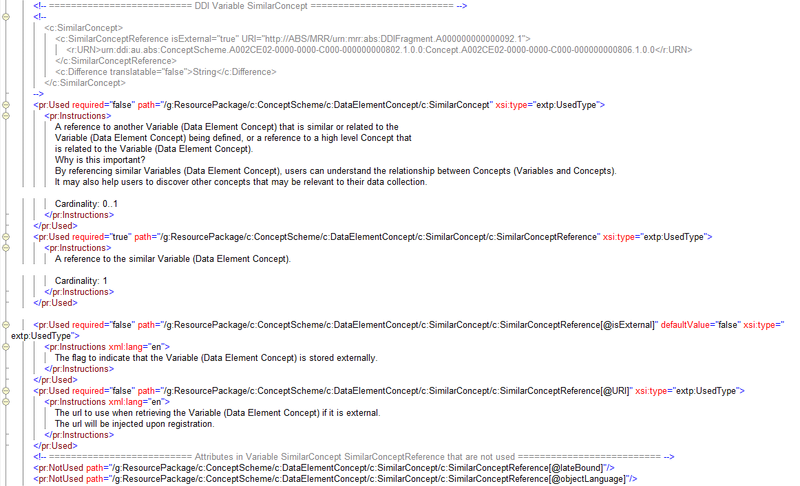
ABS: variable 3
Notes:
No EDDI presentation complete without actual DDI…
You will notice that we have a profile for profiles…

Slide 15
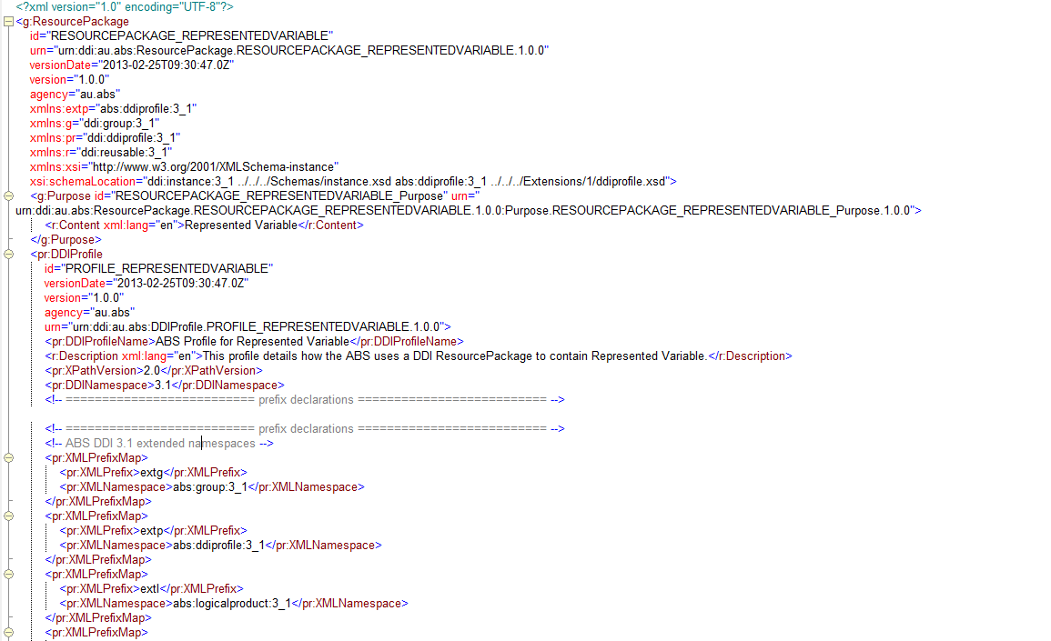
ABS: represented variable 1
Notes:
No EDDI presentation complete without actual DDI…
You will notice that we have a profile for profiles…

Slide 16
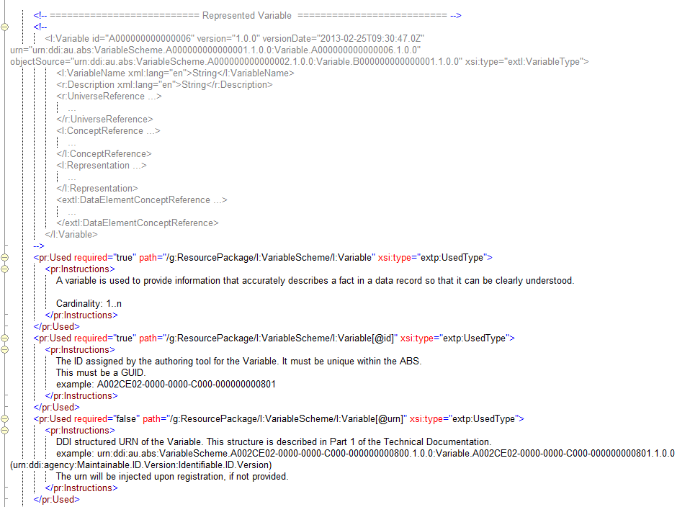
ABS: represented variable 2
Notes:
No EDDI presentation complete without actual DDI…
You will notice that we have a profile for profiles…

Slide 17
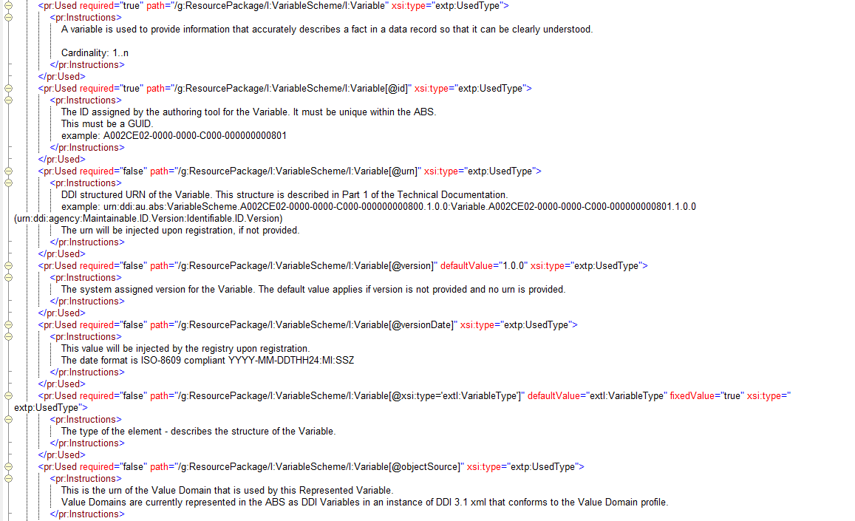
ABS: represented variable 3
Notes:
No EDDI presentation complete without actual DDI…
You will notice that we have a profile for profiles…

Slide 18
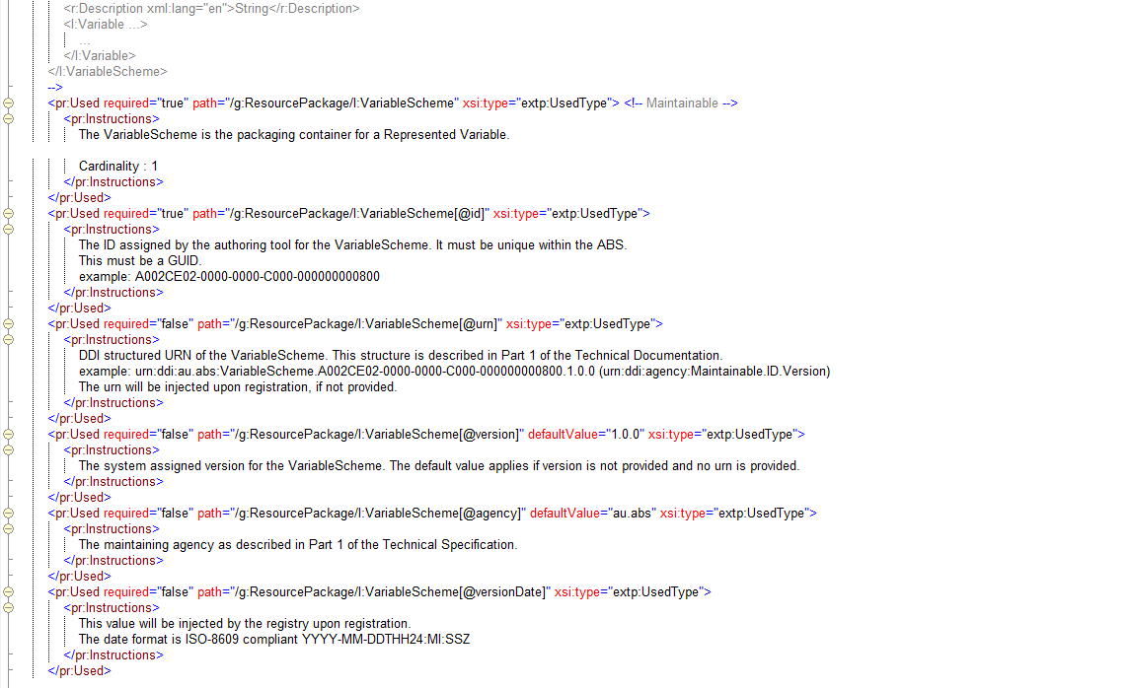
ABS: represented variable 4
Notes:
No EDDI presentation complete without actual DDI…
You will notice that we have a profile for profiles…

Slide 19
ABS: a wish list
To improve machine actionability, we wish:
DDI profiles had hierarchical structure
DDI supported GSIM objects
DDI was more decisive about representation
Notes:
Based on our experiences
Copy-reference

